Slide 1


QI DATA REPORTING

Slide 2


WELCOME!
Please mute yourself
If you have a question, please enter it in the chat or raise your hand (Reactions)
REC
This webinar is being recorded

Slide 3
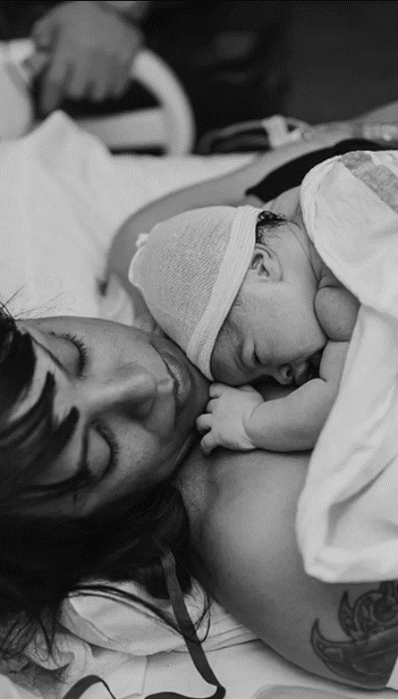
Why Postpartum Care?
1/3—1/2 of Florida’s pregnancy-related deaths occur after the mother goes home.
3/4 of Florida’s drug-related deaths occur after the mother goes home.
50% of postpartum strokes occur within 10 days.
20% of postpartum mothers experience a mental health disorder.
Up to 40% of women do not attend the 6-week postpartum visit.

Slide 4

Women desire improved postpartum care
Qualitative studies point to women’s lack of satisfaction with postpartum care compared to maternal care
With women noting a steep drop off in care in the early postpartum period
Women reported wanting additional, early postpartum care
Martin A, et. al. Views of women and clinicians on postpartum preparation and recovery. Matern Child Health J 2014.
Tully KP, et. al. The fourth trimester: a critical transition period with unmet maternal health needs. Am J Obstet Gynecol 2017

Slide 5
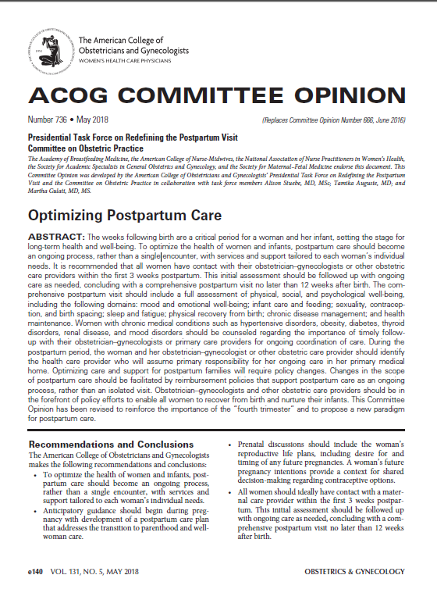
Redefining postpartum care: ACOG CO #736
To optimize the health of women and infants, postpartum care should become an ongoing process, rather than a single encounter
All women should ideally have contact with maternal care provider within the first 3 weeks postpartum (2 week post birth health check)
  Blood pressure checks
  Breastfeeding support
  Mental health well-being
  Contraception
Initial assessment should be followed up with ongoing care as needed
Conclude with a comprehensive postpartum visit approximately 6 weeks postpartum, NO LATER than 12 after birth

Slide 6
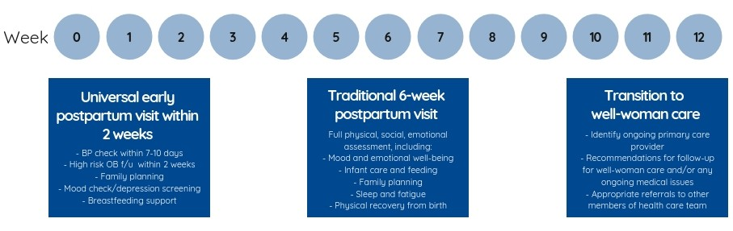
New Postpartum Care Continuum
An early postpartum visit (within 2 weeks of delivery) provides women with an essential maternal safety check including blood pressure evaluation, wound/perineum evaluation, breastfeeding support, mental health well-being, and family planning, among other essential health services.
Universal early postpartum visit within 2 weeks
-BP check within 7-10 days
-OB F/U with 2 weeks
-Family Planning
-Mood check/depression screening
Breastfeeding
Traditional 6-week postpartum visit
Full physical, social, emotional assessment, including:
-Mood and emotional well-being
-Infant care and feeding
-Family Planning
-Sleep Fatigue
-Physical recovery from birth
Transition to well-woman care
-Identify ongoing primary care provider
-Recommendations for F/U for well-women care and/or any ongoing medical issues
-Appropriate referrals to other members of health care team

Slide 7
AIM
QI Outcome Measures
By 6/2024, FPQC participating hospitals will:
1. Increase % of patients with a 2-week PP visit scheduled prior to discharge by 20%*
2. Increase patient PP education by 20%*
Includes benefits of early PP visits, warning signs, and family planning
* Baseline will be established with the first quarter of hospital data

Slide 8
AIM
Primary Key Drivers
By 6/2024, FPQC participating hospitals will:
Increase % of patients with a 2-week PP visit scheduled prior to discharge by 20%*
Increase patient PP education~ by 20%*
Process for Maternal Discharge Risk Assessment & Arranging Early PP Visits
Comprehensive PP Patient Discharge Education
Respectful care is a universal component of every driver and activity
Clinician PP Engagement and Education

Slide 9
Postpartum Access & Continuity of Care (PACC)
Global AIM: Improve maternal health through hospital-facilitated continuum of postpartum (PP) care by coordinating and providing respectful, timely, and risk-appropriate coordinated care and services.
AIM
Primary Key Drivers
Secondary Key Drivers
Develop a process flow to schedule early risk-appropriate PP visits/encounters prior to discharge and align policies and procedures accordingly
By 6/2024, FPQC participating hospitals will:
Increase % of patients with a 2-week PP visit scheduled prior to discharge by 20%*
Increase patient PP education~ by 20%*
Process for Maternal Discharge Risk Assessment & Arranging Early PP Visits
Conduct a PP Discharge Assessment prior to discharge
Implement universal Maternal Discharge Risk Assessment & schedule/arrange risk-appropriate PP care including obstetrical, specialty & community services before discharge
Verbally educate patients on the benefits of early risk-appropriate PP visits/encounters (Post-Birth Health Check) and provide written materials
Comprehensive PP Patient Discharge Education
Verbally educate all patient on PP Warning Signs and provide written materials
Verbally educate patients on the benefits of and options for pregnancy spacing, family planning and contraceptive choice and provide written materials
Establish a system to ensure that all patients receive recommended and documented PP education and discharge information
Respectful care is a universal component of every driver and activity
Develop a strategy to engage and educate inpatient and outpatient providers and staff using initiative promotional and education materials
Clinician PP Engagement and Education
Plan in place to continue to engage and educate new hires
Develop a strategy to engage and educate ER physicians & staff about pregnancy/PP care including PP screening & care practices.
~ Includes benefits of early PP visits, warning signs, and family planning
* Baseline will be established with the first quarter of hospital data

Slide 10
Data type and frequency of reporting
Patient-level data
Patient demographics
Hospital-level data
Staff education
Standardized documentation
Policies and guidelines to support PACC
Postpartum care and referrals

Slide 11
Data type and frequency of reporting
Patient-level data
Patient demographics
Hospital-level data
Staff education
Standardized documentation
Policies and guidelines to support PACC
Postpartum care and referrals

Slide 12
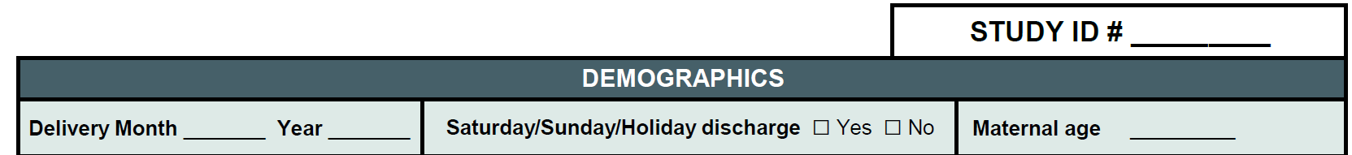
STUDY ID
Assign Study ID # 001 to the first patient whose data will be submitted to FPQC
Number consecutively all patients submitted to FPQC throughout the initiative

Slide 13
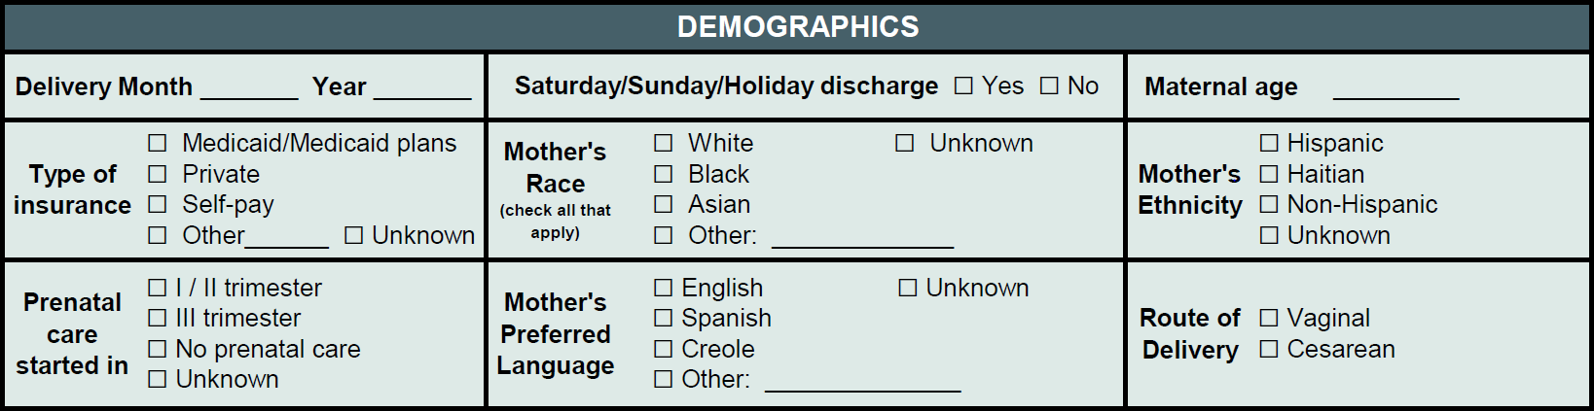
DEMOGRAPHICS
Inform case composition and track population change overtime
Disaggregate measures to identify differences between population groups

Slide 14
DEMOGRAPHICS
The age of the mother at the time of delivery. Completed years only. Do not round up.
Inform case composition and track population change overtime
Disaggregate measures to identify differences between population groups

Slide 15
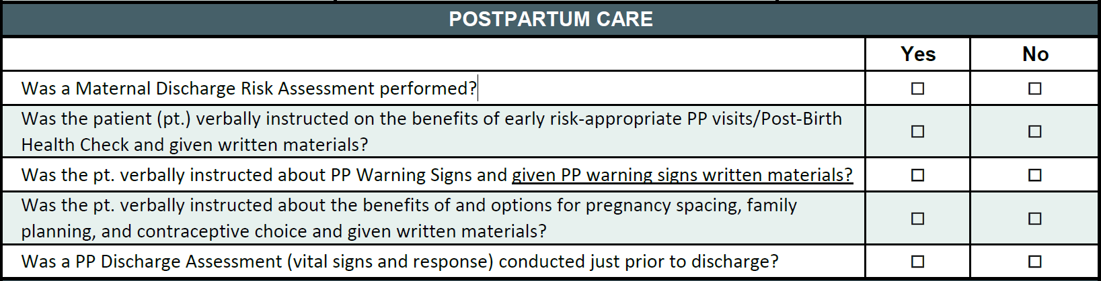
POSTPARTUM CARE

Slide 16
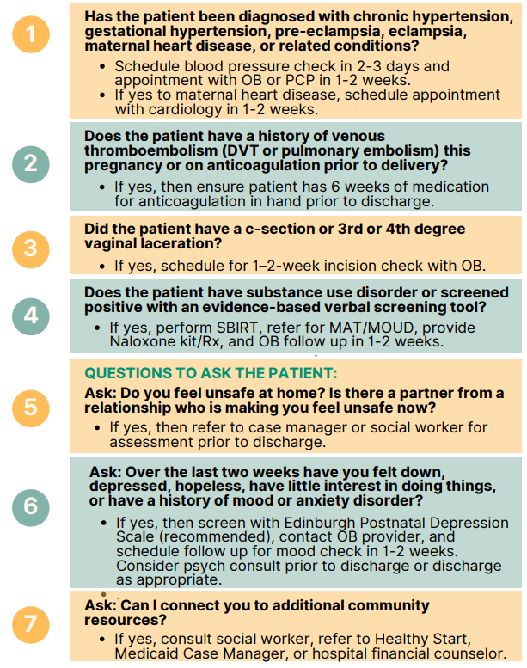
Was a Maternal Discharge Risk Assessment performed?
Needs to be adapted to your EHR
Poster/paper form available
Standardize documentation

Slide 17
- Was the patient (pt.) verbally instructed on the benefits of early risk-appropriate PP visits/Post-Birth Health Check and given written materials?
- Was the pt. verbally instructed about PP Warning Signs and given PP warning signs written materials?
- Was the pt. verbally instructed about the benefits of and options for pregnancy spacing, family planning, and contraceptive choice and given written materials?
Patient education
Educational materials available at www.FPQC.org/PACC
Standardize documentation

Slide 18

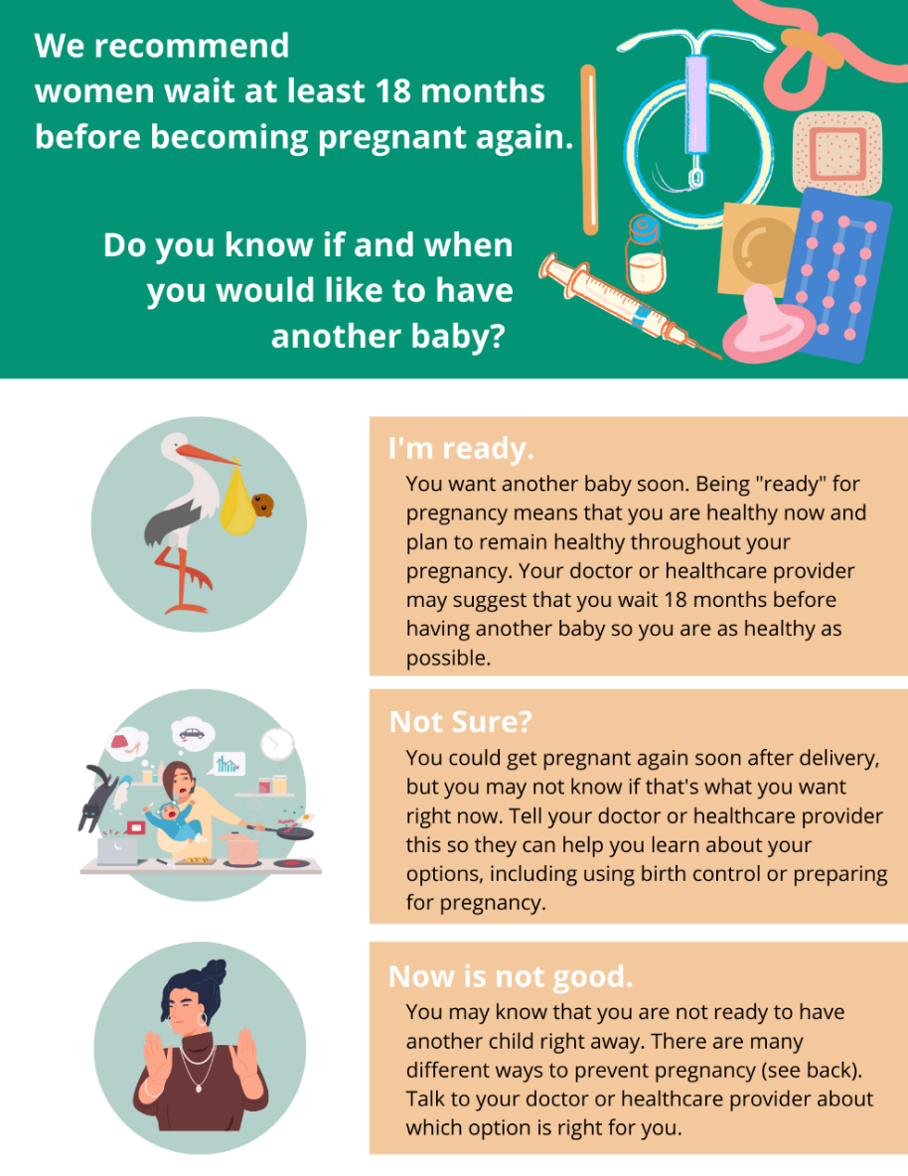
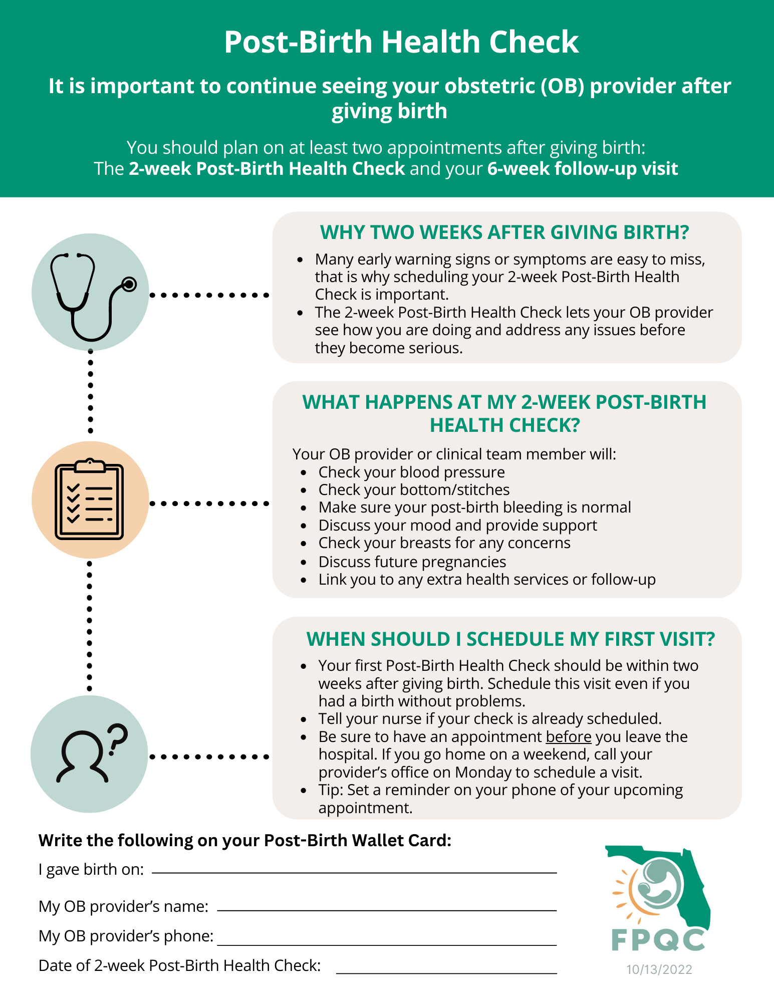
Patient education

Slide 19
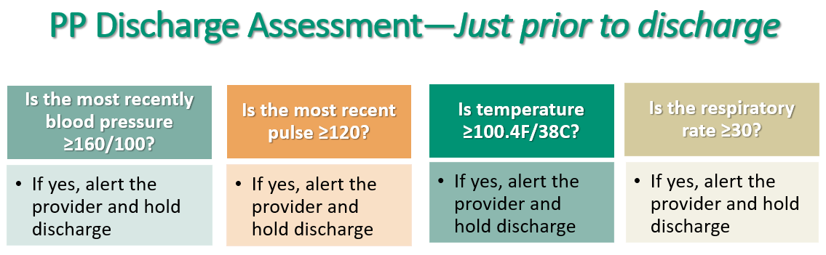
Was a PP Discharge Assessment (vital signs and response) conducted just prior to discharge?
Standardize documentation

Slide 20
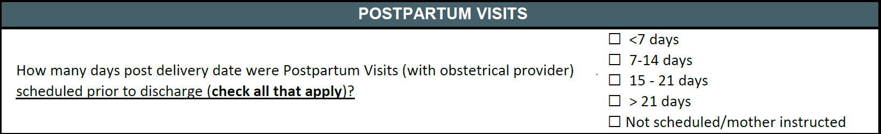
POSTPARTUM VISITS
Check all that apply! – Pay special attention to the early PP visit
Scheduling Flow should specify who, when and how PP visit is to be scheduled and documented

Slide 21
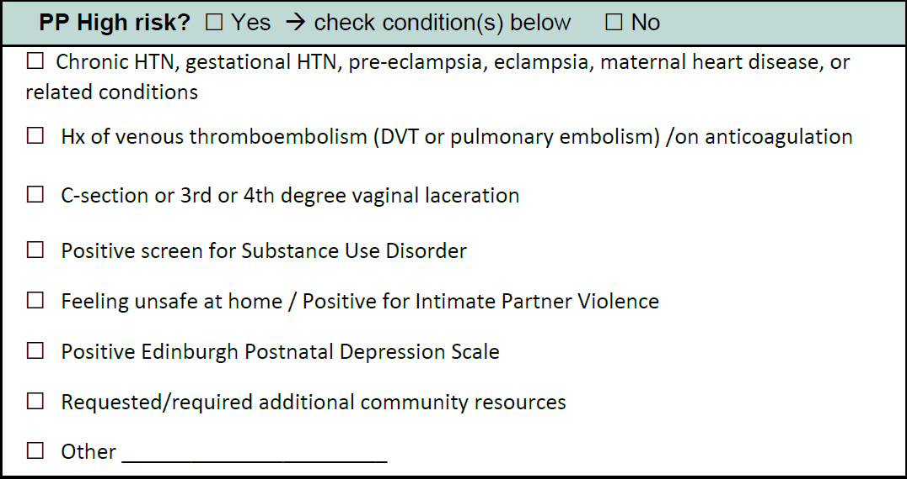
Comorbidities

Slide 22
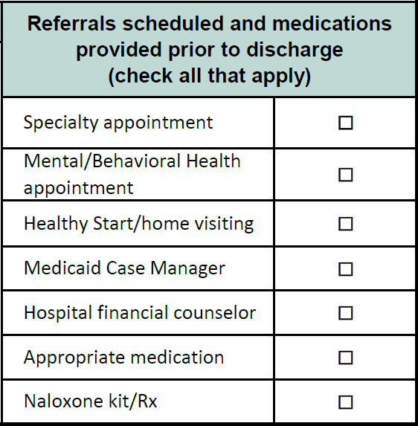
Referrals

Slide 23
INCLUSION AND EXCLUSION CRITERIA
Inclusion criteria (qualifying patients):
Include women admitted for delivery who are discharged home, regardless of infant outcome.
Exclude:
Pregnant women who are in observation status or seen in the ED; pregnant women not admitted for delivery; women admitted for delivery who die prior to discharge or are transferred to other hospitals

Slide 24
Sampling
If your hospital has 40 births per month or more:
report 20 systematically selected discharged deliveries per month
If your hospital has less than 40 births per month:
report the first 10 delivery charts per month.

Slide 25
Sampling: Selection Process
1. Divide the total number of delivery discharges that occurred at your facility in a given month by 20
e.g. Your hospital had 105 discharged deliveries in January
Divide 105 by 20 = 5.25 → Round down: 5
2. Select every “nth” chart where “n” is the result of that division
e.g. 5 is your nth for January. Report data on every 5th chart

Slide 26
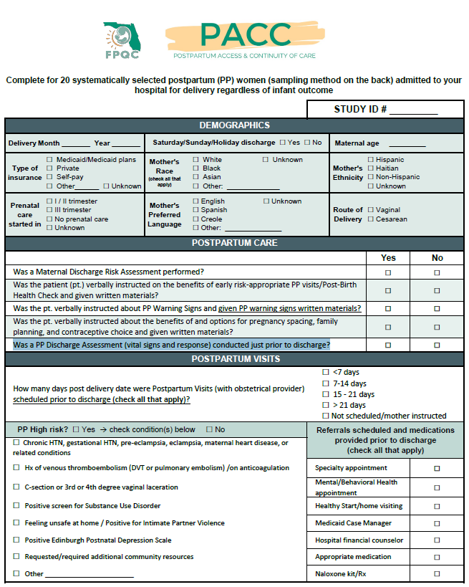
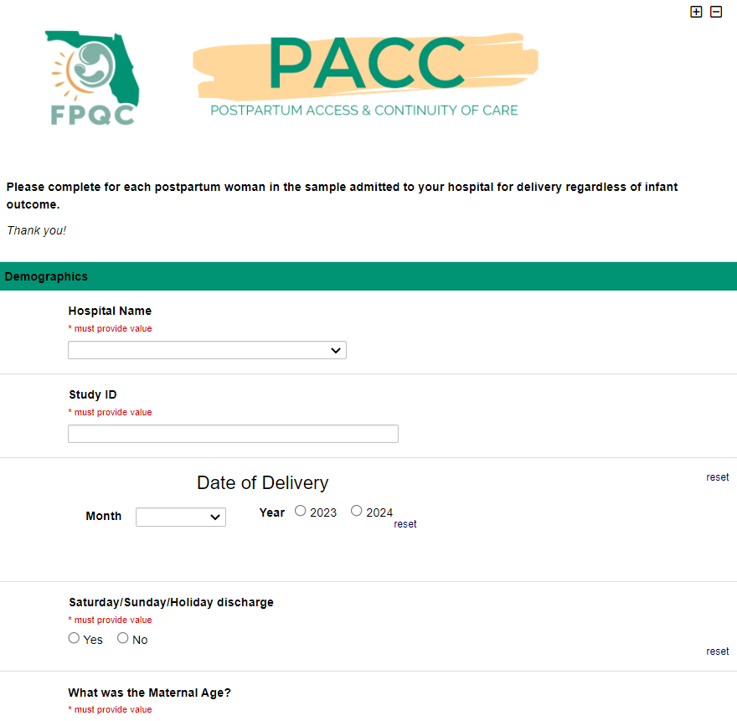

PROCESS TO COLLECT AND SUBMIT YOUR DATA
1
2
3
Identify
Cases
Enter data in the
REDCap data portal
Abstract medical record
Number of deliveries/month
If 40 deliveries or more: 20 Systematically selected patients
If less than 40 deliveries: First 10 patients
Link will be sent to the project and data lead once DUA is fully executed

Slide 27
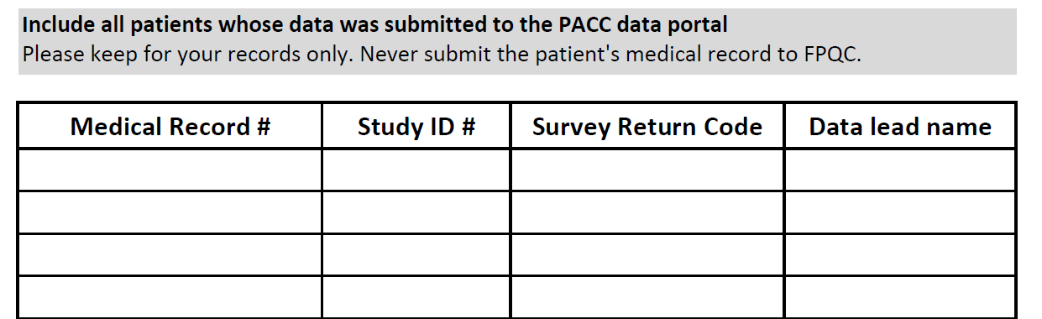
KEEP TRACK OF YOUR CASES
Please keep a log of the patients whose data is submitted to FPQC.

Slide 28
Data type and frequency of reporting
Patient-level data
Hospital-level data
Staff education
Patient demographics
Standardized documentation
Postpartum care and referrals
Policies and guidelines to support PACC

Slide 29
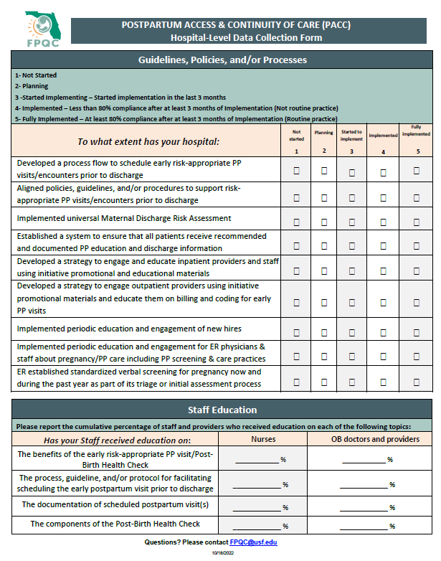
HOSPITAL-LEVEL DATA
Not started
Planning
Started to implement
Implemented
Fully Implemented
Cumulative Percent

Slide 30
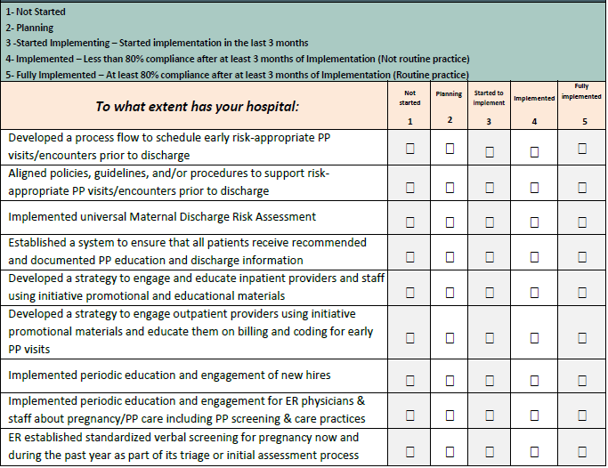
Structural Measures

Slide 31

What are Structural Measures?
Structural Measures help us to assess where your facility is on implementation within our Initiative.

Slide 32
How are we Measuring this?
Implement and/or reinforce key processes, guidelines, policies, and resources to support PACC.
Report as follows:
1. Not started
2. Planning
3. Started Implementing - started implementation in the last 3 months
4. Implemented - less than 80% compliance after at least 3 months of Implementation (Not routine practice)
5. Fully Implemented - at least 80% compliance after at least 3 months of Implementation (Routine practice)

Slide 33
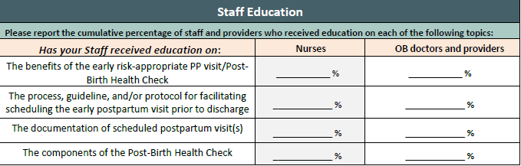
Staff Education
- Report cumulative percent

Slide 34
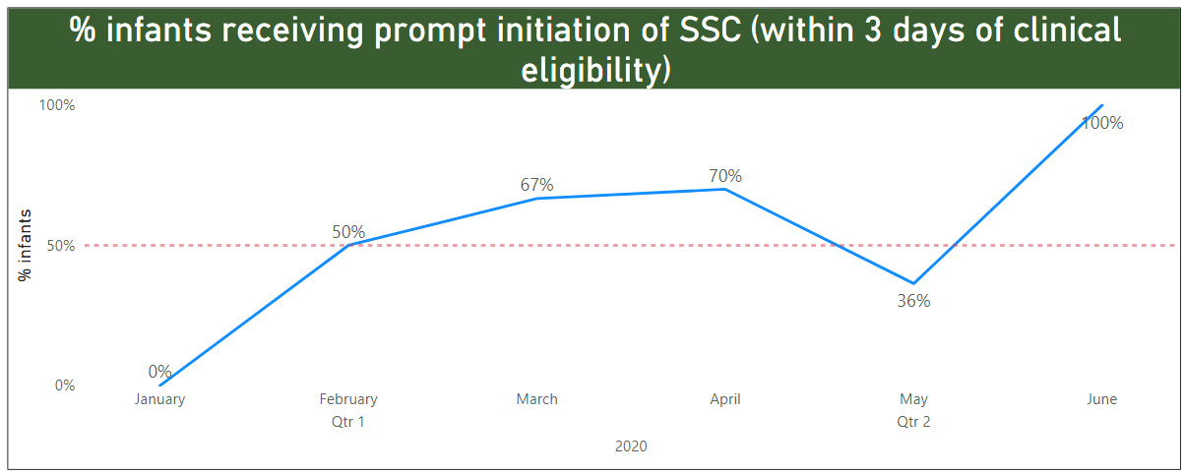
Sample Report
HOSPITAL-SPECIFIC
% of patients for whom an early Postpartum Visit was scheduled prior to discharge

Slide 35
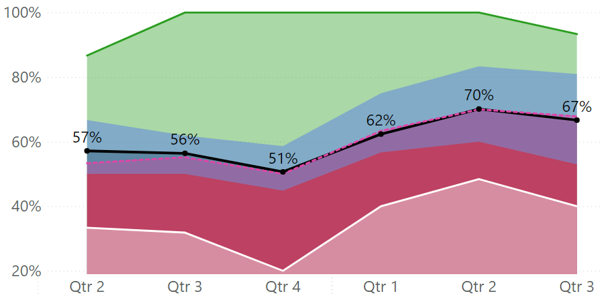
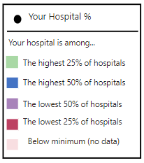
Sample Report
HOW DOES YOUR HOSPITAL COMPARE TO OTHERS

Slide 36
Why we collect data for QI?
Informs progress and outcome of your work
Identify areas of opportunity and strength
Data for learning not for judgment- Maximize learning

Slide 37
How to use your data for improvement?
Initial data points will be a surrogate baseline
Review your data every month for evaluating and guiding improvement. Use it to prompt discussion and action!
Create a system that can be maintained long after the project ends: check if you are holding your gains overtime!
Data need to be strong, detailed and actionable!
Notes:
Administrative datasets are not clinically detailed enough to evaluate and measure quality of care

Slide 38
QI MONTHLY CYCLE
Coaching Call
Submit Data
Review Data Report
Discuss and Disseminate Data Report
Identify opportunities *PDSA*
Coaching Call
QI REPORTS
Aim
Run Charts
Tracks Process, Structural and Outcome Measures
Add your PDSAs
Identify issues
PDSA
Submit Data
Disseminate and Discuss Data Report
Review Data Report

Slide 39
Postpartum Access & Continuity of Care (PACC)
Global AIM: Improve maternal health through hospital-facilitated continuum of postpartum (PP) care by coordinating and providing respectful, timely, and risk-appropriate coordinated care and services.
AIM
Primary Key Drivers
Secondary Key Drivers
Develop a process flow to schedule early risk-appropriate PP visits/encounters prior to discharge and align policies and procedures accordingly
By 6/2024, FPQC participating hospitals will:
Increase % of patients with a 2-week PP visit scheduled prior to discharge by 20%*
Increase patient PP education~ by 20%*
Process for Maternal Discharge Risk Assessment & Arranging Early PP Visits
Conduct a PP Discharge Assessment prior to discharge
Implement universal Maternal Discharge Risk Assessment & schedule/arrange risk-appropriate PP care including obstetrical, specialty & community services before discharge
Verbally educate patients on the benefits of early risk-appropriate PP visits/encounters (Post-Birth Health Check) and provide written materials
Comprehensive PP Patient Discharge Education
Verbally educate all patient on PP Warning Signs and provide written materials
Verbally educate patients on the benefits of and options for pregnancy spacing, family planning and contraceptive choice and provide written materials
Establish a system to ensure that all patients receive recommended and documented PP education and discharge information
Respectful care is a universal component of every driver and activity
Develop a strategy to engage and educate inpatient and outpatient providers and staff using initiative promotional and education materials
Clinician PP Engagement and Education
Plan in place to continue to engage and educate new hires
Develop a strategy to engage and educate ER physicians & staff about pregnancy/PP care including PP screening & care practices.
~ Includes benefits of early PP visits, warning signs, and family planning
* Baseline will be established with the first quarter of hospital data

Slide 40
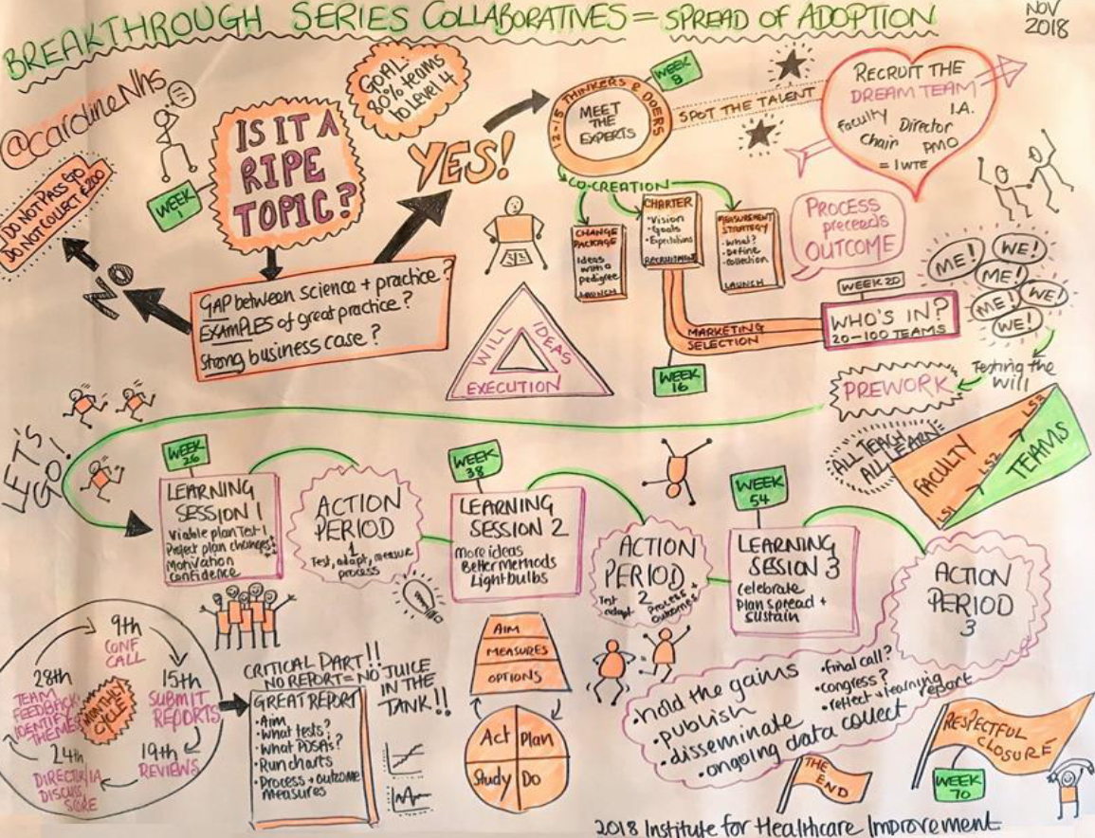

Slide 41
Secondary Outcome Measures
The Agency for Health Care Administration could report rates on:
Emergency room utilization (60-day rate)
Hospital readmissions (60-day rate)
Postpartum visit attendance (<21 days; <84 days)
Hypertension Cardiovascular Disease
Infection
Hemorrhage
Thromboembolism
Substance Use Disorder
The data has a delay of 6-9 months

Slide 42
Important requests
Track completion of your hospital’s Data Use Agreement
Let us know of any changes in your PACC team: Data Lead resources
Submit your Hospital-Level Data in December
Patient-level data collection starts in January – (January data is due February 15th)

Slide 43





Questions?
erubio1@usf.edu
fpqc@usf.edu
www.fpqc.org
“To improve the health and health care of all Florida mothers & babies”

