Slide 1
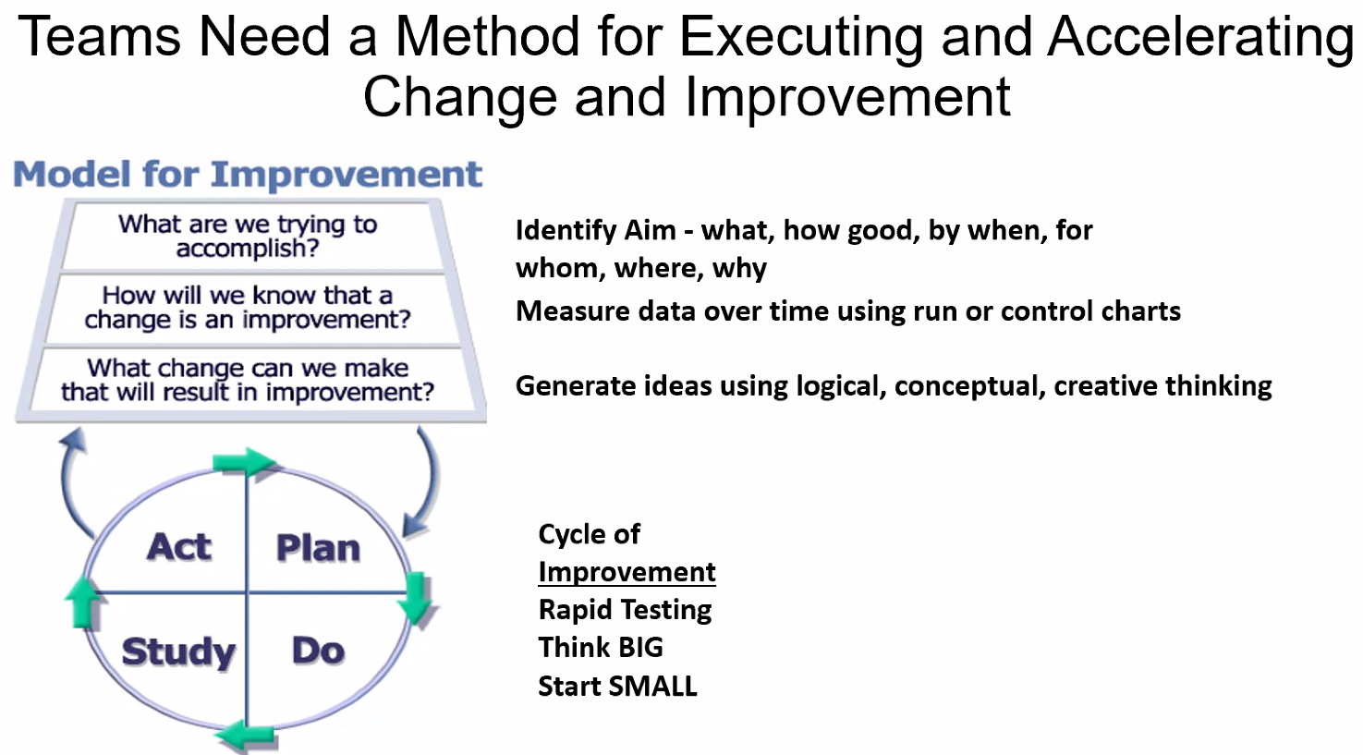
Plan-Do-Study-Act Example
Updated 3/25/2025

Slide 2
PDSA
Notes:
By planning, trying it, observing the results, and acting on what you’ve learned, you can make the impact or achieve the goal or AIM.
Cycle of improvement is a quick test that even though brief you should be able to know if it is working on not, make adjustments where needed, and try again. Usually suggested to start small. Working with 1 provider for example before pushing something out to the entire department or multiple provider groups, trialing something with a small group of nurses before educating an entire team on something that might not be ready yet.

Slide 3
Coaching Call Report Out PDSA
What did you test and why?
Did you reach the outcome you thought you would?
Did you collect data?
What worked and what didn't work?
Should what you tested be kept, changed, or abandoned?

Slide 4
Another way to view PDSA Cycles
PDSA #
Driver impacted
Facilitator
Dates of test
Location
Testing population
Estimated number impacted
Test description
What worked well
What didn't work
What did we learn that was unexpected
Next steps

Slide 5
TGH PDSA - Physician Discharge Summary
PDSA # | 1
Driver impacted | Key Driver #1
Facilitator | small number of USF Midwives/Physicians
Dates of test | previous 2 weeks
Location | TGH Postpartum floor
Testing population | USF Postpartum Patients
Estimated number impacted | 30 per week
Test description | New PP Discharge template that included Maternal discharge risk assessment
What worked well | Easy to fill out and hard stops for compliance
What didn't work | no changes however would consider adding something related to “s/p SW consult” for those appropriate patients (i.e., those with anxiety or depression on meds, +UDS but not actual documented substance use disorder, those with resource needs, etc.). Currently free texting “patient d/c home after SW consult and clearance”.
What did we learn that was unexpected | Everyone (even within same provider group) use different templates. Need to standardize
Next steps | Update the templates and add smart text option

Slide 6
Example Coaching Call Agenda
Team Successes
Team challenges/barriers
30/60/90 Day Plans
Data Updates
Announcements

