Slide 1
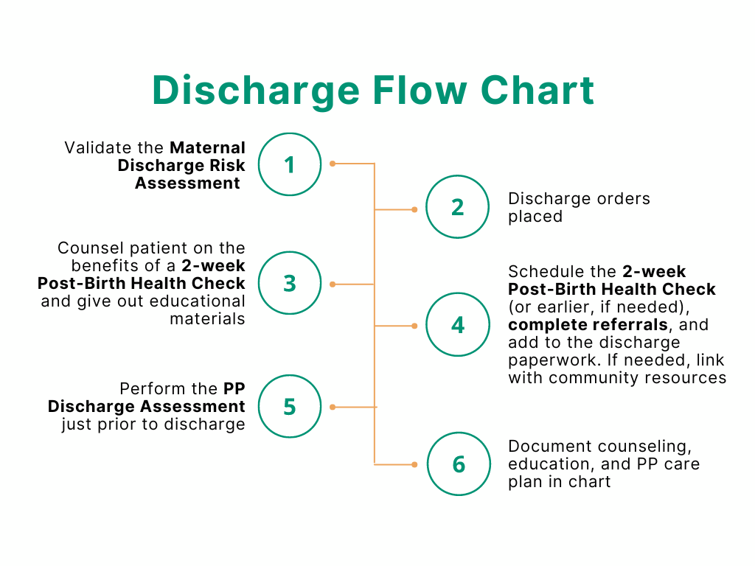
1. High Risk Screening & Early PP Visits

