Slide 1

Global AIM: Improve maternal health through hospital-facilitated continuum of postpartum care by coordinating and providing respectful, timely, and risk-appropriate coordinated care and services.
Primary Key Driver
Secondary Drivers
Develop a process flow to schedule early risk-appropriate PP visits/encounters prior to discharge and align policies and procedures accordingly
Process for Maternal Discharge Risk Screening & Arranging Early Postpartum Visits
Conduct a PP Discharge Assessment prior to discharge
Implement universal Maternal Discharge Risk Screening for PP care & schedule/arrange risk-appropriate PP care including obstetrical, specialty, & community services before discharge
Respectful care is a universal component of every driver & activity

Slide 2
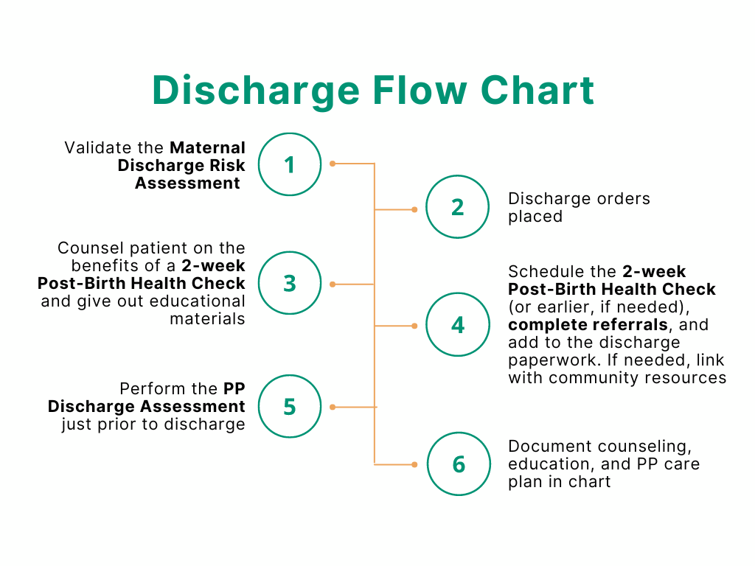
1. High Risk Screening & Early PP Visits

Slide 3
Maternal Discharge Risk Assessment
1
Has the patient been diagnosed with chronic hypertension, gestational hypertension, pre-eclampsia, eclampsia, maternal heart disease, or related conditions?
Schedule blood pressure check in 2-3 days & appointment with OB or PCP in 1-2 weeks.
If yes to maternal heart disease, schedule appointment with cardiology in 1-2 weeks.
2
Does the patient have a history of venous thromboembolism (DVT or pulmonary embolism) this pregnancy or on anticoagulation prior to delivery?
If yes, then ensure patient has 6 weeks of medication for anticoagulation in hand prior to discharge.
3
Did the patient have a c-section or 3rd or 4th degree vaginal laceration?
If yes, schedule for 1–2-week incision check with OB.
4
Does the patient have substance use disorder or screened positive with an evidence-based verbal screening tool?
If yes, perform SBIRT, refer for MAT/MOUD, provide Naloxone kit/Rx, and OB follow up in 1-2 weeks.

Slide 4
Maternal Discharge Risk Assessment
QUESTIONS TO ASK THE PATIENT:
5
Ask: Do you feel unsafe at home? Is there a partner from a relationship who is making you feel unsafe now?
If yes, then refer to case manager or social worker for assessment prior to discharge.
6
Ask: Over the last two weeks have you felt down, depressed, hopeless, have little interest in doing things, or have a history of mood or anxiety disorder?
If yes, then screen with Edinburgh Postnatal Depression Scale (recommended), contact OB provider, and schedule follow up for mood check in 1-2 weeks. Consider psych consult prior to discharge or discharge as appropriate.
7
Ask: Can I connect you to additional community resources?
If yes, consult social worker, refer to Healthy Start, Medicaid Case Manager, or hospital financial counselor.

Slide 5
PP Discharge Assessment—Just prior to discharge)
Is the most recently blood pressure ≥160/100?
If yes, alert the provider and hold discharge
Is the most recent pulse ≥120?
Is temperature ≥100.4F/38C?
If yes, alert the provider and hold discharge
If yes, alert the provider and hold discharge
Is the respiratory rate ≥30?
If yes, alert the provider and hold discharge
1. High Risk Screening & Early PP Visits

