Slide 1

Obtaining an Accurate Blood Pressure for Perinatal Patients
Patricia B Walton, MSN, RNC-OB, C-EFM,CHSE
Margie Boyer, MS,RNC-OB, C-EFM,ONQS, FAWHONN
& Daniela Crousillat, MD, FACC

Slide 2
Standard guidelines are necessary for measurement of BP for pregnant and postpartum women

Slide 3
Blood Pressure Assessment Best Practices
Accurate blood pressure(BP) measurement is essential for clinical decision making.
It’s essential to have properly maintained equipment and a variety of BP cuff sizes and shapes available.
Both automatic and manual BP equipment must have documentation of being calibrated annually. Check manufacturer and hospital policy as more frequent calibration may be required.
Failing to accurately measure BP in a consistent manner can lead to misdiagnosis, delays in treatment, worsening disease, increased morbidity and even death.

Slide 4
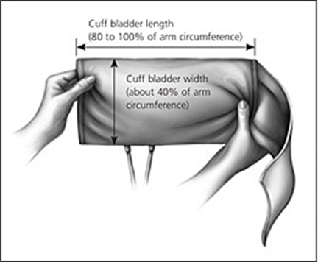
Best Practices: BP Cuff Sizes
The width of the cuff should cover between 40-50% of the circumference of the arm.
The bladder of the cuff encircles 80% of the arm.

Slide 5
Best Practices BP Cuffs
Ensure Correct size BP cuff is used by measuring the patient’s arm circumference:
• Small Adult: less than 26 cm
• Regular Adult: Greater than 26 cm and less than or equal to 34 cm
• Large Adult: Greater than 34 cm and less than 44 cm
• Extra Large Adult: Greater than 44 cm & less than or equal to 52 cm
• Thigh Cuff: Greater than 50 cm
*Reminder: Check with your BP cuff manufacturer for accurate cuff sizes and measurements

Slide 6
Best Practice: Measurement of the arm
Locate mid-upper arm:
Measure the length of the arm between the acromion process (bony protuberance on shoulder) and the olecranon process (bony protuberance at elbow). Divide the distance in half to locate the mid-upper arm.
Determine arm circumference:
Wrap a tape measure around the mid-upper arm to determine arm circumference (typically measured in centimeters) with the arm placed down relaxed against the body as you would position to take a BP. Obtain the appropriately sized cuff for BP measurement.

Slide 7
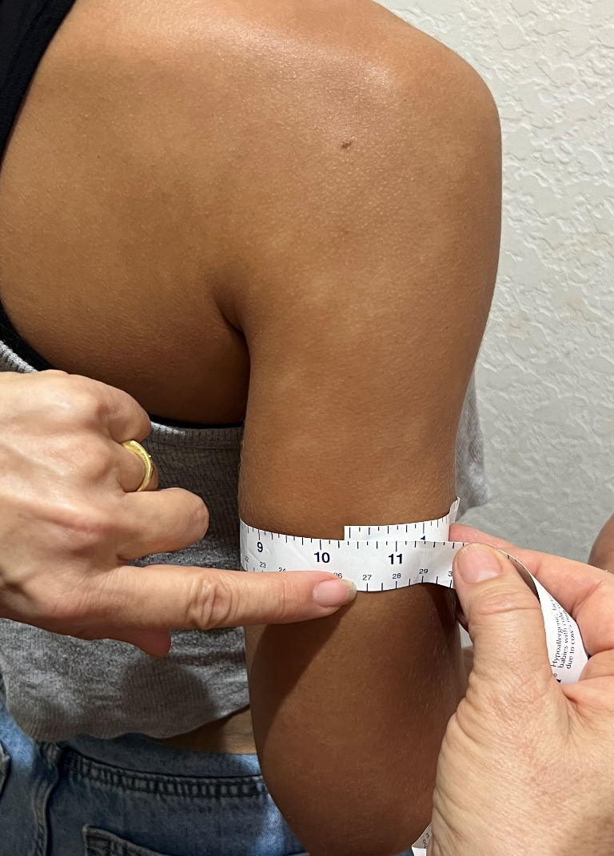
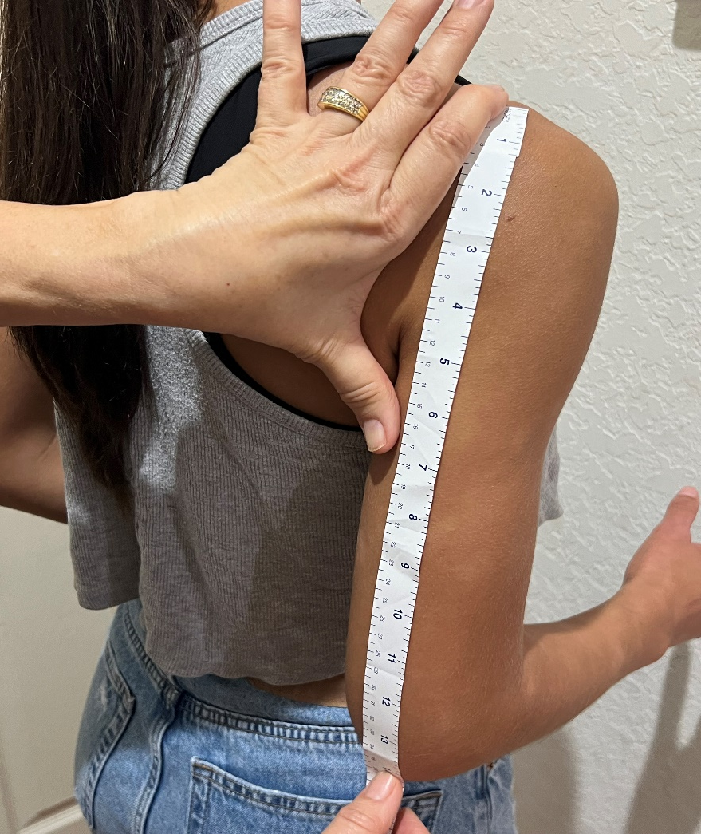
Best Practice: Measure Mid-Upper Arm
Measure from acromion process(shoulder) to olecranon process(elbow). Divide in half and measure arm circumference

Slide 8
Importance of Taking an Accurate BP
ERROR | EFFECT
Bladder or cuff too wide | False-low reading
Bladder or cuff too narrow or too short | False-high reading
Cuff wrapped too loosely or unevenly | False-high reading
Deflating cuff too slowly | False-high diastolic
Deflating cuff too quickly | False-low systolic and false-high diastolic reading
Arm below heart level | False-high reading
Arm above heart level | False-low reading
Arm not supported | False-high reading
Inflating too slow | False-high diastolic reading
Repeating assessments too quickly | False-high systolic reading

Slide 9
Best Practices BP Assessment
Ensure correct patient positioning and BP guidelines are followed:
• Wait 5 minutes with patient sitting quietly before assessing BP
• Ensure patient has emptied their bladder first
• Sitting or semi-reclining position with back supported
• Legs uncrossed
• Feet flat on the floor if sitting in a chair
• Upper arm exposed without clothing
• Forearm supported
• Arm positioned at the level of the heart
• Explain no talking during the procedure
• Check for caffeine intake in the last 30 minutes
• Check if patient is a smoker in the last 30 minutes
• Check for any exercise in the last 30 minutes
• Verbalize an understanding: “If you get an elevated BP, you do not just assume it is because of pain and ignore the result.”
Initial Severe Range BP requires re-assessment within 15 minutes

Slide 10
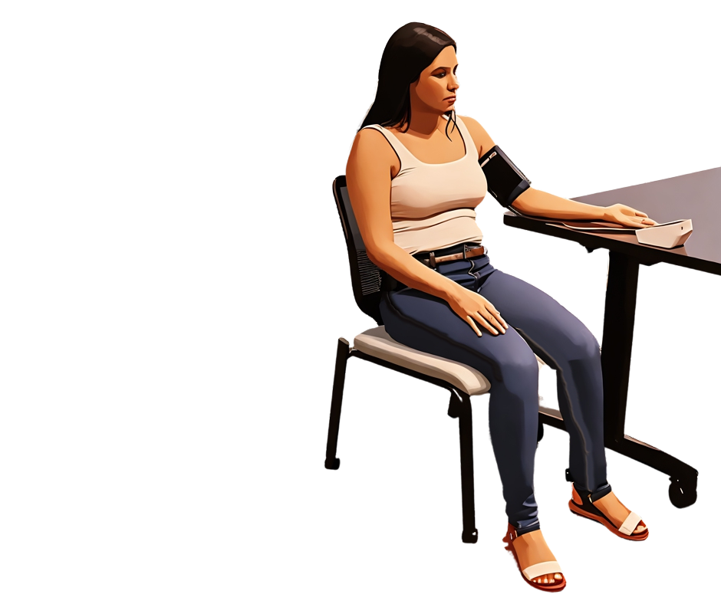
Back to Basic for Accurate BP
Cuff at heart level
Arm is bare
Back is supported
Arm is supported
Legs uncrossed with feet flat on floor

Slide 11
Best Practices Automated BP
Do not assume an unwitnessed automatic BP is accurate:
If an elevated BP is noted but unwitnessed, the BP will need to be retaken and witnessed to ensure all the BP guidelines were followed.

Slide 12
Best Practices Manual BP
Demonstrated ability to take a manual BP:
Positioned stethoscope earpieces in ears and placed diaphragm of stethoscope directly on skin over the brachial pulse site.
Inflated cuff to 30 mmHg above the patient’s last systolic BP.
Released the valve on the cuff and deflated it at a rate of 2–3 mmHg/second.
Noted point at which Korotkoff sounds began.(Systolic)
Continued slowly releasing the air until the sound disappeared. (Diastolic)
Did not leave cuff inflated for a prolonged period.
Removed cuff from patient’s arm.
Deflated cuff completely and waited at least 5 minutes before rechecking blood pressure if needed.
***A manual BP is the gold standard for taking an accurate BP

Slide 13
RN Assessment Key Points
Do not make assumptions that a patient’s hypertension is being caused by something else e.g. Race, obesity, socioeconomic status, mental health, diet, pain or anxiety.
If using automated BP, it is extremely important the clinician is present to ensure BP taken appropriately as per competency outline.
If the patient must remain recumbent, remember left uterine displacement with cuff at the level of the right atrium.
The provider should be notified immediately when any confirmed Systolic BP is ≥ 160 or Diastolic is ≥110. Order sets and hospital policy may require lower BPs to be reported - know and follow your hospital policy.
Share BP readings with the patient and discuss plan of care.

Slide 14
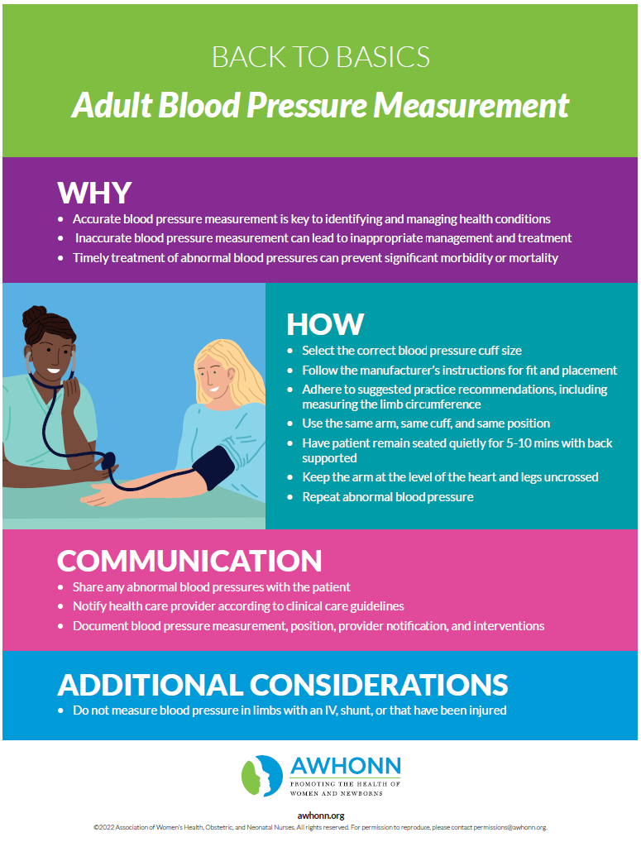
AWHONN Clinician Resource Example:

Slide 15
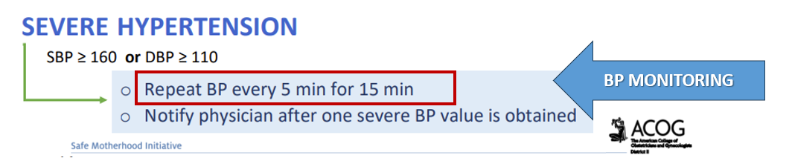
Monitoring & Management
Two severe BP values 15-60 minutes apart confirm Persistent SHTN–> begin treatment ASAP.
Note: frequent BP monitoring is essential for patient safety.
ACOG recommends every 5 min for 15 min for severe range(see below)

Slide 16
References
Alice Hurrell, MBBS, Louise Webster, PhD, Lucy C. Chappell, PhD, Andrew H. Shennan, MD (February 2022). The assessment of blood pressure in pregnant women: pitfalls and novel approaches. American Journal of Obstetrics & Gynecology, Volume 226, Issue 2, Pages S804-S818.
American College of OBGYN (ACOG) Safe Motherhood Initiative 2020
American Heart Association: Steps For Accurate BP Readings 2018
CMQCC HDP toolkit (2021) pp 42-49
NIH, Self-Measured Blood Pressure, May 2023
Potter, P., Perry, A., Stockert, P., & Hall, A. (2023). Fundamentals of nursing. (11th ed.). Elsevier-Saunders
Preeclampsia Foundation: http://www.preeclampsiafoundation.org

