Slide 1

Improving Maternal Care
Through Joint Commission Maternal Levels of Care Verification

Slide 2

Maternal Levels of Care Verification
This program is designed to help deliver confidence across all levels of maternal care and dramatically improve outcomes by ensuring that women receive risk-appropriate care and promoting collaboration among facilities and providers.
Notes:
Donna

Slide 3


The Program…
Provides a standardized description of maternity facility capabilities and personnel
Provides a framework for integrated systems that addresses maternal health needs from basic to high-risk
Confirms hospitals have a plan for assessing risk and referring patients to
a higher level of care facility in obstetric emergency situations
Enables EMS to know which facilities have the appropriate services, staff,
and equipment to care for patients who develop complications
Promotes collaboration among area health care organizations with differing levels of care
Encourages Levels III and IV organizations to provide education and training to Levels I and II
Encourages state and regional authorities to work together, facilitating a coordinated system of care and policies to improve outcomes in communities
Notes:
Katie

Slide 4
Four Level of Care Assessed
Level I: Basic Care – Care for low to moderate-risk pregnancies, demonstrating the ability to detect, stabilize, and initiate management of unanticipated maternal-fetal or neonatal problems that occur during the antepartum, intrapartum, or postpartum period until the patient can be transferred to a facility at which the specialty maternal care is available
Level II: Specialty Care – Level I, plus moderate- to high-risk antepartum, intrapartum, and postpartum conditions
Level III: Subspecialty Care – Levels I and II, plus care for more complex maternal medical conditions, obstetric complications, and fetal conditions
Level IV: Regional Perinatal Health Care Centers – Levels I, II, III, plus on-site medical and surgical care of the most complex maternal conditions and critically ill pregnant women and fetuses throughout antepartum, intrapartum, and postpartum care
Notes:
Valerie

Slide 5
MLC General Overview
Available to hospitals and critical access hospitals
Does not require organization to be Joint Commission accredited
On-site review
3-year cycle
Developed in collaboration with ACOG
Standards constantly reviewed for updates and changes
Several states have already adopted MLC to enhance maternal care throughout the state

Slide 6
On-Site Review Process-Overview
A comprehensive on-site review to verify the level of care
provided at a hospital.
Levels I, II – 1-day assessment by one Joint Commission reviewer
Levels III, IV – 2-day assessment by one Joint Commission reviewer
The assessment also verifies that agreements are in place with providers of other levels of care to ensure the smooth transfer of patients in need of advanced services.
Organizations are required to:
Follow Clinical Practice Guidelines (CPGs)
Have a Performance Improvement (PI) plan
The Joint Commission uses a collaborative approach, providing you valuable feedback and recommendations.
Notes:
Katie

Slide 7
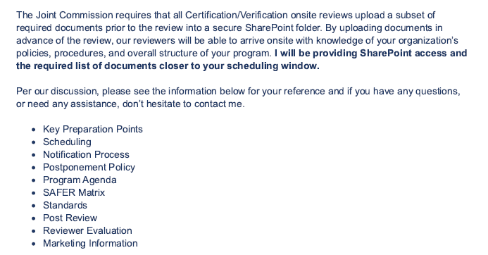
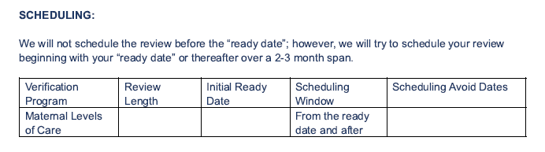
Post application email excerpts

Slide 8
Initial Verification Roadmap
Prepare
Onsite
Polish up policies, protocols, procedures to ensure compliance with standards
3
TJC surveyor(s) arrives onsite
8
Contact TJC
Celebrate!
3-4 months (can be concurrent with steps 1-5
1-2 days
6
2
Contact Brian Johnson to start the application process
Verification decision received
1
Inquire
1-2 days
Start the process with TJC – Meet Brian!
7
4
TJC processes Application
Post Verification
Day 1
TJC
Submit application for survey
Annual fee starts to be assessed upon application – time varies
Complete any RFIs
60 days
3 days – 2 weeks/ includes phone call with Account Executive
5
Notes:
Highlighte the wait between steps 5-6

Slide 9


Application - Clinical Practice Guidelines
ACOG Obstetric Care Consensus for Levels of Maternal Care
American College of Obstetrics and Gynecology Clinical Guidelines and Standardization of Practice to Improve Outcomes and Clinical Guidance
The Society for Maternal Fetal Medicine Publications and Guidelines
Association for Women's Health, Obstetric, and Neonatal Nurses Practice Briefs
Guidelines for Perinatal Care, 8th edition
17

Slide 10
Application - Performance Improvement Plan
Briefly describe the scope of the Performance Improvement activities for your program.
Identify the composition of the management team – by profession and organization title.
Describe the current year’s performance improvement goals and objectives for the program.
Describe the activities that are currently underway to achieve or meet the current year’s Performance Improvement goals and objectives.
Describe the process for the program’s performance improvement plan including how the plan fits within your organization’s overall performance improvement plan, who has responsibility and authority for organization-wide performance improvement and how program specific data and information is shared across the organization.
18

Slide 11
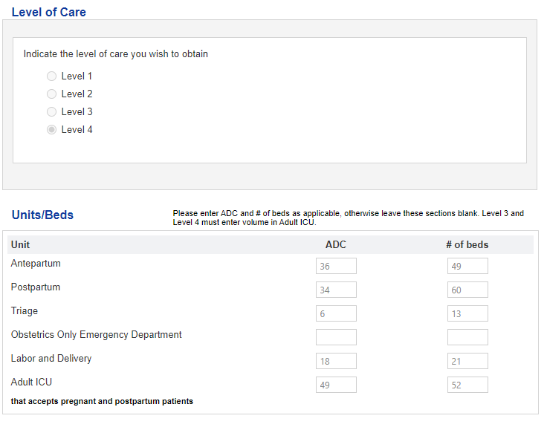
Joint Commission Application
https://codes.ohio.gov/ohio-administrative-code/rule-5122-29-08

Slide 12
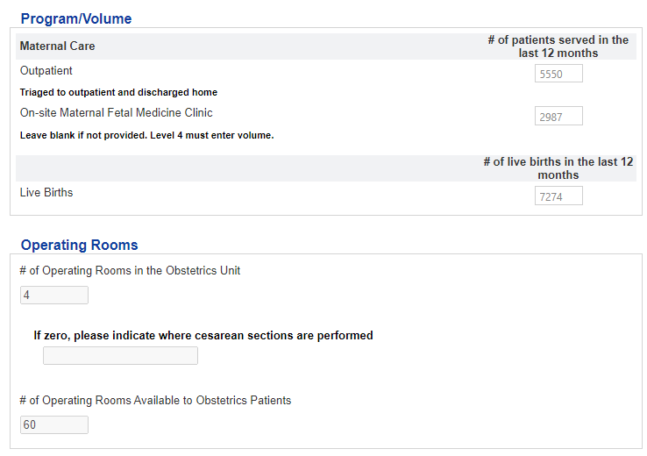
Joint Commission Application
https://codes.ohio.gov/ohio-administrative-code/rule-5122-29-08

Slide 13
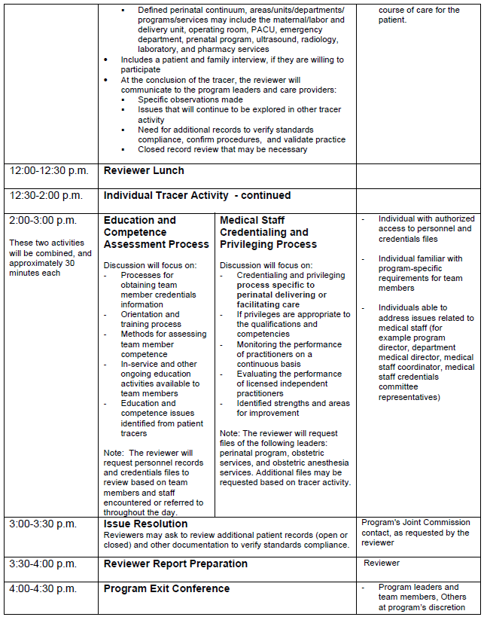
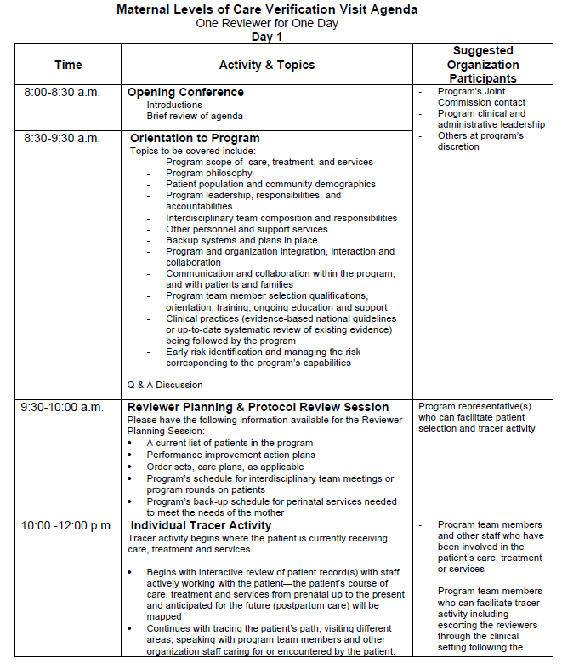
Notes:
Available in the VPG

Slide 14
Tips and Tidbits
Application submission triggers the annual fee charge
Survey ready date has to be at least the day after application submission.
After submission we will work to schedule your verification close to the survey ready date
  Reduce the number of avoid dates
  Consider forgoing 30-day notice

Slide 15
Advanced Certification Perinatal Care and Maternal Levels of Care-Select Differences
Program Features | Advanced Certification in Perinatal Care | Maternal Levels of Care Verification
Requires performance measures, including thresholds for eligibility | X
Intracycle monitoring | X
Requires the use CPGs & evidence-based practices | X | X
Must meet requirements in Appendix A including accreditation-specific PC standards for OB | X
Assesses capabilities, resources, and equipment, competency | X | X
Requires patient tracer during survey | X | X
Addresses patient safety | X | X
Requires performance improvement plan | X | X
Develop evidence of standards compliance in response to requirements for improvement based on survey | X | X
Requires outcome stratification by race, ethnicity, and preferred language | X
Requires elements of AIM bundles (hemorrhage, hypertension, safe c/s practices, SUD, MH, respectful care) | X
Requires universal screening for mental health, substance use disorder, and health-related social needs | X
Data collection | Deep dive into quality measures | To share best practices to improve outcomes
Length of cycle | 2 years | 3 years
Volume criteria | Minimum of 40 deliveries per year and compliance with the measure threshold criteria | Minimum of 10 patients served by the time of the review

Slide 16
Joint Commission Cycle
E-App/
E-App updates
Onsite
Award (Day 2 - 60 after onsite)
Maintain
36 months
compliance with standards
Annual fee payment
Starts the process
Requires updates
if changes
prior to renewal
3-4 month wait post application
depends on survey ready date
2-60 days post onsite
time depends on RFI
Award Letter includes certificate

