Slide 1
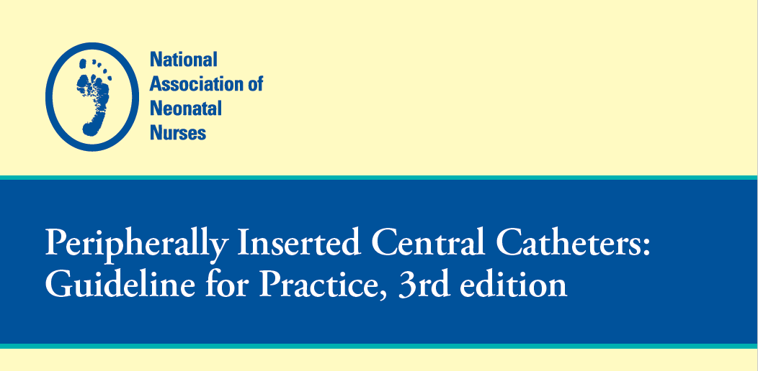

Slide 2
Summary of the key points, best practices, and evidence-based recommendations from National Association of Neonatal Nurses’ (NANN) Peripherally Inserted Central Catheters: Guideline for Practice, 3rd edition
SOOTHE Noxious Stimuli Workgroup
July 1, 2025

Slide 3
Rationale for Vascular Access in Neonates
The increasing number of critically ill and extremely-low-birth-weight neonates requires reliable vascular access for parenteral nutrition, IV fluids, and medications
Conditions such as gastroschisis and other bowel anomalies often necessitate long-term parenteral support
Peripheral IVs (PIVs) and umbilical catheters are limited by short dwell times and higher complication risks
  Extended-dwell PIVs

Slide 4
Best Practices and Evidence-Based Recommendations
Use and Advantages of PICCs
  PICCs offer safe, long-term venous access with fewer complications and lower infection rates than surgically placed CVCs
  RN-led vascular access teams improve PICC outcomes and reduce costs
  Ultrasound and echocardiography improve placement accuracy, decrease radiation exposure, and allow real-time monitoring
Definitions and Tip Positioning
  A PICC is inserted peripherally and threaded into the superior vena cava (SVC) or inferior vena cava (IVC)
  Proper tip placement is essential to minimize complications – see Figure 1A and 1B
  Midline catheters, which remain in peripheral circulation, are appropriate for fluids with osmolality <600 mOsm/kg, pH 5–9, and short-term non-irritant medications

Slide 5
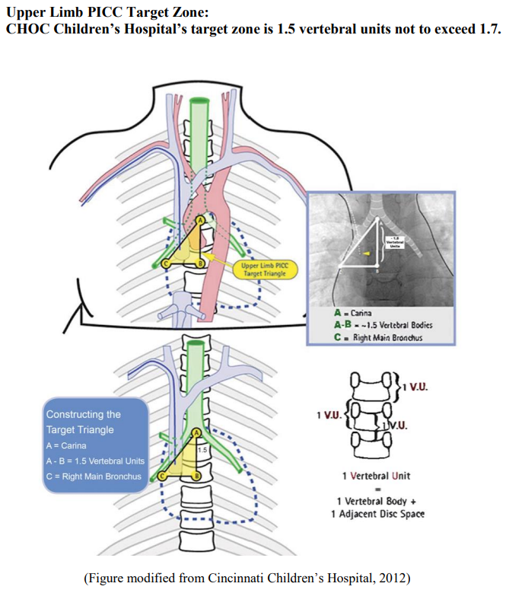
Figure 1A:
Upper Extremity PICC Line Placement

Slide 6
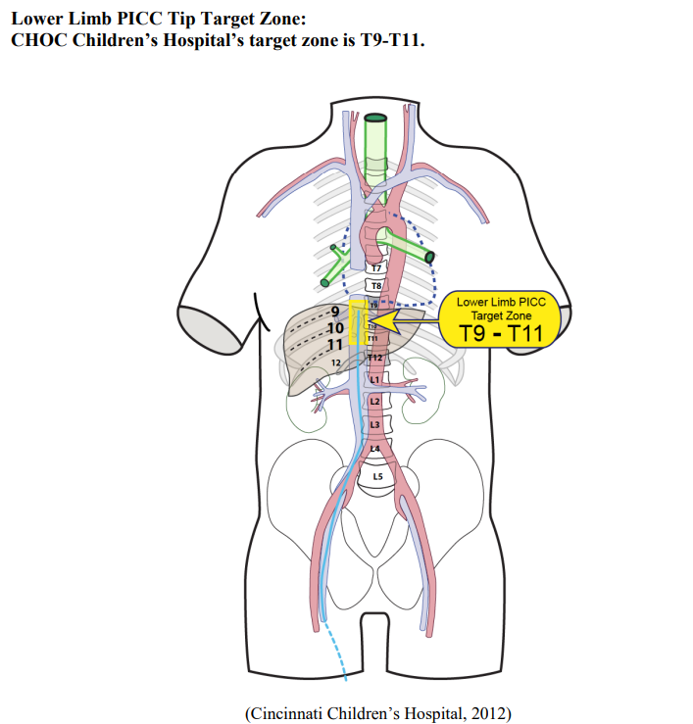
Figure 1B:
Lower Extremity PICC Line Placement

Slide 7
Risks of Non-Central Catheters
Noncentral venous catheters carry a 28% higher complication rate due to risk of infiltration, phlebitis, and malposition
Central placement reduces these risks significantly
A careful risk-benefit assessment is critical if a catheter cannot be advanced centrally

Slide 8
Device Selection Strategy
Early vascular access device (VAD) planning improves outcomes: select the most appropriate device early in hospitalization to preserve veins and avoid pain from multiple PIV attempts
Selection factors include:
  Anticipated length of therapy
  Type of therapy (osmolality, pH, irritants)
  Infant's age, weight, diagnosis, and vasculature
An algorithmic approach helps tailor VAD decisions and is a recommended quality improvement strategy

Slide 9
Limitations of PIVs
High complication rates (up to 78%) and early failure (up to 95%)
In extremely premature infants (<1,000g), IV access is difficult and often painful
PICC use reduces PIV insertion attempts by 50% and preserves venous integrity

Slide 10
Indications and Monitoring
PICCs are ideal for neonates needing:
  6 days of IV therapy
  Hyperosmolar or pH-extreme medications
  Difficult peripheral access
  Long-term TPN or antibiotics
Monitoring via ultrasound, echo, or X-ray ensures proper placement and helps detect migration or complications

Slide 11
Infusate Considerations
Osmolality: Solutions >600 mOsm/kg (e.g., TPN, high dextrose) should use central access
pH: Solutions <5 or >9 (e.g., vancomycin, phenobarbital) should also be centrally administered
Chemical irritants: Calcium, dopamine, amphotericin B increase risk for phlebitis/thrombosis in peripheral veins
Peripheral administration is only acceptable for short durations and if veins are large enough to support hemodilution.

Slide 12
Cost and Operational Considerations
Midlines become cost-effective after 3–4 days of use
PICCs placed by nurses are significantly more cost-efficient than surgical CVCs
Early PICC placement avoids repeated PIV attempts and associated hospital costs

Slide 13
Candidate Selection for PICCs
Ideal candidates include:
  Premature or low birth weight infants
  Infants needing prolonged IV therapy
  GI, cardiac, renal, or respiratory disorders
  Need for irritant or hyperosmolar infusions
  Limited peripheral access
Relative contraindications / precautions:
  Active infection (bacteremia/fungemia)
  Coagulopathies
  Fractures
  Severe edema or reduced venous return
  Cardiac anomalies requiring surgical input

Slide 14
Key Clinical Principles / Takeaway Points
Central access should be prioritized in infants receiving complex or long-term therapies
PIVs, although commonly used, are not optimal for many critically ill neonates
RN-led, ultrasound-guided PICC programs are best practice for high-quality, cost-effective vascular access.

