Slide 1

Global AIM: Improve maternal health through hospital-facilitated continuum of postpartum care by coordinating and providing respectful, timely, and risk-appropriate coordinated care and services.
Primary Key Driver
Secondary Drivers
Develop a strategy to engage and educate inpatient and outpatient providers and staff using initiative promotional and education materials
Clinician Postpartum Engagement and Education
Plan in place to continue to engage and educate new hires
Develop a strategy to engage and educate ER physicians & staff about pregnancy/PP care including PP screening & care practices
Respectful care is a universal component of every driver & activity

Slide 2
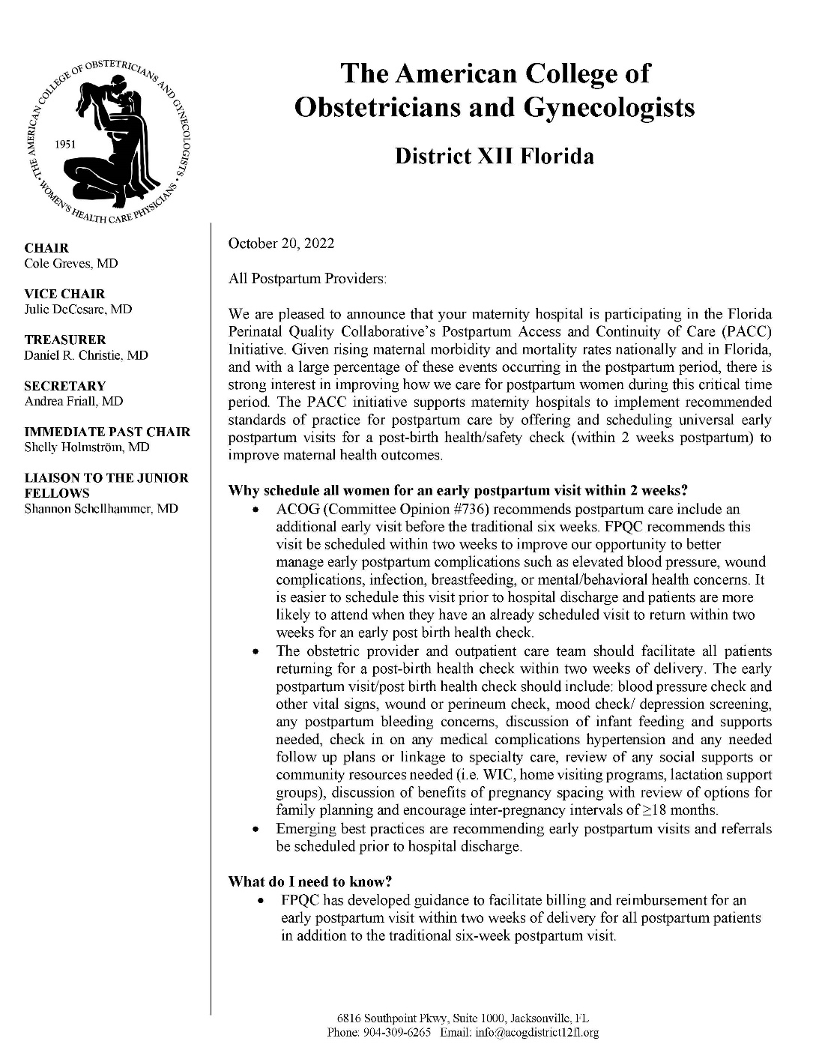
Outpatient Provider Letter
Customizable
Explains scope of the PACC initiative
Why 2-week PP visits are potentially life-saving
What materials to share with links to the site and documents
Partnerships
Contact information
3. Clinician PP Engagement & Education

Slide 3
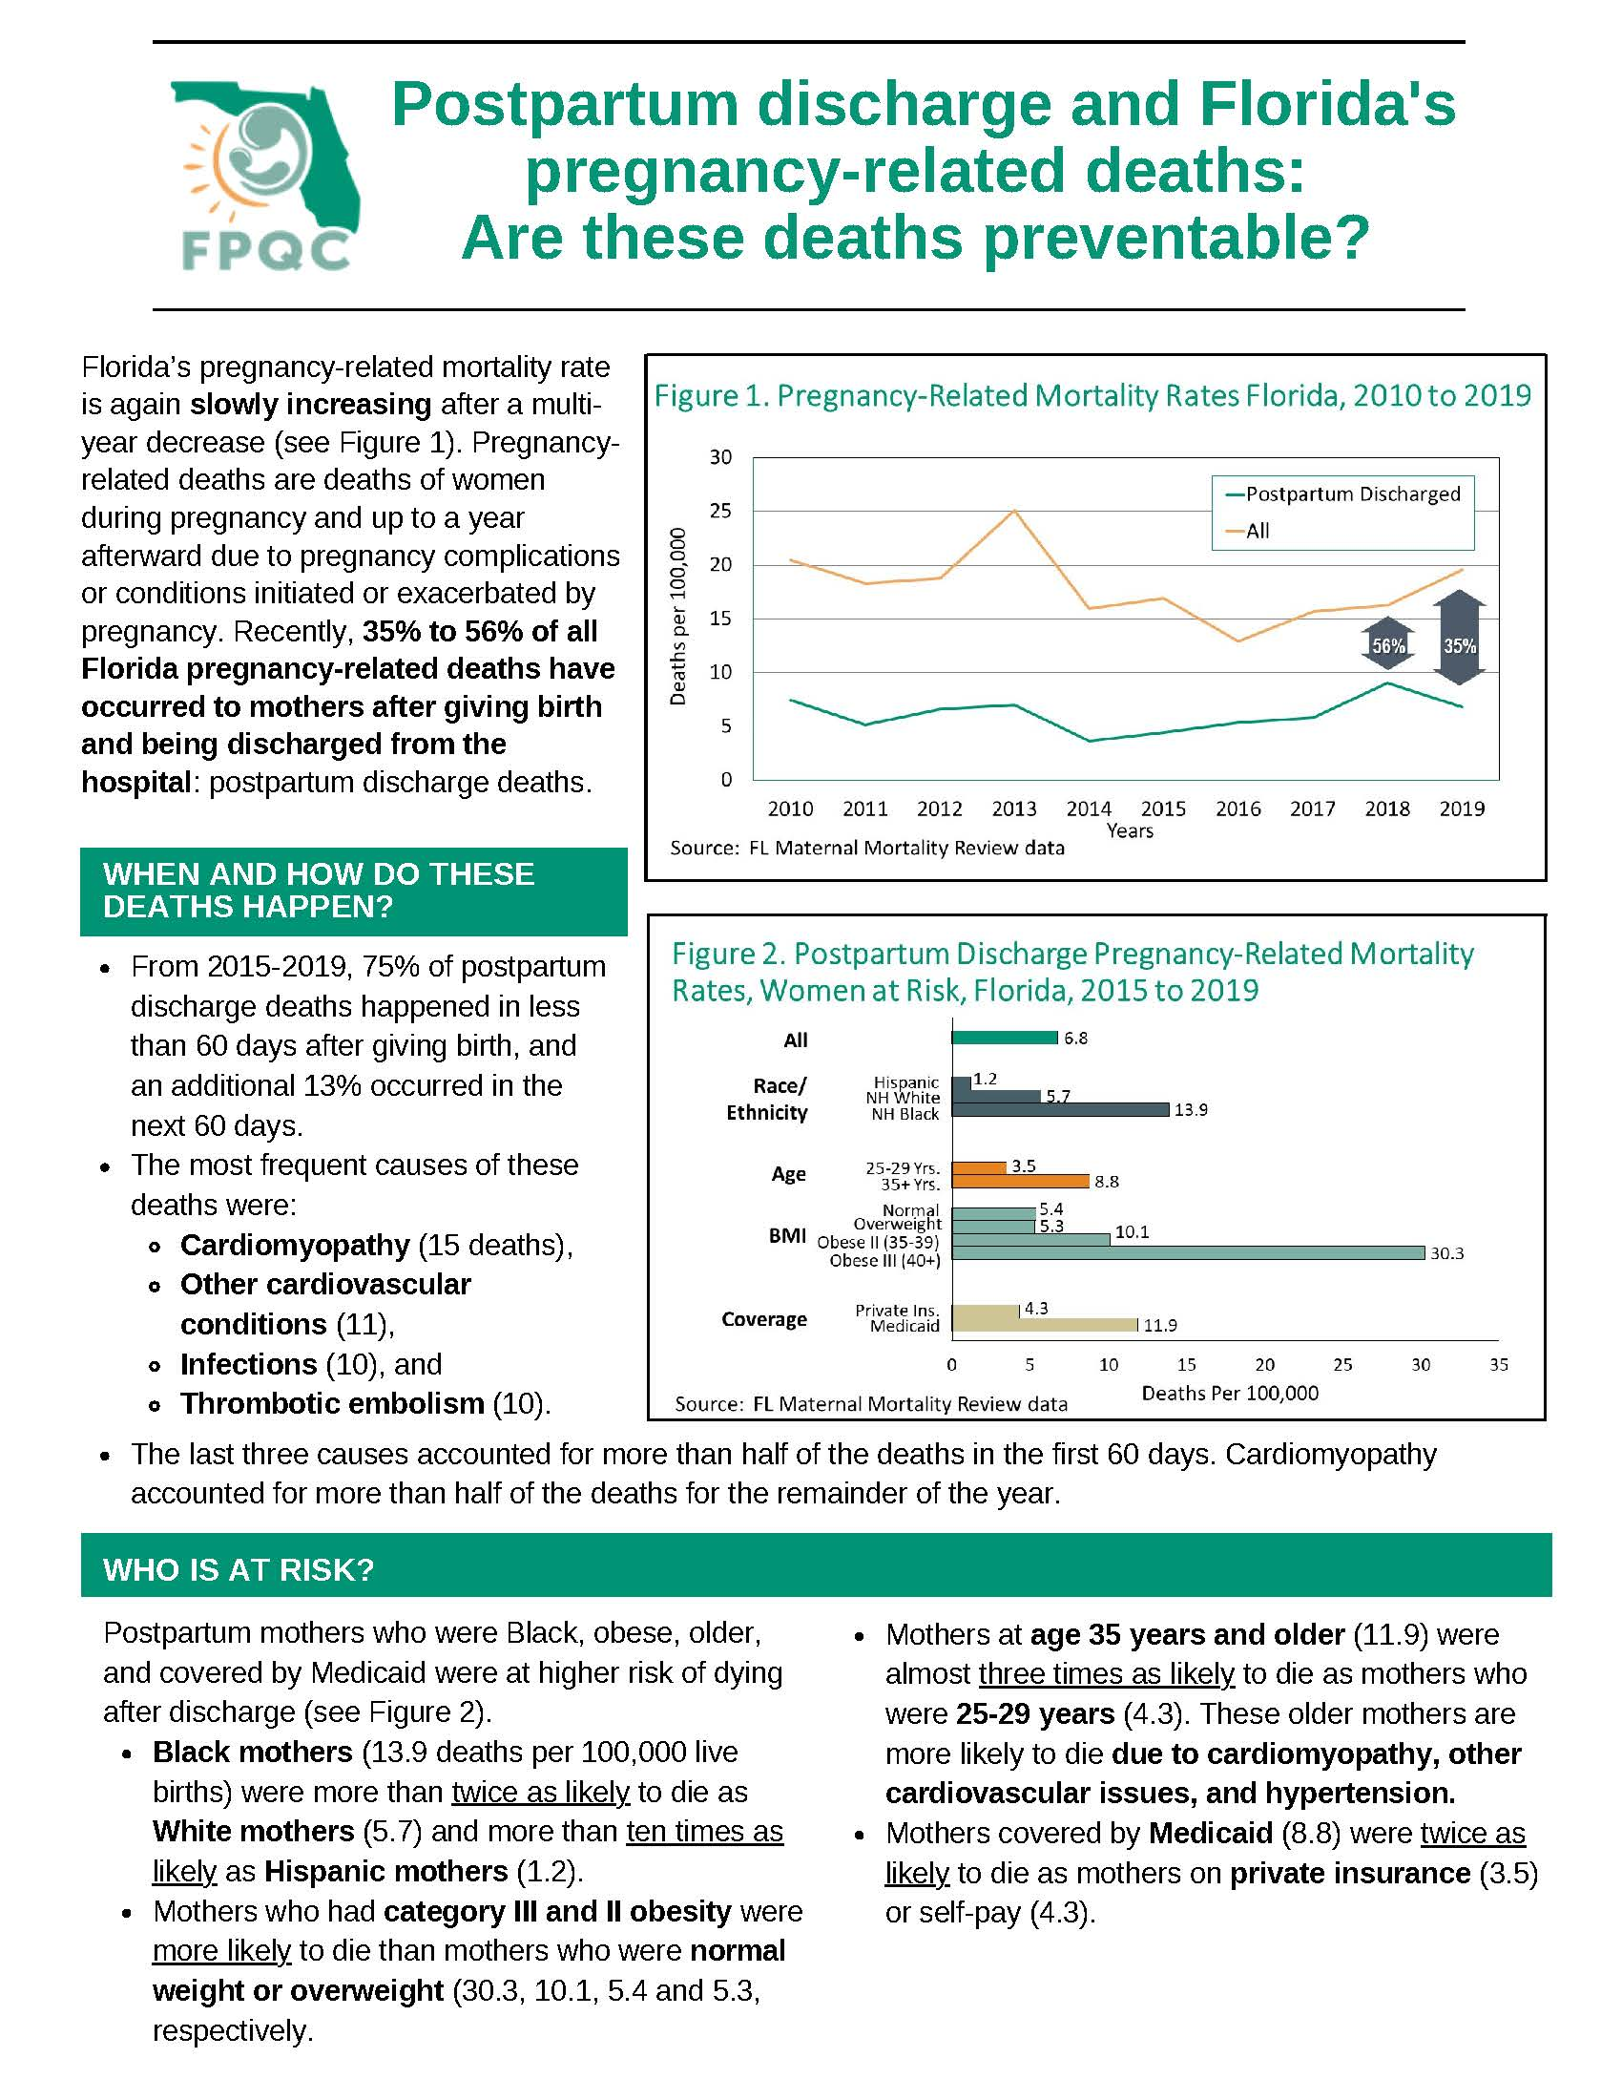
Postpartum Mortality Brief
(For Providers)
3. Clinician PP Engagement & Education

Slide 4
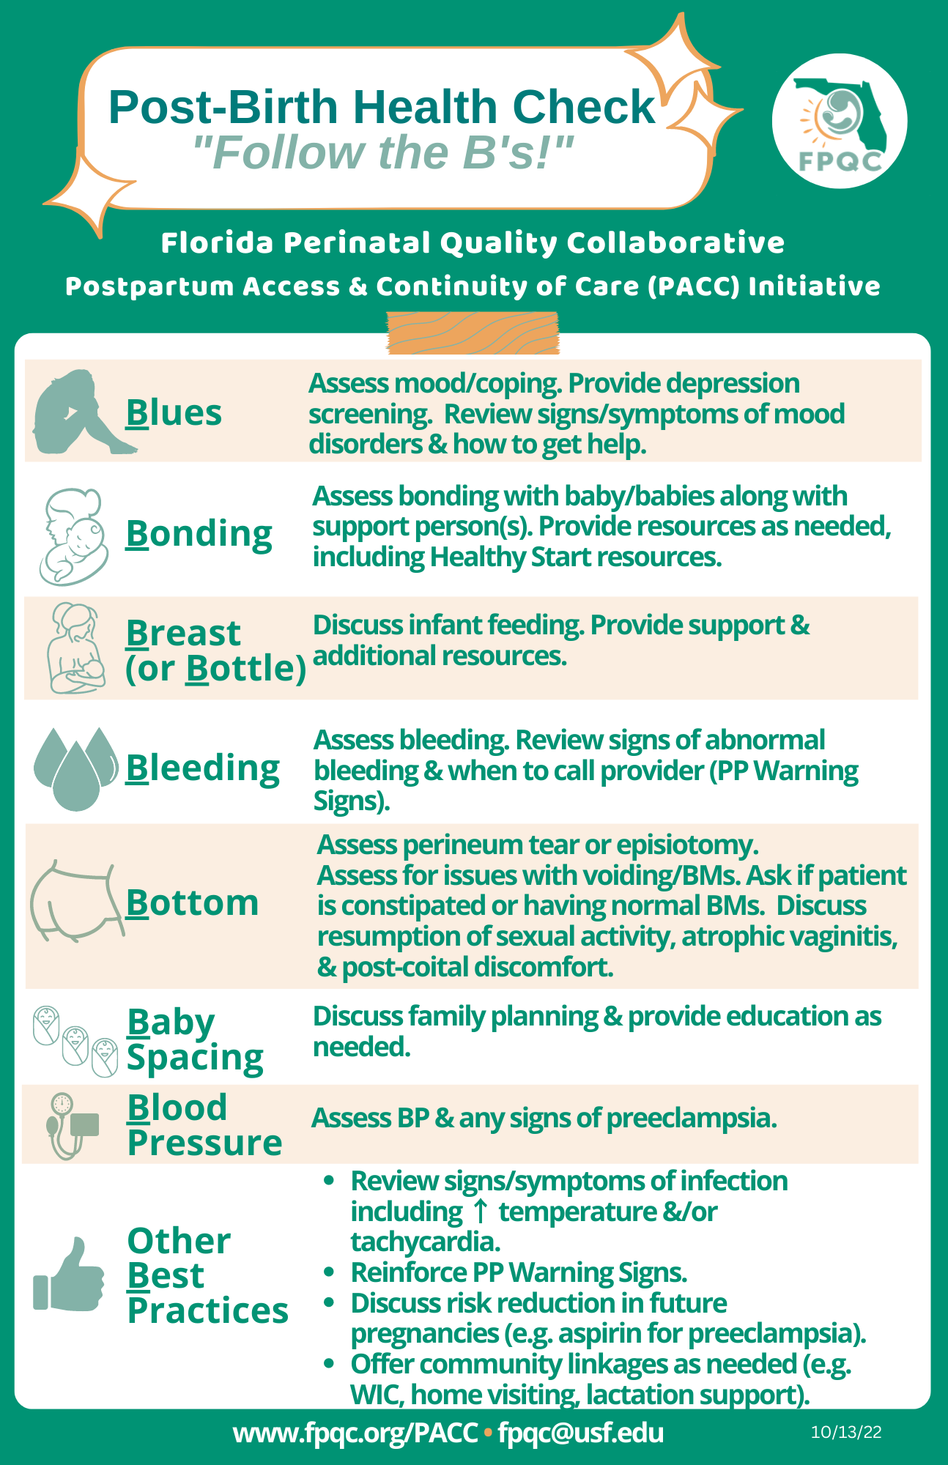
Post-Birth Health Check: Provider's Offices
(For Providers)
3. Clinician PP Engagement & Education

Slide 5
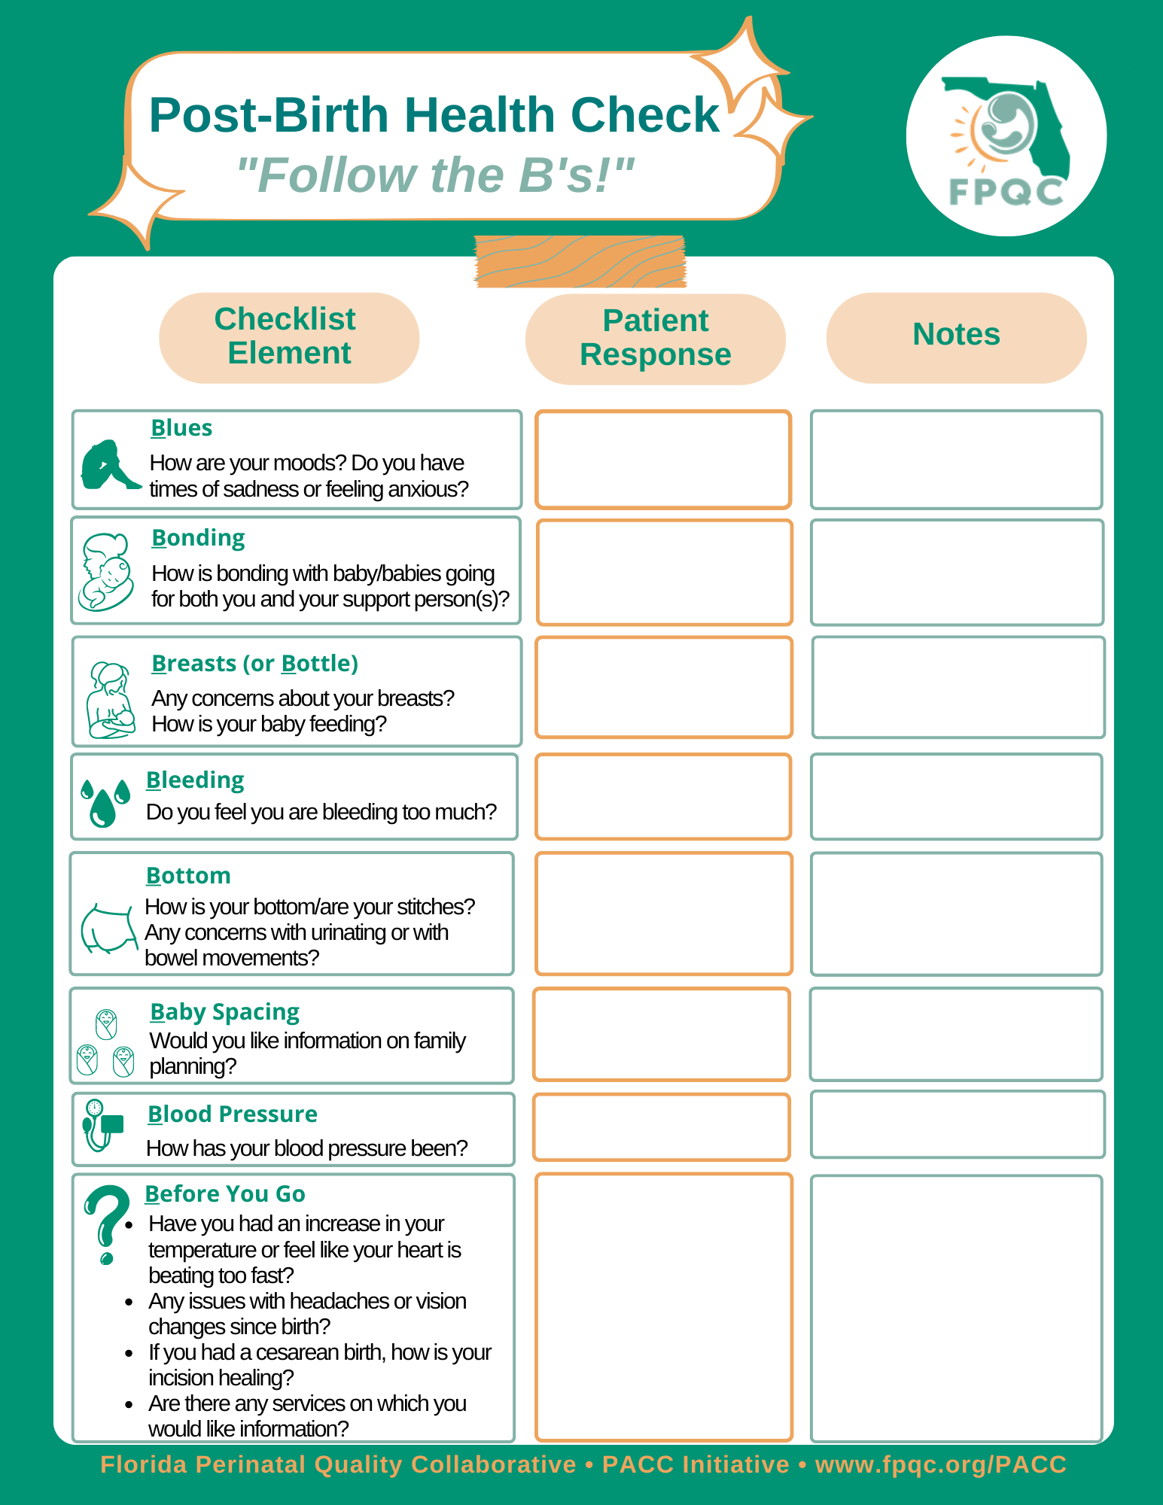
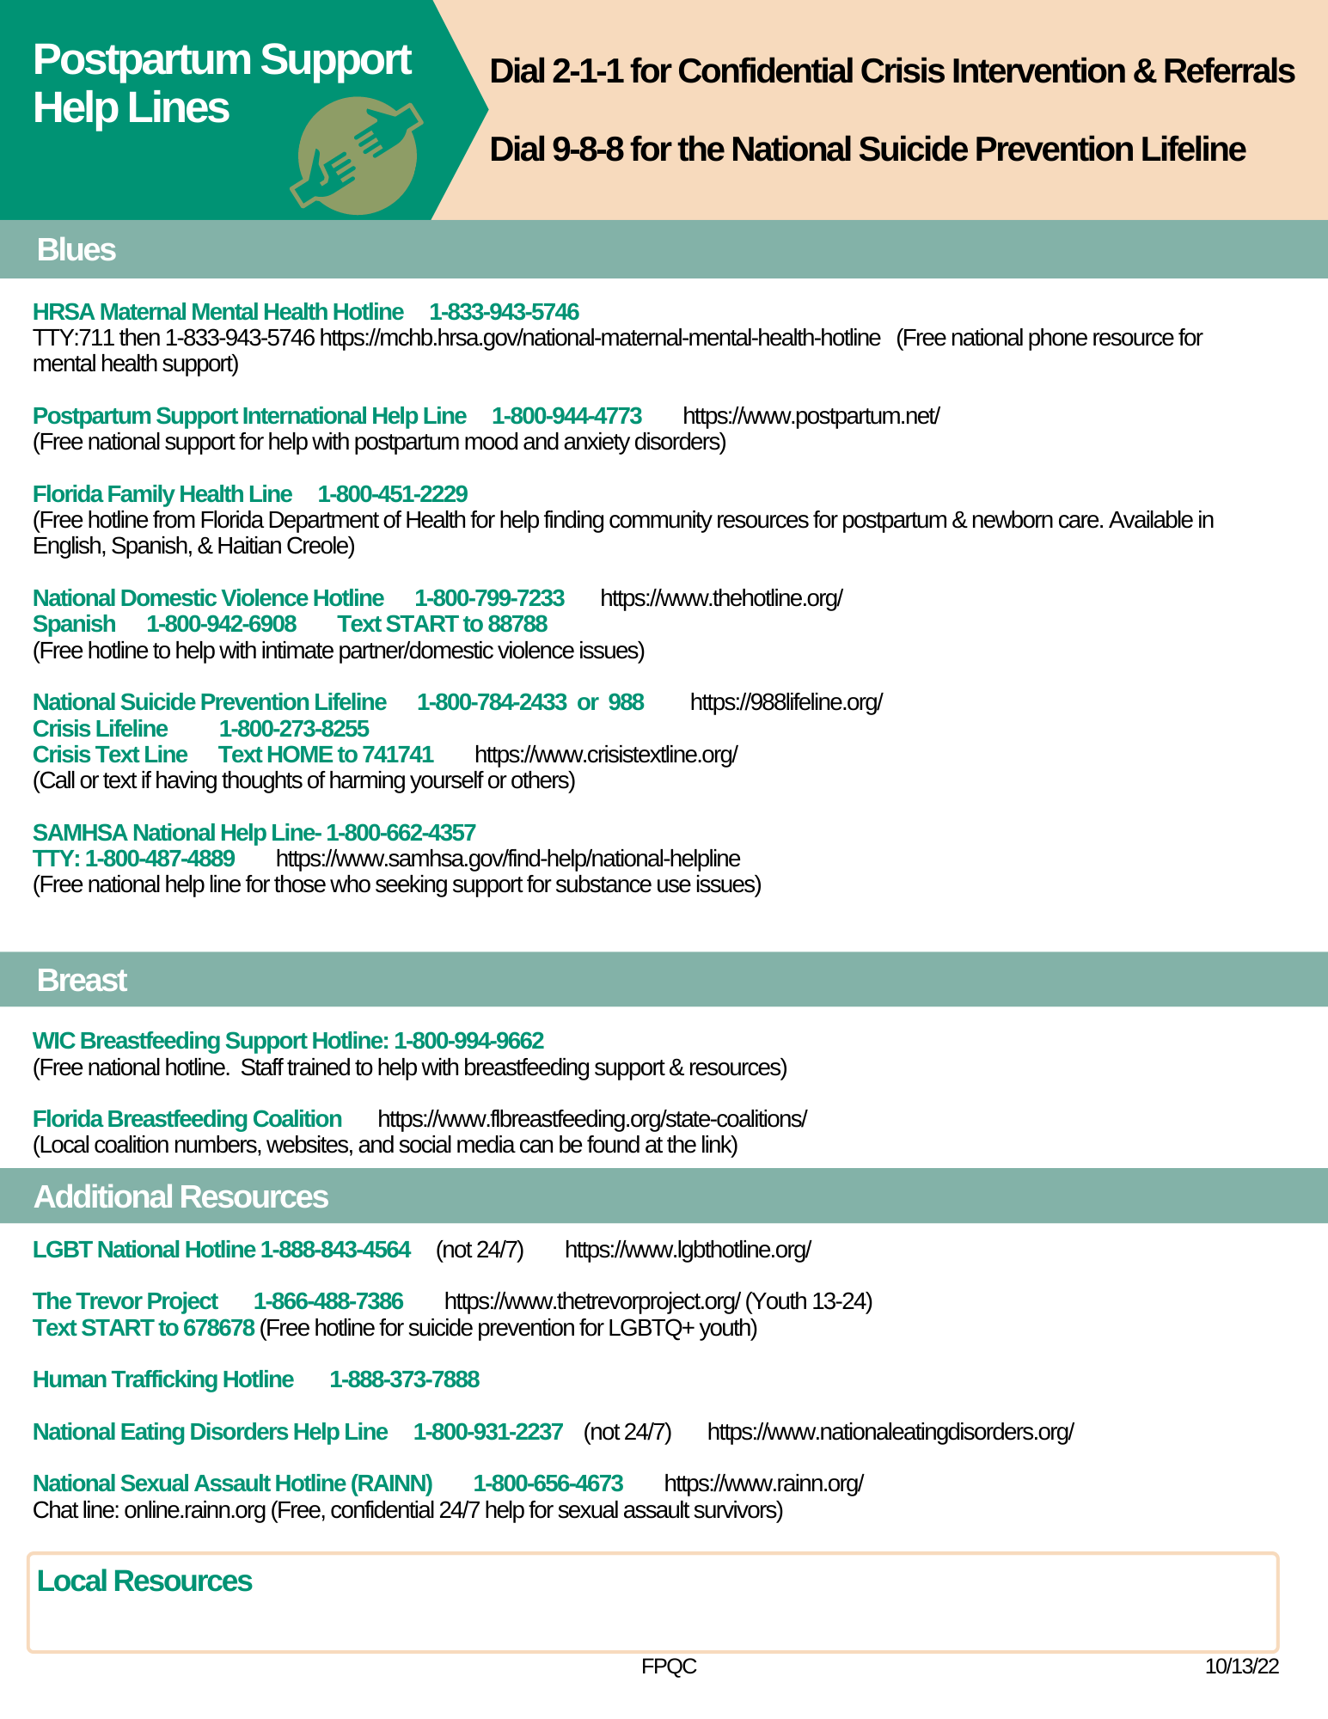
Post-Birth Health Check: Provider Offices (For Patients)
3. Clinician PP Engagement & Education

Slide 6
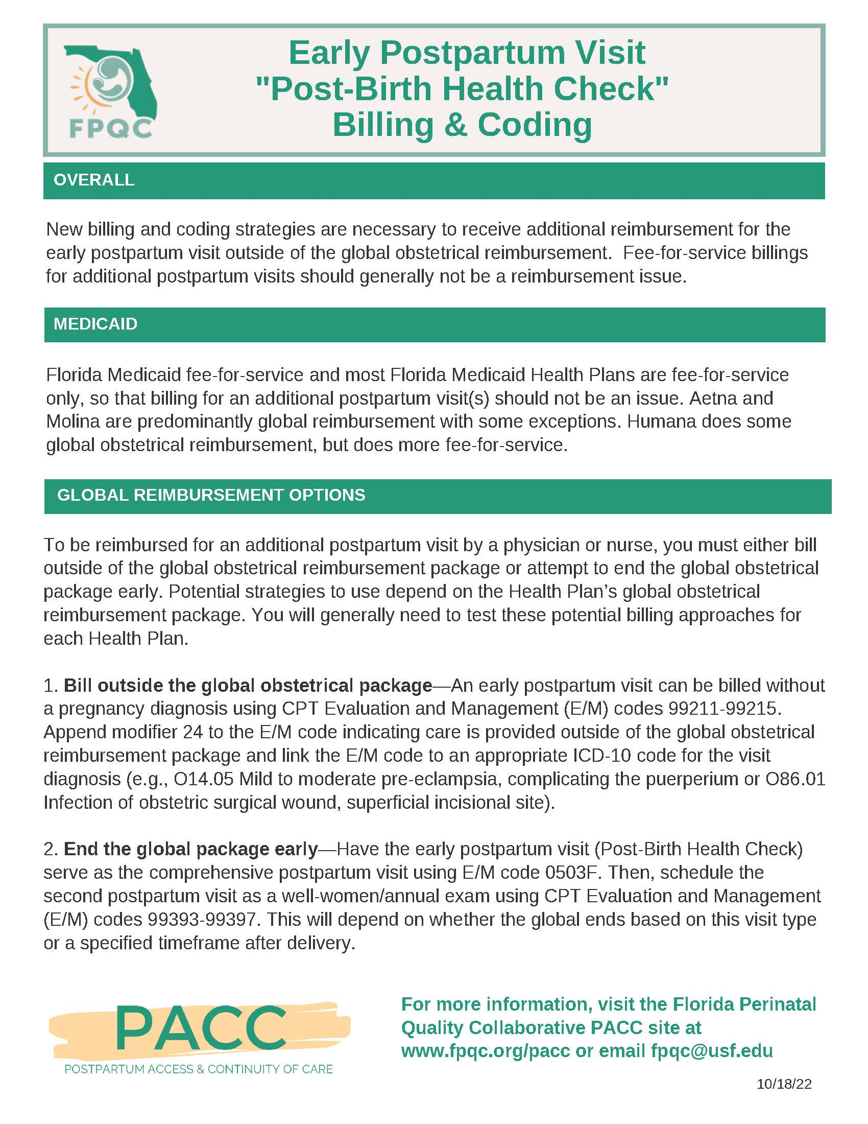
Post-Birth Health Check: Billing & Coding Suggestions
3. Clinician PP Engagement & Education

