Slide 1




Slide 2
Disclosures
Nothing to disclose

Slide 3
Objectives
Discuss Florida’s postpartum discharge pregnancy-related mortality including leading causes of postpartum death, timing and place
Describe quality improvement drivers to help prevent postpartum discharge related deaths
Discuss respectful care and the family perspective
Review the PACC QI Drivers and Toolkit to assist

Slide 4



Slide 5
Maternal Mortality Definitions
Maternal Mortality (Uses death certificate only)
Death of a woman while pregnant or within 42 days of termination of pregnancy, irrespective of the duration and site of the pregnancy, from any cause related to or aggravated by the pregnancy or its management but not from accidental or incidental causes.
Pregnancy-Associated Mortality (Uses enhanced surveillance)
Death of a woman, from any cause, while she is pregnant or within one year of pregnancy.
Pregnancy-Related Mortality (Based on Maternal Mortality Review)
Pregnancy-associated death that resulted from:
        Complications of the pregnancy;
        The chain of events initiated by pregnancy; or
        Aggravation of an unrelated condition by pregnancy effects resulting in death.

Slide 6
Pregnancy-Related Mortality Rates
Florida, 2010 to 2019
56%
35%
Years
Source: FL Maternal Mortality Review data
6
Notes:
The top orange line is the overall pregnancy-related mortality rate. The bottom green line is pregnancy-related deaths after the mother was discharged home from delivery hospitalizations. The percentages in the gray arrows are the estimated percentage of all pregnancy-related deaths that occurred after the mother was discharged from the hospital.

Slide 7
Postpartum Discharge Pregnancy-Related Deaths
By Time Period, Florida, 2015 to 2019
Days After Birth
Source: FL Maternal Mortality Review data

Slide 8
Underlying Cause of Death for Less Than the First 60 Days
Postpartum Discharge Pregnancy-Related Deaths
By Time Period, Florida, 2015 to 2019
Source: FL Maternal Mortality Review data

Slide 9
Underlying Cause of Death for 60+ Days
Postpartum Discharge Pregnancy-Related Deaths
By Time Period, Florida, 2015 to 2019
Source: FL Maternal Mortality Review data

Slide 10
Postpartum Discharge Pregnancy-Related Deaths with a Stand-Alone Postpartum ER Visit, Florida, 2015 to 2019
Days After Birth
Source: FL Maternal Mortality Review data

Slide 11
Postpartum Discharge Pregnancy-Related Mortality Rates, Women at Risk, Florida, 2015 to 2019
Coverage
Private Ins.
Medicaid
Normal
BMI
Overweight
Obese II
Obese III
Age
25-29 Yrs.
35+ Yrs.
Hispanic
Race/Ethnicity
NH White
NH Black
Source: FL Maternal Mortality Review data
Deaths Per 100,000
11

Slide 12
Postpartum Discharge Pregnancy-Related Deaths By Cause and Preventability, Florida, 2015 to 2019
Number of Postpartum Discharge Deaths
12

Slide 13
Topic MMRC Recommendation Themes
Improvement recommendations in the following areas:
Chronic disease management before & after pregnancy: 33 recommendations
Postpartum visit: 16 recommendations
Provider education: 11 recommendations
Sepsis: protocol and provider education: 5 recommendations
Source: FL Maternal Mortality Review data

Slide 14
Source: FL Maternal Mortality Review data
Pregnancy-Associated Mortality Ratios by Cause of Death
Florida, 2010-2020
Drug-Related Deaths:
Leading cause; More than all pregnancy complications
More than 75% die after discharge for delivery
More likely to have had a prior standalone ER visit than other conditions
4
Notes:
This is the Pregnancy-Associated Mortality Ratios by Cause of Death excluding pregnancy-related mortality. Drug-related deaths are the leading cause of death by far and increasing over time especially in 2020. There are more drug-related deaths each year in Florida than all of those death due to pregnancy complications. Most notably, more than 75% of these mothers die after being discharged after delivery.

Slide 15

Why Early Postpartum Care?
50% of postpartum strokes occur within 10 days of discharge (Too G, et al, 2018)
20% of women discontinue breastfeeding before the first 6-weeks (Stuebe, et al, 2014)
Up to 40% of women do not attend the 6-week postpartum visit (ACOG CO #736 2018)
As many as 1 in 5 women experience a postpartum mental health disorder
Notes:
Suzanne to add citations
Stuebe AM, et. al. Prevalence and risk factors for early, undesired weaning attributed to lactation dysfunction. J Womens Health (Larchmt) 2014;23:404–12.
Martin A, et. al. Views of women and clinicians on postpartum preparation and recovery. Matern Child Health J 2014;18:707–13. 5.
Tully KP, et. al. The fourth trimester: a critical transition period with unmet maternal health needs. Am J Obstet Gynecol 2017;217:37–41.
Optimizing postpartum care. ACOG Committee Opinion No. 736. American College of Obstetricians and Gynecologists. Obstet Gynecol 2018;131:e140–50.
. Illinois Maternal Morbidity and Mortality Report. Illinois Department of Public Health. (October 2018)
Too G , Went T , Boehme AK , Miller EC , Leffert LR , Attenello FJ , et al. Timing and Risk Factors of Postpartum Stroke . Obstet Gynecol 2018

Slide 16

Women desire improved postpartum care
Qualitative studies point to women’s lack of satisfaction with postpartum care compared to maternal care
With women noting a steep drop off in care in the early postpartum period
Women reported wanting additional, early postpartum care
Martin A, et. al. Views of women and clinicians on postpartum preparation and recovery. Matern Child Health J 2014.
Tully KP, et. al. The fourth trimester: a critical transition period with unmet maternal health needs. Am J Obstet Gynecol 2017

Slide 17
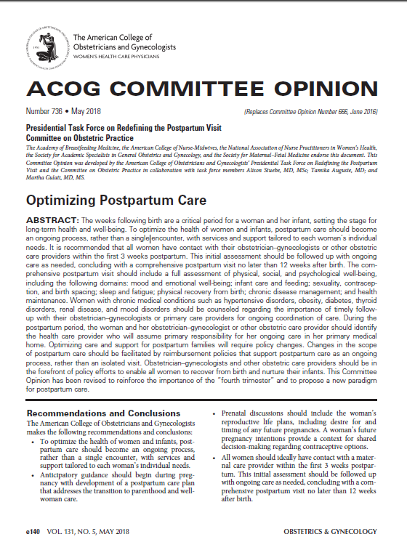
Redefining postpartum care: ACOG CO #736
To optimize the health of women and infants, postpartum care should become an ongoing process, rather than a single encounter
All women should ideally have contact with maternal care provider within the first 3 weeks postpartum (2 week post birth health check)
  Blood pressure checks
  Breastfeeding support
  Mental health well-being
  Contraception
Initial assessment should be followed up with ongoing care as needed
Conclude with a comprehensive postpartum visit approximately 6 weeks postpartum, NO LATER than 12 after birth

Slide 18
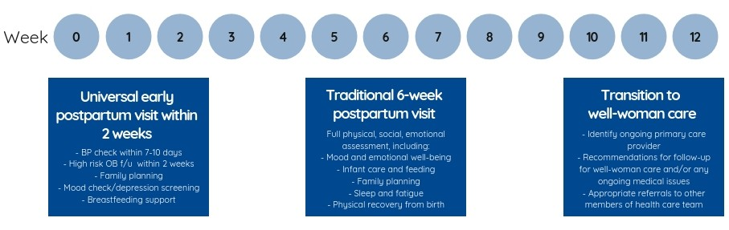
New Postpartum Care Continuum
An early postpartum visit (within 2 weeks of delivery) provides women with an essential maternal safety check including blood pressure evaluation, wound/perineum evaluation, breastfeeding support, mental health well-being, and family planning, among other essential health services.
Universal early postpartum visit within 2 weeks
-BP check within 7-10 days
-OB F/U with 2 weeks
-Family Planning
-Mood check/depression screening
Breastfeeding
Traditional 6-week postpartum visit
Full physical, social, emotional assessment, including:
-Mood and emotional well-being
-Infant care and feeding
-Family Planning
-Sleep Fatigue
-Physical recovery from birth
Transition to well-woman care
-Identify ongoing primary care provider
-Recommendations for F/U for well-women care and/or any ongoing medical issues
-Appropriate referrals to other members of health care team

Slide 19

Global AIM: Improve maternal health through hospital-facilitated continuum of postpartum care by coordinating and providing respectful, timely, and risk-appropriate coordinated care and services.
AIM
Primary Key Drivers
By 6/2024, FPQC participating hospitals will:
Increase the % of patients with a 2-week PP visit scheduled prior to discharge by 20%*
Increase patient PP education by 20%*
Process for Maternal Discharge Risk Screening & Arranging Early Postpartum Visits
Comprehensive Postpartum Patient Discharge Education
Clinician Postpartum Engagement and Education
Respectful care is a universal component of every driver & activity

Slide 20
Global AIM: Improve maternal health through hospital-facilitated continuum of postpartum care by coordinating and providing respectful, timely, and risk-appropriate coordinated care and services.
Primary Key Driver
Secondary Drivers
Develop a process flow to schedule early risk-appropriate PP visits/encounters prior to discharge and align policies and procedures accordingly
Process for Maternal Discharge Risk Screening & Arranging Early Postpartum Visits
Conduct a PP Discharge Assessment prior to discharge
Implement universal Maternal Discharge Risk Screening for PP care & schedule/arrange risk-appropriate PP care including obstetrical, specialty, & community services before discharge
Respectful care is a universal component of every driver & activity

Slide 21
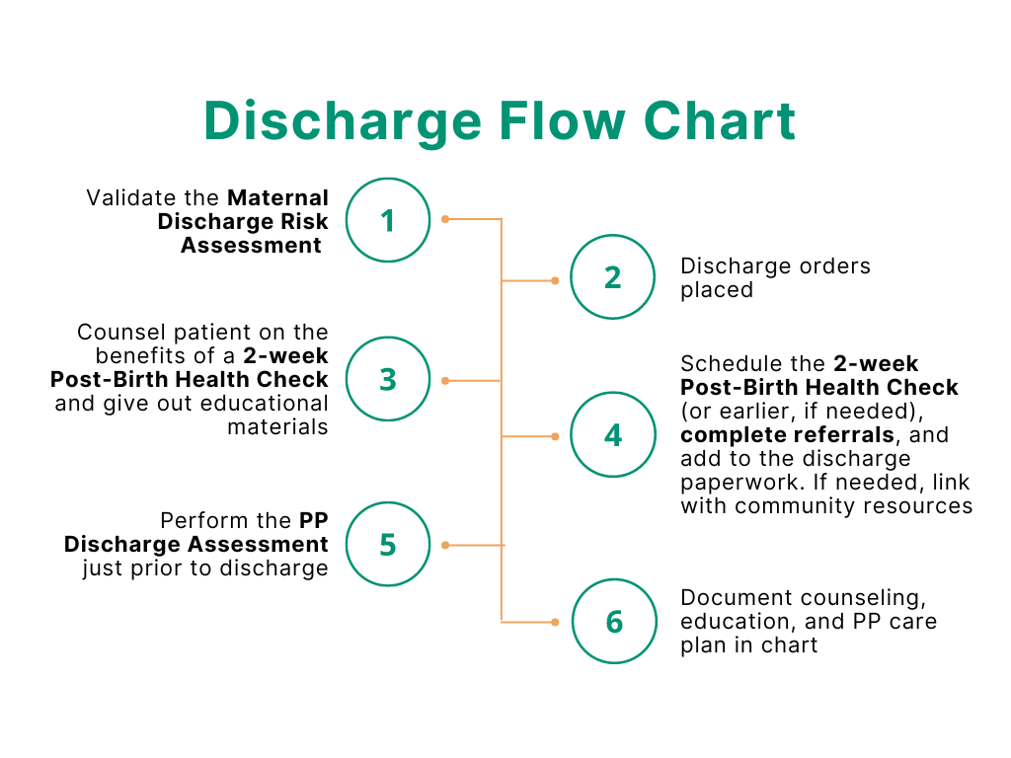
1. High Risk Screening & Early PP Visits

Slide 22
Maternal Discharge Risk Assessment
1
Has the patient been diagnosed with chronic hypertension, gestational hypertension, pre-eclampsia, eclampsia, maternal heart disease, or related conditions?
Schedule blood pressure check in 2-3 days & appointment with OB or PCP in 1-2 weeks.
If yes to maternal heart disease, schedule appointment with cardiology in 1-2 weeks.
2
Does the patient have a history of venous thromboembolism (DVT or pulmonary embolism) this pregnancy or on anticoagulation prior to delivery?
If yes, then ensure patient has 6 weeks of medication for anticoagulation in hand prior to discharge.
3
Did the patient have a c-section or 3rd or 4th degree vaginal laceration?
If yes, schedule for 1–2-week incision check with OB.
4
Does the patient have substance use disorder or screened positive with an evidence-based verbal screening tool?
If yes, perform SBIRT, refer for MAT/MOUD, provide Naloxone kit/Rx, and OB follow up in 1-2 weeks.

Slide 23
Maternal Discharge Risk Assessment
QUESTIONS TO ASK THE PATIENT:
5
Ask: Do you feel unsafe at home? Is there a partner from a relationship who is making you feel unsafe now?
If yes, then refer to case manager or social worker for assessment prior to discharge.
6
Ask: Over the last two weeks have you felt down, depressed, hopeless, have little interest in doing things, or have a history of mood or anxiety disorder?
If yes, then screen with Edinburgh Postnatal Depression Scale (recommended), contact OB provider, and schedule follow up for mood check in 1-2 weeks. Consider psych consult prior to discharge or discharge as appropriate.
7
Ask: Can I connect you to additional community resources?
If yes, consult social worker, refer to Healthy Start, Medicaid Case Manager, or hospital financial counselor.

Slide 24
PP Discharge Assessment—Just prior to discharge)
Is the most recently blood pressure ≥160/100?
If yes, alert the provider and hold discharge
Is the most recent pulse ≥120?
Is temperature ≥100.4F/38C?
If yes, alert the provider and hold discharge
If yes, alert the provider and hold discharge
Is the respiratory rate ≥30?
If yes, alert the provider and hold discharge
1. High Risk Screening & Early PP Visits

Slide 25
Global AIM: Improve maternal health through hospital-facilitated continuum of postpartum care by coordinating and providing respectful, timely, and risk-appropriate coordinated care and services.
Primary Key Driver
Secondary Drivers
Verbally educate patients on the benefits of early risk-appropriate PP visits/encounters (Post-Birth Health Checks)
Verbally educate all patient on PP Warning Signs and provide written materials
Comprehensive Postpartum Patient Discharge Education
Verbally educate patients on the benefits of and options for pregnancy spacing, family planning and contraceptive choice and provide written materials
Establish a system to ensure that all patients receive recommended and documented PP education and discharge information
Respectful care is a universal component of every driver & activity

Slide 26
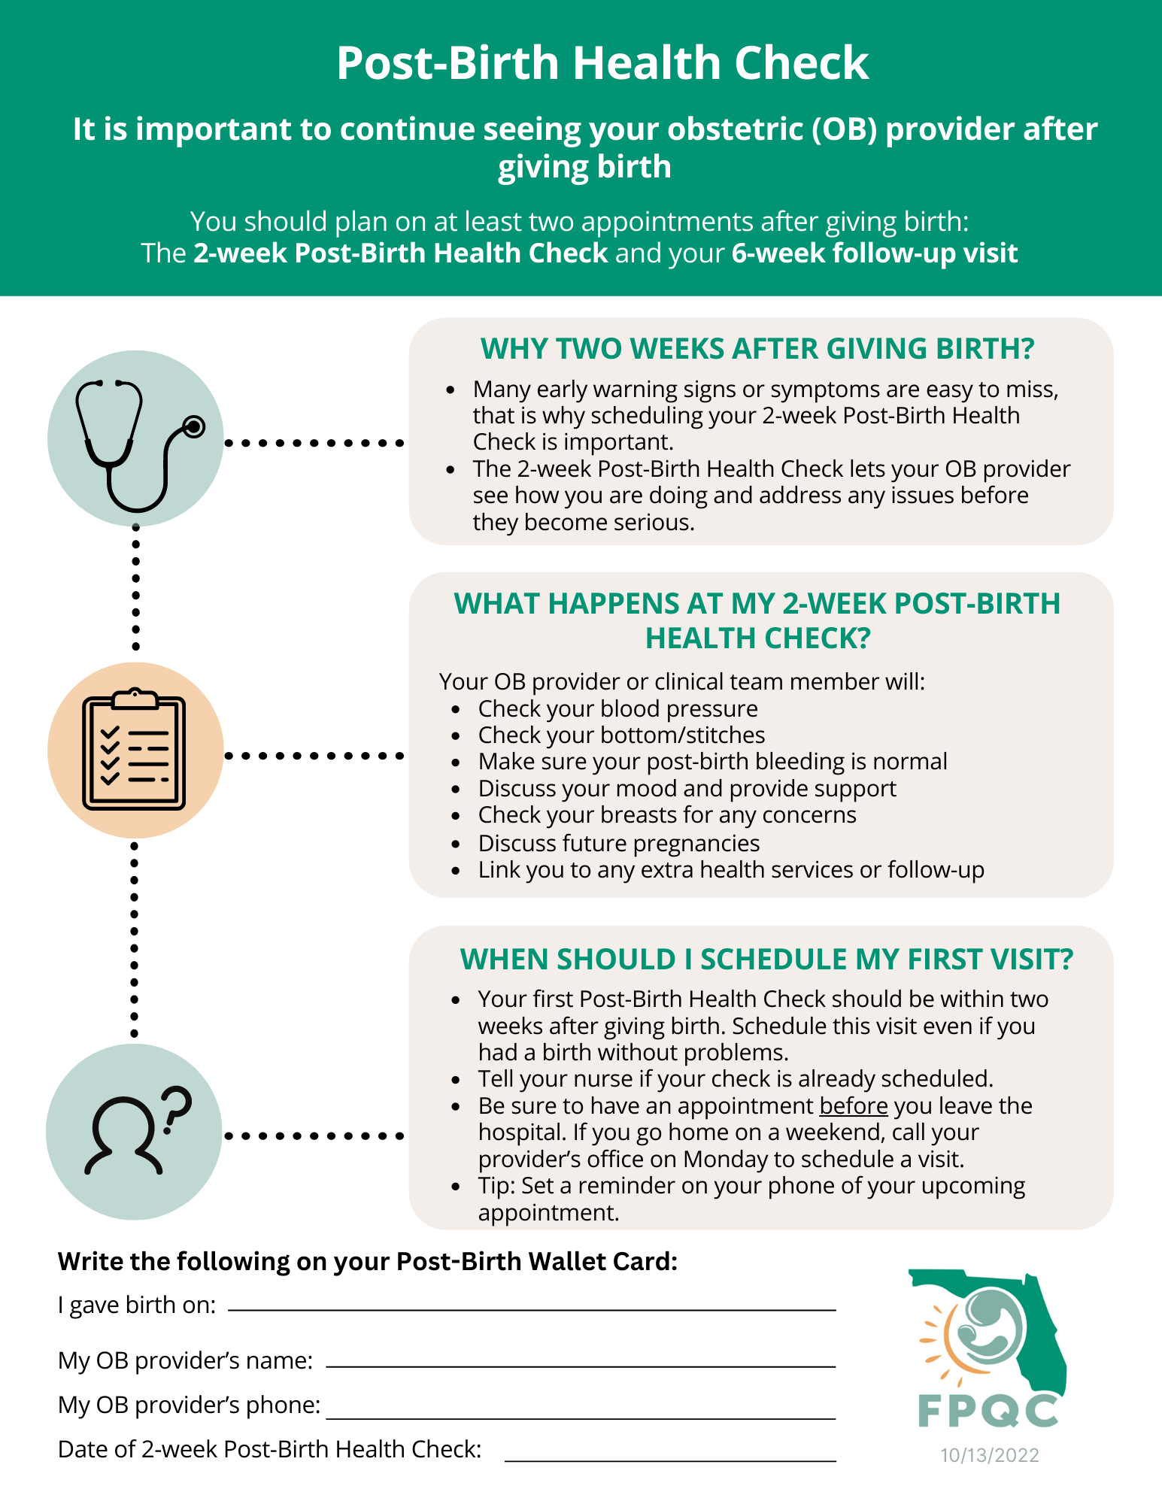
Post-Birth
Health Check
2. Comprehensive PP Discharge Education

Slide 27
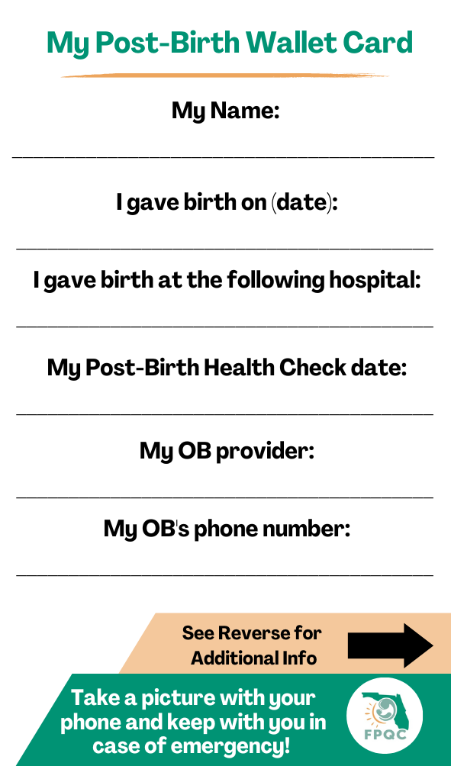
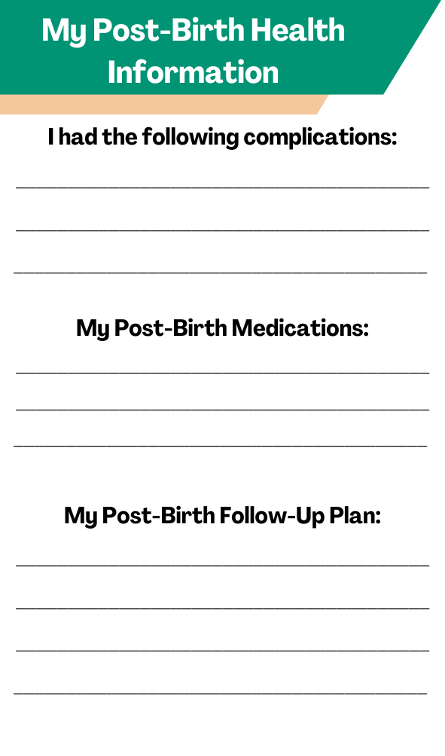
My Post-Birth Wallet Card
2. Comprehensive PP Discharge Education
Reverse Side

Slide 28
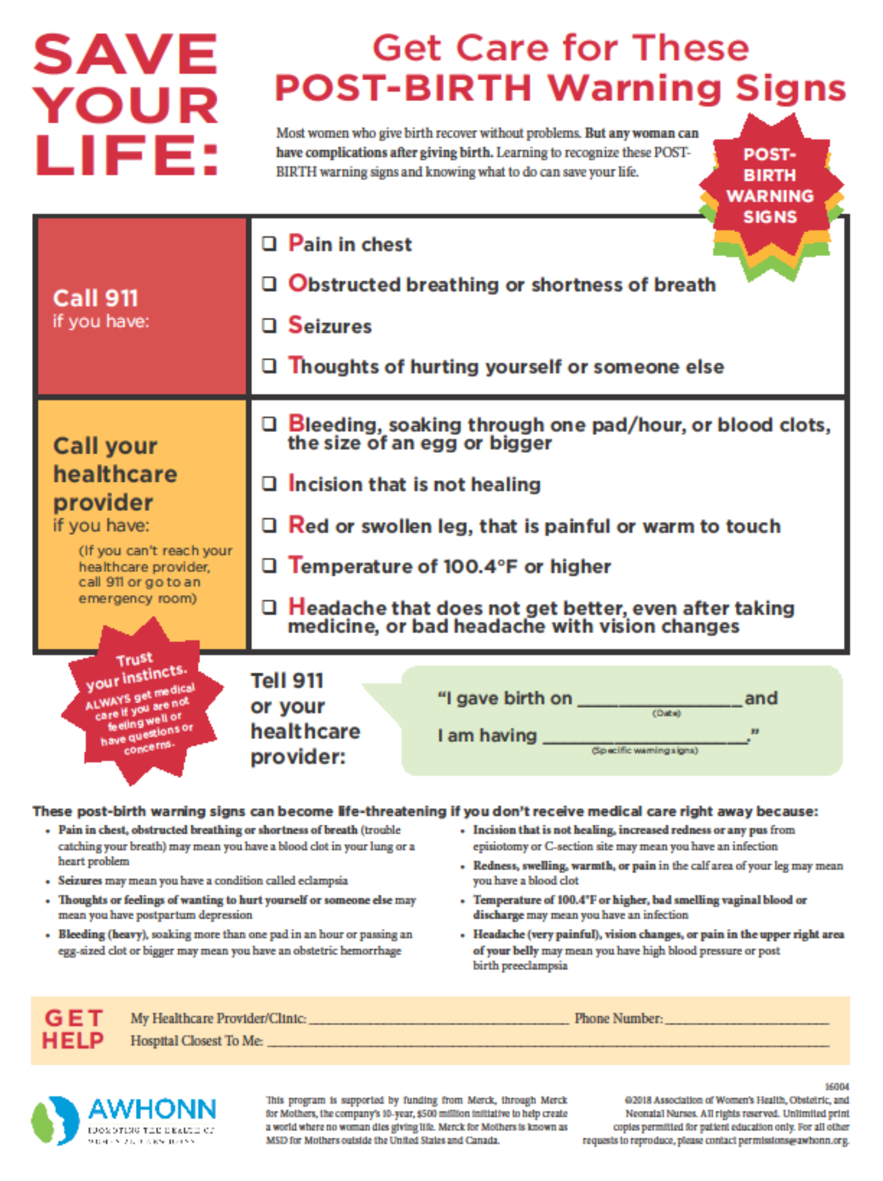
Post-Birth
Warning Signs
2. Comprehensive PP Discharge Education

Slide 29










Hear Her Campaign Poster
Headache that won’t go away or gets worse
Trouble breathing
Dizziness or fainting
Chest pain or fast-beating heart
Severe swelling, redness or pain of your leg or arm
Fever of 100.4 or higher
Change in your vision
Vaginal bleeding or discharge after pregnancy
Thoughts of harming yourself
Overwhelming tiredness
Multiple ER and health care contacts for same reason!
Source: CDC Hear Her Campaign

Slide 30
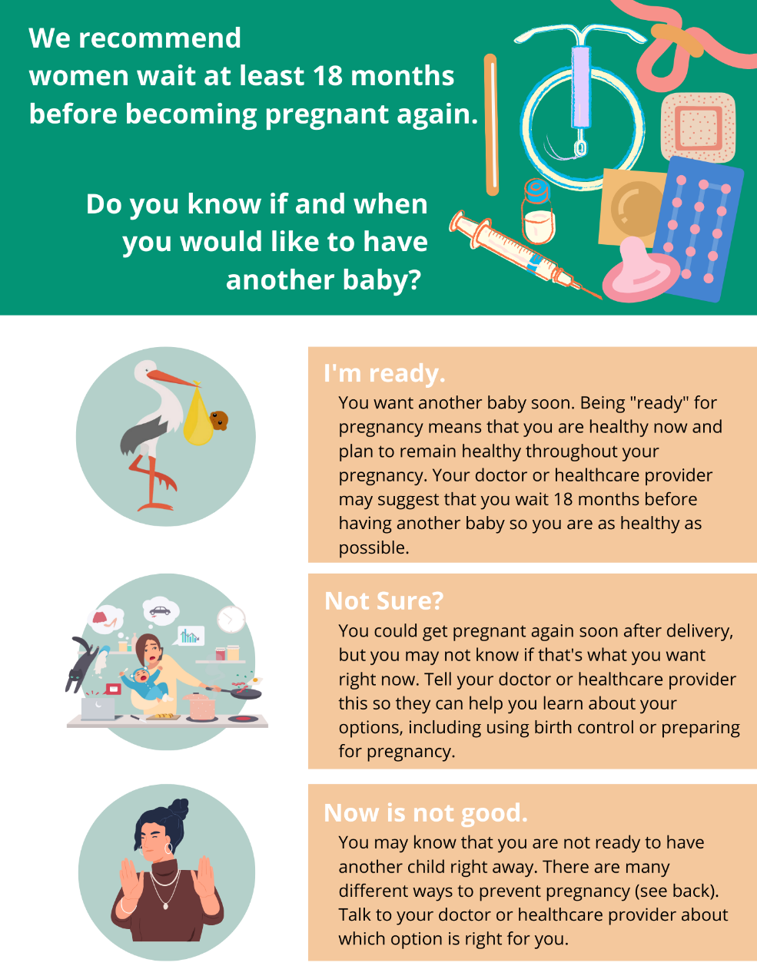
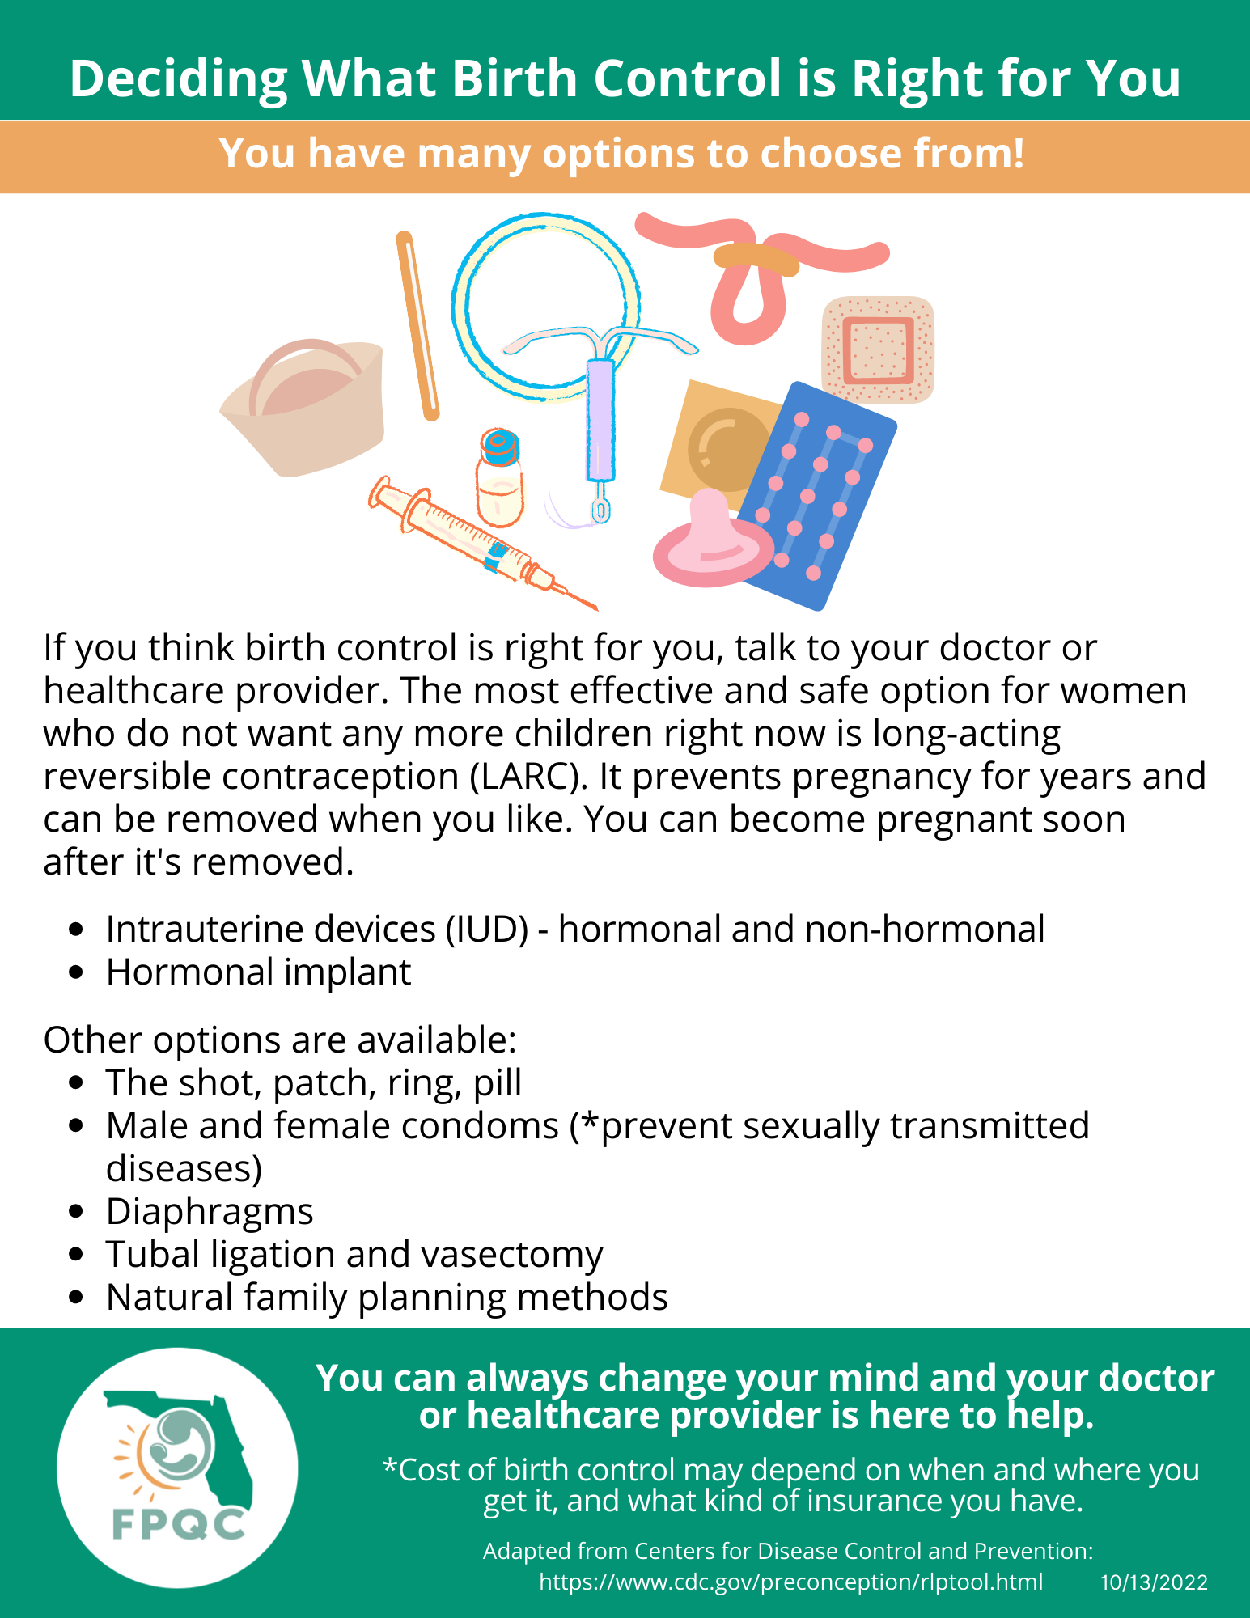
Patient Education on Pregnancy Spacing Benefits
2. Comprehensive PP Discharge Education
Reverse Side

Slide 31
Global AIM: Improve maternal health through hospital-facilitated continuum of postpartum care by coordinating and providing respectful, timely, and risk-appropriate coordinated care and services.
Primary Key Driver
Secondary Drivers
Develop a strategy to engage and educate inpatient and outpatient providers and staff using initiative promotional and education materials
Clinician Postpartum Engagement and Education
Plan in place to continue to engage and educate new hires
Develop a strategy to engage and educate ER physicians & staff about pregnancy/PP care including PP screening & care practices
Respectful care is a universal component of every driver & activity

Slide 32
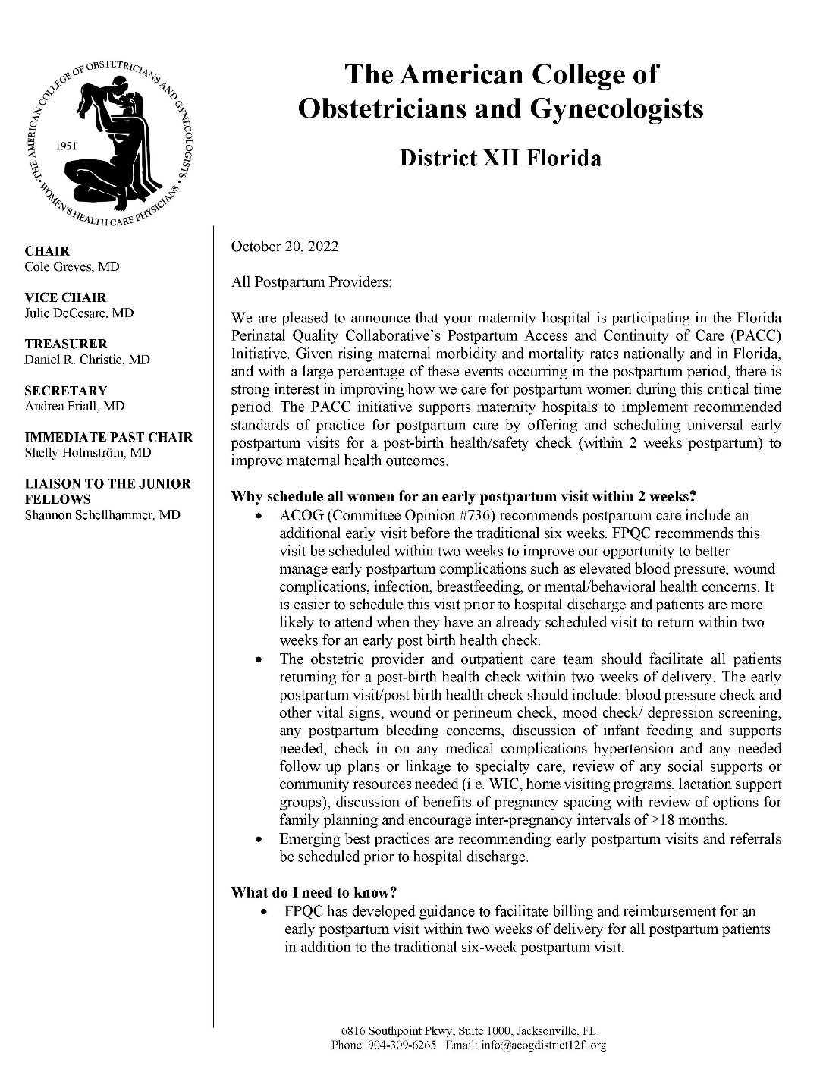
Outpatient Provider Letter
Customizable
Explains scope of the PACC initiative
Why 2-week PP visits are potentially life-saving
What materials to share with links to the site and documents
Partnerships
Contact information
3. Clinician PP Engagement & Education

Slide 33
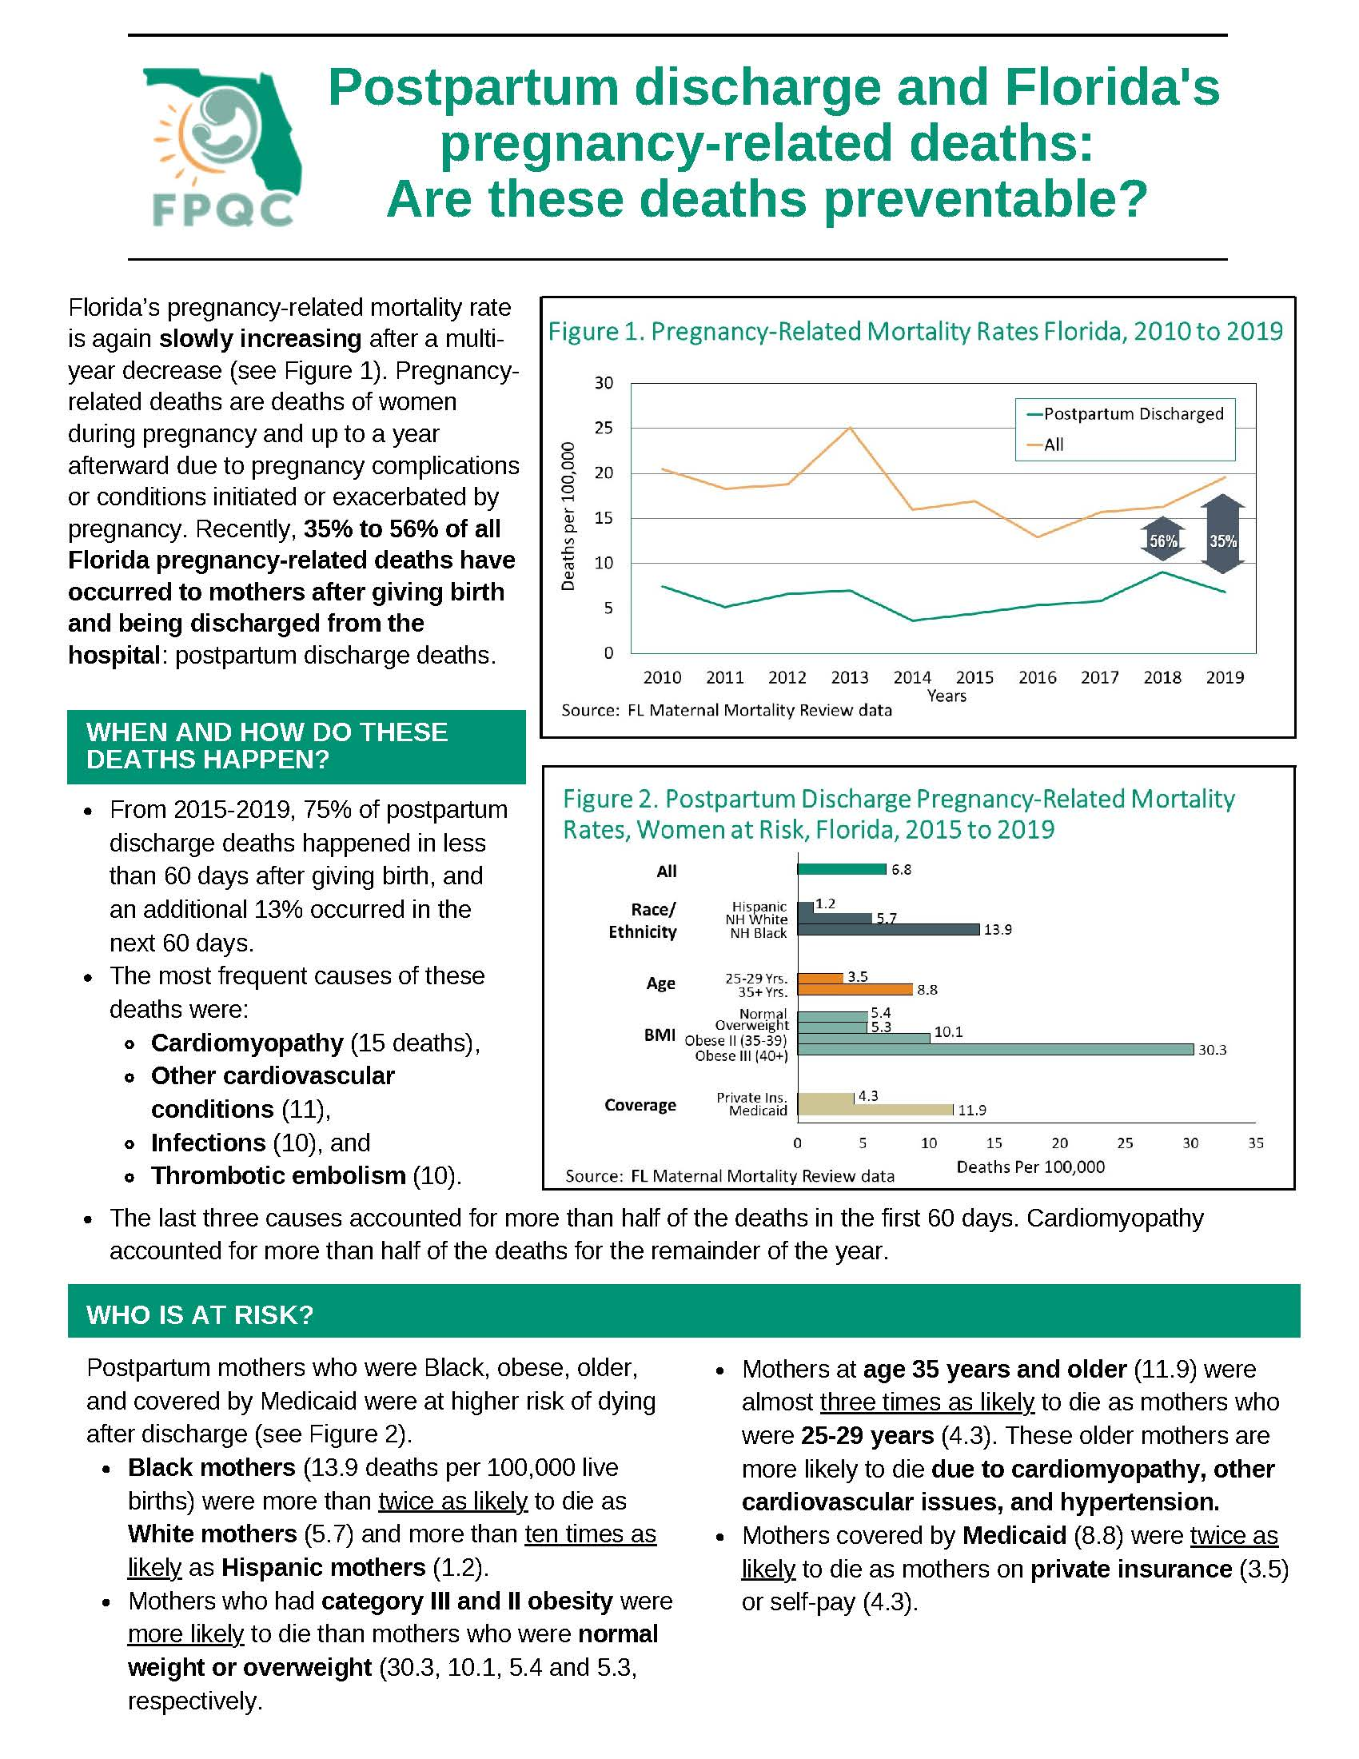
Postpartum Mortality Brief
(For Providers)
3. Clinician PP Engagement & Education

Slide 34
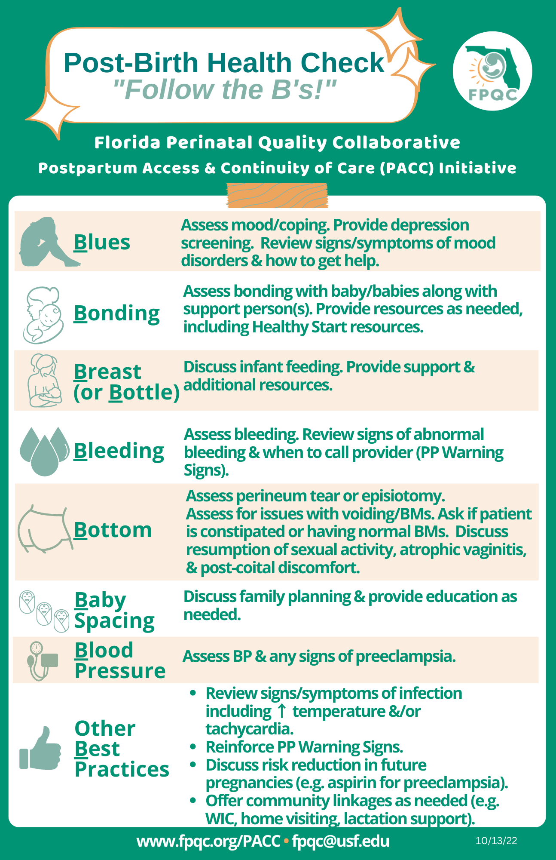
Post-Birth Health Check: Provider's Offices
(For Providers)
3. Clinician PP Engagement & Education

Slide 35
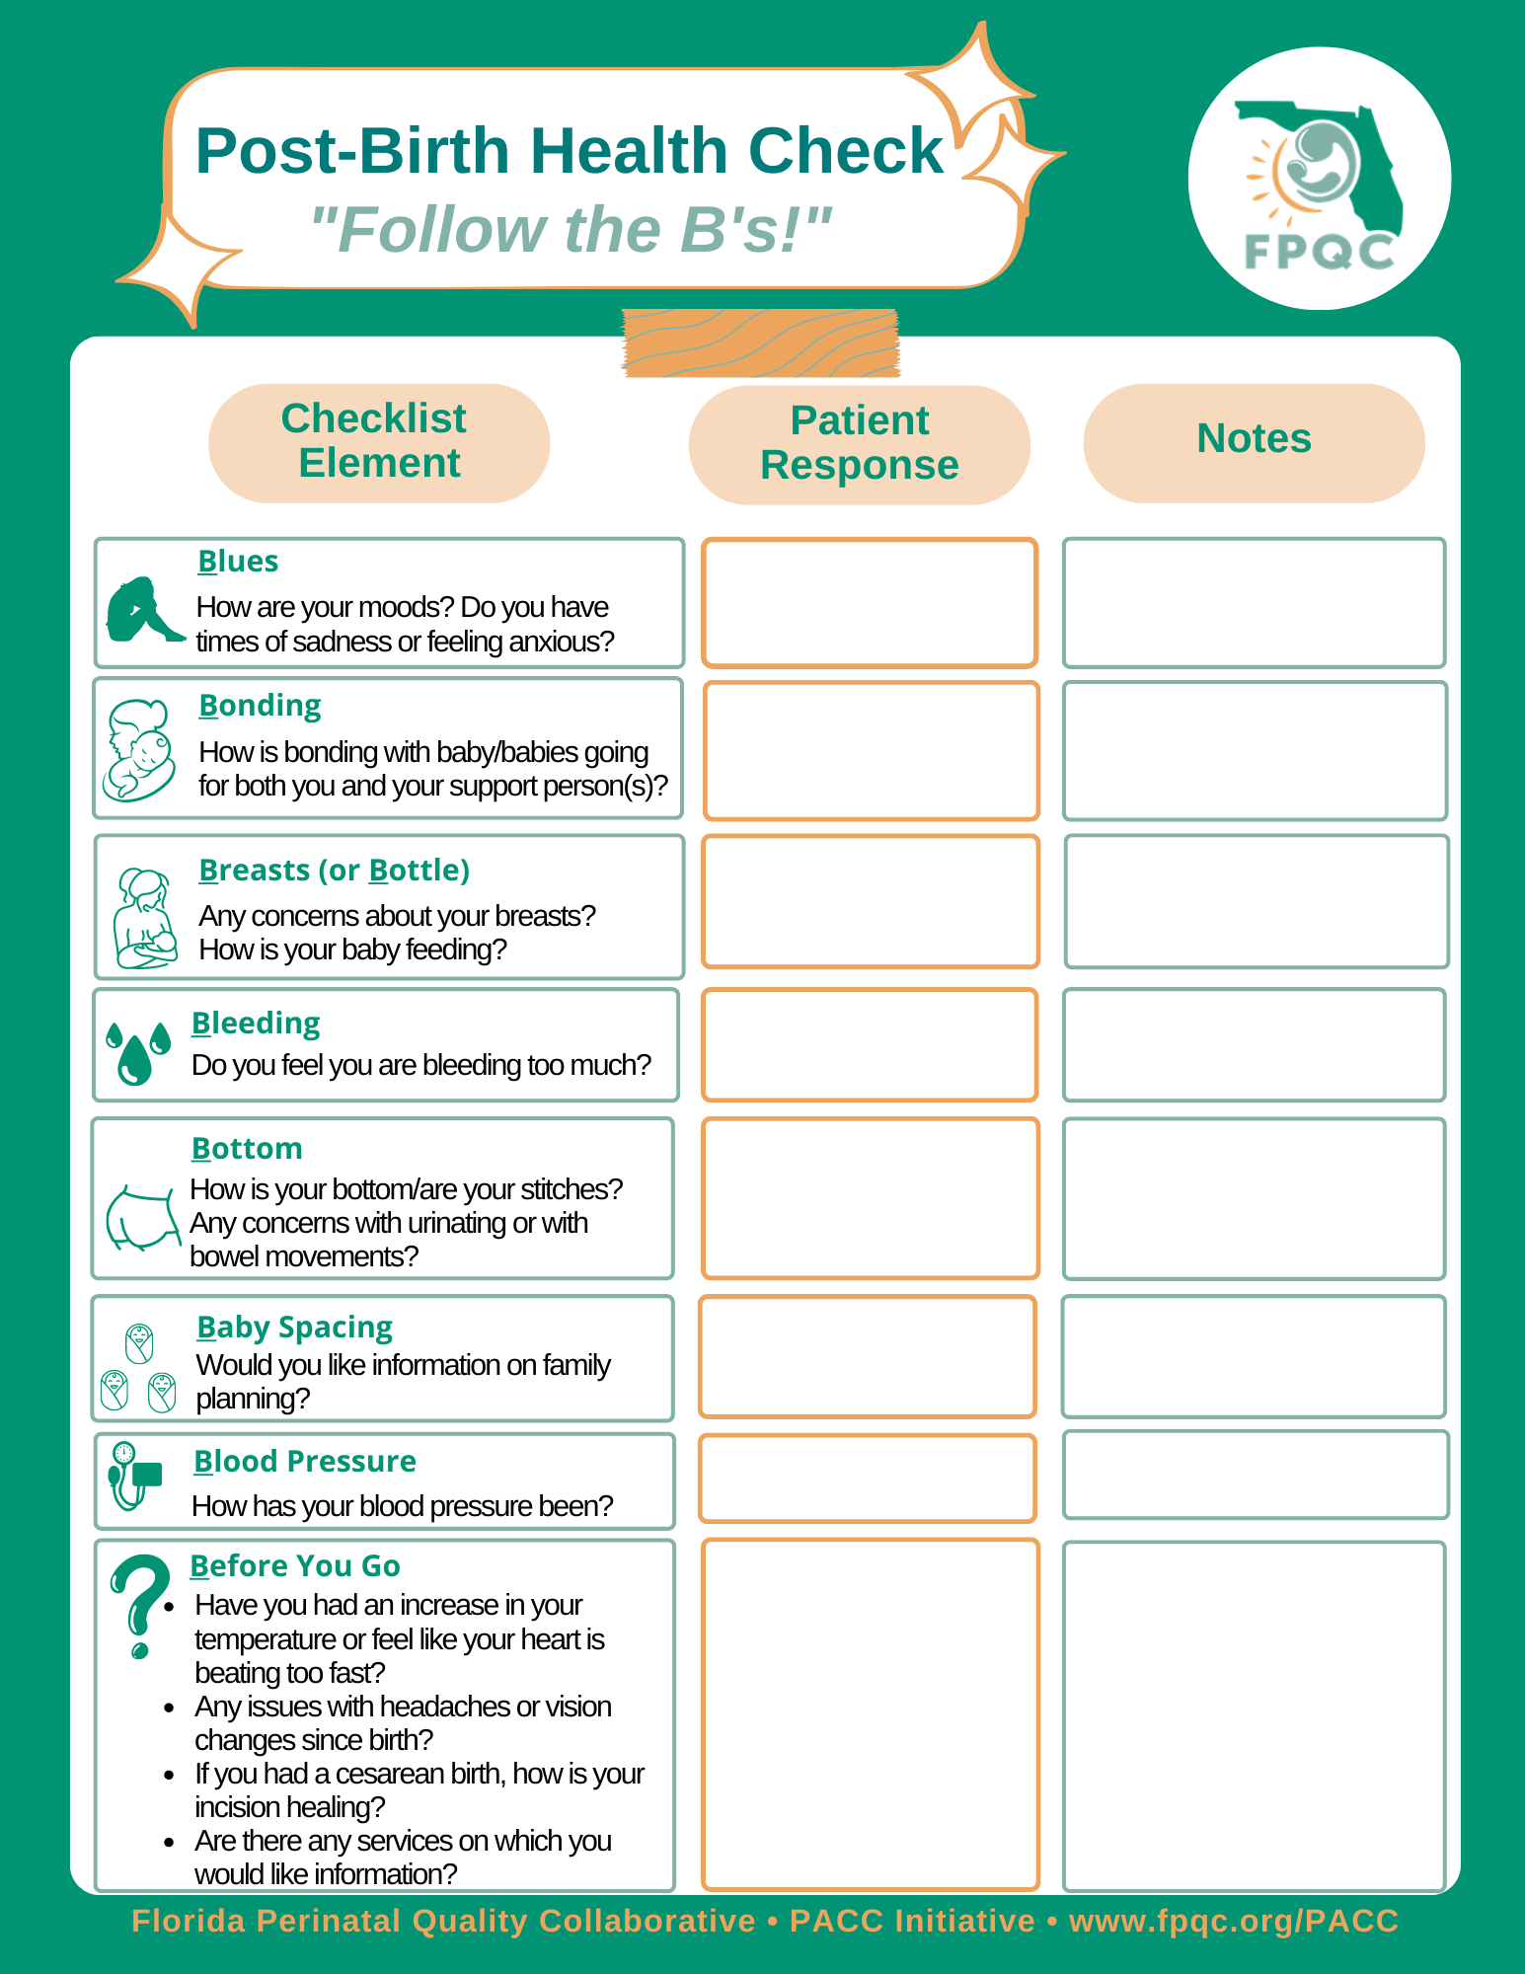
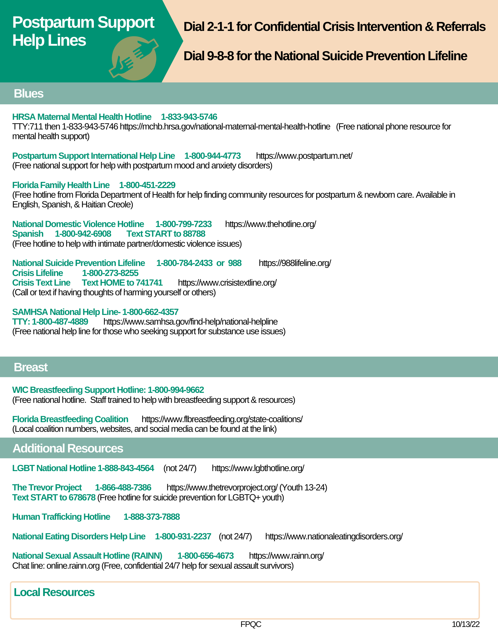
Post-Birth Health Check: Provider Offices (For Patients)
3. Clinician PP Engagement & Education

Slide 36
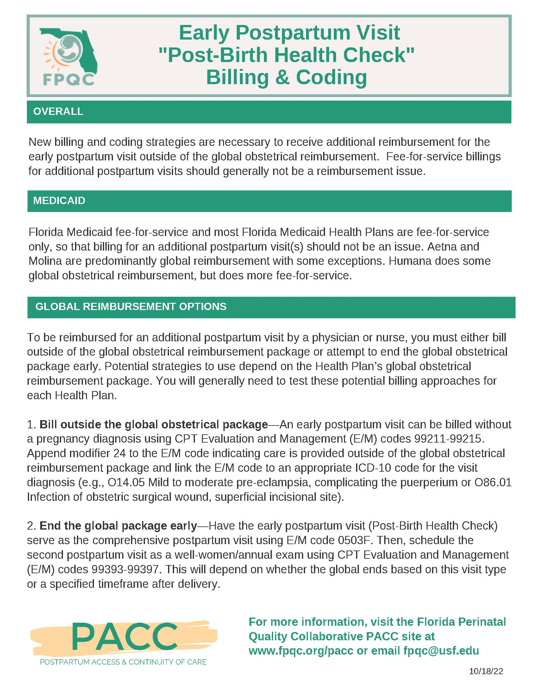
Post-Birth Health Check: Billing & Coding Suggestions
3. Clinician PP Engagement & Education

Slide 37
Postpartum ER Care—Mortality Prevention
ER care can prevent some postpartum deaths based on
Florida Maternal Mortality Review Findings
1.
2.
3.
Ask women ages 15-45 years if they have been pregnant in the past year?
If yes, add postpartum complications to your differential
Check for early postpartum warning signs and their medical problem list
3. Clinician PP Engagement & Education
4.
5.
6.
If needed, review postpartum checklist descriptions
If unsure, seek OB consultation early
If discharged, arrange referral and educate when to return

Slide 38
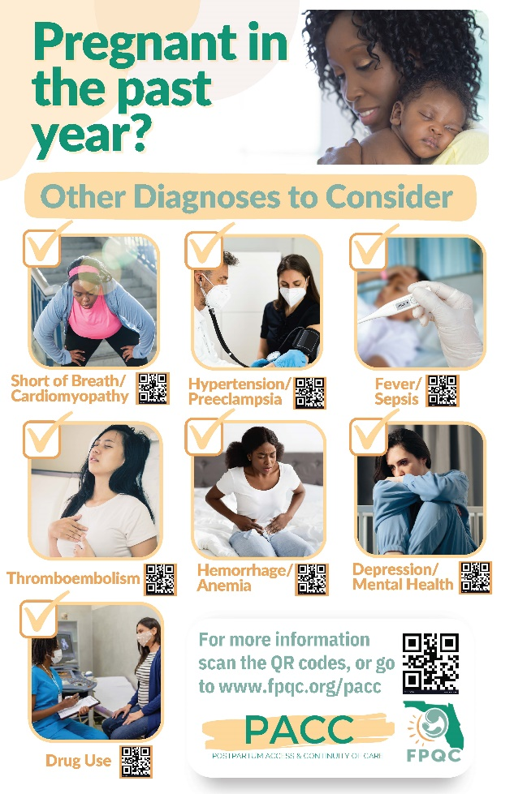
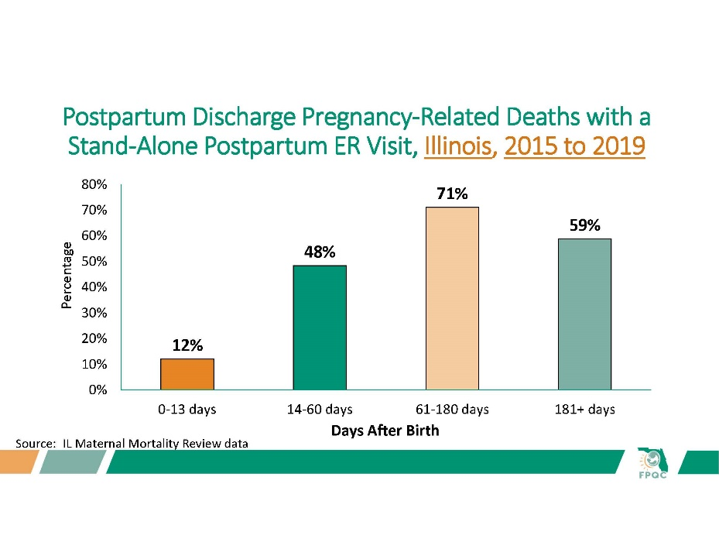
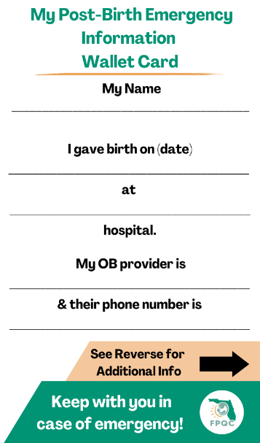
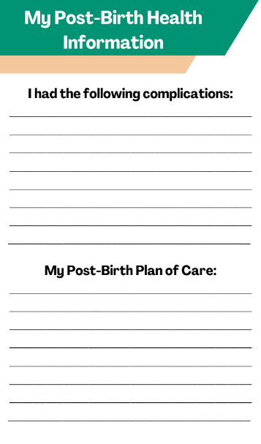
Postpartum ER Care—Mortality Prevention
Front
Back
3. Clinician PP Engagement & Education
Provider Educational Presentation
Maternal Wallet Card
Provider Educational Poster/Flyer

Slide 39
Global AIM: Improve maternal health through hospital-facilitated continuum of postpartum care by coordinating and providing respectful, timely, and risk-appropriate coordinated care and services.
AIM
Primary Key Drivers
By 6/2024, FPQC participating hospitals will:
Increase the % of patients with a 2-week PP visit scheduled prior to discharge by 20%*
Increase patient PP education by 20%*
Process for Maternal Discharge Risk Screening & Arranging Early Postpartum Visits
Comprehensive Postpartum Patient Discharge Education
Clinician Postpartum Engagement and Education
Respectful care is a universal component of every driver & activity

Slide 40
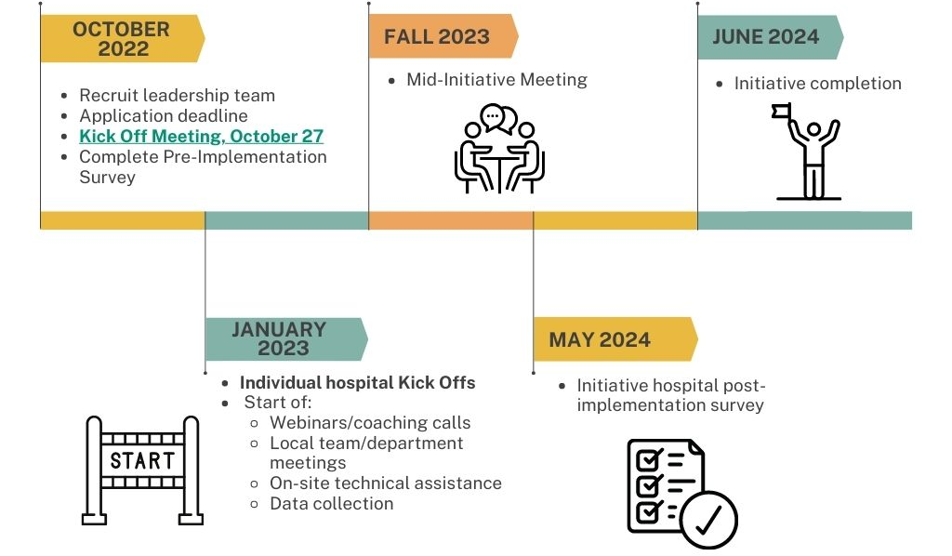
PACC Initiative Timeline

Slide 41
Only with all of us working together can we make an achievable change in the postpartum health of Florida’s mothers…

Slide 42




Questions?
wsappenf@usf.edu
fpqc@usf.edu
www.fpqc.org
“To improve the health and health care of all Florida mothers & babies”
Florida Perinatal Quality Collaborative
Florida Perinatal Quality Collaborative
@TheFPQC

