Slide 1

Implementation
Maya Balakrishnan, MD
Associate Professor of Pediatrics, USF
FPQC MOM Initiative Kick-off
May **, 2016

Slide 2
Objectives
Review 10 key recommendations
Discuss challenges & potential solutions
Plan out 1st cycle of your hospital’s PDSA

Slide 3
AIM
Primary
≥50% feeds are comprised of ≥50% MOM
Secondary
≥50% of mothers intend to provide MOM*
≥50% of mothers have MOM volume ≥500 ml*
≥50% mothers intending to BF have a nutritive BF*
*As there is no baseline data available for some measures, the ≥50% aim for collaborative goals may change as participating hospitals collect data & perform data analysis

Slide 4
PRIMARY DRIVERS
SECONDARY DRIVERS
Document informed decision
Aim
Intent to provide MOM
Hospital grade pump available at maternal discharge
Lactation assessment
by 24-h of NICU admission

Slide 5
Standardize a process to
provide maternal education & advocate for MOM
Recommendation
Standardize a process to provide maternal education & advocate for MOM

Slide 6
Provide BF education
& measure competencies
Recommendation
Hospital policy to support BF
Healthcare providers should be familiar w/AAP & ACOG statements re: BF
Education & competencies for all medical & nursing staff caring for infants & high-risk mothers

Slide 7
Standardize a process for lactation assessments
Recommendation
Standardize process for lactation assessments including initial assessment ≤24 h of NICU admit

Slide 8
PRIMARY DRIVERS
SECONDARY DRIVERS
Hospital grade pump available at maternal discharge
Lactation assessment
≤24-h of NICU admission
MOM pumped volume ≥500 ml/day on day 7, 14, 28,
& discharge
Aim
1st pumping ≤6 hours of infant’s life
MOM available ≤72 h of life

Slide 9
Determine who is responsible & available
to initiate or assist with BM pumping
(including 1st occurrence ≤6 h of of infant’s life)

Slide 10
PRIMARY DRIVERS
SECONDARY DRIVERS
MOM available ≤72 h of life
≥50% of feeding volume comprised of MOM
on day 7, 14, 28,
& discharge
Aim
Non-nutritive BF documented
Nutritive BF
≤7 days before discharge
Skin-to-Skin care ≤10 days

Slide 11
Standardize a process to monitor MOM supply
Recommendation
Standardize process to monitor MOM supply
  Day 3,7, & 14
Medical & nursing providers should routinely review mother’s pumping logs

Slide 12


Slide 13
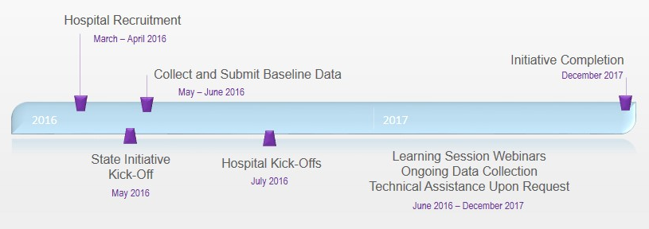
MOM Initiative Timeline
Let’s prioritize our potential interventions!

Slide 14
Prioritization matrix
HIGH
IMPACT | QUICK WINS | MAJOR PROJECTS
 | FILL INS | THANKLESS TASKS
EFFORT
LOW
HIGH

Slide 15
IHI’s Model for Improvement
Form core team
Set an AIM
Establish measures
Select changes to be made
Test changes w/PDSA
Implement changes on a larger scale
http://www.ihi.org/offerings/IHIOpenSchool/Courses/Pages/default.aspx

Slide 16
Plan your 1st PDSA cycle
PLAN
What is the objective of the change being tested?
What will happen & why?
What is the plan to test & measure the change?
Who? What? When? Where?
Example:
Objective & change tested: Within 10 weeks of starting this program, I will lose 1 lb per week to achieve a 10 lb weight loss by exercising 3 times per week.
Prediction: I will lose 1 lb per week because I will have increased caloric expenditures.
Testing & Measurement: I will use same scale in my home to check weight daily at the same time, record the result in lbs in a diary, & reassess results of intervention in 2 weeks.

Slide 17
MOM Resources
Website: FPQC.org → Current Projects → Mother’s Own Milk
News/Announcements
FPQC MOM Toolkit
Tool Box
  New and updated resources continually added
  http://health.usf.edu/publichealth/chiles/fpqc/momtoolbox
Archived webinars

Slide 18
Any questions?

Slide 19
Document a mother’s informed decision.
Recommendation
Counsel all high-risk mothers on benefits
Document mother’s informed decision

Slide 20
Have MOM available ≤72 h of infant’s birth

Slide 21
Standardize a process to secure a sufficient number of double-electric breast pumps
Recommendation
Standardize a process to ensure appropriate supplies are available to support & facilitate BF & provision of EBM in the NICU

Slide 22
Standardize a process to ensure appropriate supplies are available to facilitate BF & MOM
Recommendation
Standardize a process to ensure appropriate supplies are available to support & facilitate BF & provision of EBM in the NICU

Slide 23
Standardize guidelines for
Skin-to-skin care
Non-nutritive BF
Use of test weights
Transition to nutritive BF
Use of nipple shields
Discharge feeding plan
BF support

