Slide 1
MOM in the NICU:
Background and Significance
Douglas Hardy
May 18, 2016

Slide 2
Objectives
Review the association between breastfeeding and reduced infant mortality.
Identify the benefits of human milk in the term and in the high-risk premature infant
Identify the benefits of breastfeeding on maternal health
Explore the need for a Mother’s Own Milk Initiative in Florida

Slide 3
Benefits of Breastfeeding
It is safe and inexpensive
It is complete nutrition through 6 months of life
Breast milk provides:
  important digestive enzymes
  protective immunologic factors and regulators
  growth factors
  anti-oxidants
  anti-inflammatory compounds
Notes:
Why breast milk? Breast milk is safe, inexpensive and a source of complete nutrition for the term infant through 6 months of life. Breast milk provides important digestive enzymes, protective immunologic factors and regulators, growth factors, anti-oxidants and anti-inflammatory compounds.

Slide 4
Benefits of Breastfeeding
Infant benefits
  Reduced infant mortality
  Lower rates of childhood infection
  Lower rates of chronic disease
Maternal benefits
  Immediate post-partum benefits
  Long term benefits related to cumulative breastfeeding time
Notes:
There are benefits of breastfeeding that accrue to infants and their mothers. Infants benefit from lower mortality rates, fewer childhood infections and lower rates of chronic illness as adults. Mothers have short term medical and psychosocial benefits from breastfeeding during the immediate post-partum period as well as longer term health benefits with accumulated lifetime breastfeeding.

Slide 5
Sudden Infant Death and breastmilk
Sudden Infant Death Syndrome – SIDS
  Risk reduced 36% – 45% with any breastfeeding
  Exclusive breastfeeding reduces risk by 73% (Pediatrics. 2011;128(1):103-110)
Notes:
Hauck, et al performed a meta-analysis of 288 studies on SIDS and breastfeeding. They found that the risk of SIDS is reduced by 36-45% with any breastfeeding and by 73% with exclusive breastfeeding.

Slide 6
Infant mortality and breastmilk
21% of the US infant mortality rate has been attributed in part to increased rate of SIDS in infants who never breastfed, independent of sleep position (Pediatrics. 2004;113(5):e435-e439)
900 fewer babies would die each year in the US if 90% of mothers exclusively breastfed for 6 months
Exclusive breastfeeding for 6 months and weaning after 1 year could prevent 1,000,000 infant deaths per year in the 42 developing countries in which 90% of the world’s childhood deaths occur
Notes:
It has been estimated that 21% of infant mortality in the US can be attributed in part to an increased rate of SIDS in infants who have never breastfed, independent of sleep position. 900 fewer babies would die each year in the US if 90% of mothers exclusively breastfed for 6 months. And 1 million infant deaths could be prevented annually in the 42 developing countries in which 90% of the world’s childhood deaths occur.

Slide 7
Fewer later childhood infections
Gastrointestinal infections
Otitis media
Lower respiratory tract illness
Urinary tract infections
Botulism
Notes:
In the term infant, breastfeeding has been associated with fewer childhood infections, including gastrointestinal infections, otitis media, lower respiratory tract illness, urinary tract infections and botulism.

Slide 8
Lower rates of chronic disease
Obesity
Diabetes
Leukemia and lymphoma
Inflammatory bowel disease
Allergic diseases
  Asthma, atopic dermatitis, eczema
  Celiac disease
Notes:
In the term infant, breastfeeding has also been associated with lower rates of chronic disease such as obesity, diabetes, leukemia and lymphoma and inflammatory bowel disease. Allergic diseases such as asthma, atopic dermatitis and eczema are less common. Celiac disease is reduced if breastmilk is being given at the time of the infant’s first exposure to gluten.

Slide 9
Maternal benefits of breastfeeding
Decreased postpartum blood loss
May help mothers return to their pre-pregnancy weight faster.
Allows mother to actively participate in the infant’s care and promotes mother-infant bonding
Increased child spacing
Mothers without gestational diabetes are less likely to develop Type II diabetes
Less risk of postpartum depression
  Lower risk of child abuse or neglect
Notes:
Before we turn to the premature infant, let’s review the benefits of breastfeeding for the mother. These include decreased post-partum blood loss, potentially quicker return to pre-pregnancy weight, promotion of mother-infant bonding and increased child spacing, reducing the risk of preterm births. In mothers without gestational diabetes, breastfeeding duration was associated with decreased risk of type 2 diabetes. Mothers who breastfeed have decreased post-partum depression. The risk of child abuse and neglect by mothers who did not breastfeed was 2.6 times that of breastfeeding mothers.

Slide 10
Cumulative breastfeeding time
Reduction in hypertension (OR 0.89)
Reduction in hyperlipidemia (OR 0.81)
Reduction in cardiovascular disease (OR 0.9)
Reduction in diabetes (OR 0.74)
Reduced risk of breast cancer (primarily premenopausal) and ovarian cancer (OR 0.72)
  Estimated that each year of breastfeeding reduces risk of breast cancer by 4.3%
Reduction in rheumatoid arthritis (RR 0.8)
  RR 0.5 with > 24 months cumulative lifetime
Notes:
Cumulative lactation history of 12-23 months led to reduction in hypertension, hyperlipidemia, cardiovascular disease and diabetes. Breast cancer and ovarian cancer risk was reduced by 28% with breastfeeding more than 12 months and each year of breastfeeding was estimated to reduce the risk of breast cancer by 4.3%. The relative risk of rheumatoid arthritis was reduced by 20% with breastfeeding for 12-23 months and by 50% for cumulative breastfeeding of longer than 24 months.

Slide 11
AAP Policy Statement - 2012
The AAP recommends an exclusive human milk diet for premature infants.
  Mother’s Own Milk (MOM) is 1st Choice
  Donor milk if MOM is not available
    Avoidance of formula for initiation of feeds
    Used as a bridge for MOM
  Premature infant formula should not be used unless there is no other viable choice
Notes:
In the 2012 Policy Statement, “Breastfeeding and the use of human milk”, the American Academy of Pediatrics reaffirmed its support for breastfeeding and the importance of an exclusive human milk diet for the premature infant. Although donor milk is not identical to mother’s own milk (MOM), it is recognized as an appropriate substitute if MOM is not able to be used.

Slide 12
Human Milk in the NICU
Enhanced feeding tolerance
Human milk contributes to a preterm infant’s host defense development
  Lower rates of NEC and late onset sepsis
Fewer hospitalizations for illnesses during the first year after discharge
Decreased incidence of severe retinopathy of prematurity
Improved neurodevelopmental outcomes
Notes:
Human milk is more digestible and enhances feeding tolerance. It contributes to a preterm infant’s host defense development resulting in lower rates of NEC and late onset sepsis as well as fewer hospitalizations for illnesses during the first year after discharge. Infants fed human milk have a lower incidence of severe retinopathy of prematurity. Intelligence tests and white matter and total brain volumes better in 8 year olds who were fed human milk in the NICU. Extremely preterm infants who received the greatest proportion of human milk had significantly greater scores for mental, motor and behavioral ratings at ages 18 months and 30 months (predominant, not necessarily exclusive human milk). These remain significant after adjustment for confounding factors such as maternal age, maternal education, maternal marital status, race and infant morbidities. These better neurodevelopmental and motor outcomes are noted despite lower growth rates compared with preterm formula.

Slide 13
Necrotizing enterocolitis
Protective factors for prevention of NEC in human milk
  Immunoglobulins
  Oligosaccharides
  Lactoferrin
  Growth factors
    Epidermal Growth Factor
    Heparin-binding Epidermal Growth Factor
Notes:
Let’s look specifically at necrotizing enterocolitis (NEC). NEC is devastating intestinal disease primarily affecting premature infants. Risk factors include prematurity, hypoxia, bacterial colonization of intestine and formula feeding. The development of NEC is multifactorial and mortality may reach 30%. Human milk contains a number of protective factors, including immunoglobulins, oligosaccharides, lactoferrin and growth factors.

Slide 14
Necrotizing enterocolitis
ELBW infants in15 centers participating in the NICHD-NRN Glutamine Trial 1999-2001 (J Pediatr. 2016 – in press)
Overall incidence of NEC of 10.2%
Infants fed exclusively preterm formula had an incidence of NEC of 11.1%
Infants fed a mixed diet of preterm formula and human milk had an incidence of NEC of 8.2%
Infants fed > 98% human milk had an incidence of NEC of 1.3% (p=0.002)
Notes:
Using data from 15 centers in the NICHD-NRN glutamine trial between 1999 and 2001, researchers were able to compare the incidence of NEC in ELBW infants who were fed either 98% or more human milk, exclusively preterm infant formula or a mix of human milk and preterm formula. No donor milk was used in these centers. The incidence of NEC overall was 10.2%. The incidence of NEC in ELBW infants fed exclusively preterm formula was 11.1%. The incidence in infants on a mixed diet was 8.2%. The incidence of NEC in infants fed > 98% human milk was 1.3% (p=0.002)

Slide 15
Necrotizing enterocolitis
Meta-analysis of 4 RCT suggest 58% reduction of NEC with human milk feedings in preterm infants
Reduction of 77% in preterm infants fed exclusive human milk vs human milk supplemented with bovine fortifier (J Pediatr. 2010;156(4):562-567)
  One case of medical NEC could be avoided if 10 infants received exclusive human milk
  One case of surgical NEC or death could be avoided if 8 infants received exclusive human milk
Notes:
Meta-analysis of 4 randomized clinical trials between 1983 and 2005 suggest 58% reduction of NEC with human milk feedings in preterm infants. There was a 77% reduction of NEC in preterm infants fed exclusive human milk vs human milk supplemented with bovine fortifier (J Pediatr. 2010;156(4):562-567). This translates to avoiding 1 case of medical NEC if 10 infants received exclusive human milk and avoiding 1 case of surgical NEC or death for every 8 infants receiving exclusive human milk

Slide 16
Business case for human milk
291 VLBW infants at Rush University Medical Center between 2008 and 2012 (Neonatology. 2015;107(4):271-276)
Impact of feeding human milk during the first 14 days
  Risk of NEC
  NEC-related hospital costs
  Hospital costs unrelated to NEC.
Results
  3.5 greater risk of NEC with any formula DOL 1-14 (p=.020)
  Additional $43,818 in NICU costs due to NEC (p<.001)
  Decrease of $534 in Non-NEC NICU costs for each additional ml/kg/day of human milk in DOL 1-14 (p<.001)
Notes:
There is a strong business case for the use of human milk, either mothers own milk or even donor milk, in the reduction of NEC. In 2015, Johnson, et.al. published an article titled “Cost Savings of Human Milk as a Strategy to Reduce the Incidence of Necrotizing Enterocolitis in Very Low Birth Weight Infants” in the journal Neonatology. This was an NIH funded prospective cohort study of more than 290 very low birth weight infants at Rush University medical center between February 2008 and June 2012. The study looked at the impact of feeding human milk during the first 14 days of life on the risk of NEC, On the NEC related hospital costs and on non-NEC related hospital costs. The results showed the 3.5 Times greater risk of recognizing inner colitis with any formula exposure in the first 14 days of life. Additional costs for and I see you hospitalization related to NEC we're nearly $44,000. And there was an associated decrease of over $500 in in ICU costs not related to NEC for each additional milliliter for per day of human milk during the first 14 days of life.

Slide 17
Costs savings in ELBW infants
If 90% of infants were fed > 98% human milk:
  928 fewer cases of NEC and 121 fewer deaths annually
  Direct medical costs associated with NEC would be reduced by $27.1 million annually
  Indirect nonmedical costs associated with NEC would be reduced by $563,655 annually
  Costs attributable to premature death would be reduced by $1.5 billion
Notes:
The researchers in the previously mentioned article using data from the glutamine trial ran a simulation based on 2012 population demographics in the United States and estimated that feeding either exclusively preterm formula or a mixed diet of human milk and preterm formula would result in 928 excess cases of NEC and 121 excess deaths annually compared with a model in which 90% of the ELBW infants received more than 98% of their diet as human milk. The estimated annual cost saved by an exclusive human diet would be $27.1 million in direct medical costs, nearly $564,000 in indirect medical costs and $1.5 billion in cost attributed to premature death.

Slide 18
Late onset sepsis and MOM
Late onset sepsis (LOS) occurs in up to 22% of VLBW infants (Am J Obstet Gynecol. 2007;196:e1-e8)
The additional hospital cost associated with LOS has been estimated as $10,055 (J Pediatr. 2013;162:243-249)
The incidence of LOS has been shown to be reduced by 19% for each 10 ml/kg/day of human milk (J Perinatol. 2013;33:514-519)
A Norwegian study of ELBW infants showed early full enteral feedings with primarily human milk to be associated with a lower rate of LOS (Pediatrics. 2005;115:e269-e276)
Notes:
Late onset sepsis occurs in up to 22% of VLBW infants and up to 52% of ELBW infants. Johnson, et.al. estimate that the additional hospital costs associated with late onset sepsis to be over $10,000. Patel, et.al. demonstrated a dose-dependent relationship between human milk feedings and reduction of late onset sepsis, with each 10 ml/kg/day of human milk reducing the risk by 19%. And Rønnestad, et.al. showed a lower incidence of late onset sepsis in a cohort of Norwegian ELBW infants who reached full enteral feeds early and who were fed ~ 82% of their diet as human milk, vs 48% human milk in contemporaries from other studies.

Slide 19
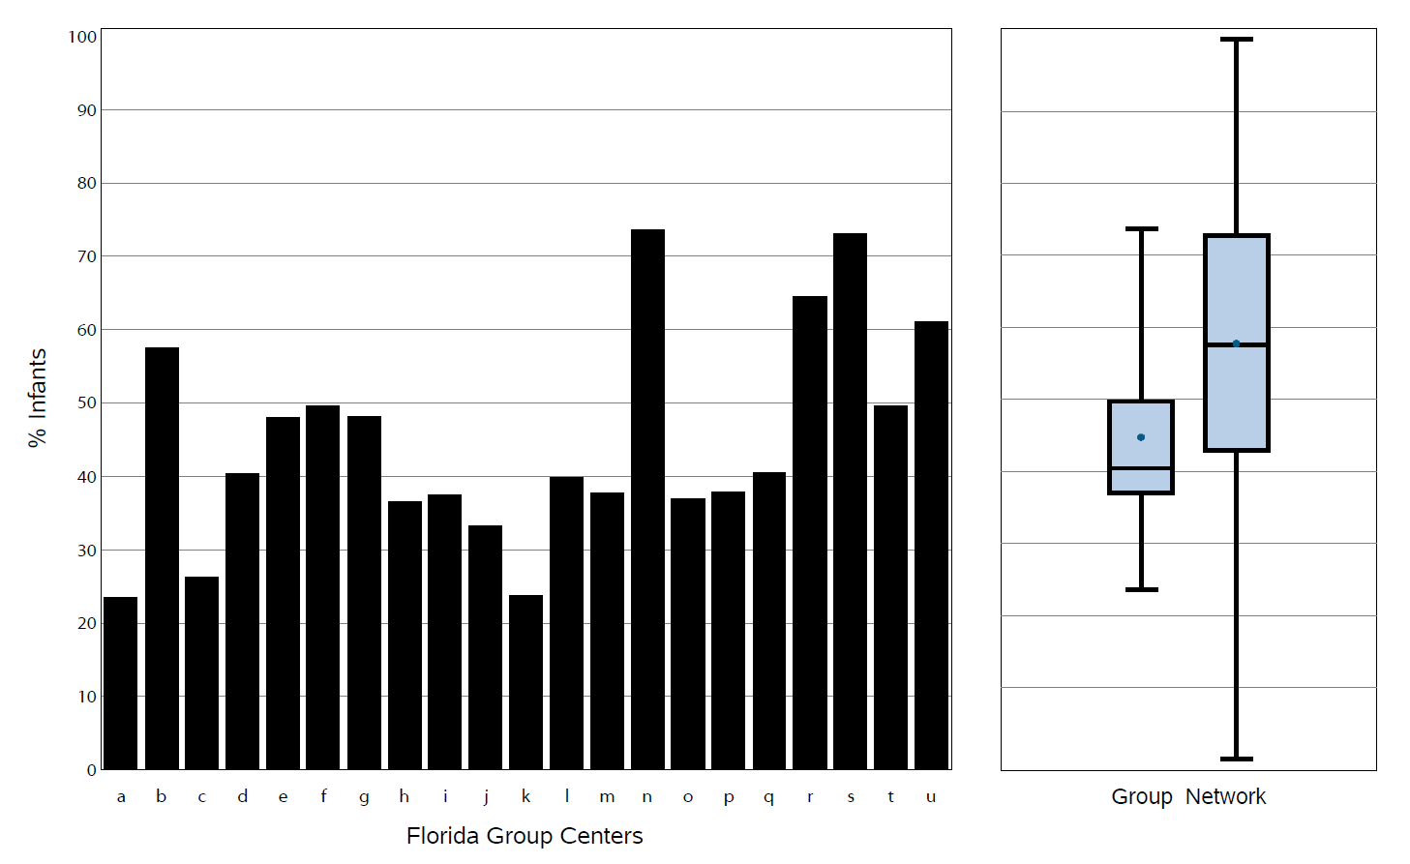
Any Human Milk at Discharge Home
Florida VON report 2013
Median 40.4
Notes:
So why do we need a mother’s milk initiative in Florida? When the Florida Perinatal Quality Collaborative had the Vermont Oxford Network run our most recent state wide report for 2013, we found large amount of variation across Florida in the percentage of infants receiving ANY human milk on the day of discharge – a pretty low bar to be sure. Only 2 of 21 VON centers reached 70%. And only 5 centers reached 50%. Three centers fed < 25% of their VLBW infants any human milk at discharge. Overall, 45.7% of VLBW infants in Florida’s 21 VON NICUs received any human milk on the day of discharge. The median percentage of individual Florida hospitals was 40.4% while the median for the Vermont Oxford Network was 55.4%.

Slide 20
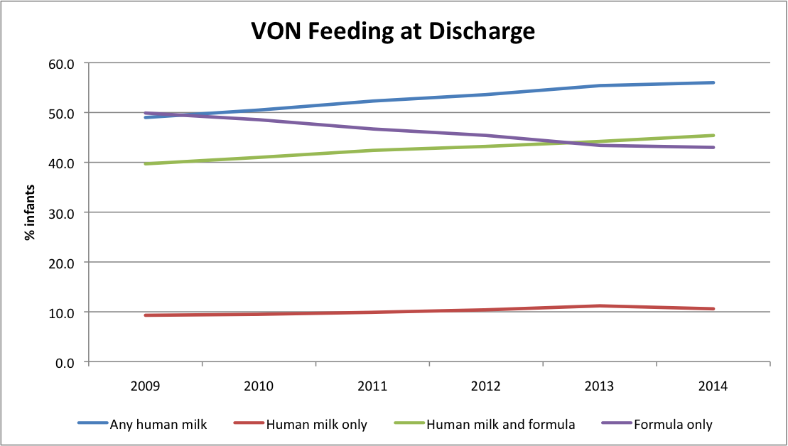
VON VLBW from 2009 to 2014
Notes:
This slide shows Vermont Oxford Network data for VLBW infants and their diet on the day of discharge from 2009 until 2014, which is the last year for which we have complete VON data. The blue line represents any human milk and you can see that it is trending upwards towards 60%. The purple line represents those infants fed only formula and it's good that we can see that has been dropping over time. The green line represents the combination of human milk feedings and formula feedings. But what is really disappointing is the red line which been hovering at approximately 10% across the entire six year timeframe and represents exclusive human milk feedings at discharge.

Slide 21
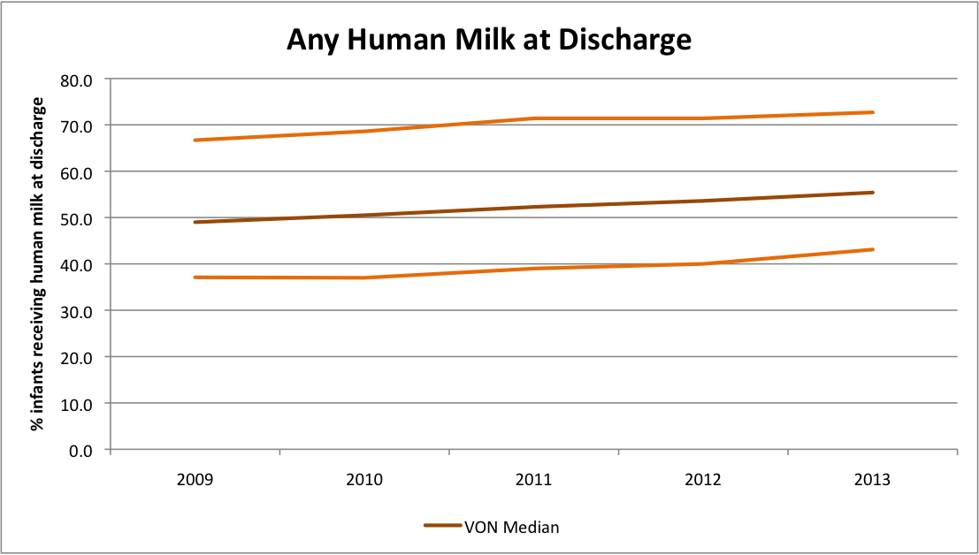
VON from 2009 to 2013
Notes:
In this slide, the upper orange line represents the 75th percentile for VON centers. The lower orange line is the 25th percentile. The brown bar represents the Vermont Oxford Network median over the five-year time frame. You can see that it’s been steadily increasing.

Slide 22

Our Iceberg is Melting!
Notes:
How many of you are familiar with John Kotter and change leadership? In his book, “Our Iceberg is Melting”, he proposes that the first of 8 steps to lasting culture change is creating a sense of urgency. This next slide should create that sense of urgency with regards to the need for change in Florida’s NICUs.

Slide 23
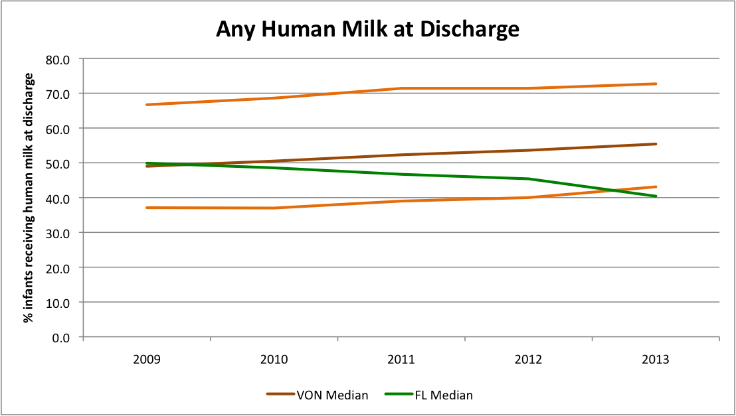
Florida vs VON from 2009 to 2013
Notes:
This is the same slide we saw before but with Florida data for 2009-2013 added. The green bar represents the median for VLBW infants receiving any human milk at discharge across VON centers in Florida. It has decreased from 49.9% in 2009 to 40.4% in 2013, for the first time falling below the VON 25th percentile. So the time seems ripe for a statewide initiative to improve the use of mother’s own milk in Florida.

Slide 24
Questions or Comments

