Slide 1

Global AIM: Improve maternal health through hospital-facilitated continuum of postpartum care by coordinating and providing respectful, timely, and risk-appropriate coordinated care and services.
Primary Key Driver
Secondary Drivers
Verbally educate patients on the benefits of early risk-appropriate PP visits/encounters (Post-Birth Health Checks)
Verbally educate all patient on PP Warning Signs and provide written materials
Comprehensive Postpartum Patient Discharge Education
Verbally educate patients on the benefits of and options for pregnancy spacing, family planning and contraceptive choice and provide written materials
Establish a system to ensure that all patients receive recommended and documented PP education and discharge information
Respectful care is a universal component of every driver & activity

Slide 2
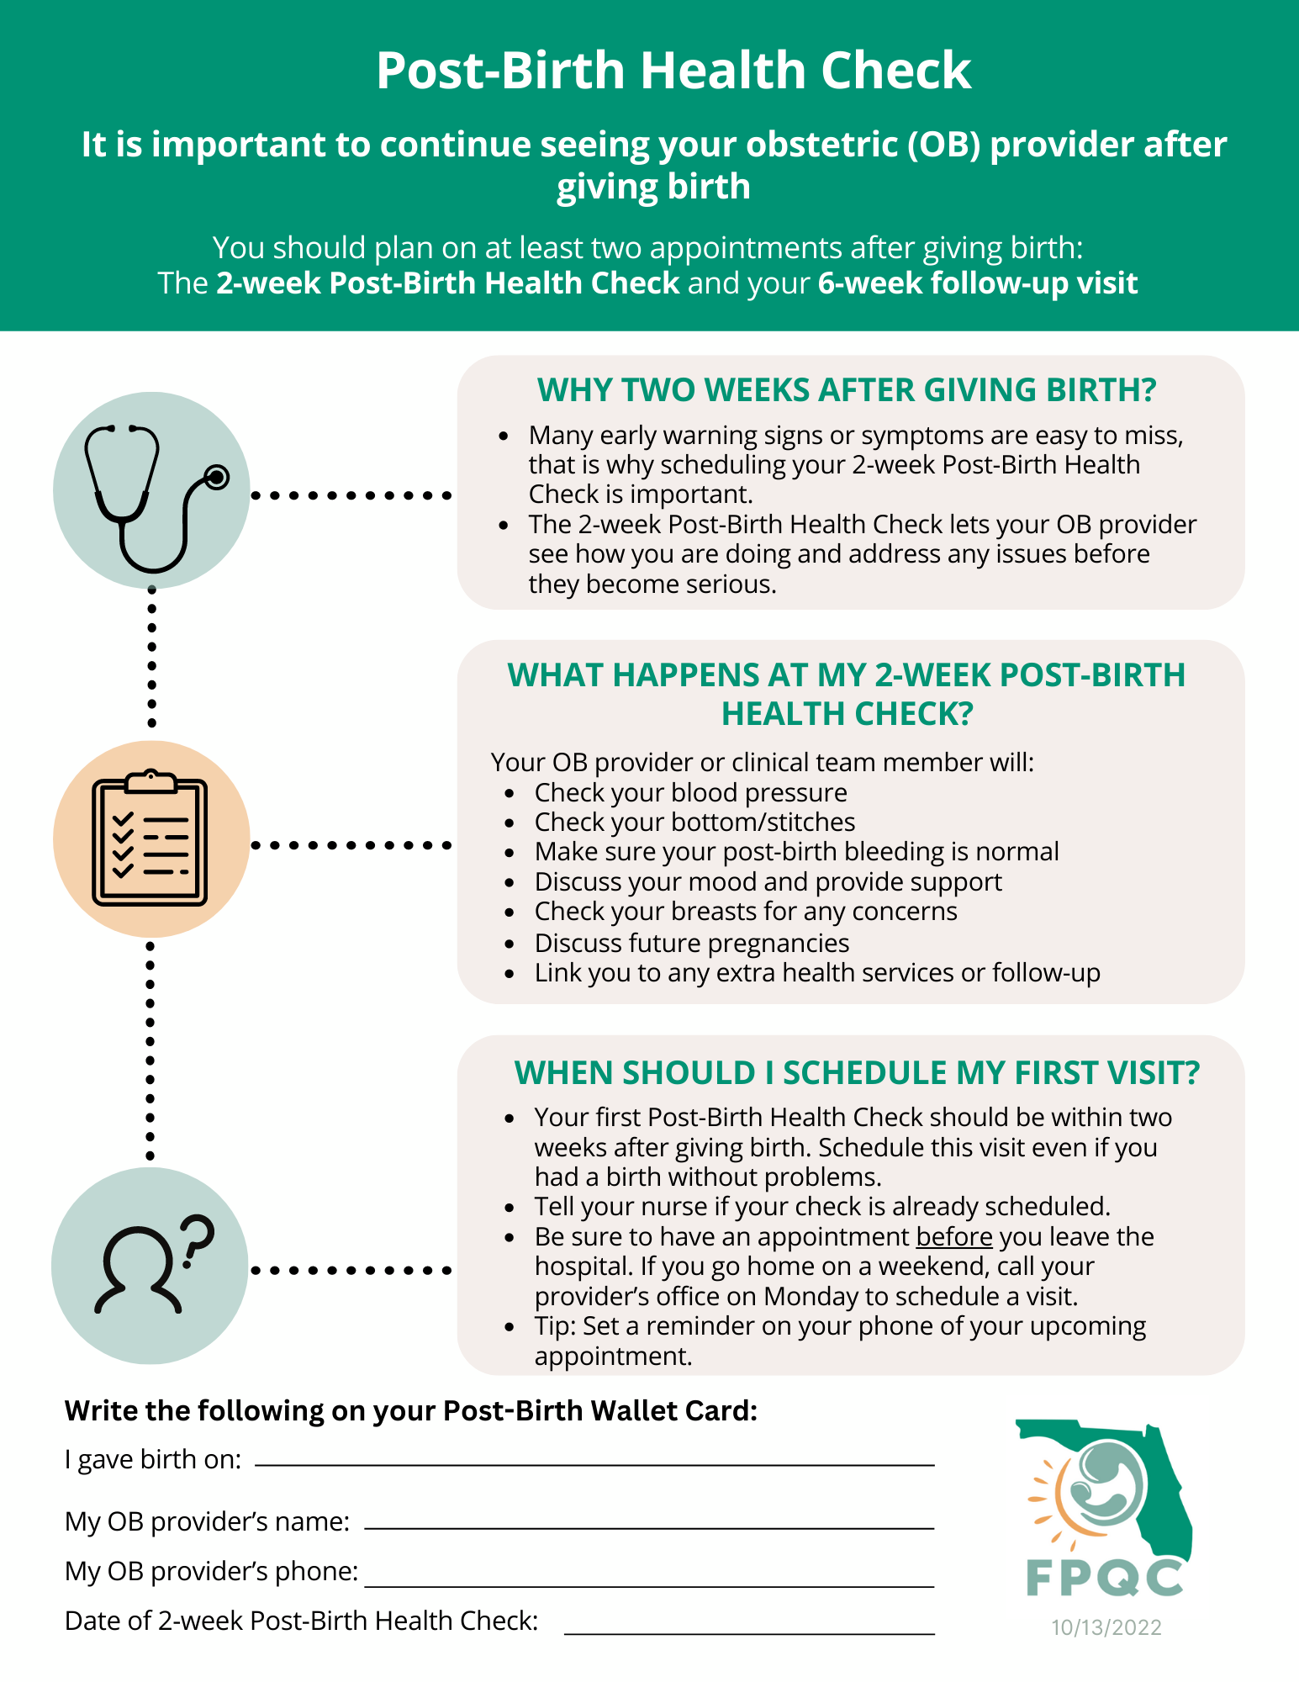
Post-Birth
Health Check
2. Comprehensive PP Discharge Education

Slide 3
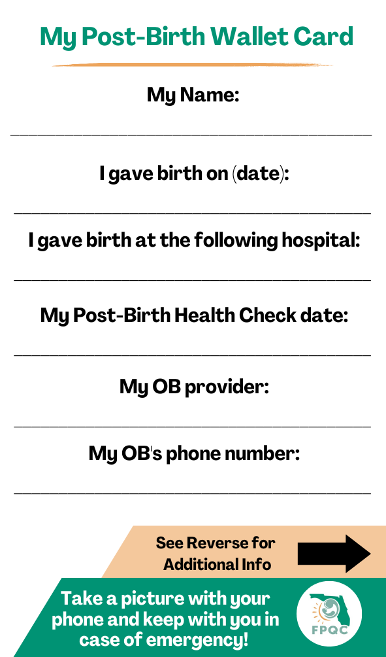
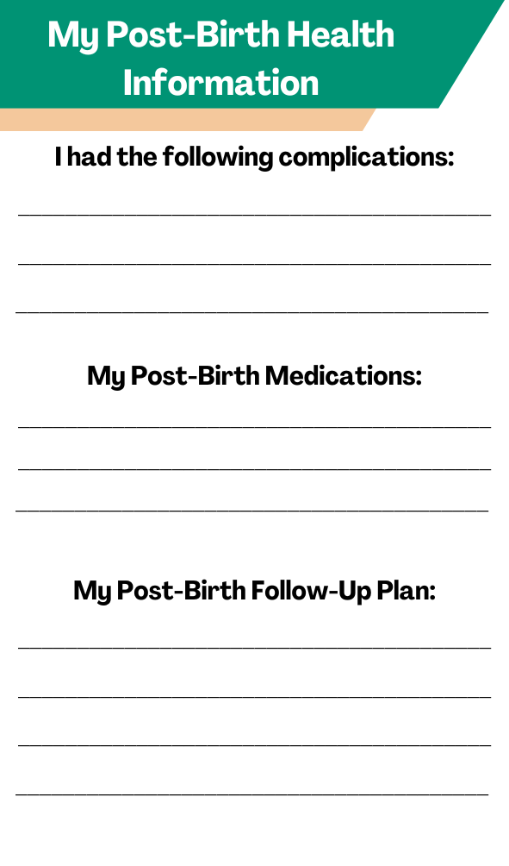
My Post-Birth Wallet Card
2. Comprehensive PP Discharge Education
Reverse Side

Slide 4










Hear Her Campaign Poster
Headache that won’t go away or gets worse
Trouble breathing
Dizziness or fainting
Chest pain or fast-beating heart
Severe swelling, redness or pain of your leg or arm
Fever of 100.4 or higher
Change in your vision
Vaginal bleeding or discharge after pregnancy
Thoughts of harming yourself
Overwhelming tiredness
Multiple ER and health care contacts for same reason!
Source: CDC Hear Her Campaign

Slide 5
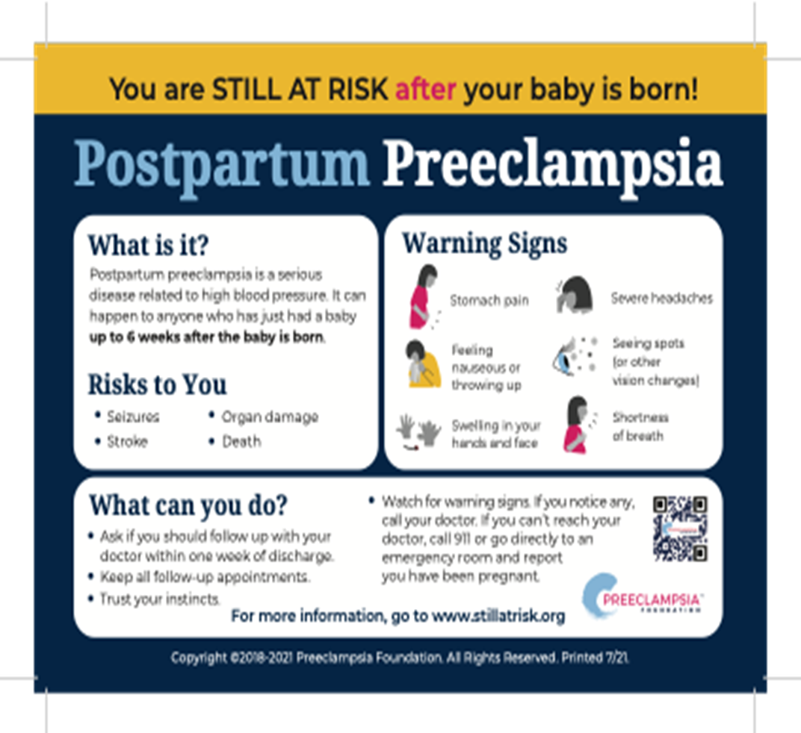
Preeclampsia Foundation

Slide 6
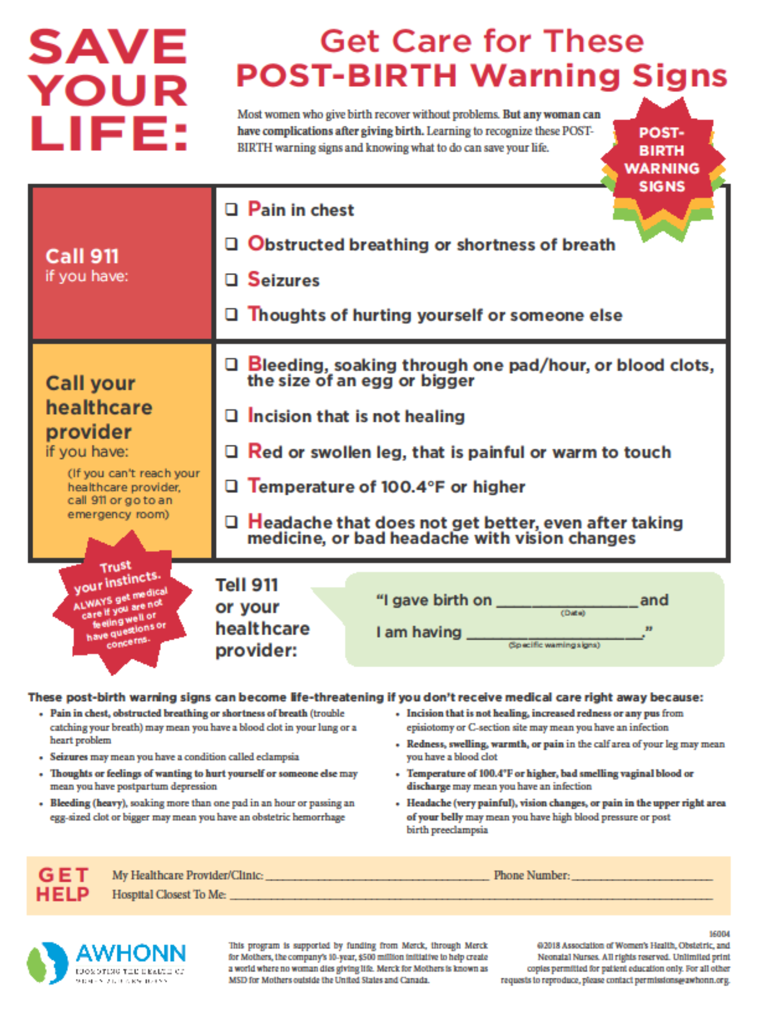
Post-Birth
Warning Signs
2. Comprehensive PP Discharge Education

Slide 7

Voice of a Patient: Sarah’s Story
https://youtu.be/SQW41jhNY1w

Slide 8
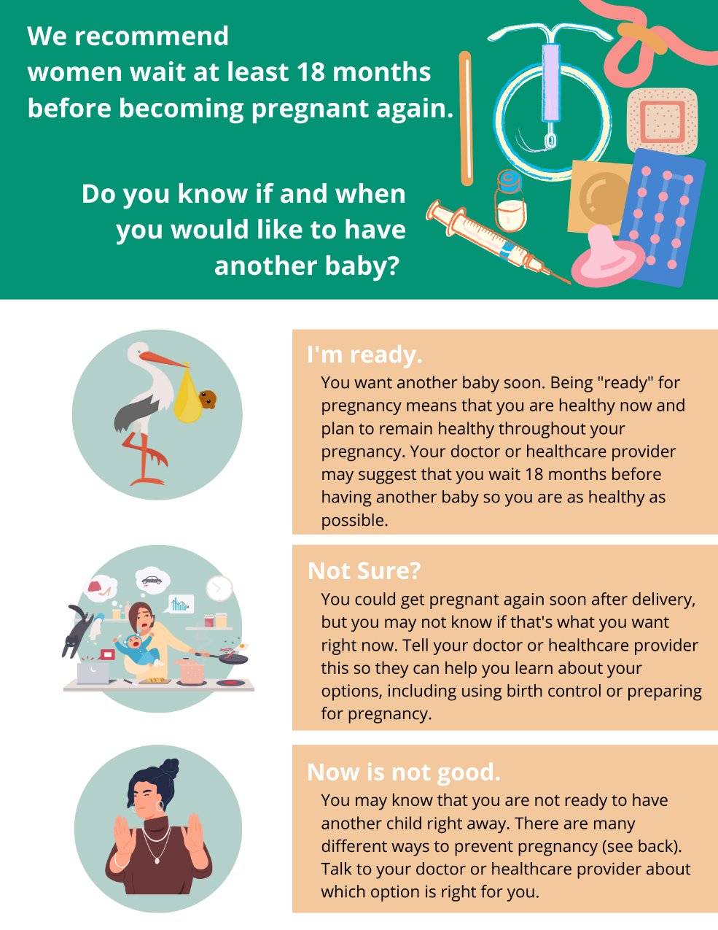
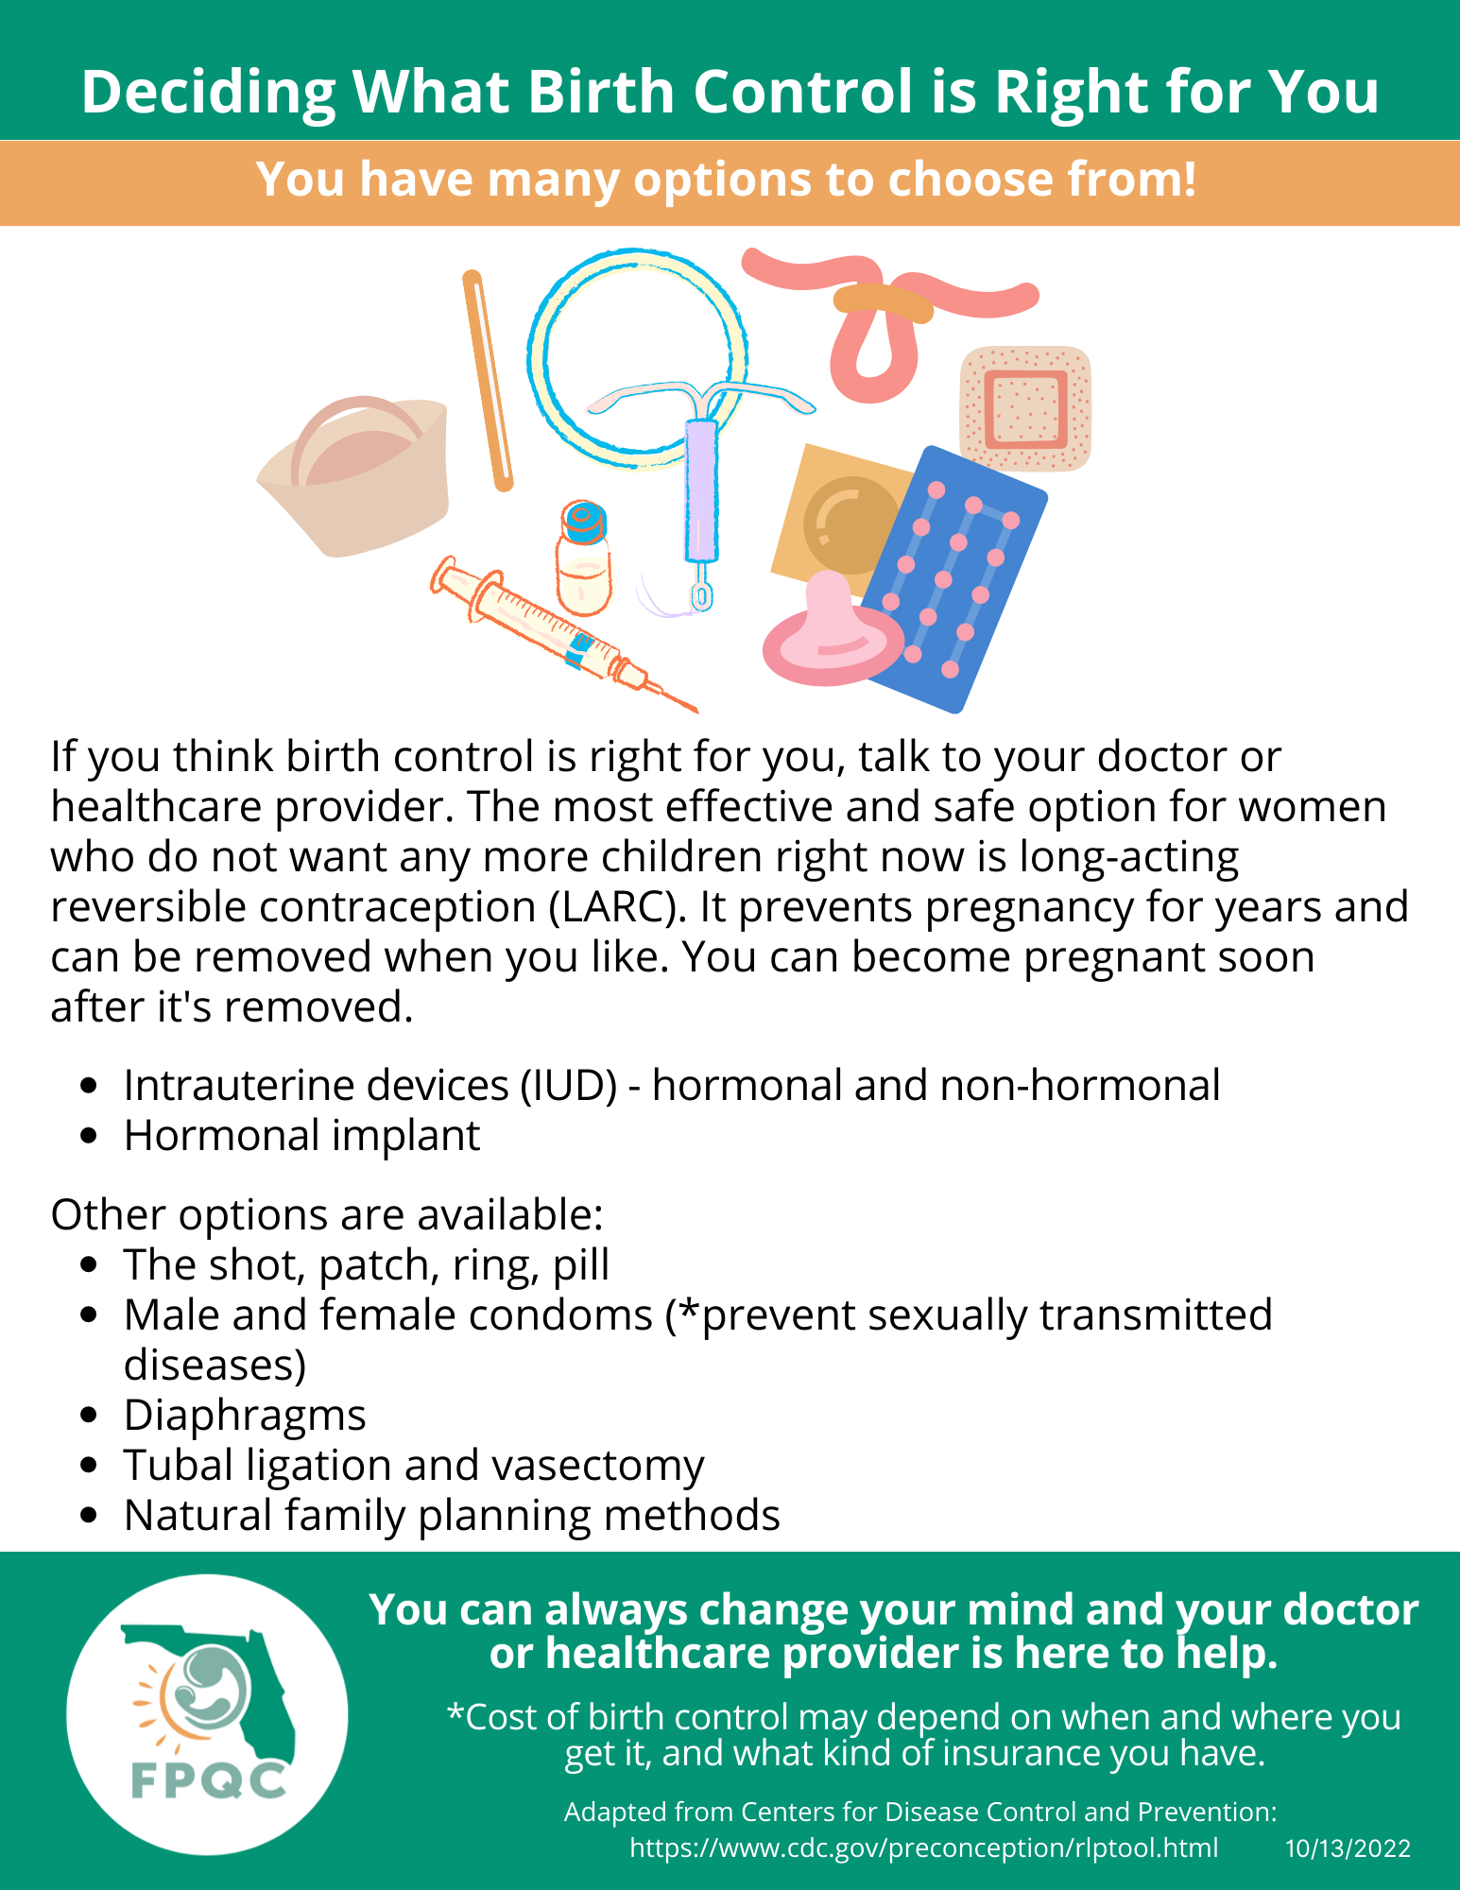
Patient Education on Pregnancy Spacing Benefits
2. Comprehensive PP Discharge Education
Reverse Side

