Slide 1



PROVIDE 2.0 Celebration Webinar
Promoting Primary Vaginal Deliveries
Let’s Celebrate YOU!!
Florida Perinatal Quality Collaborative • May 4, 2022

Slide 2
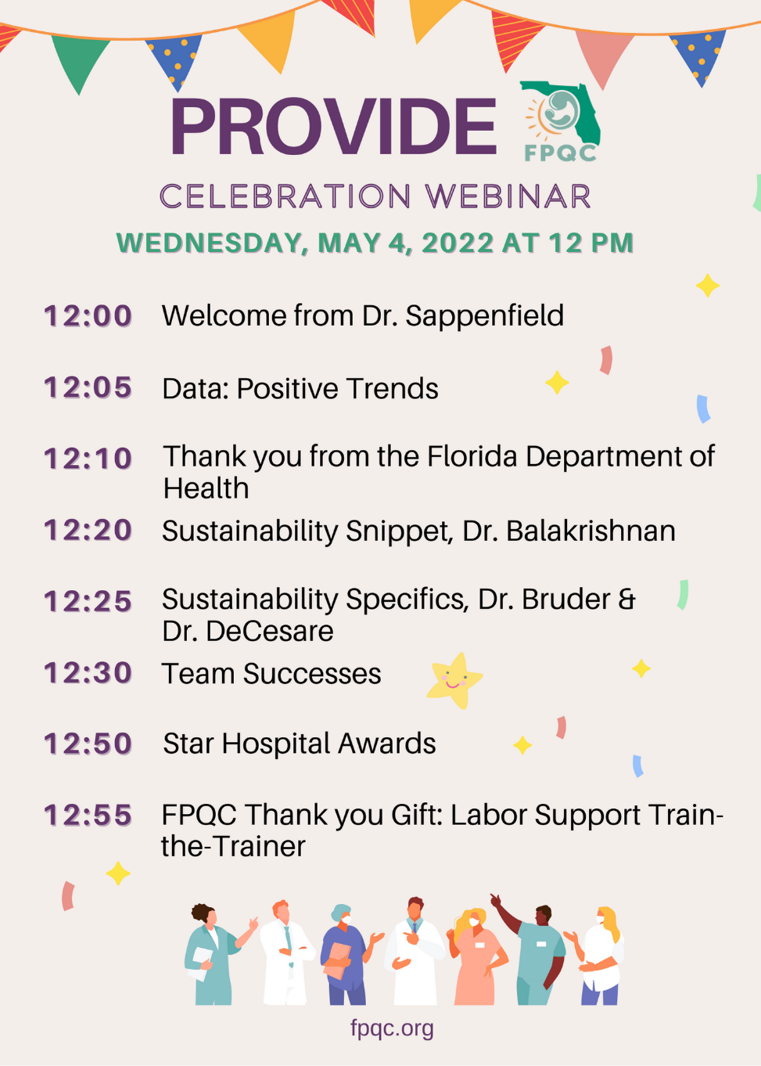
Agenda & Important Information
WELCOME!
Please use the chat!
Your name, hospital, and successes
Remember to mute yourselves!
HAVE FUN!

Slide 3
PROVIDE Data Summary: Positive Trends

Slide 4
NTSV Cesarean Rates, U.S. States, 2020
FL 27.8
US
25.6
HP 2030 Goal—23.6%
Source: NCHS (2021) Provisional Birth Data 2020

Slide 5
NTSV Cesarean Rates
1.5%
Source: NCHS, CDC Birth Data

Slide 6
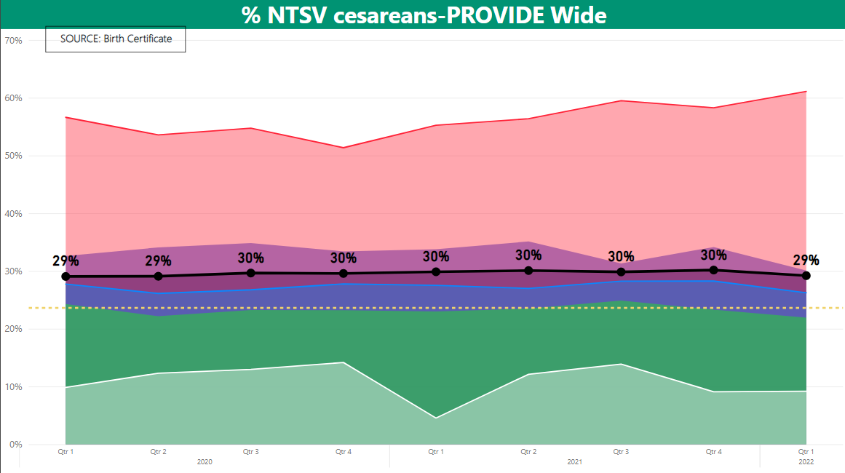

% NTSV Rate for ALL PROVIDE hospitals, 2020-Q1 2022
Highest 25% of hospitals
Highest 50% of hospitals
Lowest 50% of hospitals
Lowest 25% of hospitals

Slide 7
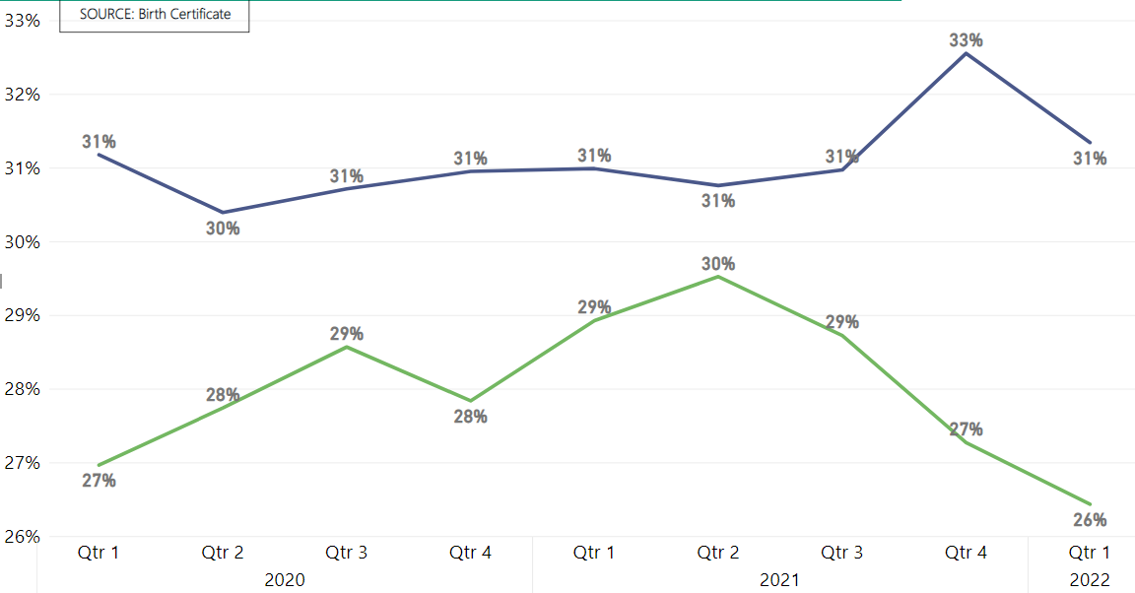
% NTSV c/s Rates by Payer Source
Private Insurance
Medicaid

Slide 8
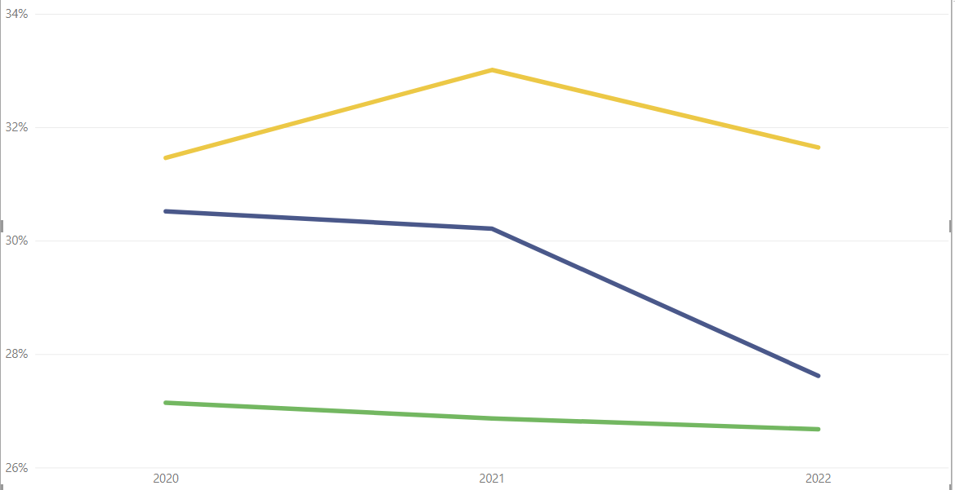
% NTSV Rates by Race/Ethnicity, PROVIDE Hospitals
34%
32%
Hispanic
30%
28%
NH-Black
NH-White
26%
2020
2021
2022
Source: FPQC PROVIDE (FDOH Birth Certificates)

Slide 9
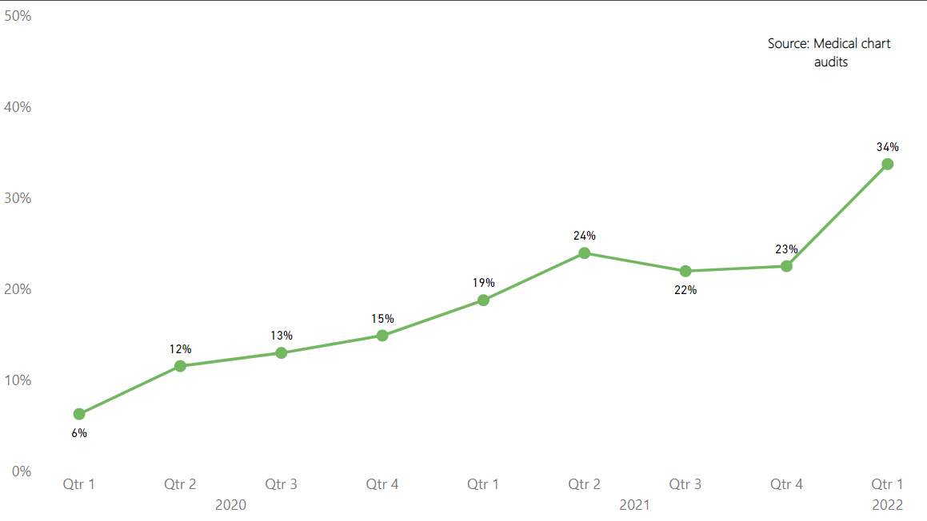
Induction- Pre-c/s Checklists Completed

Slide 10
Hospital-Level Measures
“Most Improved Change Components”

Slide 11
Hospital-Level Measures
Highest % Staff Education
Nurse Education | Q1 2020 | Q1 2022
Pain Management | 59% | 85%
Labor Support | 60% | 81%
Latent Labor Management | 64% | 85%
Labor Progress | 70% | 81%
Active Labor Management | 77% | 86%

Slide 12
Special Thanks from
Florida Department of Health
Kelly Rogers
Section Administrator
Maternal and Child Health
Bureau of Family Health Services

Slide 13
Sustaining your improvement

Slide 14

Sustainability QI Snippet
Featuring Maya Balakrishnan, MD, CSSBB
Used with permission & adapted from the presentation “Sustaining your gains” by Karen Fugate, 2021
Notes:
Click the arrow to play the video directly from the slide

Slide 15


Sustaining your improvement
Scoville R, Little K, Rakover J, Luther K, Mate K. Sustaining Improvement. IHI White Paper. Cambridge, Massachusetts: Institute for Healthcare Improvement; 2016. (Available at ihi.org)
Fact # 1: You have expended enormous effort on your QI project.
Fact # 2: Hard won improvements backslide when we turn attention to another project

Slide 16

Standardization
Processes exist to help define & disseminate standard work (what to do, how to do it)
Have you incorporated the “new way of doing things” into guidelines & policies?
What is your plan to onboard new staff?
Do you have clear roles & responsibilities for “the new way”?
Have you considered other visual aides easily accessible to front-line staff?
Make sure staff know what is expected, what to do & how to do it
Used with permission & adapted from the presentation “Sustaining your gains” by Karen Fugate, 2021

Slide 17
Accountability
How do you know staff are continuing to practice “the new way”?place to review execution of standard work
Periodic review of compliance
→ Needs refresher? Has environment changed & “the new way” needs adjustment?
Provide standards & seek feedback
Set & communicate expectations – resolve for excellence
Used with permission & adapted from the presentation “Sustaining your gains” by Karen Fugate, 2021

Slide 18

Visual Management
Process performance information is continuously available to synchronize staff attention & guide current activities
Continue to focus on the “why” and the WIIFM
Beat your drum!
  Provide simple, basic data
  What are the vital few metrics you need to continue to share? How often? Who is responsible?
Staff need data to guide their work
  How will you provide the data (e-mail, bulletin board, huddles)?
Out of sight, out of mind!
Used with permission & adapted from the presentation “Sustaining your gains” by Karen Fugate, 2021

Slide 19
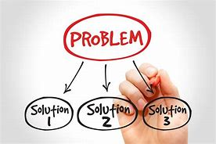
Problem solving
Methods for surfacing & addressing problems solvable at the front line, & for developing improvement capability
Do you promote problem solving at the front-line level?
Do you have expert resources for staff?
Who are they? How have you prepared them?
Who can staff go to when they have questions on “the new way”?
The expert in anything was once the beginner.
Used with permission & adapted from the presentation “Sustaining your gains” by Karen Fugate, 2021

Slide 20

Escalation
Frontline staff scope issues & escalate those that require management action to resolve (e.g., cross-department coordination)
Do you have a process for staff to escalate concerns to leadership when “the new way” is not followed or is not working?
  Issues that may need interdepartmental coordination or cannot be resolved by frontline staff.
Do you have a plan to follow up on concerns?
  Leaders need to be able to address and solve barriers.
There is no such thing as a stupid question!
Used with permission & adapted from the presentation “Sustaining your gains” by Karen Fugate, 2021

Slide 21
Your sustainability journey
Standardization
Accountability
Visual management
Problem solving
Escalation
Used with permission & adapted from the presentation “Sustaining your gains” by Karen Fugate, 2021

Slide 22


Karen Bruder, MD & Julie DeCesare, MD

Slide 23

Strategies for continued moving the needle…
Continue to use the tools that are known to be effective
Communication between the care team is critical: the Pre-cesarean Huddle Form
Visual postings of unit data, algorithms
Have a strategy for education of new staff

Slide 24
Strategies for continued moving the needle…
Continue to perform audits on NTSV CD
Continue to track and publish provider specific rates
Keep NTSV on your Quality Dashboards
FPQC Perinatal QI Indicators

Slide 25
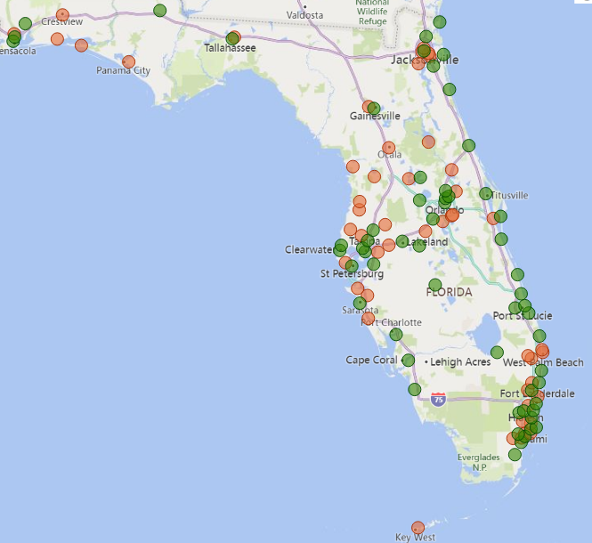

Hospital Perinatal QI Indicators
  62 PQI hospitals
  46 not participating
No charge to participate
No data submission
QI indicator report free of charge

Slide 26

Current PQI Indicators
Perinatal QI Indicator Sets
Non-medically indicated deliveries—PC-01
Nulliparous, term, single, vertex (NTSV) cesareans—PC-02
Failed inductions of labor
Severe Maternal Morbidity—CDC
Unexpected Newborn Complications—CMQCC
Severe Hypertension/Preeclampsia—ACOG AIM
Obstetric Hemorrhage—ACOG AIM
Neonatal Abstinence Syndrome
NTSV cesarean comparative measure

Slide 27
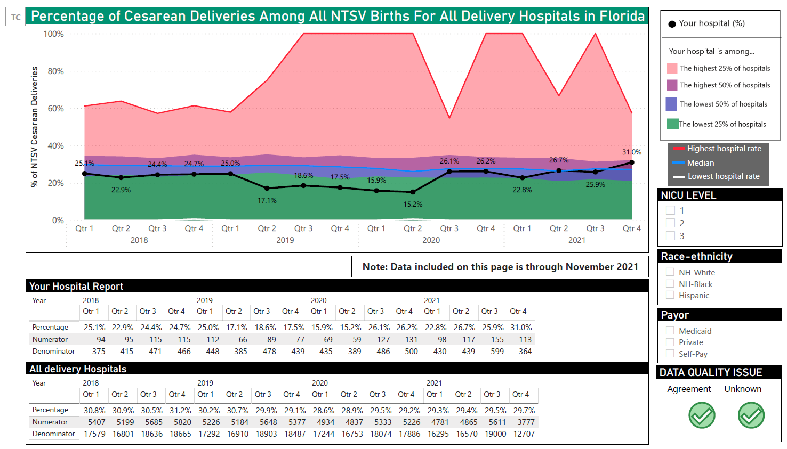

Slide 28
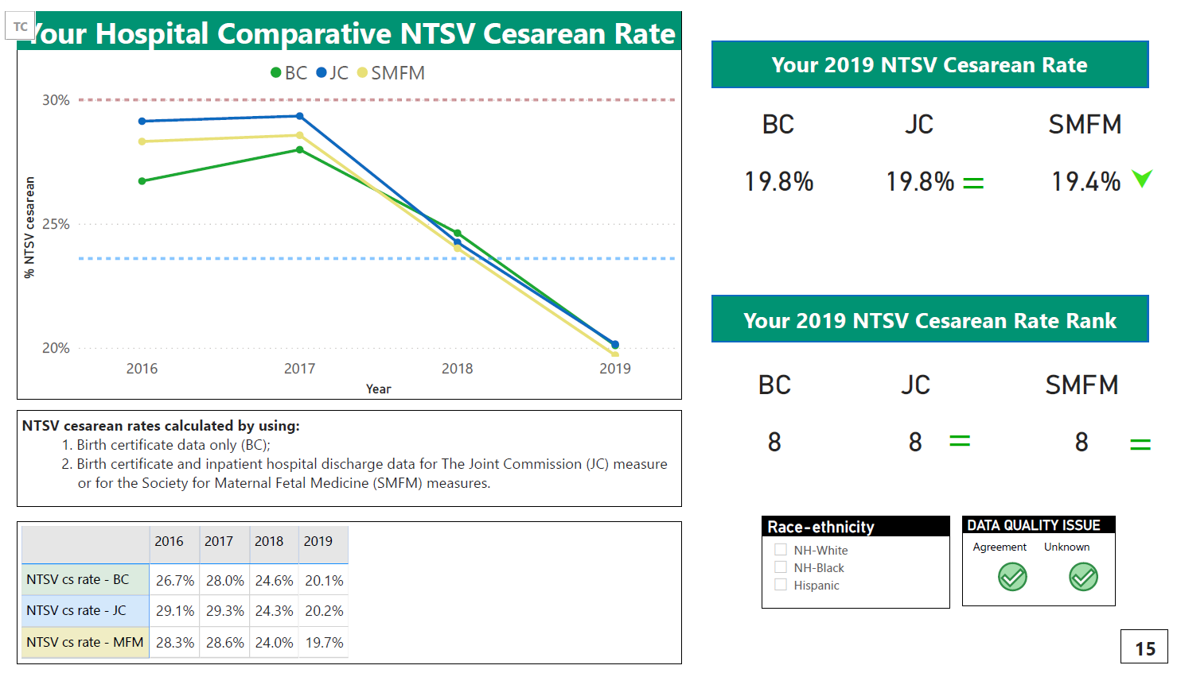

Slide 29


Slide 30
PROVIDE Team
Successes and Sustainability
Strategies

Slide 31
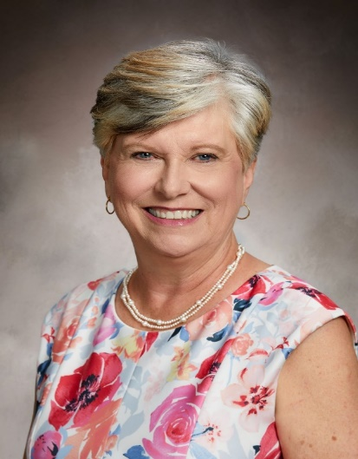
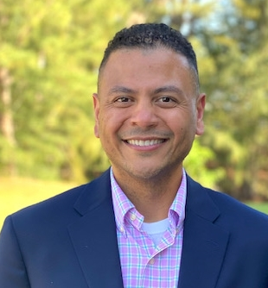
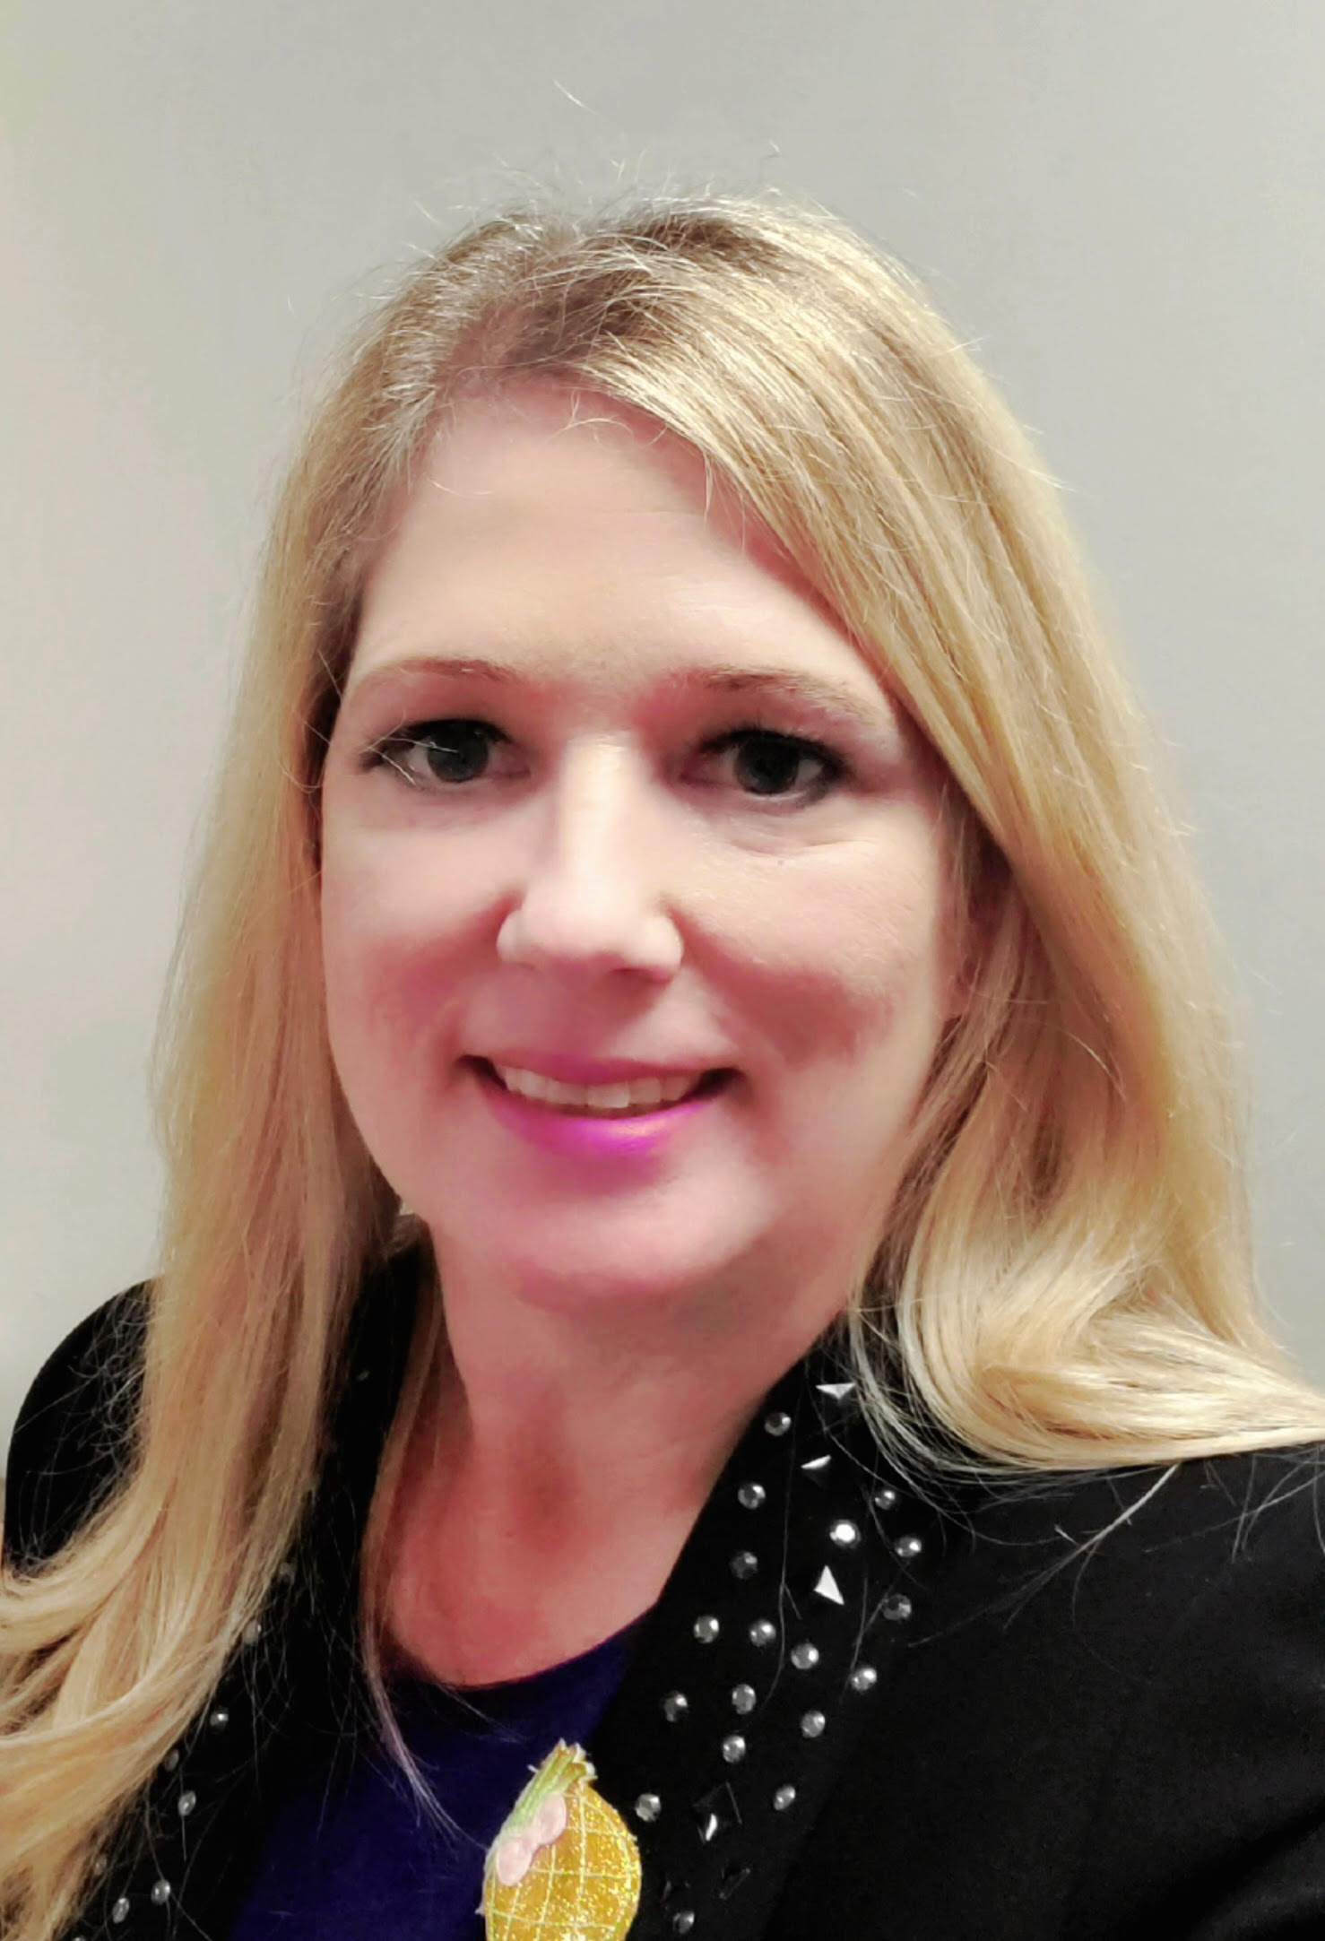
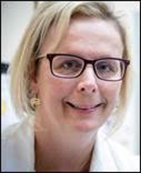
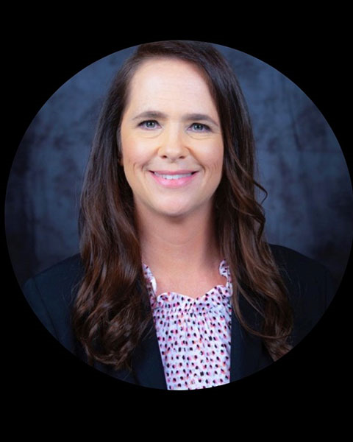
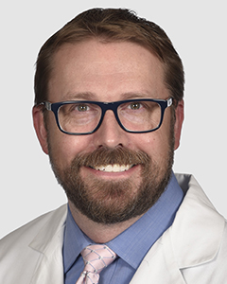
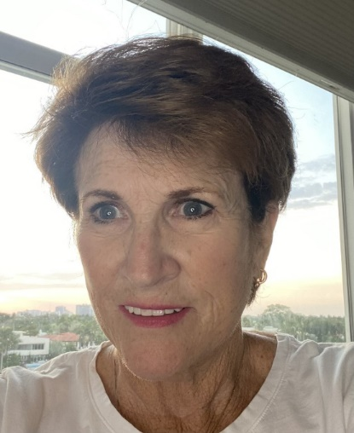
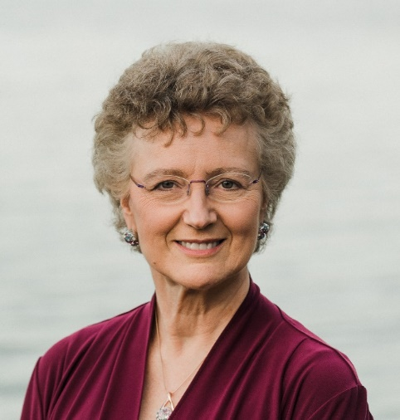
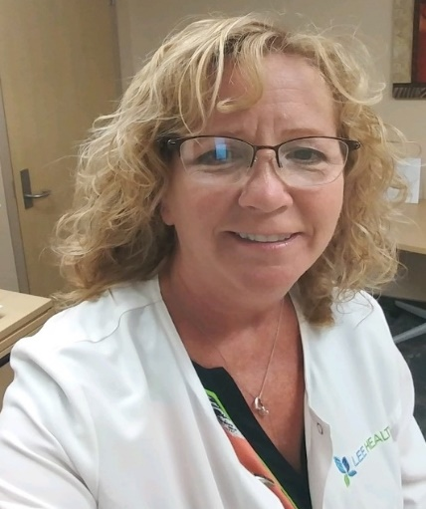
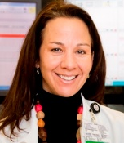

Thanks to our Nurse & Physician Coach Mentors!
Nancy Travis & Chadwick Leo
Leah Williams-Jones & Karen Bruder
Kim Huber & Cole Greves
Jane James & Karen Harris
Carol Lawrence & Julie DeCesare

Slide 32
Successes: HCA Florida, Tenet, Mt. Sinai Hospitals
Jane James, RN & Karen Harris, MD
Educated 100% of staff on NTSV
Labor support training classes held in numerous locations
Decrease in scheduled NTSV Inductions
Increased discussion & patient education regarding NTSV
Including patient in decision making with team
Implemented pre-cesarean checklist (SOAR)Incorporated multi-disciplinary “huddle” prior to decision to move to Cesarean
Successful system Grand Rounds with OBs, Nurses, C-Suite, System Leads

Slide 33
Plans for Sustainability: Hospital Team Strategies
32
Monthly NTSV Team meetings
Provider rates posted monthly
Continue daily review of cases
Collect NTSV data each week and submit to CMO monthly
Monthly review of specific provider Cesarean rates by CMO
OB/GYN Department Chair championing decrease in NTSV Cesareans
NTSV Cesarean priority topic OB Dept Meetings

Slide 34
Successes: TGH, LRH, SMH, Jacksons, TMH, Lee & UF Health
Karen Bruder, MD & Leah Williams-Jones, RN
Awards for both Providers & RNs with Low NTSV rates held monthly
Pre-Cesarean Checklist fully implemented
White Board in rooms used to write important labor milestones & plan
Badge Buddies for NTSV rates
Poster Presentations for AWHONN & Magnet conferences
Dr. RN Interdisciplinary Grand Rounds
Labor support training
Doula welcome events
OP Cervical Ripening started

Slide 35
Plans for Sustainability: Hospital Team Strategies
PQI participation
Train the Trainer Labor Support workshop launch! LDR RN & Doula
Community doula welcome events
Submit Poster to National Nursing Conference
C-suite focus meetings
Continue monthly NTSV Team meetings
Provider rates posted monthly
Continue daily review of cases
OB & RN “front line” champions
NTSV priority topic OB Dept Mtgs

Slide 36
Successes: Ascension Health, Broward Health, Memorial Hospitals,
NCH, Orlando Health Hospitals
Cole Greves, MD & Kim Huber, RN
Grand Rounds with Coach Mentors CE planned: June 23,2021
Pre-cesarean checklist initiated
Reporting Provider specific Rates
Nurses recognized as monthly NTSV "Queen"
1:1 meeting with OB/GYN Chief with every OB/GYN to review PCS. Discussion of ownership, decisions & use of the check list BEFORE starting surgery.
Include OB/GYN Residents in FPQC reduction of NTSV Cesarean

Slide 37
Plans for Sustainability: Hospital Team Strategies
Continue FPQC PQI participation
Monthly internal PROVIDE data displayed
Provider specific rates reported at OB/GYN meetings
Continue NTSV team
Post individual physician’s PCS rate by the scrub sinks outside of surgical suite
Visit offices. Honor and recognize OB/GYN that have a PCS below 23.9%. Post recognition in office

Slide 38
Successes: Baptist Medical Centers, Cleveland Clinic Florida,
Jupiter, Parrish, Santa Rosa Medical Centers
Carol Lawrence, RN & Julie DeCesare, MD
Engaged FPQC Task Force committee
Designed & shared "PROVIDE CART" (Labor Support Supplies)
60 second "PROVIDE snippet"playing in Hospital Lobby
NTSV Stars Initiative
Education for patients – Birth Preferences Worksheet encouraged
Grand Rounds, Provider and Nurse Education
QI reviews underway
Nurses & OBs attended Spinning Babies Class (Hospital Foundation supported)
Hired OB Navigator/Improve Education for Pregnant Patients
Policy to facilitate intermittent monitoring
Culture shift: Physicians trust PROVIDE initiative strategies

Slide 39
Plans for Sustainability: Hospital team strategies
Continuation of Unit Task Force
NTSV Steering Committee for OBs
NTSV Coordinator position
Continue full case review of all NTSV C/S cases
Dystocia fall-outs per ACOG to be reviewed in QI meetings
Continue to share organizational and individual provider NTSV rates
Monthly OB Quality Case Review
Enroll in FPQC PQI
Provider rates posted monthly
Hospital added Laborists & CNMs

Slide 40
Successes: Advent Health & BayCare Hospital Systems
Nancy Travis, RN & Chadwick Leo, DO
NTSV Star recognition monthly for both RN & Provider- awards include T-shirts, plaques, posters recognizing achievements; sharing NTSV success stories
Pre C/S Checklist Implemented; standardized induction of labor process
Interdisciplinary Grand Rounds presented by RN & OB & FPQC to System campuses
Labor support training classes held in numerous locations- “Train the Trainer” model launched after Spinning Babies class
Candy Bar of the Month for the teams when NTSV Cesarean benchmark met: “Show me your Twix”, “Be Kind”…… Staff celebrations
Position champions
Welcoming doulas across campuses
System providers meeting quarterly
“Nucleus” Nursing Leadership monthly meetings focus on standardizing PROVIDE structure measures across campuses

Slide 41
Plans for Sustainability: Hospital Team Strategies
PQI enrollment across system
Monthly NTSV Team meetings will continue across system campuses
Collect NTSV Cesarean data & present to Perinatal Safety Committees
Monthly review of specific provider posted Cesarean rates by OB Chair
Keep up Position of the Month!
Train the Trainer model for Labor Support Classes ongoing
Continue nurse and provider recognition
Providers plan to share rates among community hospitals
NTSV magnets & QR patient education materials in every room
NTSV 1 page education flyer for all new team members(staff, travelers, OBs)

Slide 42
PROVIDE Star Awards

Slide 43



Coaching Call Attendance—27
AdventHealth Orlando
AdventHealth Waterman
AdventHealth Wesley Chapel
Ascension St. Vincent’s Clay County
Ascension St. Vincent’s Riverside
Baptist Medical Center Beaches
Baptist Medical Center South
Bethesda Hospital
Broward Health Medical Center
Lee Health Cape Coral Hospital
Good Samaritan Medical Center
Halifax Health Medical Center
Lee Health HealthPark Medical Center
Mease Countryside Hospital
Memorial Regional Hospital
Mount Sinai Medical Center
NCH North Naples Hospital
North Florida Regional Medical Center
Sarasota Memorial Healthcare System
South Lake Hospital
South Miami Baptist Hospital
St. Mary’s Medical Center
Tallahassee Memorial Healthcare
Tampa General Hospital
UF Health Jacksonville
Wellington Regional Medical Center
Winnie Palmer Hospital for Women and Babies

Slide 44
Data Submission—45
AdventHealth Altamonte
AdventHealth Celebration
AdventHealth Daytona Beach
AdventHealth Orlando
AdventHealth Tampa
AdventHealth Waterman
AdventHealth Wesley Chapel
AdventHealth Winter Park
Ascension Sacred Heart Emerald Coast
Ascension St. Vincent's Clay County
Ascension St. Vincent's Riverside
Ascension St. Vincent's Southside
Baptist Medical Center Beaches
Baptist Medical Center South
South Florida Baptist
Bethesda Hospital Inc.
Broward Health Medical Center
Lee Health Cape Coral Hospital
Cleveland Clinic Tradition Hospital
Lee Health HealthPark Medical Center
Homestead Hospital Baptist Health
Jupiter Medical Center
Kendall Regional Medical Center
Manatee Memorial Hospital
Mease Countryside Hospital
Memorial Hospital Miramar
Memorial Regional Hospital
Morton Plant Hospital
Mount Sinai Medical Center
Naples Community Hospital
Palms West Hospital
Parrish Medical Center
Sacred Heart Hospital Pensacola
Sarasota Memorial Healthcare System
South Miami Baptist Hospital
St. Joseph's Hospital South
St. Joseph's Women's Hospital
St. Mary's Medical Center
Tallahassee Memorial Healthcare
Tampa General Hospital
UF Health Jacksonville
UF Health Leesburg
West Kendall Baptist Hospital
Winnie Palmer Hospital for Women and Babies
Winter Haven Women's Hospital

Slide 45
Structural Measure Improvement—15
AdventHealth Wesley Chapel
Ascension St. Vincent’s Riverside
Broward Health Medical Center
Lee Health Cape Coral Hospital
Halifax Health Medical Center
Lawnwood Regional Medical Center
Mease Countryside Hospital
Morton Plant Hospital
Sarasota Memorial Healthcare System
South Lake Hospital
South Miami Baptist Hospital
St. Joseph’s Hospital North
Tampa General Hospital
The Women’s Hospital at Jackson Memorial Medical Center
West Kendall Baptist Hospital

Slide 46
Outcome Measure Improvement—26
AdventHealth Orlando
AdventHealth Tampa
AdventHealth Waterman
AdventHealth Wesley Chapel
AdventHealth Winter Park
Ascension St. Vincent’s Clay County
Ascension St. Vincent’s Riverside
Baptist Medical Center Beaches
Boca Raton Regional
Broward Health Medical Center
Lee Health Cape Coral Hospital
Cleveland Clinic Indian River Center
Cleveland Clinic Tradition Hospital
Good Samaritan Medical Center
Lawnwood Regional Medical Center
Memorial Hospital West
Mercy Hospital
Mount Sinai Medical Center
North Florida Regional
Northwest Medical Center
Palms West Hospital
Parrish Medical Center
St. Joseph’s South Hospital
St. Mary’s Medical Center
Tallahassee Memorial Hospital
UF Health Jacksonville
Winnie Palmer Hospital for Women and Babies
Winter Haven Women’s Hospital

Slide 47
2021 NTSV Cesarean Rate at 2030 HP Goal—17
AdventHealth Waterman
AdventHealth Wesley Chapel
AdventHealth Winter Park
AdventHealth Zephryhills
Ascension Sacred Heart Emerald Coast
Ascension St. Vincent’s Clay County
Lee Health Cape Coral Hospital
Cleveland Clinic Tradition Hospital
Good Samaritan Medical Center
Jackson South Medical Center
Lakeland Regional Health Medical Center
Mount Sinai Medical Center
Parrish Medical Center
South Lake Hospital
St. Mary’s Medical Center
UF Health Jacksonville
Winter Haven Women’s Hospital

Slide 48


Our Gift to You!

Slide 49
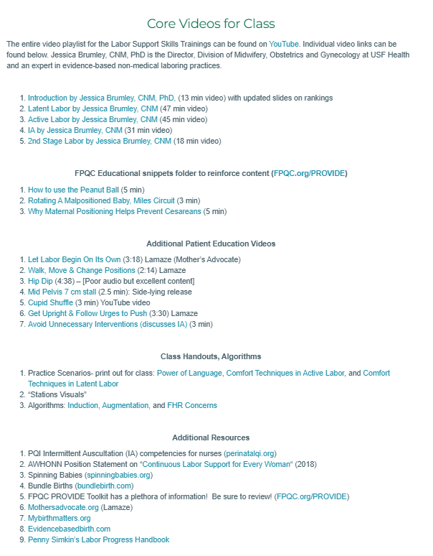
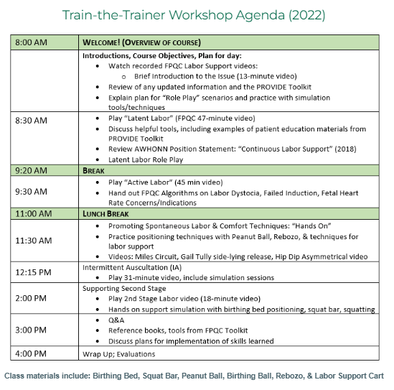
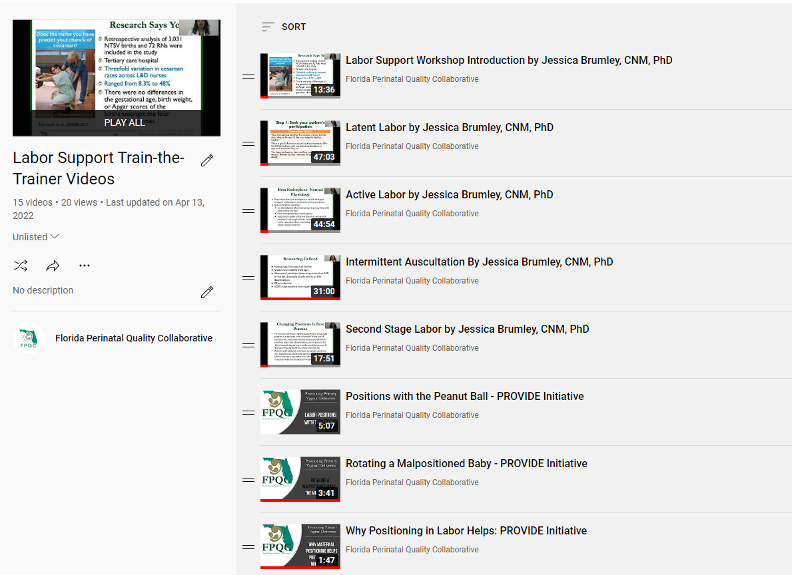
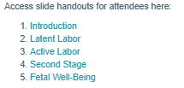

Labor Skills Workshop Train-the-Trainer
Agenda, Facilitators' Guide, & Slides
All Videos and Resources
YouTube Playlist

Slide 50

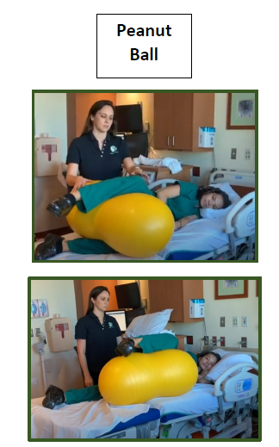
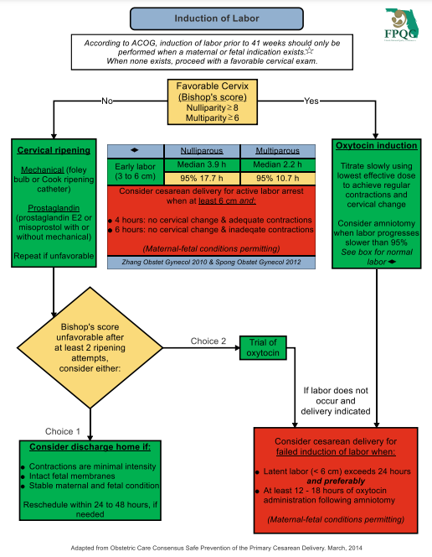
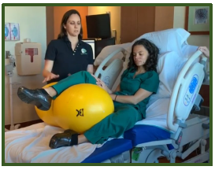
Labor Skills Workshop Train-the- Trainer
Practice Scenarios
Station Visuals
Algorithms
Visit fpqc.org/laborworkshop for updates!

Slide 51





Thank you for all you have done and continue to do to lower NTSV cesareans!
@thefpqc
Facebook.com/TheFPQC/
E-mail:
FPQC@usf.edu
Join our mailing list at FPQC.org
@TheFPQC

