Slide 1
Summary of the key points, best practices, and evidence-based recommendations from AWHONN Neonatal Skin Care: Evidence-Based Practice Guideline for Practice, 4th edition
SOOTHE Noxious Stimuli Workgroup
July 1, 2025

Slide 2
Overview of Neonatal Skin and Skin Care Practices
The skin is a vital organ at birth, responsible for:
  Barrier protection (water loss, light, and substance absorption)
  Temperature regulation
  Acid-mantle formation and infection control
  Water and electrolyte balance
  Tactile sensory function
Neonatal skin care is essential in both healthy and ill newborns, especially in the first days and weeks of life.

Slide 3
Overview of Neonatal Skin and Skin Care Practices
The primary goal is to maintain skin integrity and prevent injuries, which can lead to complications like dehydration and infection
Early exposure to irritants or toxins may contribute to atopic skin disorders and impact neurodevelopment later in life
Using evidence-based skin care practices promotes optimal short- and long-term health outcomes in infants

Slide 4
Skin Assessment
Routine assessment of the skin remains essential to prevention and treatment of the disruption to the structure and function of the skin
Dedicated interdisciplinary skin care teams can improve the early identification of skin injury in hospitalized neonates

Slide 5
Skin Assessment
Neonatal Skin Condition Score (NSCS; Lund et al., 2001) is a valid and reliable tool that has demonstrated effectiveness as an outcome-measure evaluation of interventions
A newly modified version of the Braden Q Risk Assessment Scale, called the Braden QD (Curley et al., 2018), shows promise at predicting pressure injury and indicating the need for prevention measures

Slide 6
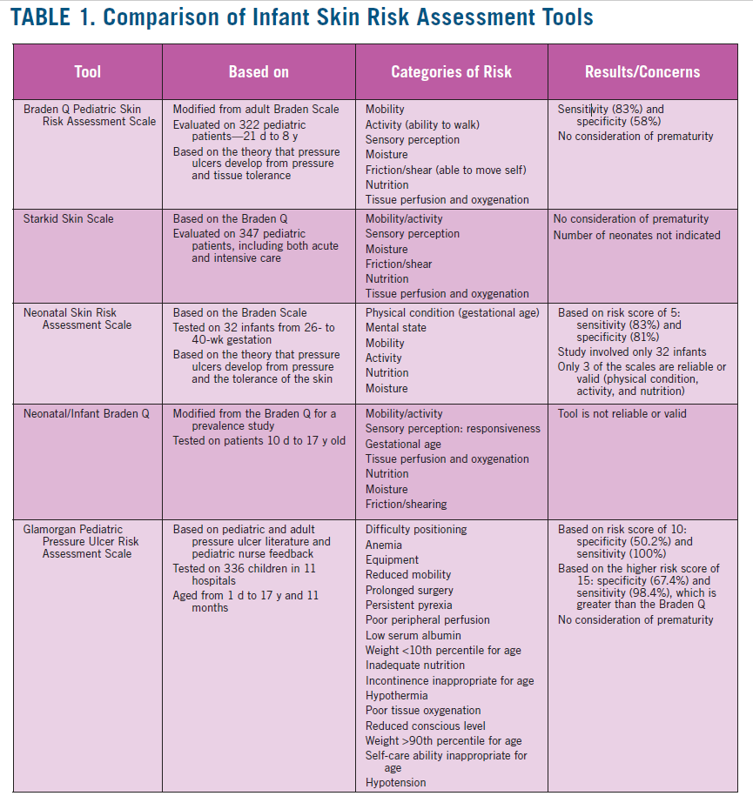

Slide 7
Skin Injury
Medical devices are the leading cause of skin injury in neonates, especially in infants <27 weeks gestation
Silver-impregnated dressings and medical-grade honey are safe and effective for treating various neonatal wounds and skin injuries (e.g., burns, pressure injuries, epidermal stripping)
Medical-grade honey is particularly useful for debridement and has been used for complex wounds
New appendices include:
  Pressure Injury Staging (Appendix C)
  Wound Healing Stages (Appendix D)
  Dressing Selection Guide (Appendix E)

Slide 8
Bathing
Previous research favored immersion bathing over sponge bathing for term and late preterm infants
Recent studies show swaddled immersion bathing benefits both term and preterm infants
  Swaddled immersion bathing promotes a contained position, which may reduce body movements and infant stress
Infants bathed with swaddling:
  Stay warmer
  Cry less compared to traditional immersion baths

Slide 9
Cord Care
For healthy newborns in healthcare settings, dry cord care is the preferred method
Recent evidence shows it is not inferior to antiseptic methods in preventing omphalitis

Slide 10
Diaper Dermatitis & Wipes
Prevention + frequent skin assessments are the most effective strategy
Recommended wipes should be:
  Free of alcohol (except mild benzyl alcohol), perfumes, and harmful preservatives like methylisothiazolinone
A diaper dermatitis assessment tool is provided (Appendix G).

Slide 11
Emollient Use
Emollients:
  Improve skin-barrier function
  Treat dry, cracked skin
  May prevent atopic dermatitis
Risk factors for eczema/dermatitis include:
  Barrier dysfunction, genetics (e.g., filaggrin defect), allergens, irritants, and environmental exposures

Slide 12
Parent / Caregiver Education
Updated guidance helps providers educate families on:
  Skin assessment and vernix
  Bathing and genital care
  Umbilical care and dermatitis
  Emollient use, cradle cap, atopic dermatitis
  Safe product selection

