Slide 1
Initial Verification Roadmap
Prepare
Onsite
Polish up policies, protocols, procedures to ensure compliance with standards
3
TJC surveyor(s) arrives onsite
8
Contact TJC
Celebrate!
1-2 days
6
3-4 months
2
Contact Brian Johnson to start the application process
Verification decision received TJC sends invoice to FPQC
1
Inquire
1-2 days
Start the process with FPQC the funding form with FQPC and access playbook
7
4
TJC processes Application
Post Verification
TJC
Submit application for survey
Annual fee starts to be assessed upon application
Complete any RFIs
3 days – 2 weeks/ includes phone call with Account Executive
5

Slide 2
Tips to reduce lag time
Application submission triggers the annual fee charge
  TJC cannot bill FPQC until after the verification onsite
  Survey ready date has to be at least the day after application submission.
After submission we will work to schedule your verification close to the survey ready date
  Reduce the number of avoid dates
  Consider forgoing 30-day notice

Slide 3
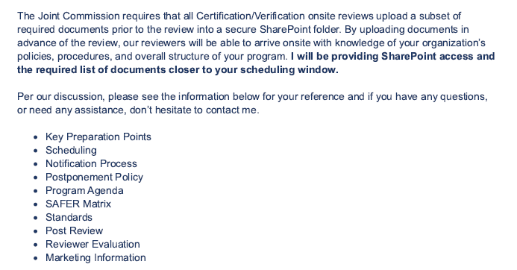
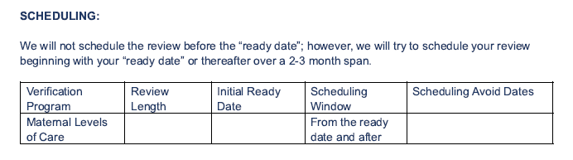
Post application email excerpts

Slide 4
Joint Commission Cycle
E-App/
E-App updates
Onsite
Award (Day 2 - 60 after onsite)
Maintain
On average 3-4 months
36 months post award
2 days to 2 months

