Slide 1
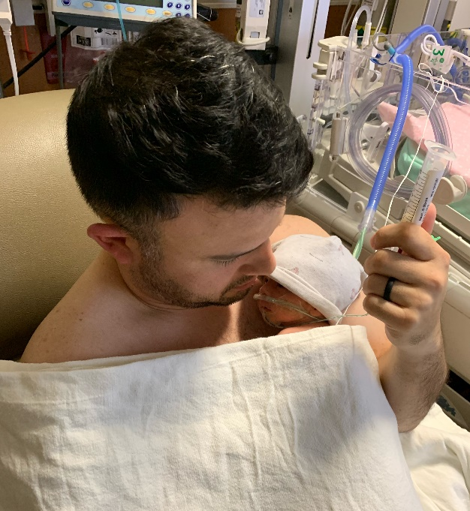
Family-Centered Care in the SCN and NICU
Mark Hudak
Samarth Shukla

Slide 2
Proposed Neonatal Initiatives
Neonatal Abstinence Syndrome 2.0
Antimicrobial Stewardship in EOS/LOS
Managing Tiny Babies
Family-Centered Care

Slide 3
Family-Centered Care
Involving the family in their infant’s care can improve infant outcome at and beyond discharge and improve family experience and clinician/caregiver satisfaction. Yet, many families face barriers and SCNs/NICUs experience challenges in achieving quality FCC.
We propose three processes for continuous quality improvement:
welcome families into the care team - ensuring that families are respected as team members; incrementally participatory in their infant’s care; confident about care after discharge; and fully attuned to their infant’s personality;
develop tools to assess the domains of respect; communication; access; family integration into care; family confidence in and competency of care; and global family readiness for discharge; and
develop strategies to use the these tools to improve these processes with each family.
Each unit will be able to benchmark and improve the quality of their family-centered care and track infant outcomes.

Slide 4
Family-Centered Care
Family-centered care is defined as a shared approach to the planning, delivery, and evaluation of healthcare that is based upon a partnership between healthcare professionals and family caregiver(s).
There are four essential domains of FCC:
Dignity and respect
Information sharing
Participation
Collaboration
Institute for Patient- and Family-Centered Care
Johnson BH & Abraham MR (2012). Partnering with Patients, Residents, and Families: A Resource for Leaders of Hospitals, Ambulatory Care Settings, and Long-Term Care Communities.

Slide 5
Challenges of the SCN/NICU Mother
Often burdened with increased psychosocial, mental health, environmental, and socioeconomic challenges during pregnancy and after delivery that correlate with increased adverse outcomes. (Hawes 2016, McGowan 2017, 2019)
Mothers with mental health challenges (McGowan 2016, 2018):
Self-report poorer readiness for infant discharge, less family support, increased concern about themselves and infant.
Infant visit to ED more likely within 90 days after discharge.
Mothers with social risk factors (Medicaid, non-English speaking): (Vohr 2017, 2018; Liu 2018)
Increased infant visits to ED
Higher rate of infant rehospitalization

Slide 6
Risks to the SCN/NICU Infant
Biologic risk: Discrete medical morbidities that may cause brain injury or alter brain development
Proximal risk: Decreased parental involvement (deficit of touching, soothing, language and communication, interaction)
Distal risk: Socioeconomic, cultural, educational adversity; racism; impaired maternal mental health; poor extended family support.

Slide 7
Maternal Care in Animals
Study of rat mothers and pups: high licking and grooming (L&G) vs. low L&G
Pups exposed to high L&G compared to low L&G mothers exhibited
Less fear
Reduced hypothalamic-pituitary response to stress, persisting into adulthood
Cross fostering resulted in reversal of effects
Possible effects on pup epigenome (increased glucocorticoid receptor gene promoter in hippocampus)
Maternal care may program offspring behavior over the lifetime

Slide 8
Stroking Care by Human Mothers
Study of mothers with history of inter-partner psychological abuse and their infants
Maternal self-reports of frequency of stroking infants at 5 and 9 weeks
Results:
Prenatal maternal depression associated with decreased infant physiological adaptability and increased negative emotionality at 29 weeks if mother reported low stroking (Sharp H et al PLoS One 2012)
Prenatal anxiety associated with infant internalizing and anxiety/depression per Child Behavior Checklist High at 2.5 years if mother reported low stroking (Sharp H et al Psychol Med 2014)
Results analogous to the animal study of L&G in rat mothers and pups

Slide 9
The Developing Brain
From 10 weeks gestation to term, the fetal brain undergoes a very complex sequence of maturation.
Neurogenesis and proliferation
Migration
Myelination
Synaptogenesis and pruning
Number of neurons increases from 13 billion at 5 months to 100 billion at term

Slide 10
The Developing Brain
Consciousness develops as connections are made between the thalamus and the cerebral cortex which transmit auditory and visual input to the cortex (24-32 weeks)
Receptive and adaptive to nuances in language at least as early as 32 weeks: vocalizations and “conversation turns”; most infant language input comes from parents

Slide 11
Environment for FCC
Provides appropriate physical space to encourage family caregiver involvement
Advantages/disadvantages of single family rooms
Facilitates optimal breast feeding
Encourages skin-to-skin care
Allows infant to discriminate touch (stroking, massage, vibration) and voices (talking, reading, singing) of caregivers
Promotes meaningful interactions between the clinician caregivers and the family caregivers (participation, reflective listening, education)

Slide 12
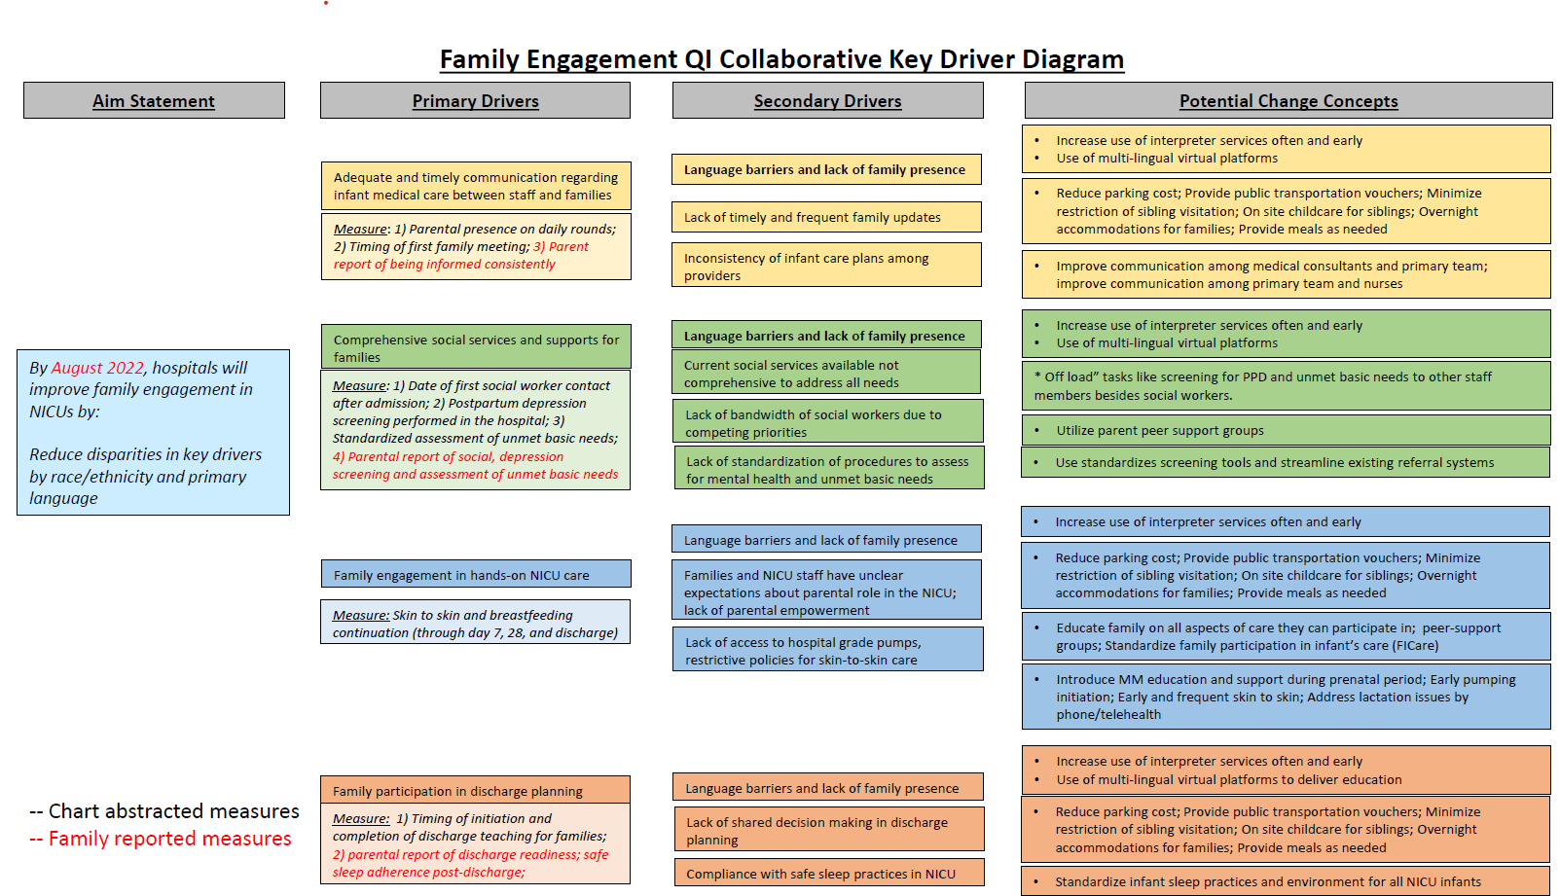

Slide 13
Opportunities for Practice Evolution
Assess and address maternal adverse mental health and stress
Decrease both maternal and infant stress
Identify and address needs of family and infant
Facilitate visitation
Improve communication
Integrate family into care discussions and decisions
Provide culturally sensitive environment
Encourage active maternal involvement in infant care
Improve transition to home processes

Slide 14
PAIRED PLUS
Multidimensional opportunity to improve FCC
Centerpiece QI initiative: Skin-to-skin care
Identify areas of strength and weakness in your ability to encourage FCC in your unit
Target one or two interventions among the 4 domains that are high opportunity (realistic and feasible in your environment): browse the toolbox!
Coaching calls
We need your feedback to refine everyone’s efforts!

