Slide 1
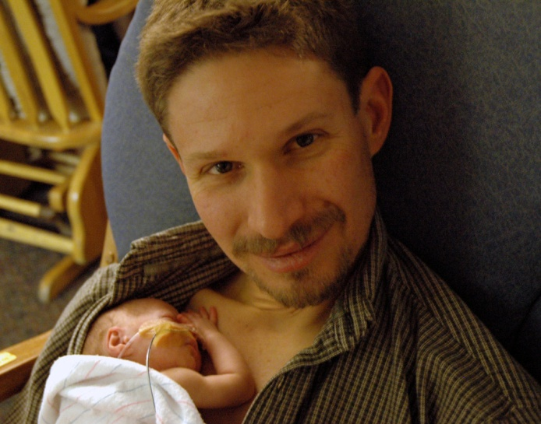
PAIRED Coaching Calls
Samarth Shukla, MD
PAIRED Clinical Co-Lead

Slide 2
What are coaching calls?
  Brainstorming sessions
  Great place to discuss barriers and challenges
  Share successes with other units
  Briefly review statewide data from all the units
  Sharing updates
  Experts/Family representative consultations
  Experiences from pilot initiative

Slide 3
Coaching call logistics
  Includes: Representatives from all participating centers, FPQC project leads, FPQC data and QI analysts and PAIRED family representatives
Schedule for coaching calls
  1-hour sessions, once a month
  Three groups due to the large number of participating centers
  Agenda for the session/topics of discussion will be sent out
  All centers are expected to attend and participate

