Slide 1


Preventing Maternal Mortality
Postpartum Care in the ER

Slide 2
Disclosures
Nothing to disclose

Slide 3
Objectives
Discuss Florida’s postpartum pregnancy-related mortality
Discuss leading causes of postpartum death, timing and place
Learn what ERs can do to prevent postpartum deaths
Understand care management of select postpartum conditions
Discuss high risk postpartum conditions warranting OB consultation

Slide 4



Slide 5
Maternal Mortality Definitions
Maternal Mortality (Uses death certificate only)
Death of a woman while pregnant or within 42 days of termination of pregnancy, irrespective of the duration and site of the pregnancy, from any cause related to or aggravated by the pregnancy or its management but not from accidental or incidental causes.
Pregnancy-Associated Mortality (Uses enhanced surveillance)
Death of a woman, from any cause, while she is pregnant or within one year of pregnancy.
Pregnancy-Related Mortality (Based on Maternal Mortality Review)
Pregnancy-associated death that resulted from:
        Complications of the pregnancy;
        The chain of events initiated by pregnancy; or
        Aggravation of an unrelated condition by pregnancy effects resulting in death.

Slide 6
Pregnancy-Related Mortality Rates
Florida, 2010 to 2019
56%
35%
Years
Source: FL Maternal Mortality Review data
6

Slide 7
Postpartum Discharge Pregnancy-Related Deaths
By Time Period, Florida, 2015 to 2019
Days After Birth
Source: FL Maternal Mortality Review data

Slide 8
Underlying Cause of Death for Less Than the First 60 Days
Postpartum Discharge Pregnancy-Related Deaths
By Time Period, Florida, 2015 to 2019
Source: FL Maternal Mortality Review data

Slide 9
Underlying Cause of Death for 60+ Days
Postpartum Discharge Pregnancy-Related Deaths
By Time Period, Florida, 2015 to 2019
Source: FL Maternal Mortality Review data

Slide 10
Postpartum Discharge Pregnancy-Related Deaths with a Stand-Alone Postpartum ER Visit, Florida, 2015 to 2019
Days After Birth
Source: FL Maternal Mortality Review data

Slide 11
Postpartum Discharge Pregnancy-Related Mortality Rates, Women at Risk, Florida, 2015 to 2019
Coverage
Private Ins.
Medicaid
Normal
BMI
Overweight
Obese II
Obese III
Age
25-29 Yrs.
35+ Yrs.
Hispanic
Race/Ethnicity
NH White
NH Black
Source: FL Maternal Mortality Review data
Deaths Per 100,000
11

Slide 12
Postpartum Discharge Pregnancy-Related Deaths By Cause and Preventability, Florida, 2015 to 2019
Number of Postpartum Discharge Deaths
12

Slide 13
Topic MMRC Recommendation Themes
Chronic disease management before & after pregnancy: 33 recommendations
Postpartum visit: 16 recommendations
Provider education: 11 recommendations
Sepsis: protocol and provider education: 5 recommendations
Source: FL Maternal Mortality Review data

Slide 14
Source: FL Maternal Mortality Review data
Pregnancy-Associated Mortality Ratios by Cause of Death
Florida, 2010-2020
Drug-Related Deaths:
Leading cause; More than all pregnancy complications
More than 75% die after discharge for delivery
More likely to have had a prior standalone ER visit than other conditions
4
Notes:
This is the Pregnancy-Associated Mortality Ratios by Cause of Death excluding pregnancy-related mortality. Drug-related deaths are the leading cause of death by far and increasing over time especially in 2020. There are more drug-related deaths each year in Florida than all of those death due to pregnancy complications. Most notably, more than 75% of these mothers die after being discharged after delivery.

Slide 15
Postpartum ER Care—Mortality Prevention
ER care can prevent some postpartum deaths based on
Florida Maternal Mortality Review Findings
1.
2.
3.
Ask women ages 15-45 years if they have been pregnant in the past year?
If yes, add postpartum complications to your differential
Check for early postpartum warning signs and their medical problem list
3. Clinician PP Engagement & Education
4.
5.
6.
If needed, review postpartum checklist & management guidelines
If unsure, seek OB consultation early
If discharged, arrange referral and educate when to return

Slide 16
Postpartum ER Care—Mortality Prevention
Ask all women ages 15-45 years if they have been pregnant in the past year?
This question should be integrated into your triage and/ or patient assessment system

Slide 17
Postpartum ER Care—Mortality Prevention
What is the medical problem list from delivery admission?
Did the patient deliver at your facility or in your health system? Do you have the discharge records?

Slide 18
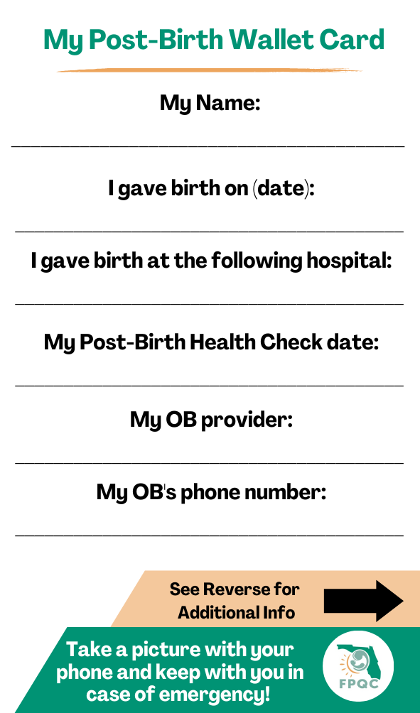
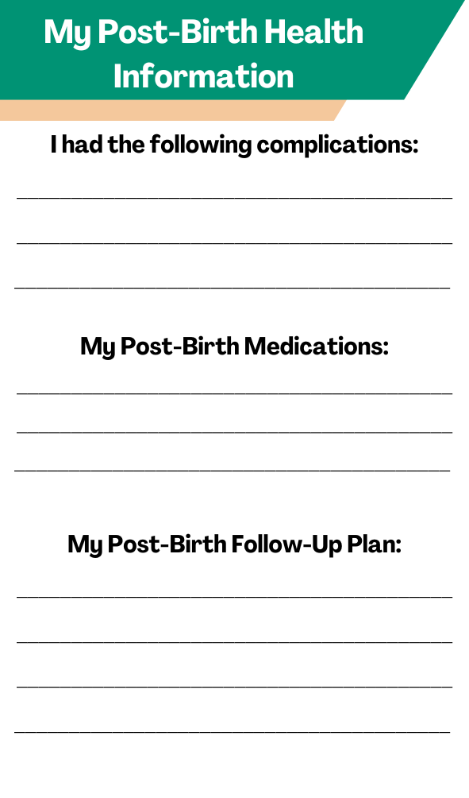
Ask if the Mother has any Discharge Information
Front
Back
Maternal Wallet Card or Discharge
Info?

Slide 19
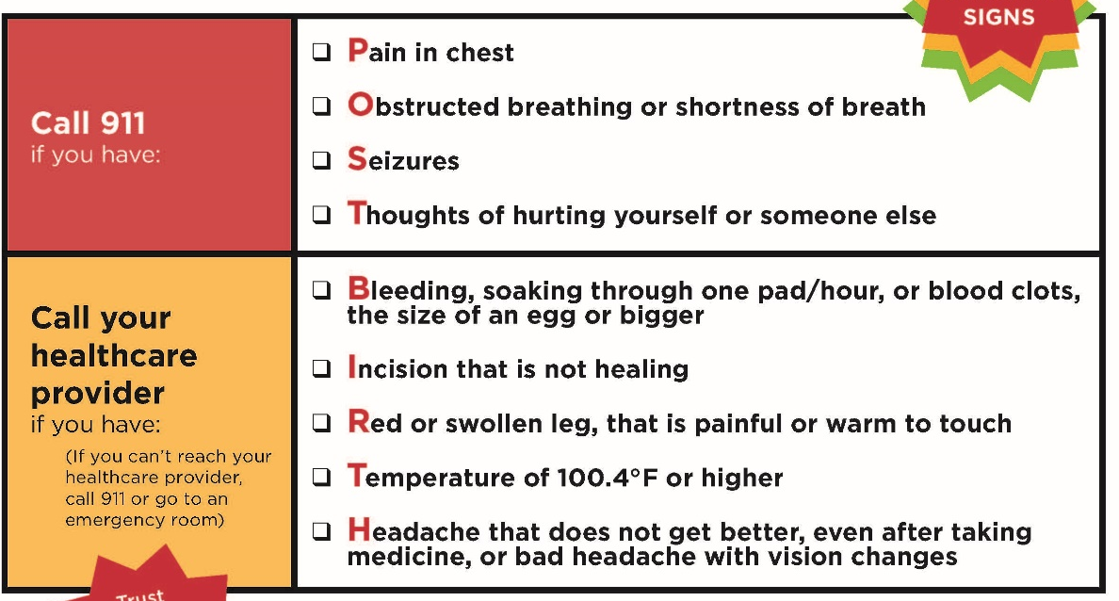

Post-Birth Warning Signs
Post-
Birth Warning Signs
Trust Your Instincts!

Slide 20










Patient—Postpartum Early Warning Signs
Headache that won’t go away or gets worse
Trouble breathing
Dizziness or fainting
Chest pain or fast-beating heart
Severe swelling, redness or pain of your leg or arm
Fever of 100.4 or higher
Change in your vision
Vaginal bleeding or discharge after pregnancy
Thoughts of harming yourself
Overwhelming tiredness
Multiple ER and health care contacts for same reason!
Source: CDC Hear Her Campaign

Slide 21
Clinical—Maternal Early Warning System
Measurement | Less Than or Equal | Between | Between | More Than or Equal
Systolic BP (mmHg) | 80 | 81-89 | 150-159 | 160
Diastolic BP (mmHg) | 49 |  | 95-109 | 110
Respiratory Rate (breaths per minute) | 10 |  | 22-29 | 30
Heart Rate (beats per minute) | 50 |  | 111-119 | 120
Oxygen Saturation (% at room air) | 94
Urine Output (ml per hour for 2 hours) | 35
Maternal agitation, confusion or unresponsiveness
Patient with hypertension reporting a non-remitting headache or shortness of breath
Patient report of constant, systemic and severe musculoskeletal pain
Any 1 red requires immediate action. Call provider immediately to come for beside evaluation | Any 1 orange should be reassessed and confirmed prior to calling the provider in 10 minutes |  | Any 2 yellow should be reassessed and confirmed prior to calling the provider in 10 minutes
RED
Orange
Yellow
Source: FDOH, ACOG/AIM, Shields 2016

Slide 22
Clinical—Maternal Early Warning System
Maternal Early Warning Measurements
Systolic BP (mmHg) | <80 | >160
Diastolic BP (mmHg) | <49 | >110
Respiratory Rate (breaths per minute) | <10 | >30
Heart Rate (beats per minute) | <50 | >120
Oxygen Saturation (% at room air) | <94
Urine Output (ml per hour for 2 hours) | <35
Maternal agitation, confusion or unresponsiveness
Patient with hypertension reporting a non-remitting headache or shortness of breath
Patient report of constant, systemic and severe musculoskeletal pain
Immediate action needed; call provider immediately to come evaluate
Reassess and confirm calling the provider in 10 minutes
RED
Yellow
Source: FDOH, ACOG/AIM

Slide 23
Cardiomyopathy / Short of Breath
Synopsis
Cardiomyopathy is a leading causes of maternal mortality, both dilated and hypertrophic.
Mothers can develop peripartum cardiomyopathy, usually in the 3rd trimester or 1st 6 weeks postpartum.
Others diseases include pulmonary hypertension, aortic dissection, unexplained sudden death, probable arrhythmia, congenital heart disease, coronary artery disease, and valvular and non-valvular disease.
Risk factors: obesity, African-American race/racism, hypertension during pregnancy, and illicit drug use (methamphetamine, cocaine).
Symptoms: shortness of breath, wheezing, palpitations, edema, chest pain, dizziness, or extreme fatigue.
Signs: hypertension, tachycardia, rales, swelling, and low oxygen saturation.
Key Points
Stabilize and transfer if necessary.
Assess for dilated cardiomyopathy and hypertrophic heart disease.
Assessment: Monitor O2 saturation and vitals, EKG, BNP, troponin, echocardiogram, chest x-ray.
Manage: Stabilize, follow systolic heart failure guidelines, consulate MFM/Cardiology, transfer if necessary.
Presents to the ER multiple times with shortness of breath or other vague symptoms; needs work up including echocardiogram (BNP and troponin when not readily available).

Slide 24
Fever / Sepsis
Synopsis
Sepsis is a “life-threatening organ dysfunction caused by a dysregulated host response to infection” (JAMA 2016; 315: 801– 10).
Sepsis is an infection with organ dysfunction and requires immediate response.
Septic shock is a subset in patients who require vasopressor support to maintain a mean arterial pressure greater than 65 mmHg and have serum lactate greater than 2mmol/L after adequate fluid resuscitation.
Key Points
Stabilize and transfer if necessary; hospital sepsis protocols should be implemented.
Monitor the “Maternal Early Warning System” closely; Leading causes: septic abortion, endometritis, pneumonia, urosepsis, appendicitis, wound infection, cholecystitis.
Consider OB consultation.
Draw tests quickly: CBC, coagulation status, comprehensive metabolic panel, venous lactic acid, blood cultures, other cultures.
Antibiotics should be administered within an hour of arrival.

Slide 25
Thromboembolism
Synopsis
The risk increases during pregnancy and postpartum.
Often presents with unilateral extremity swelling/pain; maybe erythematous warm to palpation
Roughly 75-80% of pulmonary embolisms are caused by DVT
Symptoms include shortness of breath, chest pain that worsens with deep inspiration, hemoptysis, and palpitations. Tachycardia and lowered oxygen saturation can be seen.
Clinicians need to have a high index of suspicion.
Key Points
Stabilize and transfer if necessary
Virchow’s triad is present in pregnancy and postpartum
Monitor signs and symptoms including unilateral leg pain, swelling, shortness of breath, and low O2 saturation
Imaging: Lower extremity venous doppler, V/Q scan, CT angiogram
Treatment: Heparin (low molecular weight, unfractionated)

Slide 26
Hypertension / Preeclampsia
Synopsis
Hypertensive disorders are a leading cause of maternal mortality and morbidity.
Includes Gestational Hypertension, Preeclampsia, Eclampsia, and Chronic Hypertension with Preeclampsia.
Distinguishing feature: proteinuria is a protein/creatinine ratio of 0.3 or more, a 24-hour urine protein of 300 mg/dl or more, or a urinalysis protein value of 1+ or more.
Preeclampsia with severe features includes one or more: unrelenting headache, visual disturbances, right upper quadrant pain, thrombocytopenia, elevated transaminases, elevated creatinine and pulmonary edema.
Key Points
Stabilize and transfer if necessary.
Consider OB consultation.
Antihypertensive treatment should be started quickly for persistent acute-onset severe hypertension (SBP >160 mm Hg or DBP >110 mm Hg) that is confirmed as persistent (>15 mins.). Research suggests that treatment should be administered within 30–60 minutes.
Abnormal blood pressure range—140-159 systolic or >90 diastolic should require oral treatment.
Eclampsia is usually self-limiting. Magnesium sulfate is started to prevent recurring seizures.

Slide 27
Hemorrhage / Anemia
Synopsis
Either primary/early postpartum hemorrhage (<24 hours of delivery) or secondary/delayed.
Consider the quantity of external/internal bleeding and hypovolemia signs and symptoms.
ACOG defines PP hemorrhage as cumulative blood loss of 1000mL+ or signs/symptoms regardless of delivery route.
Response needs to be tailored quickly to the estimated blood loss and patient signs/symptoms.
Key Points
Stabilize and transfer if necessary.
Quantify blood loss and monitor vital signs for hypovolemia.
Infuse crystalloids and blood products immediately.
Consider OB consultation.
Draw necessary labs immediately.
Identify and treat both internal and external bleeding sources.

Slide 28
Depression / Anxiety Disorder / Mental Health
Synopsis
Perinatal depression occurs in 20% of pregnancies, but underdiagnosed, underreported and undertreated.
Symptoms are similar to major depressive episodes outside of the peripartum period.
Suicidal ideations occur 3%, but few have active ideation with plans, intent, and means.
Ruminations about harming the baby can occur often described as “scary thoughts”. If these thoughts are not distressing to the mother, they should prompt an immediate evaluation.
Key Points
Stabilize and transfer as necessary.
Use Edinburgh Depression Scale to assess depression/anxiety. Score of 12 or more is possible depression requiring further evaluation. A score over 19 and/or a positive Item 10 for suicidal thoughts require immediate follow-up. If <2 weeks postpartum, consider “baby blues” as a cause of mood disturbance.
DSM-5 criteria: Depressed mood, diminished interest, significant weight change, insomnia or hypersomnia, psychomotor agitation or retardation, fatigue or loss of energy, feelings of worthlessness/guilt, inability to concentrate, indecisiveness, and thoughts of death and suicide. Five criteria for >2 weeks meets diagnosis.
Management: Consultation with social work and psychiatry. Consider telehealth. Initiate antidepressants or refer for psychotherapy as needed. https://flbhimpact.org/toolkits-for-clinicians/.

Slide 29
Drug Use / Opioid Use
Synopsis
Drug use is the leading cause of maternal death in Florida. Especially true after delivery with a high rate of recidivism.
Universal screening for substance use disorders in all postpartum women is a must.
Once identified, determine readiness for accepting and acting on available resources to help.
Discuss the readiness to start SUD treatment with the intent of recovering from SUD.
Life-threatening conditions should be managed first, including overdose and suicidality.
Signs, symptoms, and management are similar to others with drug use disorder.
Key Points
Identify life-threatening conditions, stabilize, and refer them as needed.
Initial workup includes a urine drug screen, CBC, LFTs, and STI testing.
Use opioids in pregnant women to manage withdraw symptoms; consider buprenorphine treatment.
Validated scales for opioids include OOWS, SOWS, and COWS.
Assess mother’s status including screening for mental health, intimate partner violence, housing, etc.
Determine infant status, available childcare, and custody needs.

Slide 30

Postpartum Reminder—Educational QR Codes
Post Poster/Flyer in Visible Locations
Educational Poster for ER Team
Reminds to ask about pregnancy in the last year
Provides a postpartum condition checklist
Provides QR code links to brief care education and management guidelines

Slide 31
Postpartum ER Care—Mortality Prevention
ER care can prevent some postpartum deaths based on
Florida Maternal Mortality Review Findings
1.
2.
3.
Ask women ages 15-45 years if they have been pregnant in the past year?
If yes, add postpartum complications to your differential
Check for early postpartum warning signs and their medical problem list
3. Clinician PP Engagement & Education
4.
5.
6.
If needed, review postpartum checklist & management guidelines
If unsure, seek OB consultation early
If discharged, arrange referral and educate when to return

Slide 32

Hear Her…
 | Hear Sanari's Story In this video from CDC’s Hear Her campaign, Sanari shares how she started to experience pain two days after delivery and was initially told it was caused by gas. But when her symptoms continued to worsen, she knew something was wrong. An abscess was eventually found on her uterus, which could have been fatal. “I’m glad I didn’t stop at ...
https://www.youtube.com/watch?v=zaFNmssfvOk

Slide 33




Questions?
wsappenf@usf.edu
fpqc@usf.edu
www.fpqc.org
“To improve the health and health care of all Florida mothers & babies”
Florida Perinatal Quality Collaborative
Florida Perinatal Quality Collaborative
@TheFPQC

