Slide 1

Let there be no wrong door for families
Assessing Social Determinants of Health
in the OBECC

Slide 2
Social Determinants of Health (SDOH)
Addressing social determinants of health is important for improving health and reducing longstanding disparities in health and health care.
Social determinants of health include factors like
socioeconomic status
education
neighborhood
physical environment
employment
social support networks
access to health care
The 2020 Surgeon General’s Call to Action to Improve Maternal Health includes the following directive:
Coordinate with community resources. Consider coordination with resources, such as group prenatal programs, WIC, home visiting programs, and others that address social determinants of health. Consider alternative approaches to expanding access and education, to include use of community health workers.
https://orwh.od.nih.gov/sites/orwh/files/docs/call-to-action-maternal-health-surgeon-general.pdf

Slide 3
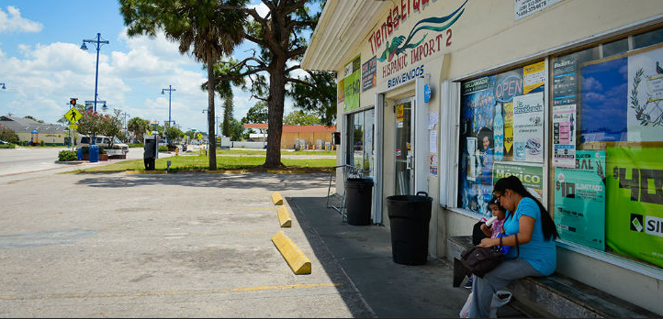
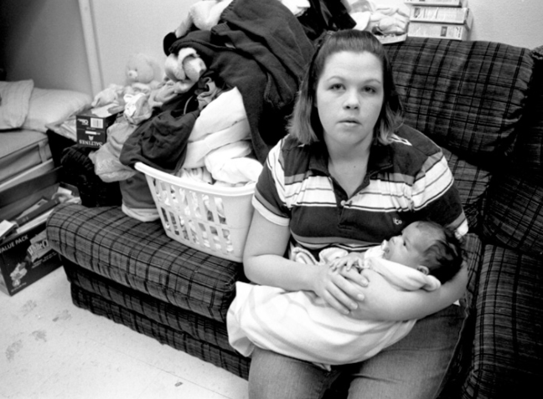
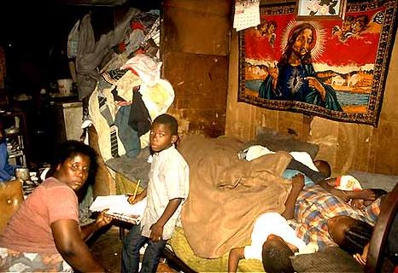
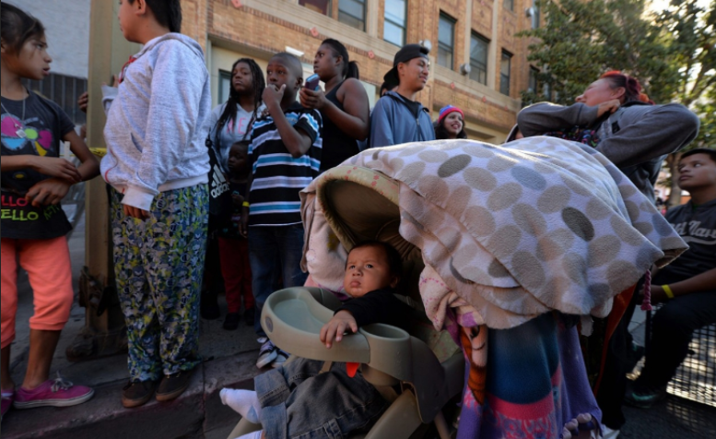
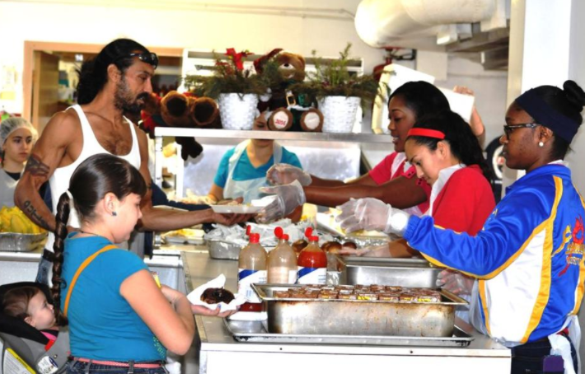
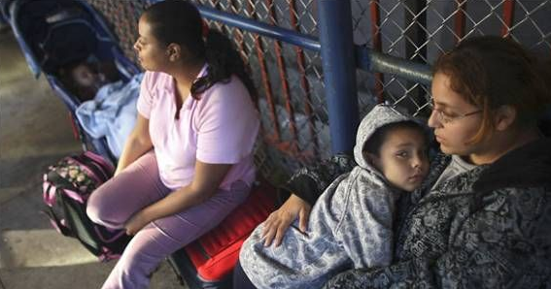
The Center for Disease Control (CDC) and the World Health Organization (WHO) have both emphasized the importance of taking into consideration the conditions in which people live, learn, work, and play when assessing health status. WHO frames the potential for these experiences to be health-damaging and is calling for society to look beyond the health sector when dealing with issues of health and disease
Council on Accreditation https://coanet.org/2018/07/understanding-the-impact-of-social-determinants-of-health/

Slide 4
At Sarasota Memorial….
…more than 50% of babies are born in to low income or poverty stricken families. Many of these babies start their lives at an immense disadvantage

Slide 5
But….
Just as communities can be a cause for poor SDOH, they can also be the catalyst for improving them and thus improving the community’s outcomes.
Council on Accreditation https://coanet.org/2018/07/understanding-the-impact-of-social-determinants-of-health/

Slide 6
Why address SDOH in the OBECC?
A huge number of pregnant women come for care through OBECCs.
The data shows that a large proportion of these women are in need.
Standardizing the assessment of SDOH in the OBECC will enable early identification of needs and allow ICM to assess and refer to community organizations that can help.
The projected outcome of this is for women to have healthier pregnancies and improved lives.

Slide 7
How will we address SDOH in the OBECC?
An interdisciplinary clinical team has developed a plan to address SDOH in the nursing documentation:
  with prompts for nursing
  default of previously recorded data between Triage to Admission History
  and trigger responses for automatic consults to ICM
The changes will occur in the OB ECC Triage Note and the OB Recurrent Patient Note and be shared within the OB Admission History. Go live is January 12th, 2022.
  Documentation within the OB ECC Triage Note, the OB Recurrent Patient Note and the OB Admission History will automatically generate a Consult to Integrated Case Management (ICM), UNLESS a consult has already been ordered for the Current Patient Visit. If the nurse assesses the patient to need another consult to ICM, this will be manually entered by the nurse. This documentation will also automatically populate ICM documentation and ICM will validate the information.

Slide 8
How will we address SDOH in the OBECC?...continued
For mothers with identified needs in the OBECC who are not being admitted, ICM will come see them in the OBECC before being discharged
For the Sarasota Hospital, mothers with identified needs who are being admitted, the W&C ICM team will see them during their admission in the hospital
For the Venice Hospital, the ICM team will follow admitted mothers

Slide 9
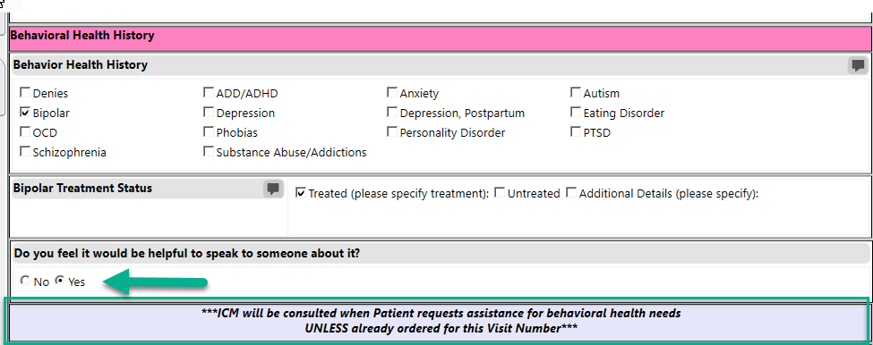
Behavioral Health History
ICM Consult will be automatically generated after document is saved if “Yes” is selected to “Do you feel it would be helpful to speak to someone about it?” UNLESS already ordered for this Visit Number.

Slide 10
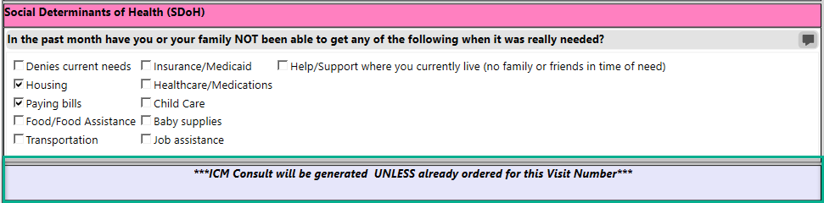
Social Determinants of Health
ICM Consult will be automatically generated after document is saved if any response is selected (except Denies current needs) to “In the past month have you or your family NOT been able to get any of the following when it was really needed?” UNLESS already ordered for this Visit Number.

Slide 11
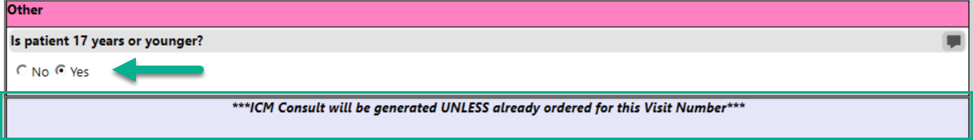
Other
ICM Consult will be automatically generated after document is saved if Yes is selected to “Is patient 17 years or younger?” UNLESS already ordered for this Visit Number.

Slide 12
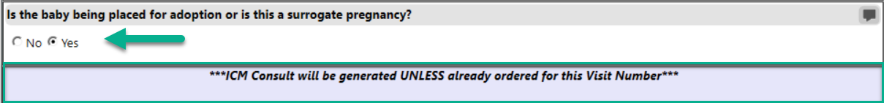
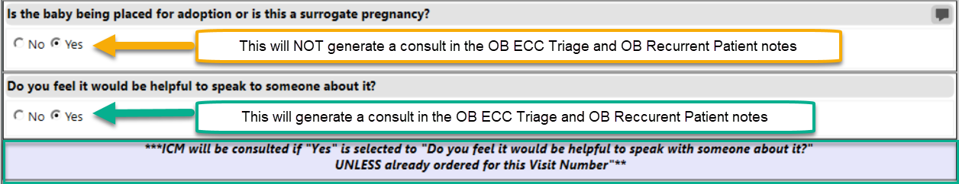
Adoption/Surrogacy – differences between OB Admission and OB ECC Triage Notes/OB Recurrent Patient Notes
OB Admission History Note
OB ECC Triage Note/OB Recurrent Patient Note
ICM Consult will be automatically generated after document is saved if Yes is selected to “Is the baby being placed for adoption or is this a surrogate pregnancy?” UNLESS already ordered for this Visit Number.
ICM Consult will be automatically generated after document is saved if Yes is selected to “Do you feel it would be helpful to speak to someone about it?” UNLESS already ordered for this Visit Number.

Slide 13
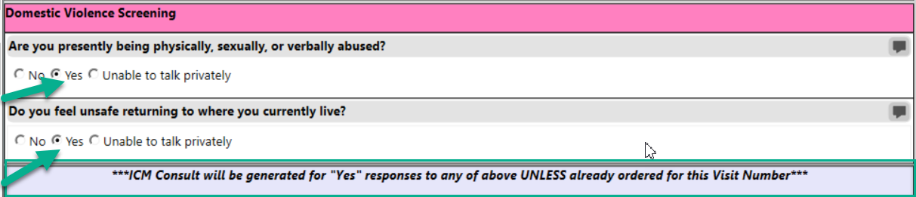
Domestic Violence Screening – NOTE CHANGES in how these questions are asked
ICM Consult will be automatically generated after document is saved if Yes is selected to “Are you presently being physically, sexually or verbally abused?” UNLESS already ordered for this Visit Number.
ICM Consult will be automatically generated after document is saved if Yes “Do you feel unsafe returning to where you currently live?” UNLESS already ordered for this Visit Number.

Slide 14
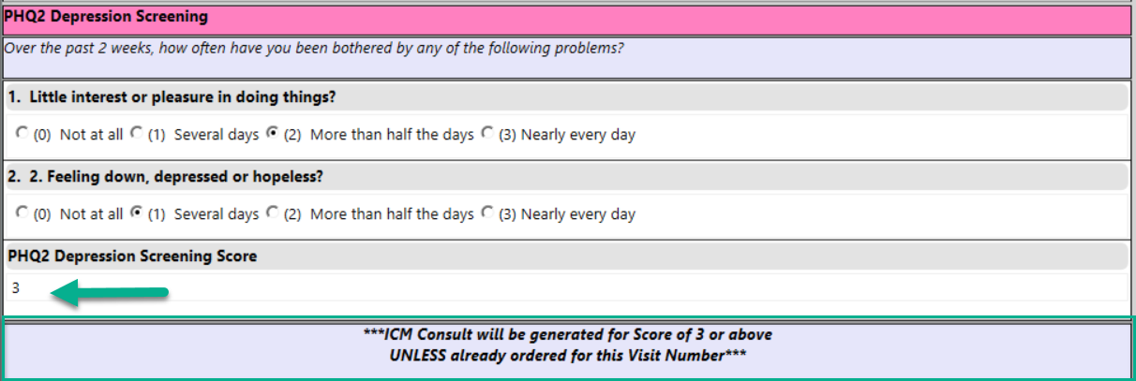
PHQ2 Depression Screening
ICM Consult will be automatically generated after document is saved if PHQ2 Depression Screening Score is “Equal to Greater Than 3” UNLESS already ordered for this Visit Number.

Slide 15
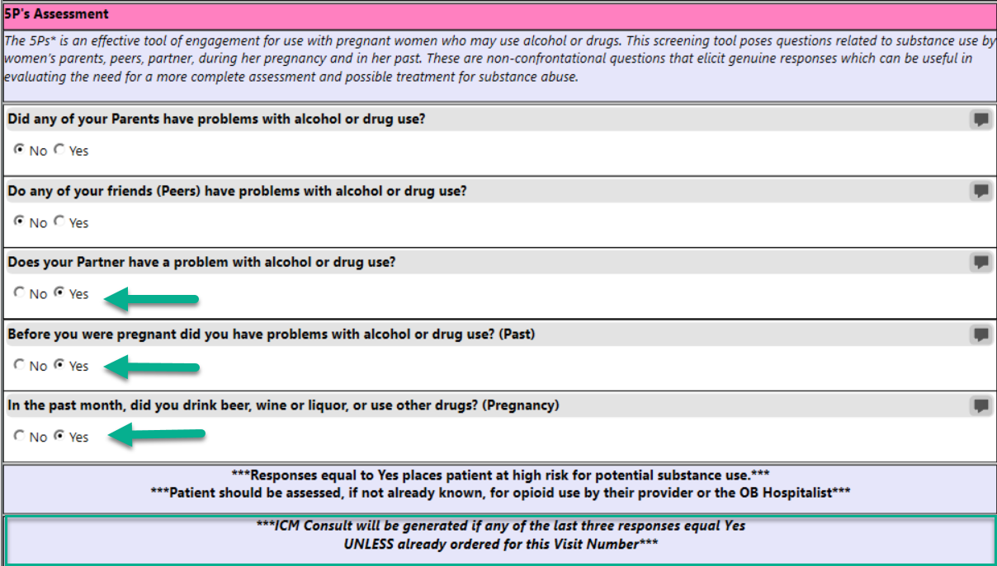
5 P’s Screening
ICM Consult will be automatically generated after document is saved if Yes is selected to “Does your partner have a problem with alcohol or drug use?” AND/OR
If Yes is selected to “Before you were pregnant did you have problems with alcohol or drug use (Past)?” AND/OR
If Yes is selected to “In the past month, did you drink beer, wine, liquor or use other drugs (Pregnancy)?”

Slide 16
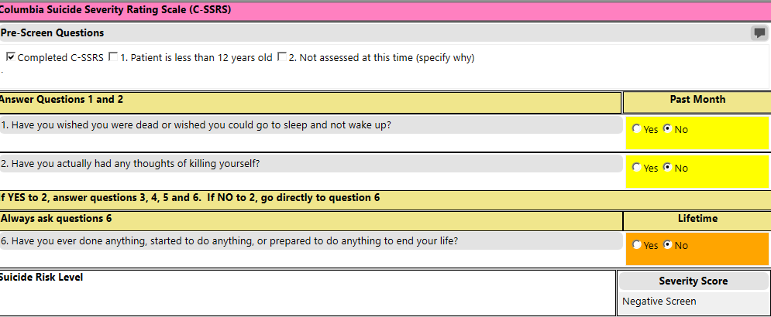
Columbia Suicide Severity Rating Scale (C-SSRS) – NEW SMH system-wide screening tool

Slide 17
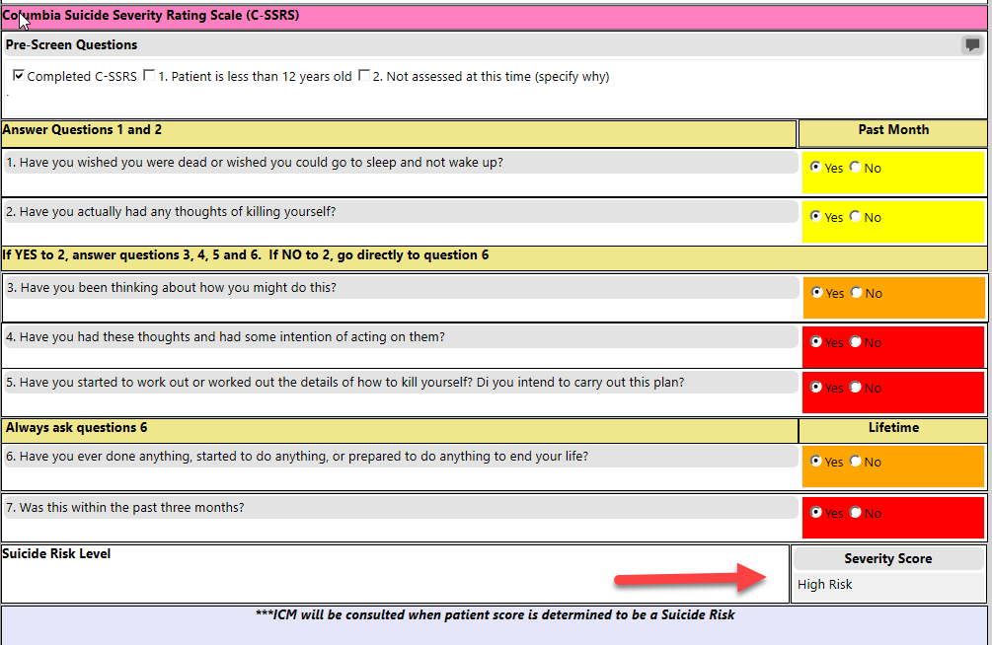
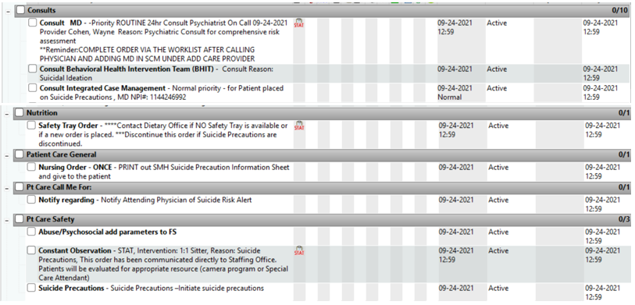
Columbia Suicide Severity Rating Scale (C-SSRS) – NEW SMH system-wide screening tool Continued…
If patient assessed to be High Risk, additional orders and consults will be generated based on hospital protocol.

Slide 18
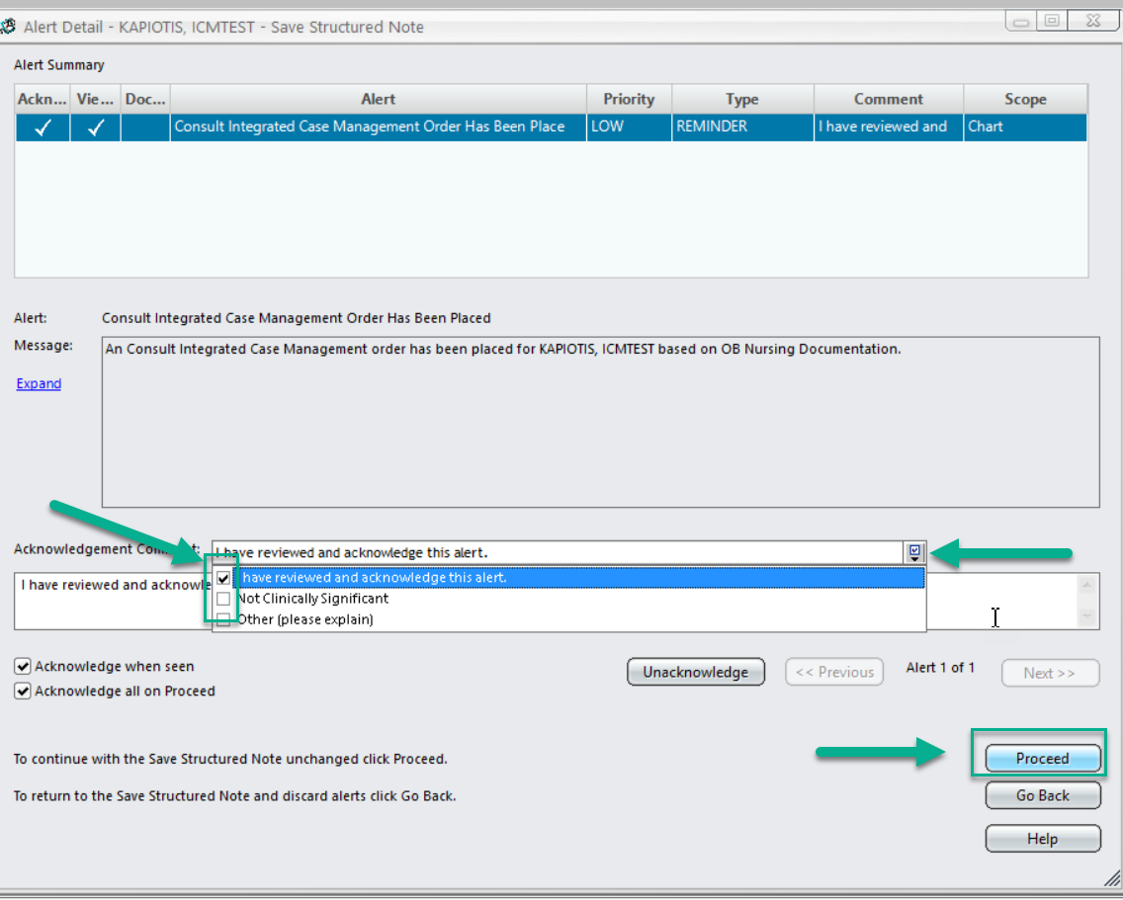
Automatic Ordering Process
Upon saving document with automatic ICM Consult orders, an Alert will display. This will be acknowledged and then proceed to save.

Slide 19
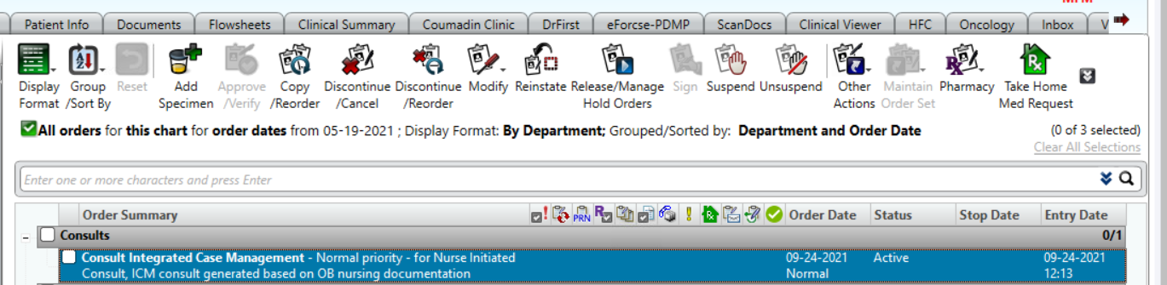
Automatic Ordering Process Continued…
The Integrated Case Manager updates the order to “Complete” once the patient has been evaluated. ICM Consult orders will NOT be automatically generated based on OB nursing documentation if an order is on the current patient visit. If the patient is assessed to have an additional/different ICM need, the order should be manually entered by the nurse.
The new Active Order will display on the Orders tab with text noting this was generated based on OB nursing documentation. The ICM Department will receive notification of the order.

Slide 20
Thank you for joining in this important work to ensure
SMHCS is not a wrong door for families in need

