Slide 1

Respectful Maternity and Family Centered Care

Slide 2
Objectives
Define Respectful Maternity Care (RMC)
Define Family Centered Care
Define cultural competence and cultural humility
Define mutual respect
  Differentiate between respectful and disrespectful care
Define shared decision making
Define accountability

Slide 3
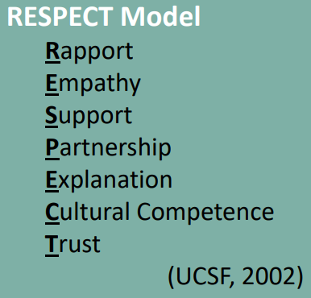
What is Respectful Maternity Care?
Respectful maternity care refers to care that:
Maintains dignity, privacy, and confidentiality
Ensures freedom from harm and mistreatment
Enables informed choice, self-determination, and respect for a patient’s preferences
Ensures access to continuous support during pregnancy, labor, childbirth and postpartum
Enables access to equitable maternity services including evidence-based care, a safe and inclusive physical environment, and necessary resources

Slide 4
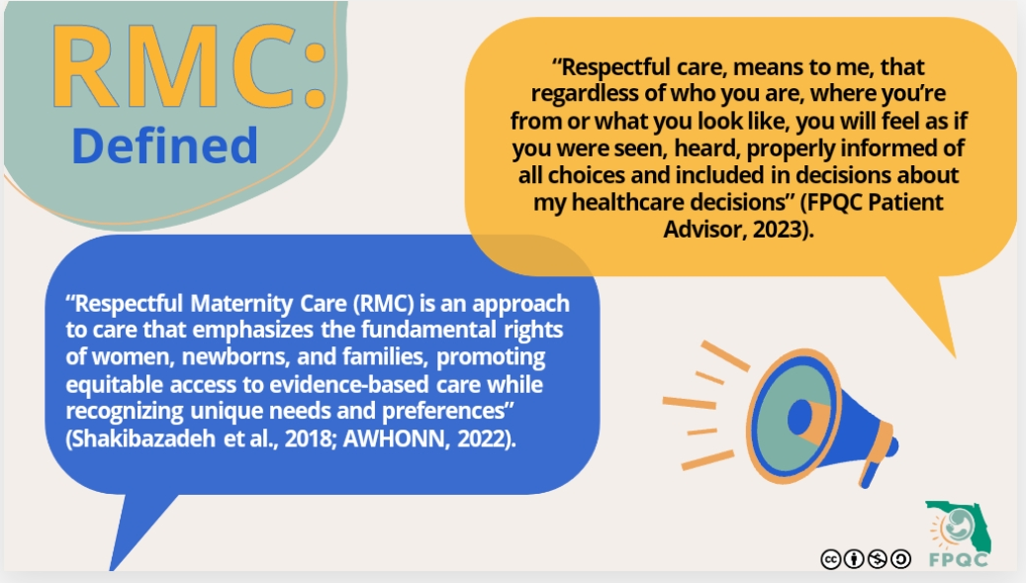

Slide 5
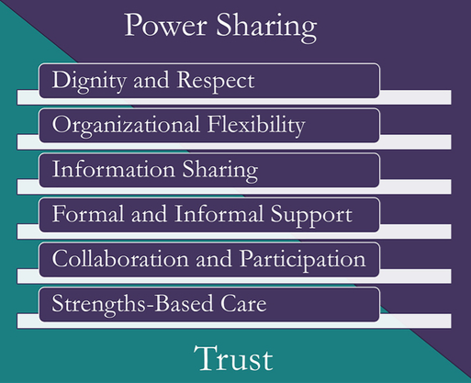
What is Respectful Family Centered Care?
Dignity and Respect
  Listening to and respecting children and families. Honoring racial, ethnic, cultural and socioeconomic background.
Organizational Flexibility
  Ensuring flexibility in organizational policies, procedures, and provider practices.
Information Sharing
  Sharing complete, honest, and unbiased information with patients and their families in ways they find useful and affirming, so that they may effectively participate in care and decision making.
Formal and Informal Support
  Providing and/or ensuring formal and informal support (example: peer to peer support) for the child and family.
Collaboration and Participation
  Collaborating with patients and families at all levels of health care: in the delivery of care to the individual child; in professional education, policy making, program development, implementation, and evaluation; and in healthcare facility design.
Strengths based care
  Recognizing and building on the strengths of individual children and families and empowering them.

Slide 6

Example of a respectful nurse/patient interaction

Slide 7
What are Cultural Competence and Cultural Humility?

Slide 8
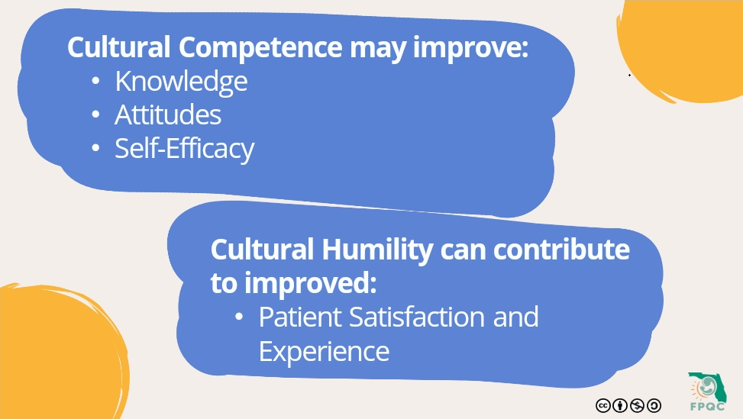

Slide 9
Cultural Humility includes the following except:
Lifelong learning
Know everything there is to know about all cultures
Self reflection
Accountibility

Slide 10
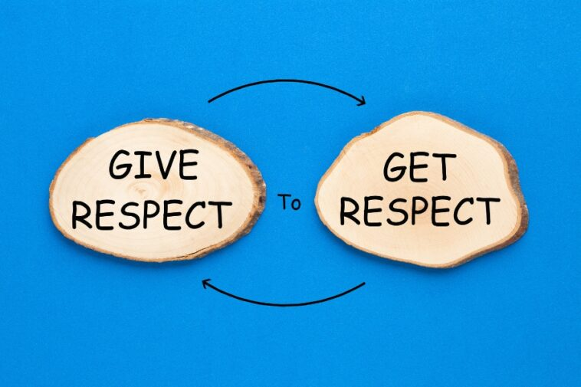
What is mutual respect?
Treating other people with dignity and recognizing their value
Having feelings of deep admiration for other people and their unique qualities
Accepting and having tolerance of other people’s differences

Slide 11
Examples of mutual respect
Actively listening to, acknowledge, and honor patient requests to the greatest extent possible. Avoid minimizing or discounting patients’ concerns and needs.
Use patient-centered communication techniques
Encourage patients to plan ahead for health care visits, by suggesting writing down questions and topics ahead of visits to promote patients empowerment and ensure that the patient’s voice is heard.

Slide 12
Drag to appropriate column
Respectful Behavior
Disrespectful Behavior
Actively Listening
Acknowledging
Encouraging
Asking the patient what they would like to be called
Shouting
Bullying
Tardiness
Swearing

Slide 13
Disrespectful behaviors
Disruptive behavior: Includes shouting, swearing, loud or inappropriate arguments, the use of force, and/or the threat of use of force, bullying, insensitive jokes or remarks, shaming and censuring staff in front of others.
Humiliating or demeaning treatment: Not as showy as flat-out disruptive behavior, but much more common, so perhaps even more insidious. Patterns of behavior such as ongoing humiliation or ignoring others.
Passive-aggressive behavior: Refusal to do tasks, deliberately delaying response to calls, and going out of the way to make others look bad while acting innocent.
Passive disrespect: Uncooperative behaviors that are not malevolent such as being chronically late to meetings, responding sluggishly to requests, and not working collaboratively with others. Resisting safe practices such as time-outs and decline to participate in improvement efforts.
Dismissive treatment of patients: Includes showing annoyance at being required to answer patient questions or conspicuously talking about a patient but never to them. Condescending behavior that makes patients feel unimportant and uninformed.

Slide 14
Shared Decision Making and Informed Consent
Discuss all available options with patients and support persons, including the ability to defer a decision when feasible and safe.
Provide high-quality, evidence-based information and care.
Confirm that full informed consent is obtained, or appropriate updating of informed consent is completed, for all interventions during all phases of care, including routine or repeated care.
  Ensure that consent or refusal of consent is documented
Use structured care plans to support patients in leading the decision-making process, whenever possible.
  Care plans can be based on birth plans created by patients
Use decision aids to help patients understand each decision to be made and the options that are available to them.
Provide continuous labor support by a member of the health care team throughout labor and birth.
Provide patients with support during and after the decision-making process.

Slide 15
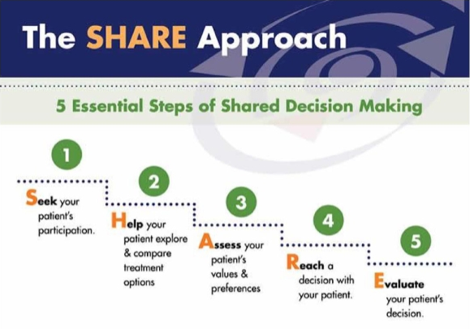

Slide 16
Barriers to Shared Decision Making
Providers
Patients
“It takes too much time”
“I know what is best for my patient”
“Patients seek my care for my experience and judgment”
Implicit or Explicit Bias
Trust in individual provider
Past experience with healthcare system
Lack of empowerment to participate in care
Fear of not being able to follow through/afford with the plan
Implicit or Explicit Bias

Slide 17
Accountability
Listen to Tim Cunningham, RN, DrPH, FAAN discuss the importance of accountability. (youtube.com)

Slide 18

Change can start with you!

Slide 19
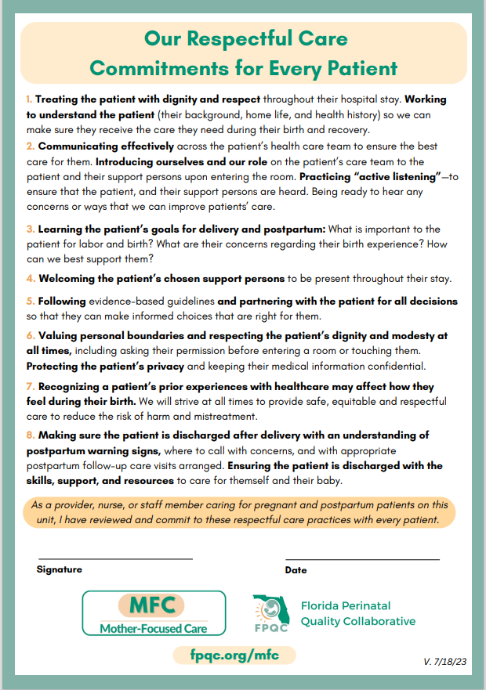
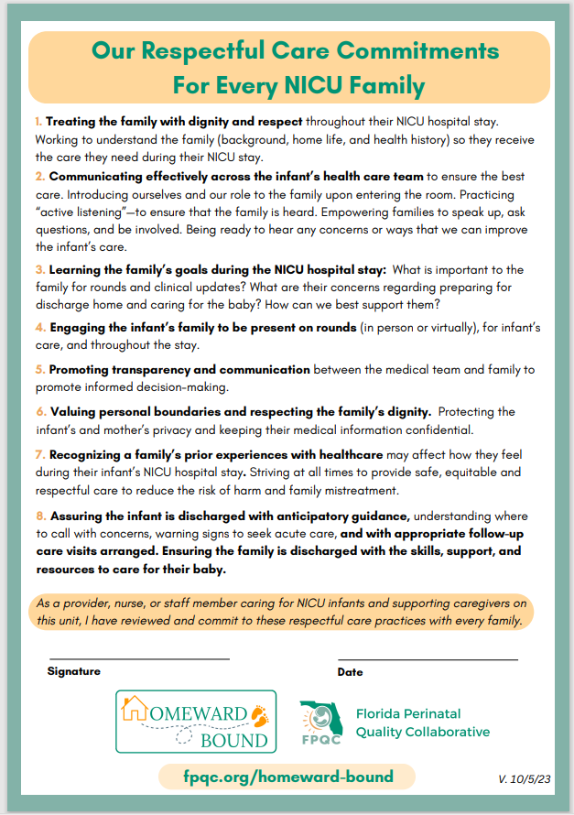
Commitment pledge for staff

Slide 20
I commit to providing respectful care to my patients and co-workers
Yes
No

Slide 21
References
AWHONN. (2023, July 15). Respectful maternity care implementation toolkit. https://www.awhonn.org/respectful-maternity-care-implementation-toolkit/
Building a culture of safety in healthcare, part one: Mutual respect. (2022). The Doctors Company | Medical Malpractice Insurance. https://www.thedoctors.com/the-doctors-advocate/third-quarter-2022/building-a-culture-of-safety-in-healthcare-part-one-mutual-respect/
First Follower: Leadership Lessons from Dancing Guy [Video]. (2010, February 11). YouTube. https://www.youtube.com/watch?v=fW8amMCVAJQ
Grissinger, M. (2015, August). A compelling call to action to establish a culture of respect. PubMed Central (PMC). https://www.ncbi.nlm.nih.gov/pmc/articles/PMC4517527/
Listen to Tim Cunningham, RN, DrPH, FAAN discuss the importance of accountability [Video]. (2022, January 21). YouTube. https://www.youtube.com/watch?v=IXWIAwwVXPA
Rose Horton Discusses Respectful Maternity Care [Video]. (2022, January 19). YouTube. https://www.youtube.com/watch?v=QETjSOP0zQw
What is Cultural Humility? [Video]. (2020, October 5). YouTube. https://www.youtube.com/watch?v=c_wOnJJEfxE

