Slide 1
PAIRED Plus Modules
Potentially Better Practices to Improve Family-Centered Care
Colby Day Richardson, MD
Notes:
Thank you for joining us to talk more about the PAIRED Plus modules as part of the overall PAIRED initiative. As we have mentioned already today, we hope that these PAIRED Plus modules will aid your centers in improving family centered care even beyond skin-to-skin care in your unit.

Slide 2
Disclosures
Members of Advisory Board for FPQC PAIRED Initiative
Notes:
The speakers during this presentation are members of the advisory board for the FPQC PAIRED Initiative but have no other relevant disclosures.

Slide 3
What is PAIRED Plus?
PAIRED Initiative → primary QI aim = skin to skin care
BUT Family Centered Care encompasses so much more!
Please see our toolkit for detailed information on change ideas, resources, and potential metrics!
Notes:
The primary aim of the PAIRED Initiative is focused on improvements in skin to skin care in the NICU as a benefit to patients, family caregivers, and the overall provision of family centered care. That being said, we recognize that family centered care as an actual culture in the NICU comprises far more than just skin to skin care. As a result, our Advisory Board and Family Advisory Council also researched a number of other topics which we felt would improve overall FCC.
Include quick introduction on the structure of this presentation.

Slide 4
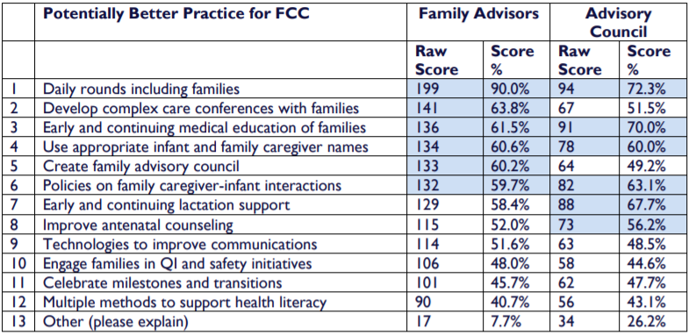
PAIRED Plus
Notes:
After several months of research and discussion, we came up with 12 potentially better practices to improve FCC and these were ranked by the Family Advisory Council and the Advisory Council to ascertain the most important areas of focus.

Slide 5
Agenda
Inclusion of families in daily rounds
    Elizabeth Simonton
Complex care conferences and early medical education
    Dr. Mitch Stern
Identifying infants and families by name
    Meredith Knapp
Notes:
Today we will hear from three of our advisory board members on specific PAIRED Plus modules that have resources, change ideas, metrics, and more available in the PAIRED toolkit. We have many more PAIRED Plus initiatives than these but wanted to introduce you to a few today.
Elizabeth Simonton will be speaking about the inclusion of families in daily rounds. Elizabeth is the CEO of ICU baby, the largest volunteer-based, nonprofit organization in Florida that supports families with a baby in the Neonatal Intensive Care Unit.
- Dr. Mitch Stern will be discussing the importance of complex care conferences and early medical education. Dr. Stern is a neonatologist and the Medical Director at HCA Florida University Hospital at Davie, the successor hospital to Plantation General Hospital. He was previously the Medical Director at Lawnwood Regional Medical Center and completed his neonatology fellowship at Columbia Presbyterian Hospital.
Meredith Knapp will discuss the importance of identifying infants and families by name. Meredith has practiced as an Occupational Therapist for 22 years with experience in acute, inpatient, outpatient, home and community settings. She is a Certified Neonatal Therapist (CNT), Neonatal Touch and Massage Therapist Certified (NTMTC), Certified Infant Massage Therapist CIMT) and Certified Brain Injury Specialist. She is currently owner and therapist for Essential Function Occupational Therapy.

Slide 6
PAIRED Plus
Notes:
Our first PAIRED Plus module discussed today will be the inclusion of families in daily rounds and will be presented by Beth Simonton.

Slide 7

Why is including families in daily rounds important?
Presented by:
Elizabeth Simonton
Notes:
- 5 minutes
- acknowledge there will be barriers
- this is an opportunity for health care providers
- regularity of rounds

Slide 8
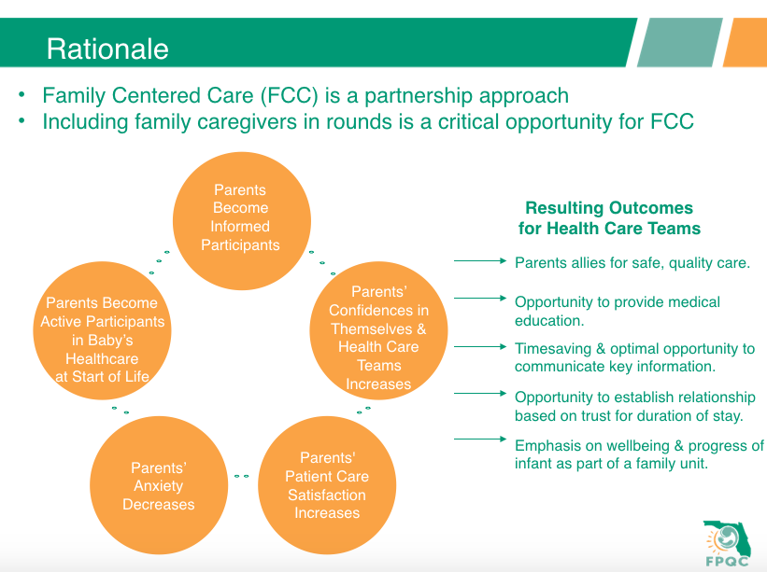
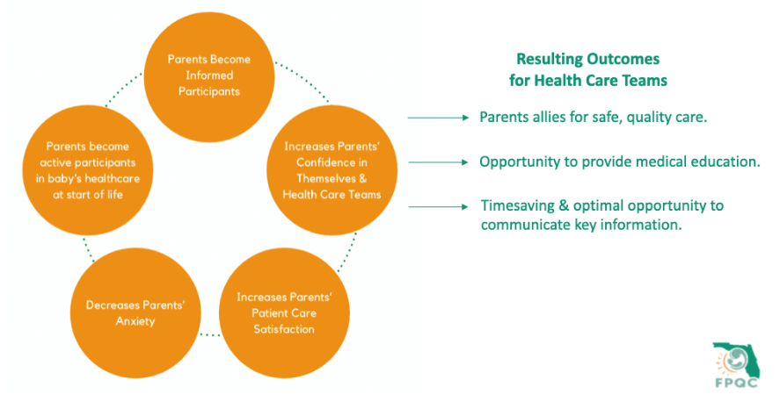
Rationale
Family Centered Care (FCC) is a partnership approach
Including family caregivers in rounds is a critical opportunity for FCC
Font is way to small, but cannot enlarge

Slide 9
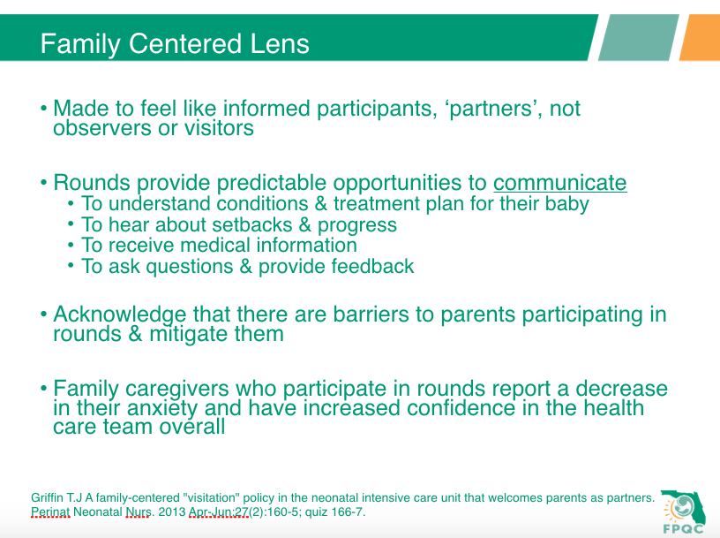
Family Centered Lens
Made to feel like informed participants, ‘partners’, not observers or visitors
Rounds provide predictable opportunities to communicate
  To understand conditions & treatment plan for their baby
  To hear about setbacks & progress
  To receive medical information
  To ask questions & provide feedback
Acknowledge that there are barriers to parents participating in rounds & mitigate them
Family caregivers who participate in rounds report a decrease in their anxiety and have increased confidence in the health care team overall
Griffin T.J A family-centered "visitation" policy in the neonatal intensive care unit that welcomes parents as partners. Perinat Neonatal Nurs. 2013 Apr-Jun;27(2):160-5; quiz 166-7.

Slide 10
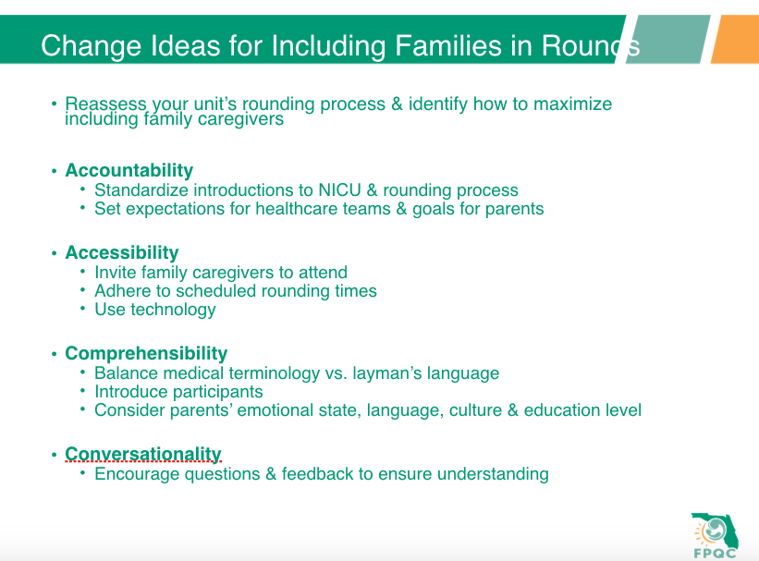
Change Ideas for Including Families in Rounds
Reassess your unit’s rounding process and maximize abilities
Accountability
  Standardize introductions to NICU & rounding process
  Set expectations for healthcare teams & goals for parents
Accessibility
  Invite family caregivers to attend
  Adhere to scheduled rounding times
  Use technology
Comprehensibility
  Balance medical terminology vs. layman’s language
  Introduce participants
  Consider parents’ emotional state, language, culture & education
Conversationality
  Encourage questions & feedback to ensure understanding

Slide 11
Change Ideas for Including Families in Rounds
Reassess your unit’s rounding process and maximize abilities
Accountability
  Standardize introductions to NICU & rounding process
  Set expectations for healthcare teams & goals for parents
Accessibility
  Invite family caregivers to attend
  Adhere to scheduled rounding times
  Use technology
Comprehensibility
  Balance medical terminology vs. layman’s language
  Introduce participants
  Consider parents’ emotional state, language, culture & education
Conversationality
  Encourage questions & feedback to ensure understanding
Be sure to check out our toolkit for resources and ideas on potential metrics to track!

Slide 12
PAIRED Plus
Notes:
Thank you Beth.
In this second presentation, we are focusing on complex care conferences and early medical education with Dr. Stern.

Slide 13
Why are complex care conferences and early medical education important?
Presented by:
Mitch Stern

Slide 14
Rationale
Stressors
Critically ill child
Job
Finances
Other children
Length of stay → a few days versus months
Communication = major factor in family’s experience and trust in the medical team
Butt ML, et al. An Integrative Review of Parent Satisfaction With Care Provided in the Neonatal Intensive Care Unit. J Obstet Gynecol Neonatal Nurs, 2013. 42 (1), 105-20.

Slide 15
Rationale
Transition from NICU to home is one of the biggest stressors during a NICU stay
Families are expected to suddenly take over complete care for their medically complex NICU graduates
Often medical teaching doesn’t occur until the END of a NICU stay
  This is stressful
  This is not in the best interest of the infant
  This is not family centered care
  This is a MISSED OPPORTUNITY
Goldstein LA. Family Support and Education. Physical & Occupational Therapy in Pediatrics. 2012

Slide 16
Rationale
Complex care conferences are a prime opportunity for improved communication
  Standardization can improve healthcare, family understanding, family satisfaction
  Family centered elements (empathetic statements, question-asking, emotional talk) positively impact family satisfaction
Quality improvement initiatives to standardize complex care conferences, especially in preterm infants and those with congenital anomalies, can improve overall family satisfaction
October TW, et al. Parent Satisfaction with Communication is associated with Physician Patient-centered Communication Patterns during Family Conferences. Pediatr Crit Care Med 2016; 17(6): 490-97.
Trujillo JA, et al. Interdisciplinary Family Conferences to Improve Patient Experience in the Neonatal Intensive Care Unit. Health & Social Work 2017; 42(4): 241-245.
Notes:
With long-term or complex NICU stays, there is often a need for formal, family care conferences. Some of these conferences may just involve the primary NICU medical team and the family, but often they require input from various other subspecialists or ancillary services in order to support the family in medical understanding, decision-making, and planning.

Slide 17
Family Centered Lens
Is this the right term for these ‘meetings’?
Who should be there? From the family? From the medical team? From a support perspective?
Who is ‘talking’? The medical team? The families?
When should these meetings occur?
Where should they occur?
Should information be presented in multiple formats? Verbal and written? What language is used – do families understand?
What follow up is available for families afterward? To review information, to ask further questions?
Notes:
But are we really focusing on family centered care with these conferences?

Slide 18
Family Centered Lens
Family caregivers have the right:
  To know who is providing medical care for their infant
  To know what patient support services are available
  To know what they can and cannot do when on the unit
  To be given information concerning diagnoses, treatment, alternatives, risks, and prognosis
  To express questions and concerns
Treatment plans should be developed through collaboration with the family caregiver and the healthcare provider

Slide 19
Milestones
Often, longitudinal communication and education can be organized as milestones to be achieved throughout a NICU stay
These milestones can take multiple creative forms to help guide parents in expectations and educational needs
  Roadmaps to home
  Milestone achievements
  Checklists of accomplishments
  Peer-to-peer education programs

Slide 20

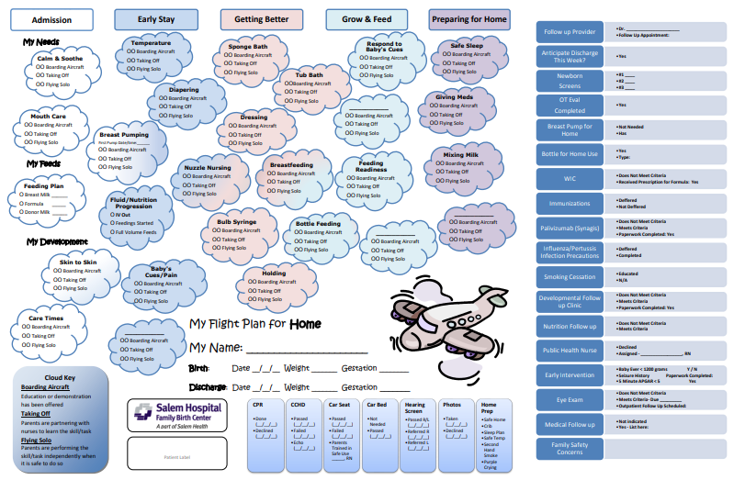
Sample Milestone Cards/Roadmap
Salem Flight Plan, credit Parent Action Committee at Salem Health. Adapted from University of Michigan
Milestone Cards, credit Inova Fair Oaks Hospital NICU

Slide 21
PAIRED Plus
Notes:
Thank you Dr. Stern.
Our final PAIRED Plus module discussed today will be on using infant and family names in interactions, discussed by Meredith Knapp.

Slide 22
Why is identifying infants and family caregivers by name important?
Presented by:
Meredith Knapp

Slide 23

Rationale
Family’s preferred name for infant should be used in all communications
  Avoid ‘your baby’, ‘baby boy/girl’, ‘twin A/B’
Why is this important??
Shows staff is familiar with infant and invested in infant’s care
Fosters bond between family caregivers and healthcare team

Slide 24
Family Centered Lens
To feel respected
To instill trust
Names are IMPORTANT
To feel recognized
To feel partnership

Slide 25
Change Ideas
NICU Process
  Standardized as part of the admission process
  Identify family’s preference for a name (both for infant and for family caregivers)
Materials
  Signs or placards
  Memory books with names
  Artwork
Training
  The importance
  The logistics

Slide 26
Change Ideas
NICU Process
  Standardized as part of the admission process
  Identify family’s preference for a name (both for infant and for family caregivers)
Materials
  Signs or placards
  Memory books with names
  Artwork
Training
  The importance
  The logistics
Be sure to check out our toolkit for resources and ideas on potential metrics to track!

Slide 27

See the PAIRED Toolkit for more ideas!
Notes:
Thank you Meredith.
Please see our PAIRED Toolkit for more information on these PAIRED Plus modules as well as many more resources. Thank you!

