Slide 1
Fetal Well-being Assessment
Monitoring and all that good stuff

Slide 2
Session Objectives
Review FPQC/CMQCC/ACOG/SMFM/AWHONN/ACNM recommendations on fetal monitoring/fetal heart rate concern
Review evidence for intermittent monitoring, intermittent auscultation
Review appropriate parameters for intermittent fetal heart rate auscultation.
Review the steps to Leopold’s maneuvers, practice performing them
Practice proper intermittent fetal heart rate auscultation procedure.
Review documentation of the results of intermittent fetal heart rate auscultation
Discuss appropriate patient teaching regarding intermittent fetal heart rate auscultation to patient and family
Review identification and management of category II tracings.

Slide 3
Background
CMQCC
Fetal heart monitoring is an essential part of monitoring the wellbeing of the fetus during labor to detect any abnormalities which may indicate intolerance of labor, so that interventions could be performed in a timely manner to prevent fetal or maternal injury or death
Intermittent Auscultation is the oldest method of fetal monitoring, having been utilized since the 1800s
Electronic Fetal Heart Monitoring developed in 1950’s
– 1970’s used nationwide in hospitals
– 1980 nearly 50% of all labors
– 1990’s 60-75% of all labors
– 2000’s 85% or more

Slide 4
The problem with EFM is...
Over use in low-risk women
Over reliance on a poor screening tool
99% false positive rate for predicting Cerebral Palsy
Low reliability (little consensus among interpreters) and low validity (poor detector of IP asphyxia)
Increased rate of interventions with significant increase in morbidity and mortality for women and babies
Can contribute to significantly more difficulty in legal cases second to interpretation disputes
  Only 50% of labors will have a completely normal strip throughout
Notes:
CEFM moved from a non evidence based diagnostic tool to a non-evidence based, poor screening tool. It has both poor validity (tool is poor detector of IP asphyxia) and poor reliability (little consensus among interpreters). Additionally it has very high false positive rate thus giving it very low specificity and high sensitivity when it is reactive. As we look at each method individually I will review the benefits and drawbacks to each method. The intra/interobserver reliability can further serve to increase medico-legal liability. Remember..only 50% of labors will show a completely normal FHR tracing throughout labor.

Slide 5
EFM versus Intermittent Auscultation
“There is evidence that the use of EFM increases the rate of cesarean deliveries and operative vaginal deliveries”
“limitations of EFM include poor inter-observer and intra-observer reliability, uncertain efficacy, and a high false-positive rate”
– ACOG Practice Bulletin 106

Slide 6
Evidence
In a Cochrane Analysis (13 RCT’s, n>37,000), researchers compared EFM to IA and found that EFM resulted in
Increased Cesarean
Increased Operative Vaginal Deliveries
No difference in perinatal mortality
No difference in Cerebral Palsy
No difference in Apgars <7 at 5 minutes
Alfirvic, Devane, Gyte, 2013

Slide 7
Intermittent auscultation for low-risk women is supported by the ACOG and noted by the ACNM to be the preferred method of monitoring for low-risk women. - CMQCC Toolkit

Slide 8
EFM versus Intermittent Auscultation
Intermittent Auscultation, for low risk women, is considered a safe alternative method
Promotes freedom of movement
Promotes hands-on nursing care (1:1 support)
Non-Invasive technique with comparable outcomes to those monitored with EFM

Slide 9
Intermittent Auscultation
“Given that the available data do not show a clear benefit for the use of EFM over IA, either option is acceptable in a patient without complications.” – ACOG
IA allows women more mobility, which in turn increases comfort and progress of labor. – ACNM
“A woman’s preferences and clinical presentation should guide selection of FHM techniques with consideration given to use of the least invasive methods.” – AWHONN
Follow AWHONN staffing guidelines 1:1 active and 2nd stage labor- AWHONN

Slide 10
Continuous Fetal Monitoring
Benefits
  Can identify early signs of developing hypoxia
  Allows closer monitoring of high risk patients
  Excellent predictor of a normally oxygenated fetus
  Records FHR and UCs simultaneously
Limitations
  High rate of false positives leading to increased interventions…C/S, etc… without better outcomes
  No agreement regarding timing of intervention
  Expensive
  Poor reliability/validity
}
Notes:
40% increase in C/S..per Cochrane review increase operative vaginal birth by 20%. Three of the Cochrane review asked women to evaluate EFM vs. IA. The women preferred IA because of the increase in labor support. Women want labor support.

Slide 11
Intermittent Auscultation
Benefits
  Evidence-based practice
  Lower rates of C/S, operative delivery and related morbidities/mortalities for mom and baby
  Increased mobility for mother…can ambulate, hydrotherapy, more comfortable
  Decrease use of analgesia/anesthesia
  Fosters more continuous labor support
  Focus on mother not machine
  Facilitates alternative birth positions

Slide 12
Intermittent Auscultation
Limitations
  Frequency of auscultation is lacking evidence but agreed upon
  Could miss an acute and sustained bradycardia (rare)
  Difficult to assess variability
  Periodicity of decelerations cannot be determined
  Attention to staffing matrix
  Requires unit education, commitment and support for sustained use
    In one study of a hospital who sig decreased their EFM usage had no change in nurses’ time spent providing labor support, not more labor intensive when factoring in time spent collecting and analyzing EFM, staffing costs not higher, but would be offset by sig improvement in outcomes and patient satisfaction
  No permanent record of FHR (could be good or bad)
Notes:
I want to speak to the notion of 1:1 nursing ratio. In one study of a hospital who sig decreased their EFM usage had no change in nurses’ time spent providing labor support, not more labor intensive when factoring in time spent collecting and analyzing EFM, staffing costs not higher, but would be offset by sig improvement in outcomes and patient satisfaction

Slide 13
Recommendations
ACNM, ACOG and AWHONN all have statements indicating that IA is an appropriate option for low risk laboring women, yet few women actually receive this option.
“Given that available data do not clearly support EFM over IA, either option is acceptable in a
patient without complications.” ACOG 2009

Slide 14
Ethical Principle
Autonomy…personal liberty and self determination
Beneficence…to do good
Nonmaleficence…to prevent harm
Justice…fair or equal treatment of individuals
Veracity…duty to tell the truth
Notes:
The question is…Is it ethical to use an intervention in the low risk labor which can increase risk to the woman and her baby without proven benefit without offering the mother informed consent?????? Are we advocating for our mom’s and baby’s. Is our own lack of knowledge, fear of litigation, distrust of the normal labor process interfering with our ability to advocate, employ these ethical principles and trust the method??? What is your value system? How does it impact your care?? Identify the ethical dilemma regarding FHR monitoring in labor. Are laboring women aware of their choices? Are they aware of the consequences? How do we resolve these dilemmas??

Slide 15
What to do?
Use fetal monitoring appropriately.
Intermittent auscultation should be the standard for low-risk women with reassuring fetal status upon admission in labor.
Agreed upon criteria for “low-risk” and the intrapartum risk factors which would require moving from IA to CEFM.
Agreed upon and consistent use of auscultation frequency.
Work towards standardization of EFM pattern identification and appropriate responses.

Slide 16
Who is a candidate for IA?
Low Risk Laboring patients
  Reassuring FHR tracing on admission
  Gestation 36 weeks or greater
  Vertex presentation
  Singleton pregnancies
  No Maternal/Fetal exclusionary factors per your department standard.
  No Intrapartum risk factors per your department standard

Slide 17
Reassuring Defined
Normal baseline rate and rhythm
Moderate variability 6-25 bpm
Absence of persistent (occurring more than 50% of the time) variable decelerations or late decelerations
20 minute strip
NOTE: Accelerations not required

Slide 18
Potential Maternal Exclusions
Any Hypertensive Disorders
Illicit Drug USe
GDM on insulin
VBAC
Cardiac Disease
Active infection

Slide 19
Potential Fetal Exclusions
IUGR
PPROM
Isoimmunization
Fetal Anomalies
Malpresentation
Multiple Gestation

Slide 20
Potential Intrapartum Exclusions
Pitocin
Epidural (not IV narcotic or Nitrous Oxide)
Magnesium
Thick Meconium
Frank Vaginal Bleeding
Maternal fever

Slide 21

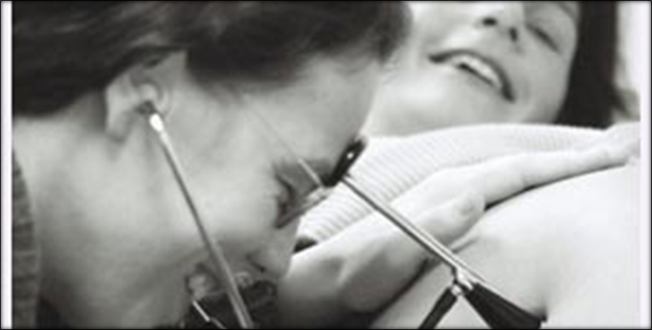
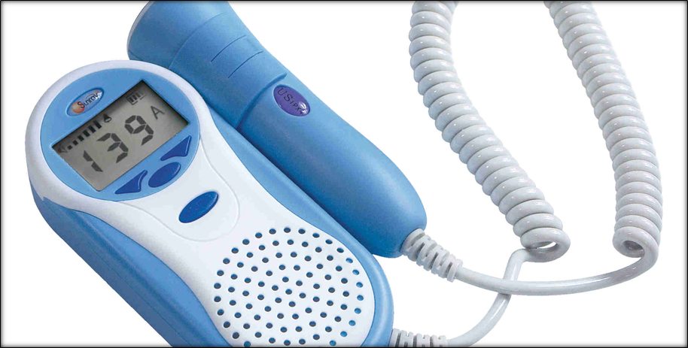
How is it done?

Slide 22
Technique for performing IA
Perform Leopold’s maneuvers to identify the fetal presentation and position.
Assist the laboring woman into a position that maximizes audibility and preserves comfort.
Assess frequency and duration of uterine contractions.
Determine the maternal pulse rate.
Place the fetoscope or Doppler over the fetal thorax or back.
Determine the baseline fetal heart rate by listening between contractions for 30 to 60 seconds and when the fetus is not moving. Verify maternal pulse rate if necessary.
Subsequently, count the fetal heart rate starting right after a contraction resolves.
Note increases (accelerations) or decreases (decelerations) from the baseline rate by counting and recording the fetal heart rate using a
multiple-count strategy agreed upon by practice protocol.
Notes:
In most of the studies, investigators used a multiple count strategy whereby the observer counted the FHR during several 5- to 15-second increments. An increase in the number obtained from each 5- or 15-second count in subsequent intervals indicated an acceleration; a decrease in the rate indicated a deceleration. If there is a question as to whether accelerations or decelerations have
been auscultated, continued auscultation during the course of a uterine contraction may provide clarification. The multiple count strategy is likely to be more accurate than a single-count
strategy

Slide 23
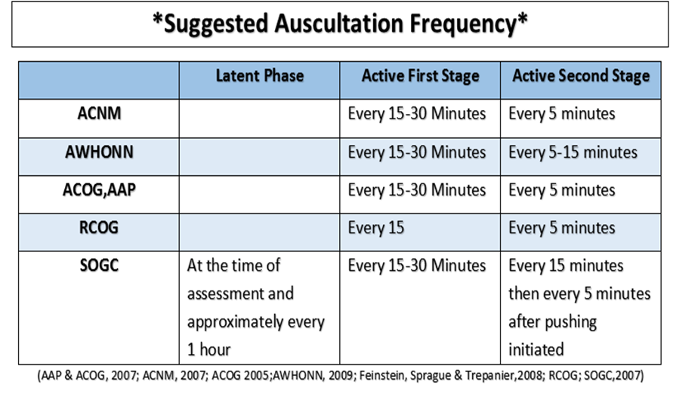

Slide 24
When to listen
Listen Before
  AROM
  Administration of narcotics
  Transfer or discharge
Listen After
  SROM/AROM
  Vaginal Exam
  Identification of abnormal contraction pattern
  Identification of abnormal vaginal bleeding

Slide 25
Where to listen
Walking
Standing
In the tub
In the shower
On the ball
On a chair
In a house
With a mouse….

Slide 26
Convert to Continuous EFM
Continuous monitoring if: IP risk factors
◦Frank bleeding not bloody show
◦Thick meconium
◦Maternal fever
◦Baseline bradycardia or tachycardia
◦Abnormal rhythm
◦Persistent decelerations after position changes
◦Uterine tachysystole noted
◦Acuity of unit
◦Severe persistent hypertension or hypotension
◦Desires Epidural
◦Augmentation with Pitocin
NOTE: May potentially convert back to IA

Slide 27
In case of non-reassuring FHT
Same as with EFM
  Increase auscultation
  Change to EFM until reassured
  Position change
  Fluid Bolus
  Oxygen
  Notify Provider
  Document

Slide 28
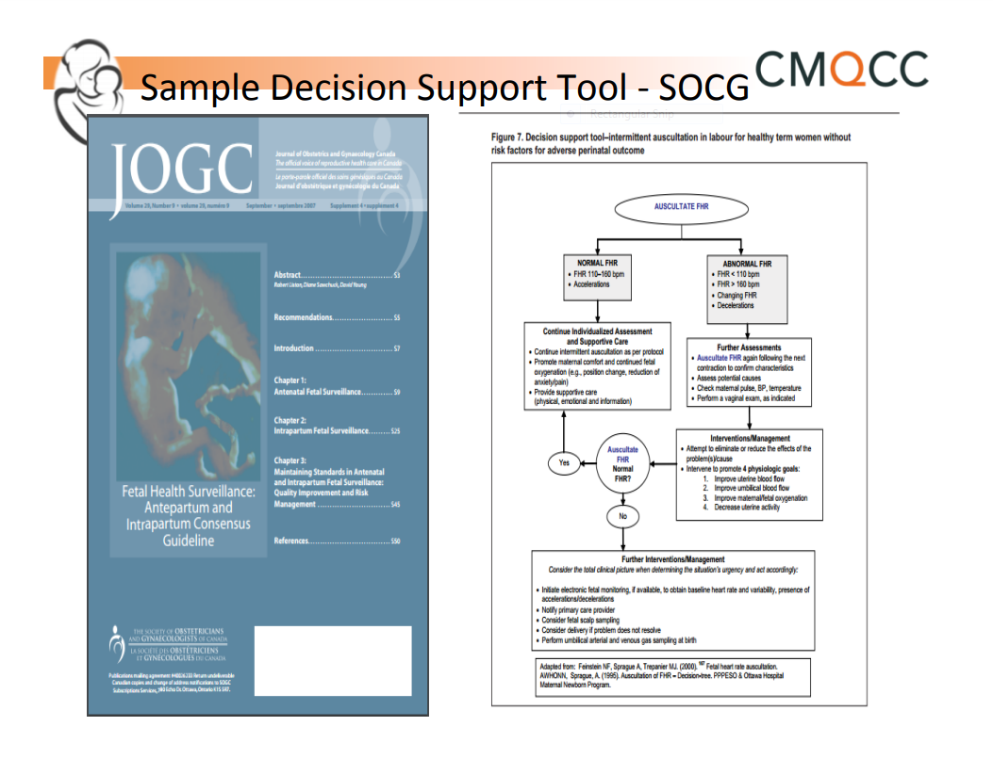

Slide 29
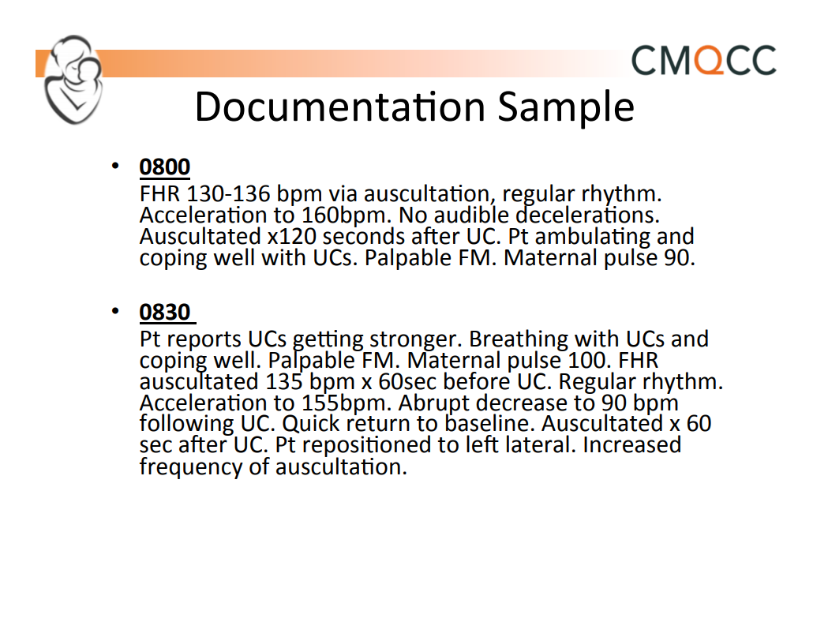

Slide 30


Slide 31
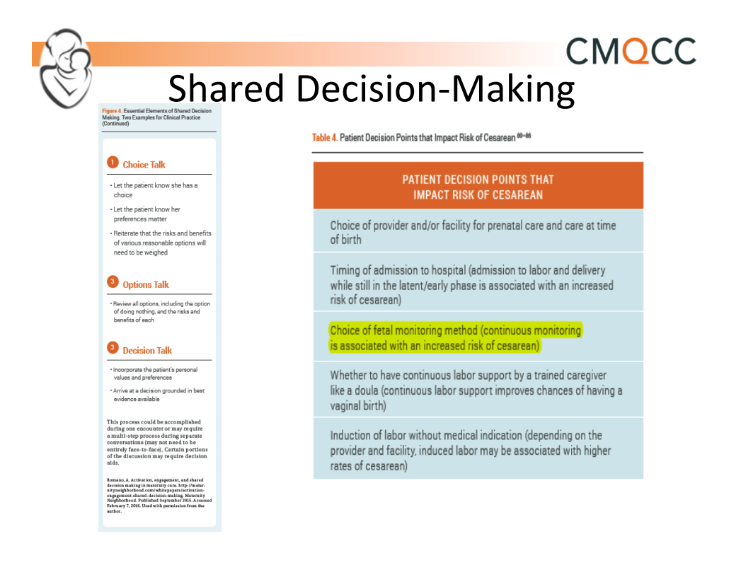

Slide 32


Slide 33
Leopolds
Step 1: The top of the uterus (fundus) is felt (palpated) to establish which end of the fetus (fetal
pole) is in the upper part of the uterus. If either the head or breech (buttocks) of the fetus are in
the fundus then the fetus is in vertical lie. Otherwise the fetus is most likely in transverse lie.
Step 2: Firm pressure is applied to the sides of the abdomen to establish the location of the spine and extremities (small parts).
Step 3: Using the thumb and fingers
of one hand the lower abdomen is grasped just above the
pubic symphysis to establish if the presenting part is engaged. If not engaged a movable body part will be felt. The presenting part is the part of the fetus that is felt to be in closest proximity to the birth canal.
Step 4: Facing the maternal feet the tips of the fingers of each hand are used to apply deep
pressure in the direction of the axis of the pelvic outlet. If the head presents, one hand is arrested sooner than the other by a rounded body (the cephalic prominence) while the other hand descends deeply into the pelvis. If the cephalic prominence is on the same side as the small parts, then the fetus is in vertex presentation. If the cephalic prominence is on the same side as the back, then the head is extended and the fetus is in face presentation
Assessing the Pregnant Abdomen
https://www.youtube.com/watch?v=nIog3oizP8A
Notes:
Can stop video at 5 minutes and 20 seconds.

Slide 34
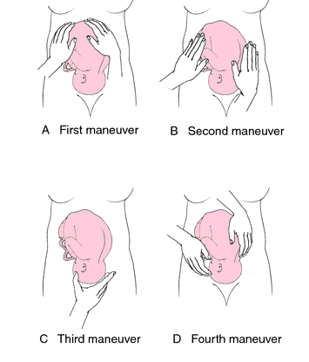

Slide 35
Audio Practice
Notes:
estimated time?

Slide 36
EFM Recommendations

Slide 37
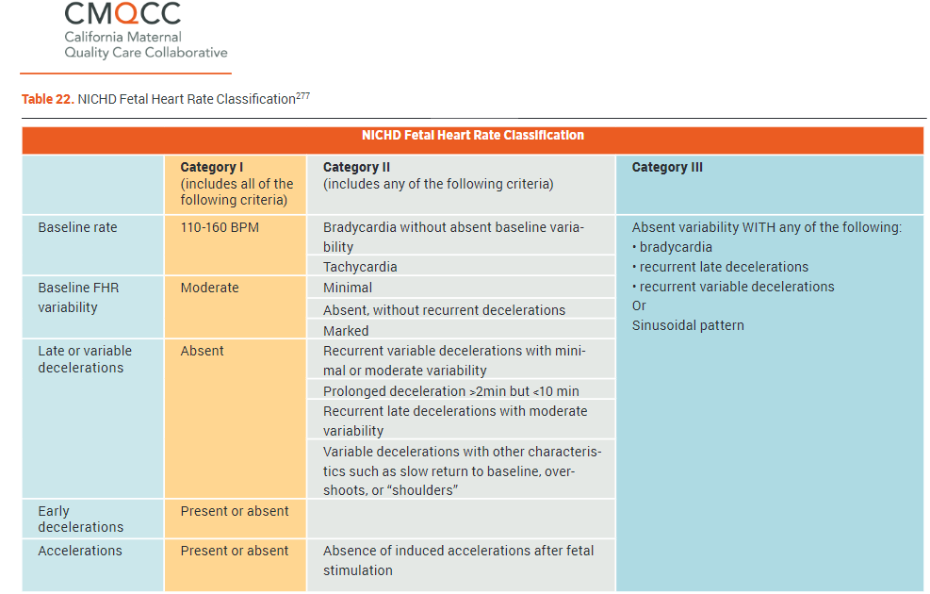
Notes:
MOst of you are likely familiar with the NICHD Fetal Heart Rate Classification Categories. This represents a professional effort to standardize Fetal Heart interpretation. As mentioned previously, one of the weakness of continuous fetal monitoring has been our lack of consistency in interpretation.

Slide 38
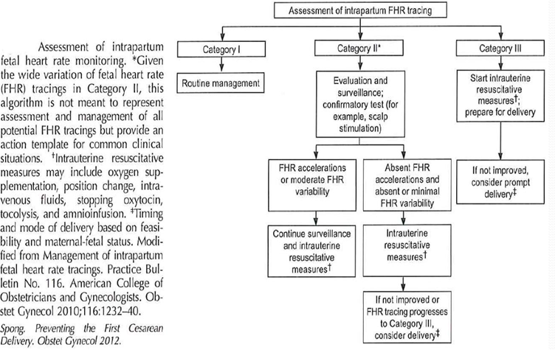
Management of FHR Tracings
Notes:
Once fetal heart interpretation is standardized, we can attempt to provide consistent guidance on the management of abnormal tracings.

Slide 39
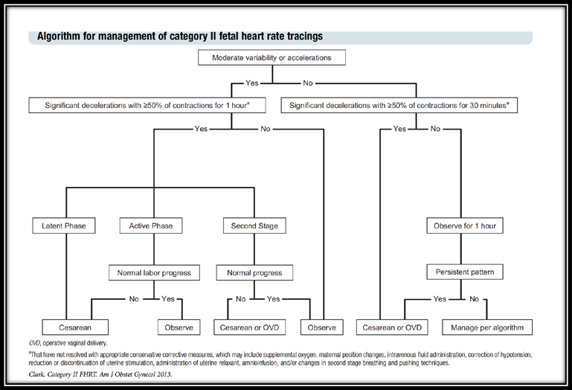
Clark’s Algorithm for Management of Cat II Tracings
Intrapartum management of category II fetal heart rate tracings: towards standardization of care

Slide 40
Professional Recommendations
AIM: “Use standardized methods in the assessment of the fetal heart rate status, including interpretation, documentation using NICHD terminology, and encourage methods that promote freedom of movement.”
ACOG: “A three tiered system for the categorization of FHR patterns is recommended.”

Slide 41
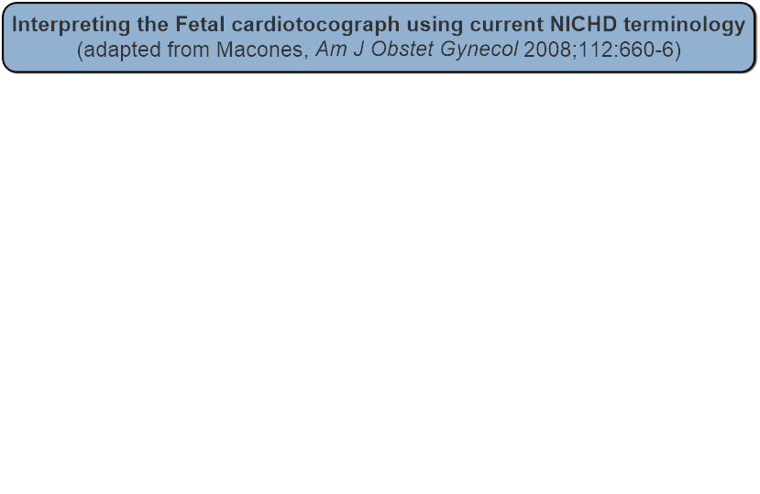
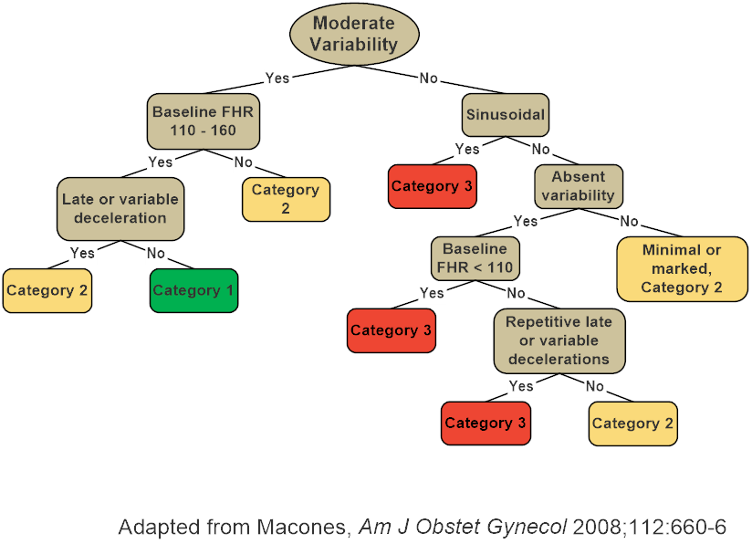

Slide 42

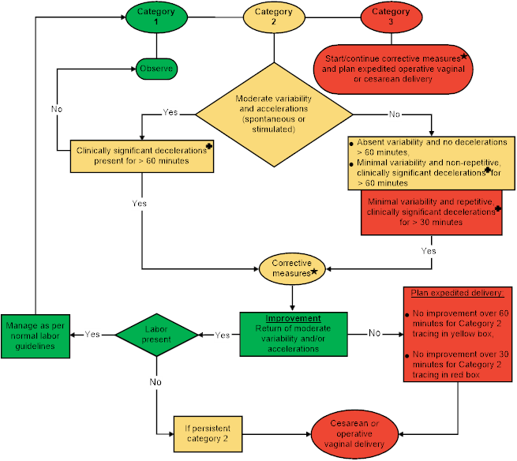

Slide 43
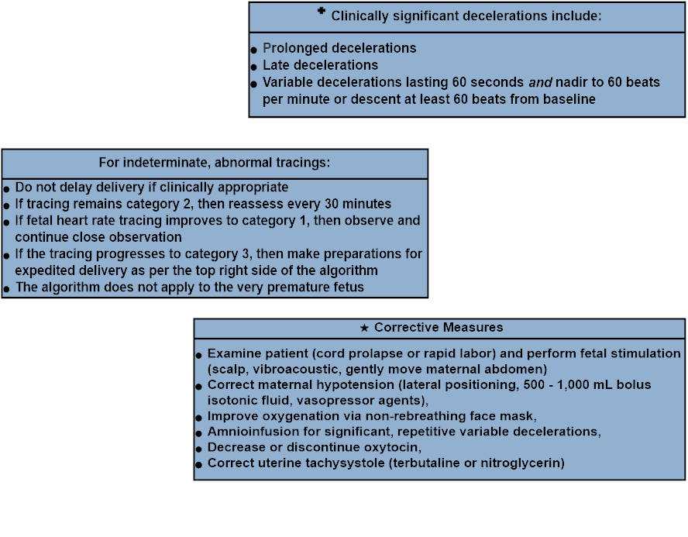

Slide 44
Category 2 Tracings:
If tracing remains category 2, then reassess every 15-30 minutes
If fetal heart rate tracing improves to category 1, then observe and continue close observation
If the tracing progresses to category 3, then make preparations for expedited delivery as per the top right side of the algorithm
Do not delay delivery if clinically appropriate
The algorithm does not apply to the very premature fetus

Slide 45
Corrective measures include:
Examine patient (cord prolapse or rapid labor)
Lateral positioning
Perform fetal stimulation (scalp, vibroacoustic, gently palpating maternal abdomen)
Correct maternal hypotension (lateral positioning, 500 - 1,000 mL bolus isotonic fluid, vasopressor agents)
Improve oxygenation via non-rebreathing face mask
Amnioinfusion for significant, repetitive variables
Correct uterine tachysystole (terbutaline or nitroglycerin)
Decrease or discontinue oxytocin
2nd Stage Labor: Consider pushing strategies (side lying, push every other contraction)

Slide 46
CMQCC’s resources
model policies

Slide 47
Patient Education

Slide 48
Patient Education
Evidence-Based Fetal Monitoring:
https://evidencebasedbirth.com/evidence-based-fetal-monitoring/
2. Continuous Electronic Fetal Monitoring in Labor: For Your Safety... But Is it Always Safe?:
http://www.givingbirthwithconfidence.org/p/bl/et/blogid=16&blogaid=1236
3. Electronic Fetal Monitoring:
http://www.givingbirthwithconfidence.org/p/bl/et/blogid=7&blogaid=1235

Slide 49
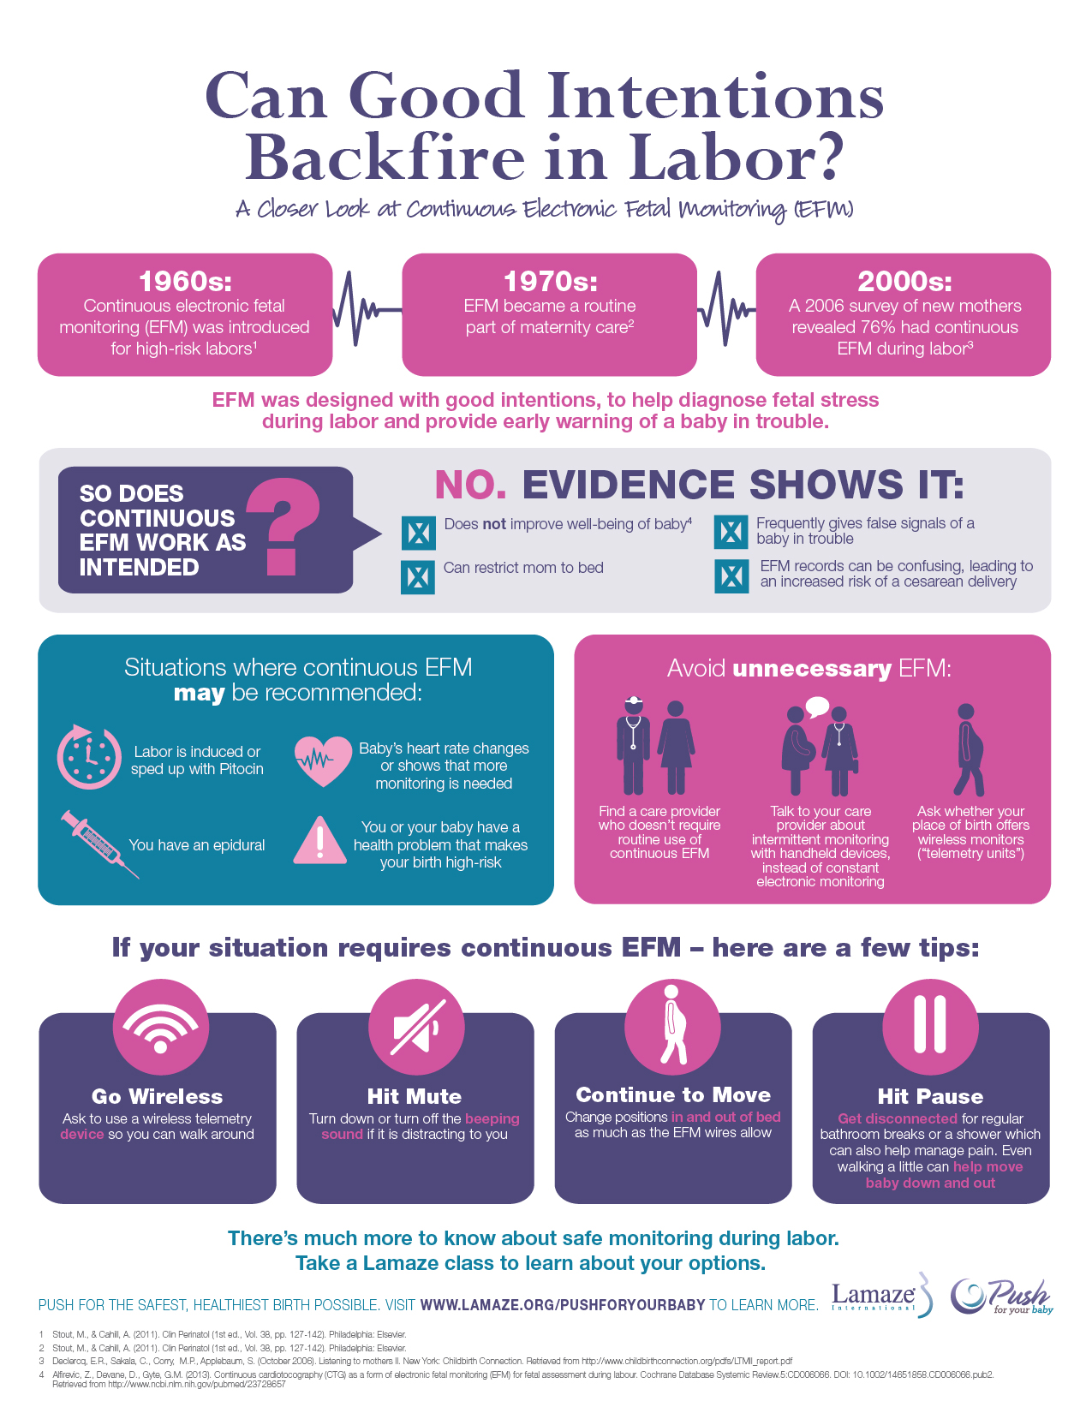

Slide 50
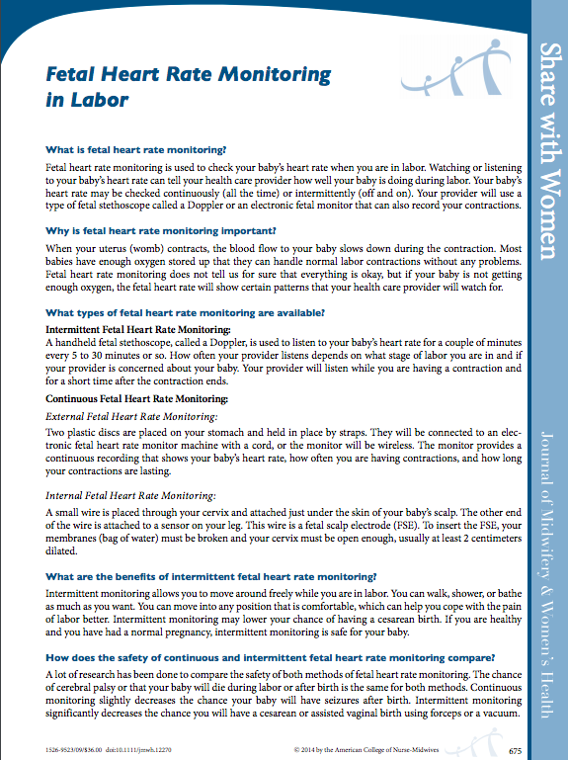

ACNM Share with Women

Slide 51
Take Home Points
Judicious use of interventions
Utilize Shared Decision Making
Standardize your language and interpretation.

