Slide 1
Supporting the VLBW Infant to Advance to Oral Feeds at the Breast –
Ivonne Hernandez PhD, RN, IBCLC
Kara del Valle, MD

Slide 2
Objectives
1. Identify signs of oral feeding readiness in VLBW infants.
2. Discuss current best practices to support transitioning to breastfeeding for VLBW infants.
Notes:
Content Outline:
Current evidence to support the physiology of oral feeding in the VLBW infant.
• Clinical Practices that support oral feeding for VLBW infants.
• Transition from gavage to oral feeding in the NICU
• Continued support to promote breastfeeding after discharge.

Slide 3
Breastfeeding: Why Try?
Done in cooperation with mothers wishes, ideally with the goal of baby breastfeeding after discharge
Enhances maternal/baby bonding
Makes mothers involvement obligatory, improving mothers chance of continued success of feeding baby at home

Slide 4
Breastfeeding: Why Try?
WHY NOT TRY?
Studies showing babies more physiologically stable on breast as compared to bottle
There are reliable techniques to position and monitor baby during latching
Test weights ensure a method to quantitate milk transfer
Systematic method of transitioning

Slide 5
Physiology of Oral feeding in the VLBW infant.
Readiness for oral feeding is in large part related to baby’s postmenstrual age
Oral feeding involves several aspects of baby's development
  Behavioral organization
  Rhythmic suck-swallow-breathe
  Cardiorespiratory regulation
Notes:
Kara ….

Slide 6
Behavioral Organization-
Quiet awake state ideal for oral feeding
28 weeks: sleep/awake states present, but not distinct and organized
32 weeks: full range from quiet sleep to awake with eyes open to crying, these behaviors are less robust and can be disorganized
Term equivalent: able to give clear hunger cues, better organized, awake

Slide 7
Feeding Readiness
SCORE | Description
1 | Alert or fussy prior to care. Rooting and/or hands to mouth. Good tone
2 | Alert once handled. Some rooting or takes pacifier. Adequate tone
3 | Briefly alert with care. No hunger cues (crying, rooting, suckling). Adequate tone
4 | Sleeping throughout care. No hunger cues. No change in tone.
5 | Significant HR, RR, O2 or work of breathing outside baseline

Slide 8
Suck-Swallow-Breathe
Nonnutritive suck: bursts of sucking followed by rest (no swallowing)
32-34 weeks: ability for suction and nipple compression, ability to move fluid back to the pharyngeal area/esophagus
Elevation of the palate and closure of larynx occur to protect airway
Nutritive suck is a slower, more effective suck than non-nutritive
35+ weeks: organization and strength of suck increases over time

Slide 9
Cardiorespiratory Regulation
Immature autonomic regulation in preterm infants leads to bradycardia and/or apnea during feeds
Regardless of feeding method preterm babies must be monitored closely when beginning oral feeds
Several studies have shown greater stability of HR, RR, O2, and less A/B during breastfeeding when compared to bottle feeding
(Meier, 1988; 1997) (Matthew& Bhatia, 1989) (Geddes et al., 2008;2009)
Notes:
Meier P. Bottle- and breastfeeding: effects of transcutaneous oxygen pressure and temperature in preterm infants. Nurs Res. 1988;37:36 – 41
Meier PP, Johnson TJ, Patel AL, Rossman B. Evidence-Based Methods That Promote Human Milk Feeding of Preterm Infants. Clinics in Perinatology 44(1):1-22.
Infants remain more physiologically stable during breast than bottle feeding because they can control the rate of milk flow when breastfeeding but only respond to it with the bottle feeding.

Slide 10
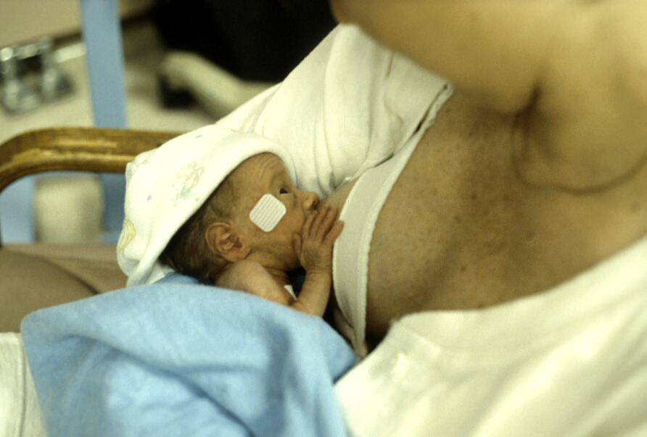
Non-Nutritive Suckling at the Breast

Slide 11
Non-Nutritive Suckling at the Breast
AKA “Dry Breastfeeding”
Used to transition infants to nutritive breastfeeding.
Is there an order needed for NNS at the breast?
Are infants that are NPO allowed to NNS at the breast?
Notes:
Here will show the initiative wide data on NNB “Non-nutritive Sucking at the Breast” The Breast is the original pacifier

Slide 12
Critical Time Points & Assessments
“Non-nutritive breastfeeding” (NNB) should be encouraged (if mother intends to breastfeed).
Established benefits of non-nutritive suckling
Mother should pump prior to holding her infant skin-to skin.
During skin-to-skin care, the infant should be allowed to suckle at the “emptied” breast.
NNB can be done before, during or after gavage feeding.
Pumping after NNB can provide added stimulation and boost milk supply

Slide 13
Transition from gavage to oral feeding in the NICU
Current insufficient evidence provides no basis for recommendations for a tube alone approach to supplementing breast feeds.
Evidence of low to moderate quality suggests that supplementing breast feeds by cup increases the extent and duration of breast feeding.
Collins CT, Gillis J, McPhee AJ, Suganuma H, Makrides M. 2016. Avoidance of bottles during the establishment of breast feeds in preterm infants. The Cochrane database of systematic reviews 10:CD005252
We need further research!

Slide 14
Transition to Breast
Non-Nutritive to Nutritive Breastfeeding
Attempt oral feedings at breast prior to routine use of bottles.
Supporting direct breastfeeding as advancing oral feeding attempts.
  Nurses should coordinate breastfeeding attempts
Teach mothers infant feeding cues and promote breastfeeding on cue, as mother is available and infant is able.
Notes:
WHICH NICUS REQUIRE A BOTTLE FEEDING ATTEMPT PRIOR TO ALLOWING BREASTFEEDING?
Bottle vs breast first feedings. Assessment of vitals nurses role and LC. Meier said if babies are on Oxygen if they need
Nurses should coordinate breastfeeding attempts with mother as tolerated by the infant.
Attempt oral feedings at the breast prior to routine introduction of bottles.
Teach mothers infant feeding cues and promote breastfeeding on cue, as mother is available and infant is able.

Slide 15
Transition to Breast
Nipple shields compensate for poor sucking and sustains latch and increases milk transfer.
  Weaning nipple shield may occur post discharge.
Training staff on appropriate use
  Access to shields for staff nurse not dependent on LC
Create Nipple Shield Guidelines
  Invert nipple shield to place over nipple
  Nipple should pull into shield
  Nipple shields should be accessible to nursing staff in various sizes.
  Washed after every feeding like pump parts.
Notes:
Who has nipple shields in their NICU PYXIS FOR NICU STAFF NURSES TO USE AS NEEDED?
Positive reinforcement of milk in the teat, nipple shield.
Suction pressures are critical for removing milk from the breast but not from the bottle. Milk tx to infant during suction when breastfeeding and likely during expression when bottle feeding.
Lau et al 2000; Suction pressures are maturationally dependent reaching values that are critical to effective and efficient

Slide 16
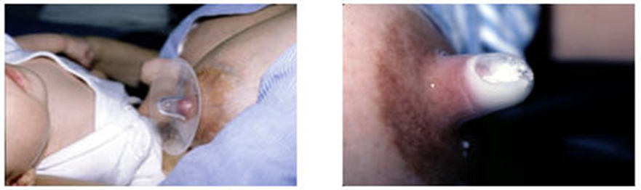
Nipple Shields
Various sizes 16 mm, 20 mm and 24 mm.
Clay, B. W. (2012). Medela. Retrieved September 6, 2012, from Nipple Shields: http://www.medelabreastfeedingus.com/tips-and-solutions/112/nipple-shields

Slide 17


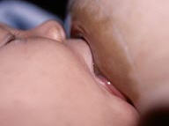
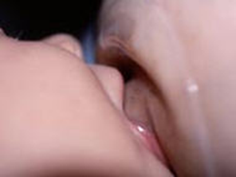
Nipple Shields
Clay, B. W. (2012). Medela. Retrieved September 6, 2012, from Nipple Shields: http://www.medelabreastfeedingus.com/tips-and-solutions/112/nipple-shields
Notes:
Positive reinforcement of milk in the teat, nipple shield. Describe latching with wide open gape and to entire shield not just the tip.. Lips should be flanged and touching the breast. Shield shouldn’t pop in and out and you shouldn’t see nipple
Used until all feedings are at breast…
Assists the infant is sustaining active feeding at the breast, increase milk transfer with less energy expenditure for infant.
BRNS resource until your staff is trained…

Slide 18
Transition to Breast
Positions cross cradle and football hold
  Head and neck support
  Boppy or pillows for support
  Use of breast compression for stimulation
  Time of active feeding
    20-30 minutes
    Use of test weight to verify if need for supplementation and effectiveness of feeding.
    Use this information to advance po feeding attempts.
  Lactation consult as needed to assist

Slide 19
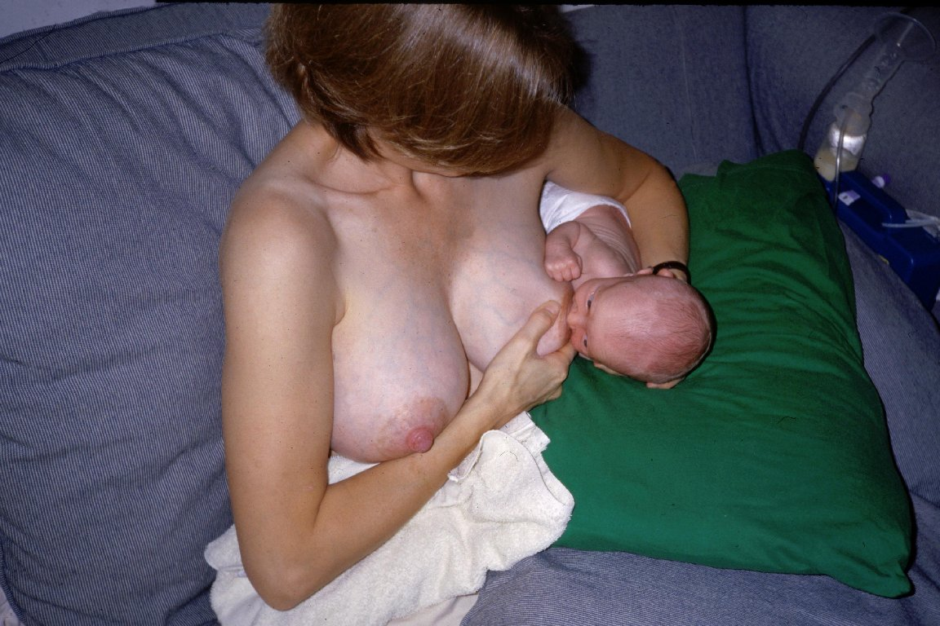
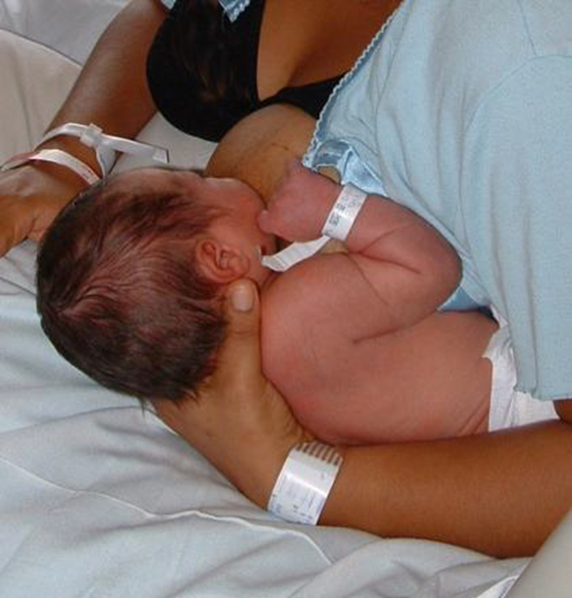
Football Hold
Notes:
Mother can view infant and has free hand for breast compression to assist in sustaining active feeding.

Slide 20
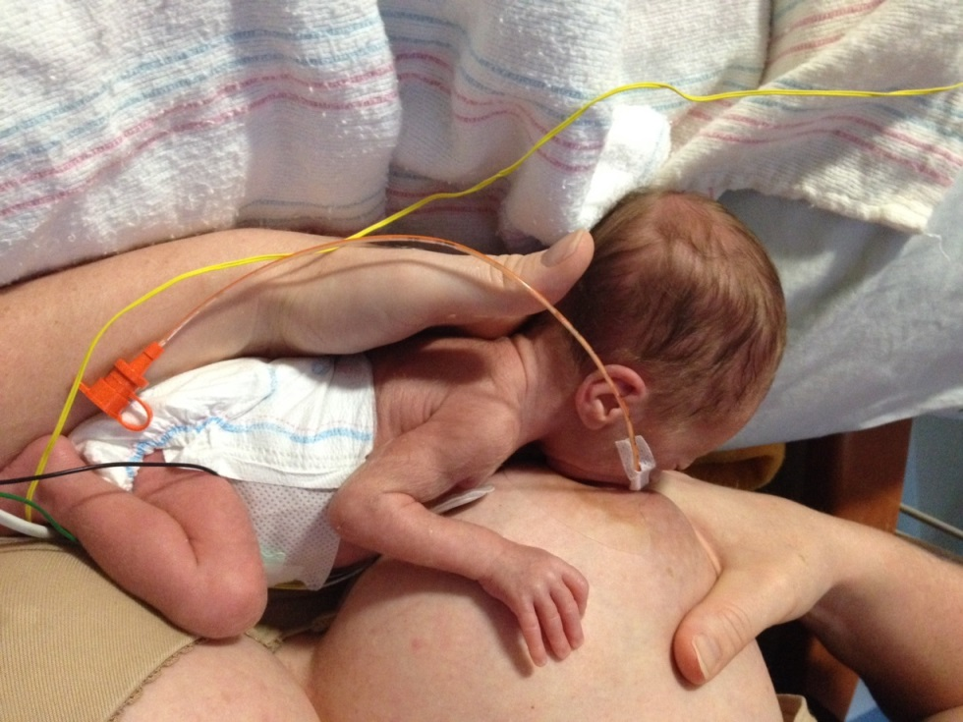
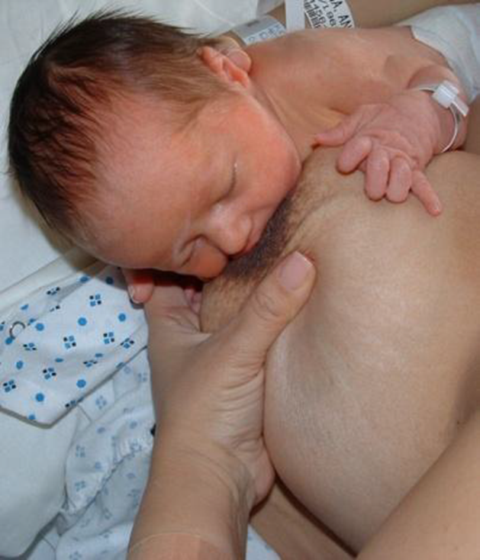
Cross Cradle Hold
Notes:
Similar to football but across, may seem more like cradle hold for mothers while providing support for head and neck.
Free hand for compression to increase active feeding at breast.

Slide 21
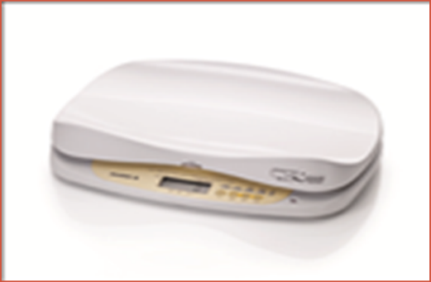
Measuring Milk Transfer
Use scale that is accurate up to 2 grams difference.
Test weights can be used to answer the following questions:
  What volume of MOM transferred
  How much should I decrease the tube feeding?
  Should any supplement be given?
  Can we increase the number of times/day baby goes to breast?
Prevents weight loss & Increases maternal confidence in BF
Notes:
How many NICUs are using tests weights?
if infant actively sucks less than 5 minutes; give full gavage feeding, for 5-15 minutes; give 1/2 of feeding, for > 15 minutes; give no supplement
(Hurst, Meier, & Engstrom, 2004) Random assignement to in home measurement of milk intake for infant needs.

Slide 22
Measuring Milk Transfer
Costs of infant scales for measuring milk transfer during breastfeeding session
Average cost of scale $1500 per scale
Expert recommendations
  1 scale per 15 infants for NICU stay
  Estimates $3.89 vs $6.48 per infant (3-5 years)
  Based on average length of stay for VLBW infants of 71 days from RUMC data using 2015$
  Meier, P, Johnson, T, Patel, A.L., & Rossman, B. (2017). Evidence-Based Methods that promote human milk feedings of preterm infants. Clinical Perinatology, 44 (1), 1-22.

Slide 23
Measuring Milk Transfer
Guidelines
Consider increasing number of times/day baby goes to breast if baby reached >75% of calculated feeding target volume
If <75 % of calculated feeding volume, give supplement
If > 75% of calculated feeding volume, skip supplement unless baby shows cues that indicate ongoing hunger.
https://health.ucsd.edu/specialties/obgyn/maternity/newborn/nicu/spin/staff/Pages/policies.aspx
Notes:
if infant actively sucks less than 5 minutes; give full gavage feeding, for 5-15 minutes; give 1/2 of feeding, for > 15 minutes; give no supplement

Slide 24
Measuring Milk Transfer
Stop doing test weights when baby has had several feedings of 90% calculated need.
Make sure you are teaching mom that this is not to PROVE her breastfeeding adequacy, but rather to make sure we don’t overfeed or do more than baby needs for us to do for him
Encourage mother to room in for serial feedings to allow for infant feeding on cue as infant is able in preparation for discharge home.
Notes:
if infant actively sucks less than 5 minutes; give full gavage feeding, for 5-15 minutes; give 1/2 of feeding, for > 15 minutes; give no supplement

Slide 25
Supporting Premature Infant Nutrition (SPIN)
Example of a policy:
Feeding Progression in the ISCC: Individualized Enteral Advancement Table (iEAT) & Infant Driven Feeding (IDF)
https://health.ucsd.edu/specialties/obgyn/maternity/newborn/nicu/spin/staff/Documents/SPIN_feedingprogressionintheiscc709.doc

Slide 26
Assessment of First Oral Feedings
Individualized approach
VS, Oxygenation, A/Bs, s/s of stress and disorganization.
Amount of MOM transferred
Infant’s feeding skills will mature at their own pace & affected by severity of illness.
  Extremely premature infants or those with higher degree of morbidity will take longer to transition to full oral feedings.
  (Jones, 2012)

Slide 27
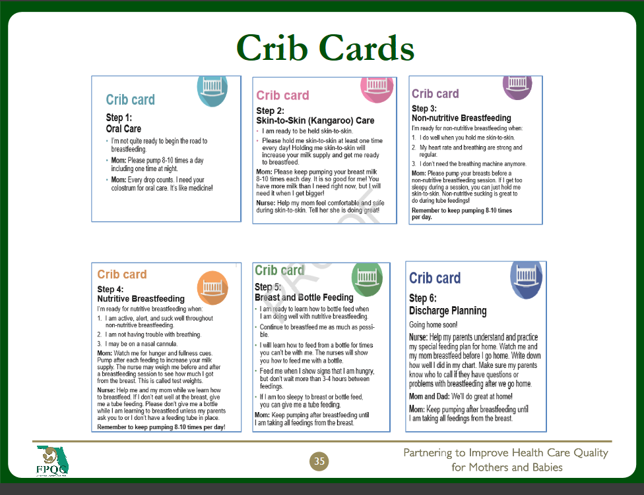

Slide 28
Supporting Direct Feedings at the Breast
The preterm infant may not consume sufficient volume to remove lipid rich hind milk
  Infant does not drain the breast effectively to remove lipid rich hind milk.
  Identify slow weight gain when consuming adequate volume of MOM from the breast
Provide supplements of pumped MOM that consists of fractionated hind milk, as needed.
  Test weights, crematocrit/ fractionate MOM
Notes:
Inquire from NICUs present how many have test weights? How many have crematocrits
Expect low response.
Add assessment for first oral feeding.
• If mother’s supply is >40 ml she may use one of several techniques to reduce the amount of flow and supply to the early breastfeeding infant which include:
o Pumping 1/2 of her milk out just prior to positioning baby at breast. If this technique is used, mother will need to pump remainder of milk out within 15 minutes of the breastfeeding session
o Schedule pumping to be 1-2 hours prior to positioning baby at breast. If this technique is used, mother will need to pump at her regular 3-hour interval
o If milk supply is ample and mother is never empty, baby may go to breast directly after mother has pumped and she can continue her regular pumping schedule

Slide 29
Supporting Direct Feedings at Breast
Indications for Fractionation of MOM
  Large producer >700 ml
  Poor weight gain
What is mom’s 24 hr pumped volume & frequency of pumping and amount per session?
What is infant’s 24 hour milk supply need?
Use Fresh Milk
Fore milk collected in the first 2-3 minutes post let down.
Notes:
*Foremilk collected in the first 2-3 minutes post let down. Adapted from Valentine, Hurst, Schanler. 1994. J Pediatric Gastroenterology & Nutrition

Slide 30
Supporting Direct Feedings at the Breast
Frequent switching the infant between breasts increases low lipid foremilk intake
  Weak suction pressures of preterm infant
  Avoid switching breasts every 5 minutes of sucking because it increases transfer of low lipid foremilk
  Excessive foremilk intake can exhibit symptoms of lactose intolerance including explosive stools and slow weight gain.
Preferred to provide some pumped MOM (use hind milk as needed) to support infant until capable of exclusively feeding at breast.

Slide 31
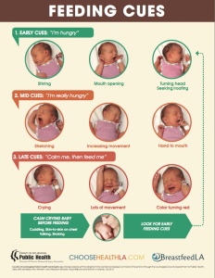
Feeding Cues
http://breastfeedla.org/feeding-cues-posters/
Free to download and print various languages

Slide 32
Continued Support to Promote Breastfeeding after Discharge
Have you thought about how you intend to feed your infant at home after discharge?
Infant’s home feeding plan should be initiated in the NICU to determine feasibility for infant and family, as well as to ensure appropriate weight gain.
Notes:
Factors that should be considered. Is mom going back to work? Does she have help at home, other children etc.
What is realistic for this mother/infant pair….
Allowing infant at breast, feeding on cue use of test weights, increasing maternal confidence in direct breastfeeding…………….

Slide 33
Continued Support to Promote Breastfeeding after Discharge
Maternal Milk Volume Related to Infant Intake
  May still need to pump as infant transitions to breast
  Review source of breast pump for use at home
  Provide referral for breastfeeding support after discharge
Discharge class in NICU
  Can provide education to help transition parents to home from NICU.

Slide 34
Continued Support to Promote Breastfeeding after Discharge
Appropriate Follow-up
Pediatrician
  Infant appointment for follow up and feeding plan specifics.
WIC at the FL Department of Health website - www.floridahealth.gov/programs-and-services/wic/
  June 1st 1-2pm
Healthy Start Programs
Florida Breastfeeding Coalition (FBC) http://www.flbreastfeeding.org/

Slide 35
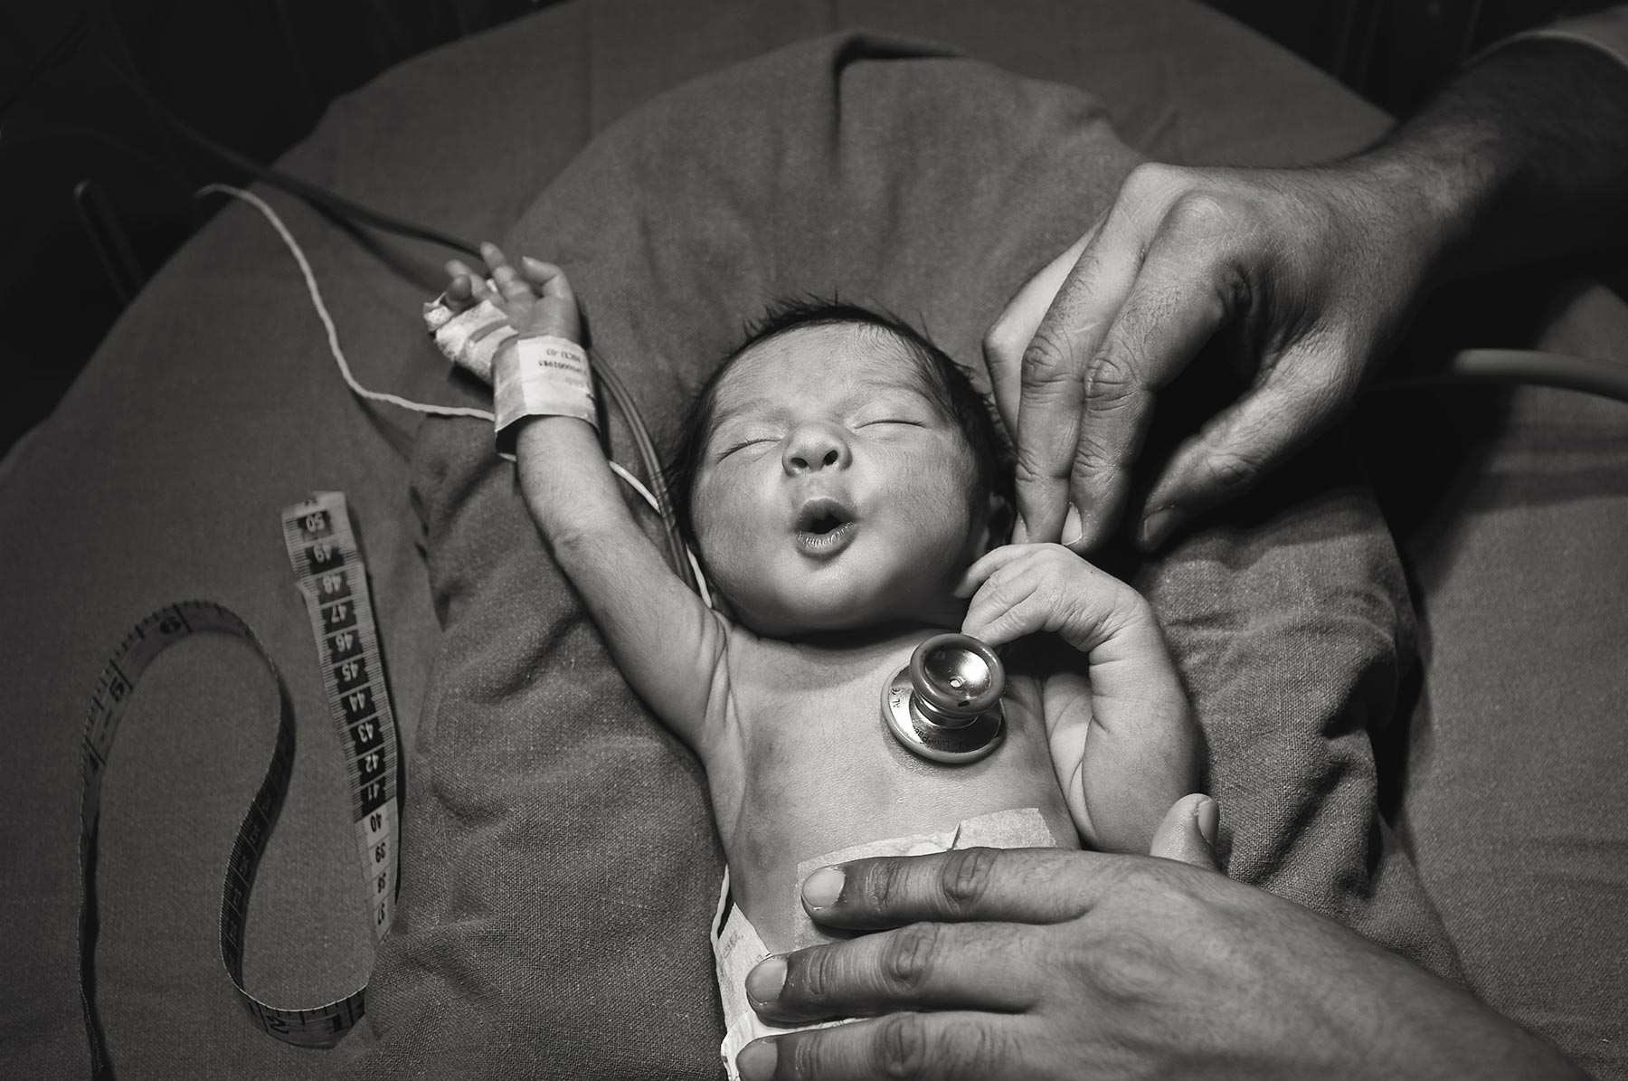
Calming your Fears…….
Any Questions or Concerns?
Notes:
Addressing your babies.

