Slide 1


Respectful Maternity Care
(RMC)

Slide 2
What is Respectful Maternity Care?
FPQC Vision, updated 2021:
All of Florida’s mothers, infants & families will have the best health outcomes possible through receiving respectful, equitable, high quality, evidence‐based perinatal care.
*****
“Respectful Maternity Care (RMC) is an approach to care that emphasizes the fundamental rights of women, newborns, and families, promoting equitable access to evidence-based care while recognizing unique needs and preferences.” (Shakibazadeh et al., 2018)
Notes:
Shaki-baza-deh

Slide 3
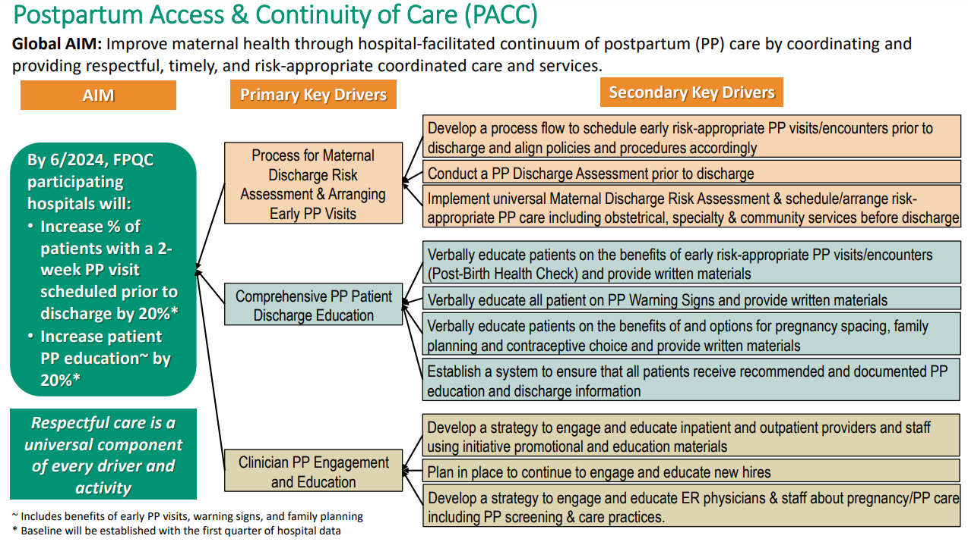
Respectful Maternity Care (RMC) Universal for FPQC Initiatives
RMC

Slide 4
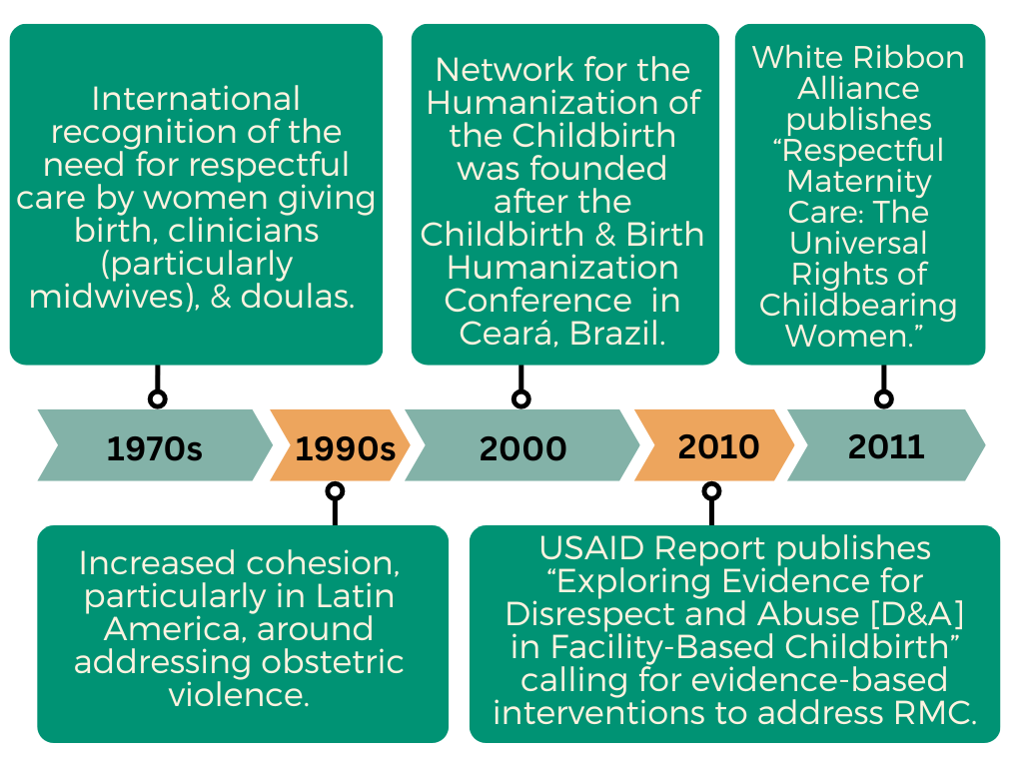
Foundations of Respectful Maternity Care (RMC)
  RMC founded on the premise that women should not be mistreated in childbirth.

Slide 5
RMC Across Clinical Organizations
Clinical organizations continue to complement and expanded upon efforts related to RMC.
ACOG Committee Opinion 587: Effective Patient–Physician Communication (2014, Reaffirmed 2021) provides recommendations including:
RESPECT Model
  Rapport
  Empathy
  Support
  Partnership
  Explanation
  Cultural Competence
  Trust
  (UCSF, 2002)
Five Step Patient-Centered Interviewing
Step 1. Set the stage for the interview (30–60 s)
Step 2. Elicit chief concern and set an agenda (1–2 min)
Step 3. Begin the interview with non-focusing skills that help the patient to express herself (30–60 s)
Step 4. Use focusing skills to learn 3 things: Symptom Story, Personal Context, and Emotional Context (3–10 min)
Step 5. Transition to middle of the interview (clinician-centered phase) (30–60 s)
(Fortin et al., 2012)

Slide 6
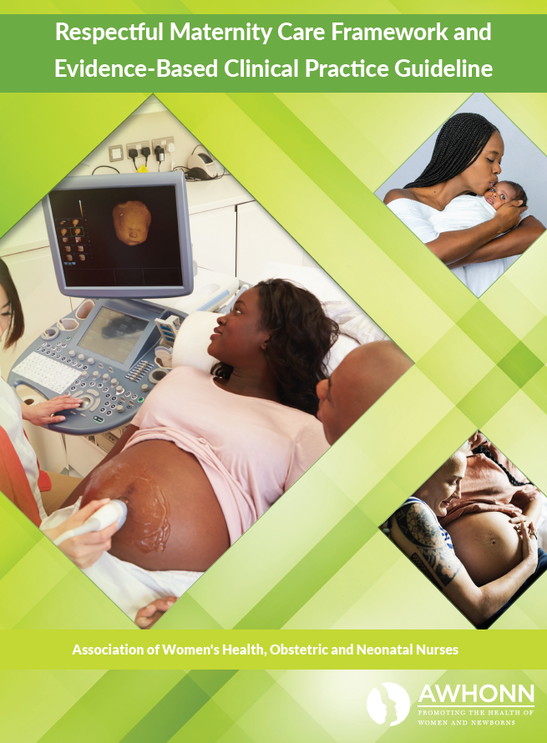
RMC Across Clinical Organizations
ACOG/AIM: “Reduction of Peripartum Racial & Ethnic Disparities: A Conceptual Framework & Maternal Safety Bundle” (2018):
  Focuses on quality/safety and highlights Response (e.g. establish discharge navigation systems), Reporting (e.g. disparities dashboards), Readiness (e.g. best practices for shared decision making), and Recognition (e.g. access to health information in a simplified format).
AWHONN Respectful Maternity Care Implementation Toolkit (2022):
  Comes with tools and resources you can use to implement within your organization. Free for members and available to non-members for a small fee. Guiding principles:
    Awareness
    Mutual Respect
    Shared Decision Making and Informed Consent
    Autonomy
    Dignity
    Accountability

Slide 7

RMC Across Clinical Organizations
International Confederation of Midwives
  Respect Workshops: A Toolkit (FREE to all!) (2020)
Toolkit intended for midwives, doctors, educators, researchers, nurses, health care workers, doulas, managers, policy-makers, advocates, and leaders to facilitate workshops promoting respectful maternity care. Comes with handouts, activities, and PPTs.
Discusses Background to RESPECT
Building RESPECT
RESPECT Resources

Slide 8
RMC in Action: Let’s Practice!
AWHONN Respectful Maternity Care Implementation Toolkit (2022):
    Mutual Respect
According to the toolkit, “Providing respectful care and holding mutual respect for
all members of the patient, family, and health care team should become
a cultural norm.”
Here are a few strategies for effective patient-centered communication
promoting mutual respect:
Giving mothers your full attention
Actively listening to patients by matching nonverbal communication, such as eye
contact, with verbal communication
Taking the time to make small talk to get to know the patient and family
Approaching each circumstance with positivity, information, and hopefulness
Scenario: You are meeting your postpartum patient for the first time. Turn to the person next to you and each take one minute to practice some of the listed communication
strategies.

Slide 9
PACC Pledge: RMC in Action
WE PROMISE TO PROVIDE RESPECTFUL POSTPARTUM (PP) PATIENT CARE TO ALL. Therefore, we will:
Actively listen to each patient, ensuring their voice and message is heard regarding their safe PP transition to home and needed after care.
Treat all patients in a respectful way that honors the patients’ beliefs and practices that may be different than our own.
Actively engage all patients in all PP plans and decision making.
Encourage our patients to ask questions and raise concerns about their PP care & conditions.
Provide high-quality, evidence-based PP education with a focus on PP warning signs, the need for an early post birth safety check, and to seek attention early.
Complete all PP care appointments and referrals prior to discharge.
Welcome the patient’s chosen support persons to be present during PP discharge education and discussions.
Ensure respectful care to all patients in PP policies & practices.
Visit fpqc.org/PACC/toolbox to download and customize your hospital’s Respectful Care Pledge!

