Slide 1








Florida’s ACOG/SMFM
Levels of Maternal Care
Notes:
Cole or Betsy

Slide 2
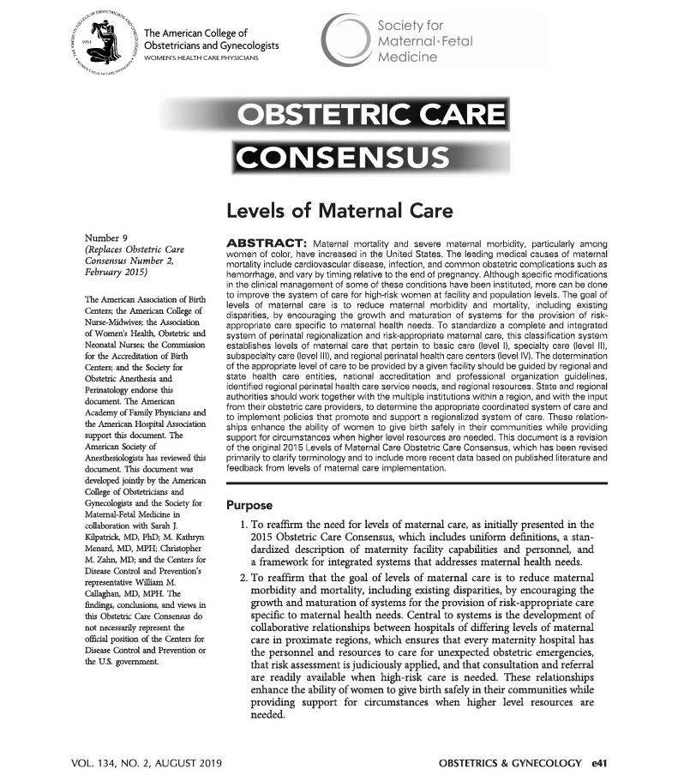
Developed by ACOG/SMFM
  Published in 2015
  Updated in 2019
  Verified in 2021

Slide 3
ACOG/SMFM Levels of Maternal Care
Level I—Basic Care:
  Care of low- to moderate-risk pregnancies with ability to detect, stabilize, and initiate management of unanticipated maternal-fetal or neonatal problems that occur during the antepartum, intrapartum, or postpartum period until the patient can be transferred to a facility at which specialty maternal care is available.
Level II—Specialty Care:
  Level I facility plus care of appropriate moderate- to high-risk antepartum, intrapartum, or postpartum conditions.
Level III—Subspeciality Care:
  Level II facility plus care of more complex maternal medical conditions, obstetric complications and fetal conditions.
Level IV—Regional Perinatal Health Care Centers:
  Level III facility plus on-site medical and surgical care of the most complex maternal conditions and critically ill pregnant women and fetuses throughout antepartum, intrapartum and postpartum care.

Slide 4
Why LOMC Designation?
Reduce maternal morbidity and mortality
Encourage risk-appropriate care based on maternal needs
Ensure that consultation and referral are readily available when high-risk care is needed
Provide outreach training opportunities by higher-acuity facility staff to lower acuity facility staff
Increase equity in perinatal outcomes

Slide 5
Why Participate in LOMC Verification?
Allows hospital leadership to know how their facility compares to ACOG/SMFM national guidelines.
Identifies gaps and provides documentation to support acquisition of needed resources.
Creates a network of hospitals committed to quality of maternal care.
Promotes national standards for quality maternity care improving outcomes and reducing disparities.
Designation of levels of care is similar to NICU/trauma and is easy for the public to understand.
Allows hospital leadership to know how their facility compares to ACOG/SMFM national guidelines.
Identifies gaps and provides documentation to support acquisition of needed resources.
Creates a network of hospitals committed to quality of maternal care.
Promotes national standards for quality maternity care improving outcomes and reducing disparities.
Designation of levels of care is similar to NICU/trauma and is easy for the public to understand.

Slide 6
Role of FPQC
With one-year of funding provided by the Florida Department of Health, FPQC will pay initial site visit cost and first year fee for any Florida maternity hospital willing to apply for and participate in The Joint Commission’s (TJC) ACOG Levels of Maternal Care verification program. This will cover nearly half of the cost of a hospital’s three-year participation.
For those hospitals applying as a Level 1, FPQC will pay the full three-year cost requiring no payment by the hospital.
Sample materials and support from clinical experts on the process of applying, preparing, and completing the LOMC verification process are available through FPQC

Slide 7
LOMC Funding Application
Hospital Commitments
Commit to pay 2nd and 3rd year verification fees to The Joint Commission (TJC) unless applying as a Level 1.
Commit to scheduling on-site verification site visit within 90 days of a completed LOMC application to the TJC with a “ready” date no later than April 1, 2024.
Commit to completing the FPQC online post-verification evaluation survey.
Acknowledge TJC billing practices; No action required. FPQC will pay after visit.
Acknowledge that FPQC will be regularly informed by TJC of a hospital’s verification progress and both the applied and verified level of maternal care.
Acknowledge that FPQC will be sharing the above information with the Florida Department of Health.

Slide 8


Maternal Levels of Care Verification
Delivering Confidence Across All Levels of Maternal Care in Florida
A program to help reduce maternal morbidity and mortality outcomes by ensuring women receive risk-appropriate care.

Slide 9
Maternal Levels of Care (MLC) – General Program Overview
The MLC has been informed by the ACOG Levels of Maternal Care (LoMC) and additional standards have been developed in collaboration with ACOG.
The Joint Commission will conduct on-site surveys to perform the MLC verification.
The MLC will be a three-year verification cycle.
MLC is open to acute care hospitals and critical access hospitals who are otherwise in compliance with CoPs and federal laws.

Slide 10
Maternal Levels of Care Verification—Standards Example
      MLCPM.03, EP 4
      The program provides support from other departments such as anesthesia, respiratory, radiology, ultrasound, laboratory, and blood bank services 24 hours a day, 7 days a week. Suitable backup systems and plans are in place that meet the emergent needs of the mother.
      Level of Care I:
      a. An anesthesia provider with the capability to administer labor analgesia and surgical anesthesia is
      readily available at all times, per the organization’s policy.
      b. The program has the ability to initiate a massive transfusion protocol and has a process in place to
      obtain more blood components, including platelets, if needed.
      c. The program has limited obstetric ultrasonography with interpretation readily available at all times, per
      the organization’s policy.
.

Slide 11
Maternal Levels of Care Verification—Standards Example
Level of Care II: (requirements for Level of Care I plus)
d. Radiologic services with interpretation are readily available per the organization’s policy and include computed tomography scan, magnetic resonance imaging, non-obstetric ultrasound imaging, standard obstetric ultrasound imaging, and maternal echocardiography.
Level of Care III: (requirements for Level of Care II plus)
e. In-house availability of all blood components.
f. Specialized obstetric ultrasound and fetal assessment, including Doppler studies, with interpretation readily available at all times, per the organization’s policy.
g. Basic interventional radiology (capable of performing uterine artery embolization), readily available at all times, per the organization’s policy.
h. Appropriate personnel and equipment available on site 24 hours a day, 7 days a week to provide the capability to ventilate and monitor women in labor and delivery until they can be safely transferred to the intensive care unit.

Slide 12
Maternal Levels of Care Verification—Standards Example
Level of Care III: (requirements for Level of Care II plus)
i. Availability of adult medical and surgical intensive care units that accept pregnant women and women in the postpartum period. The intensive care units are staffed by adult critical care providers on site 24 hours a day, 7 days a week.
j. Board certified anesthesiologist is on site 24 hours a day, 7 days a week.
Level of Care IV: (requirements for Level of Care III plus)
k. On-site medical and surgical capabilities for complex maternal conditions.
l. On-site intensive care unit care for obstetric patients who are primarily or co-managed by a maternal fetal medicine team. (Co-management includes at least daily rounds by a maternal-fetal medicine specialist physician with interaction with the intensive care unit team and other subspecialists with daily documentation)
m. A board-certified anesthesiologist with obstetric anesthesia fellowship training or experience in obstetric anesthesia physically present on site 24 hours a day, 7 days a week.

Slide 13
Minimize Risks and Improve Outcomes
Verification helps ensure patients get matched with the appropriate level of care needed to attain optimal outcomes.

Slide 14






For More Information
or Answers to Specific Questions:
Email fpqc@usf.edu
Or review our website:
www.fpqc.org/lomc
Florida Perinatal Quality Collaborative
Florida Perinatal Quality Collaborative
@TheFPQC
Notes:
Bill

