Slide 1
Welcome to the
Expanded PAIRED Initiative Kick Off
Family-Centered Care in the NICU

Slide 2
HOUSEKEEPING
Please type your name and hospital affiliation in the chat
Submit any questions throughout the event via the chat

Slide 3
PAIRED Initiative
Welcome & Introductions
Bill Sappenfield
Sue Bowles

Slide 4
How Does FPQC Choose Initiatives?
Form Infant Health Comm.
Data
Poll FPQC NICUs
Infant Health Comm.
Decides
PAIRED
Other PQCs
Guide lines
Stake holders

Slide 5
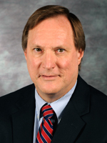
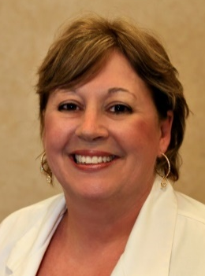
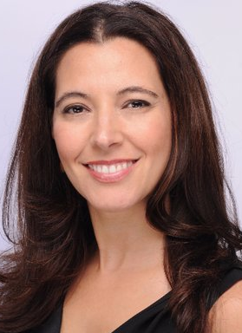
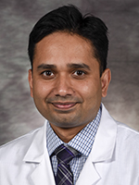
PAIRED Leadership Team
Clinical Co-Leads
Nurse Consultant
Parent Consultant
Mark Hudak
Sue Bowles
Lelis Vernon
Samarth Shukla
Notes:
Bill

Slide 6
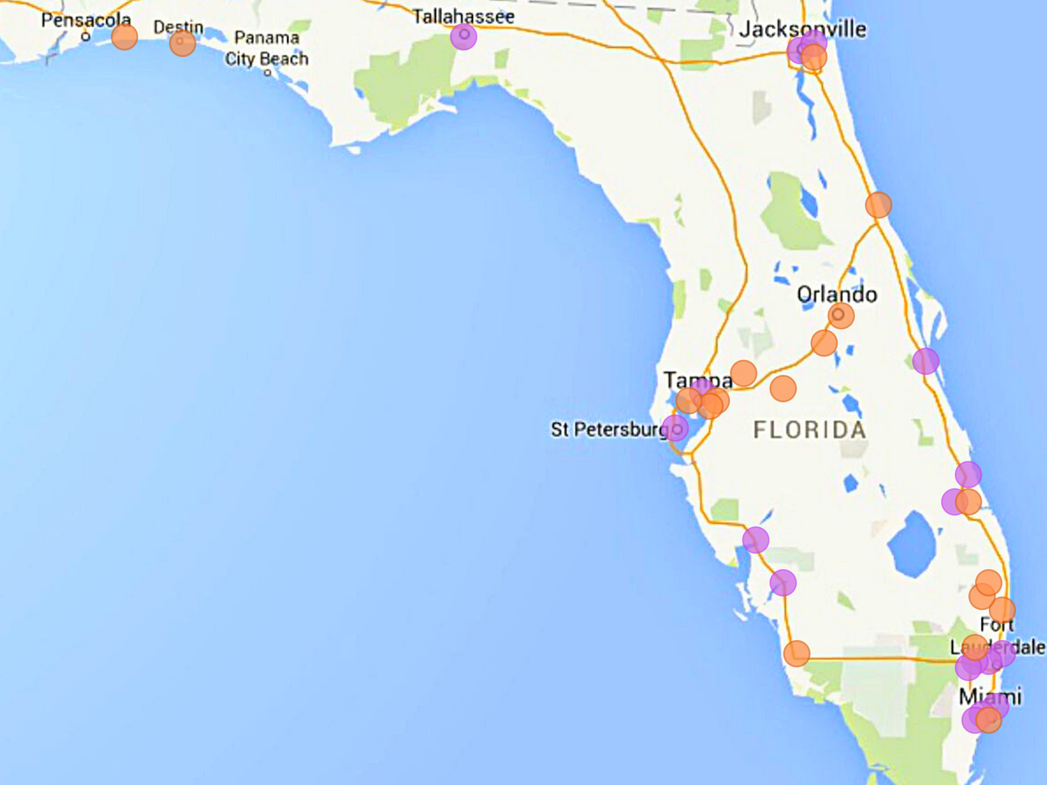
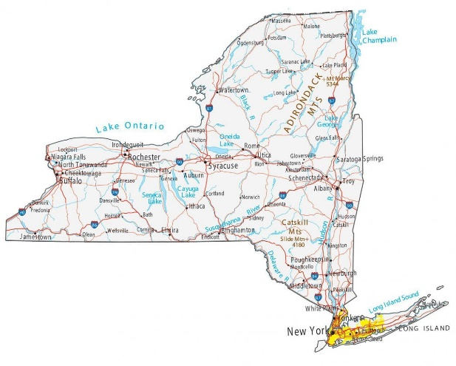
Pilot & New PAIRED Hospitals
Notes:
Purple: Pilot hospitals
Orange: New hospitals

Slide 7
SSC Level of Practice—Pre-implementation
PAIRED NICUs (n=16/16)

Slide 8
No Policy, Program or Training by FCC Practice
Pre-implementation, PAIRED NICUs (n=16/16)

Slide 9




PAIRED has several
1
Parent Representative & Advisory Committee
Pilot Initiative
2
Caregiver Survey
PAIRED+
3
4

Slide 10

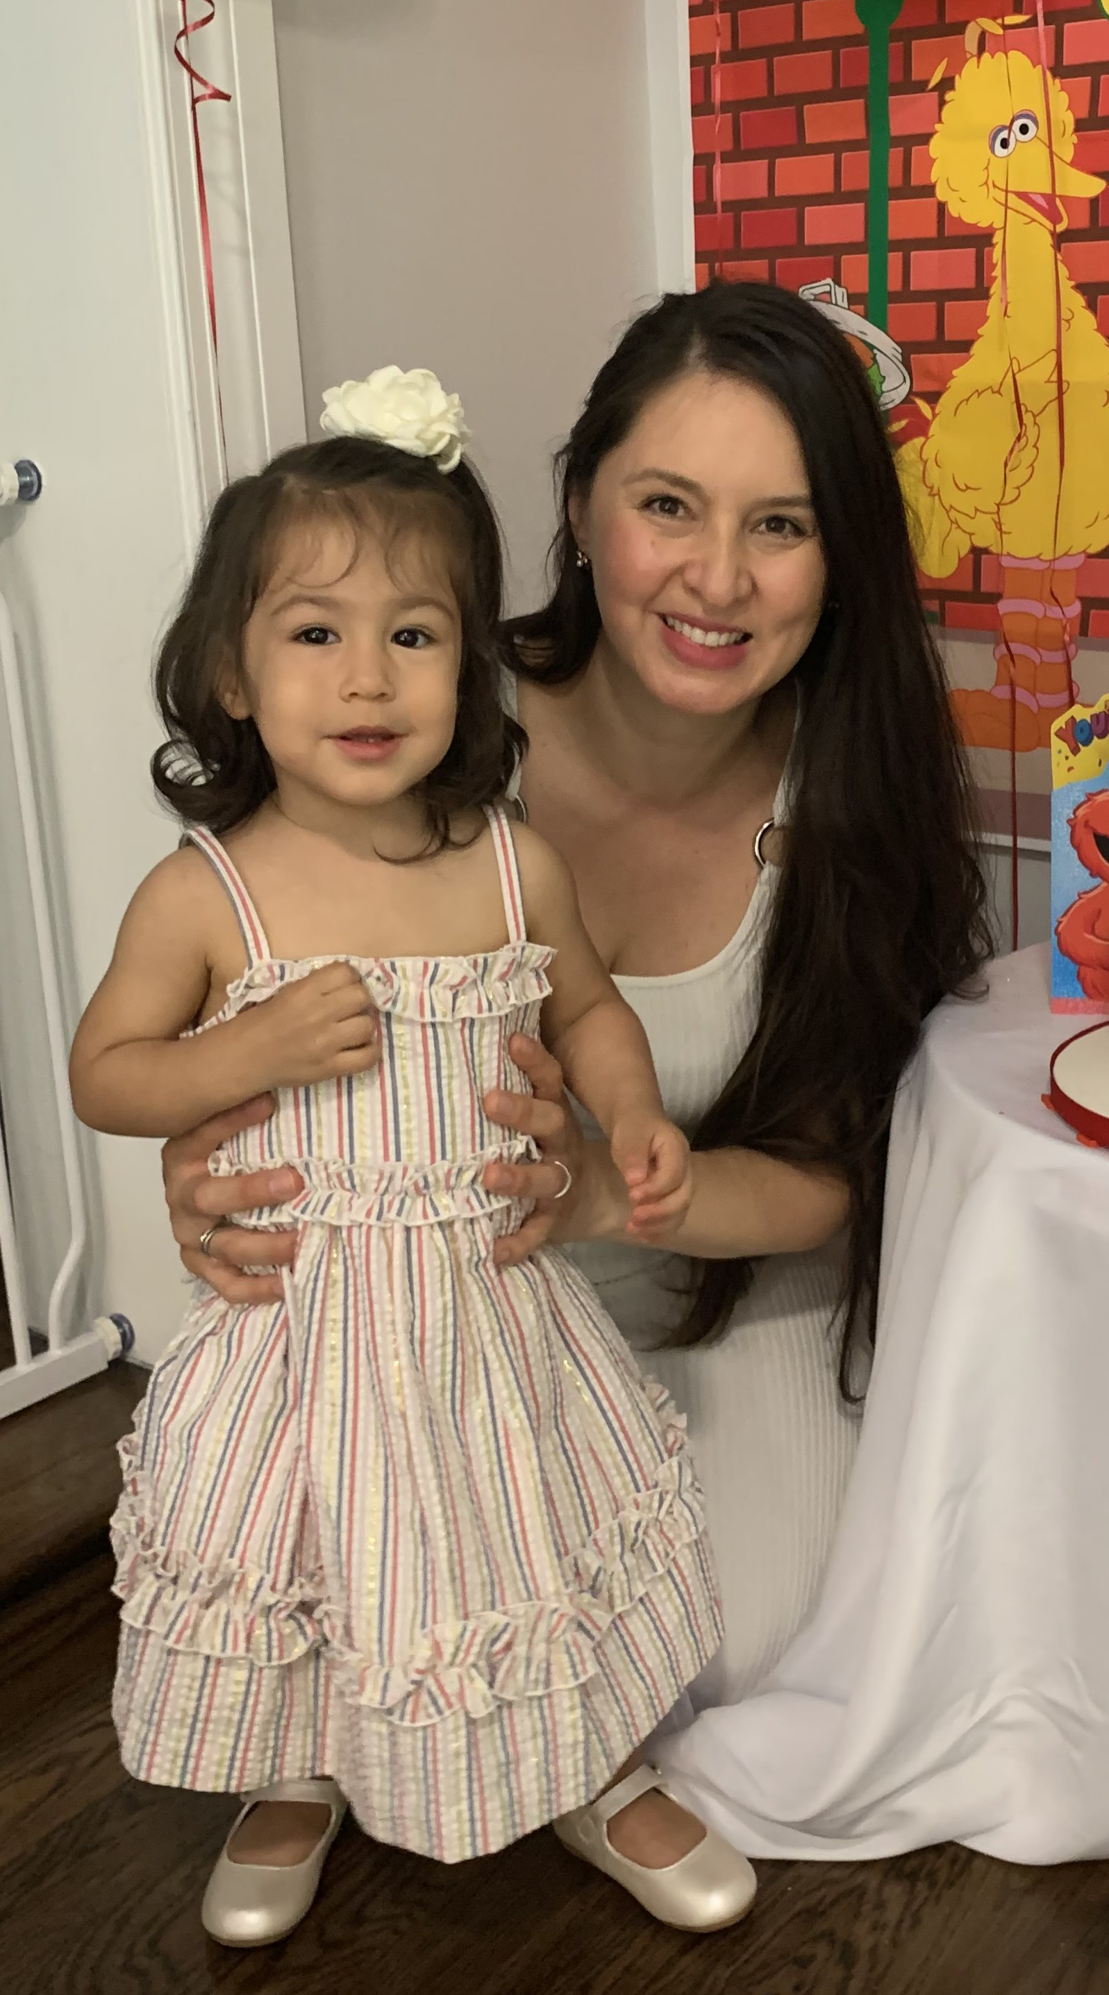
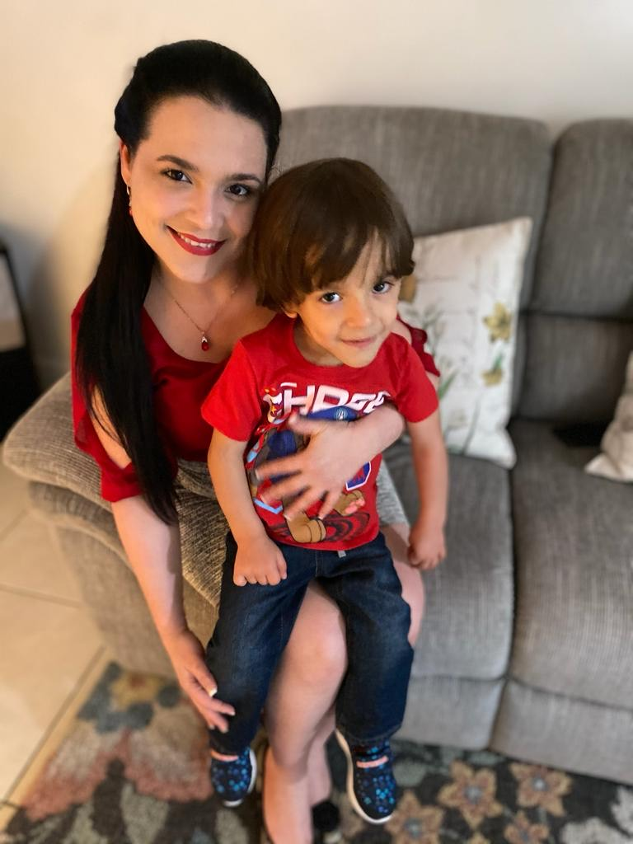
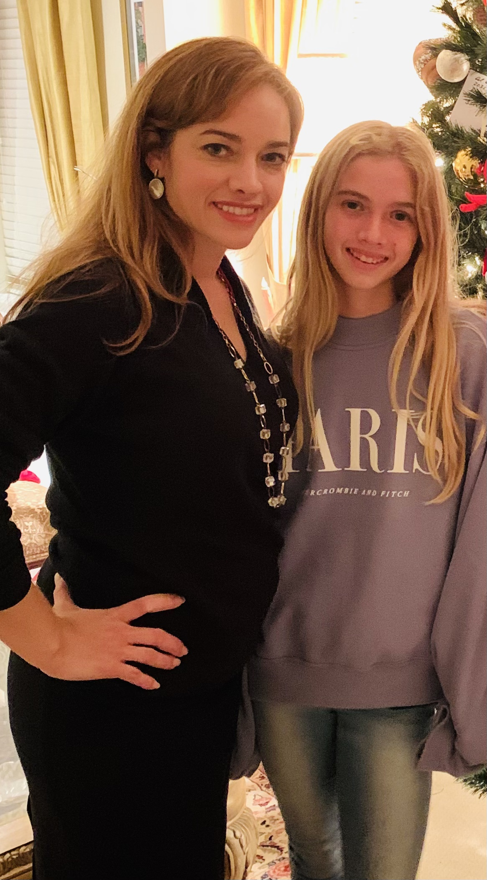
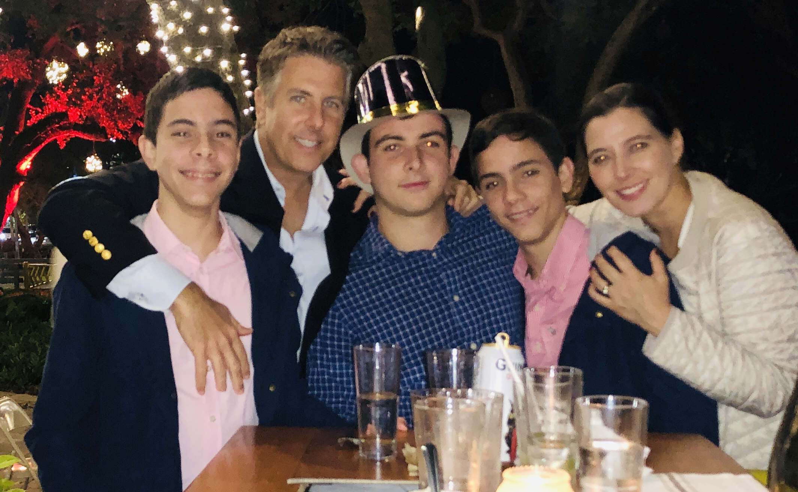
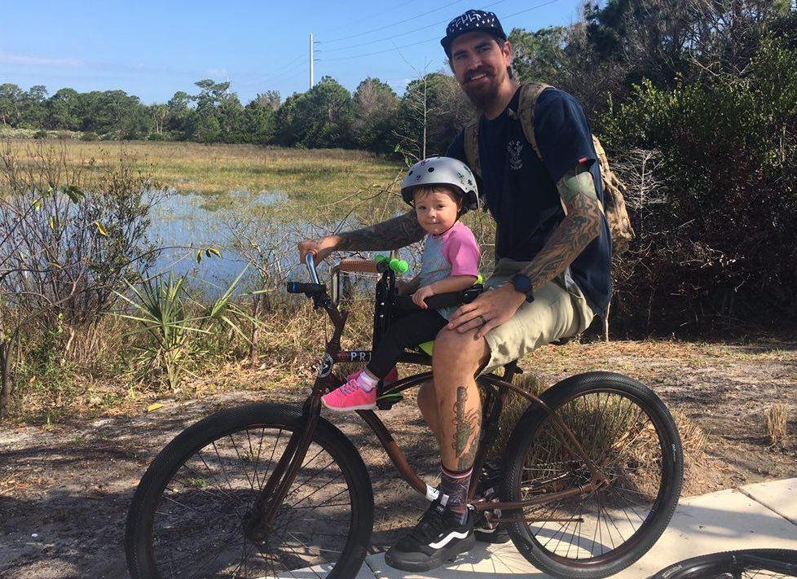
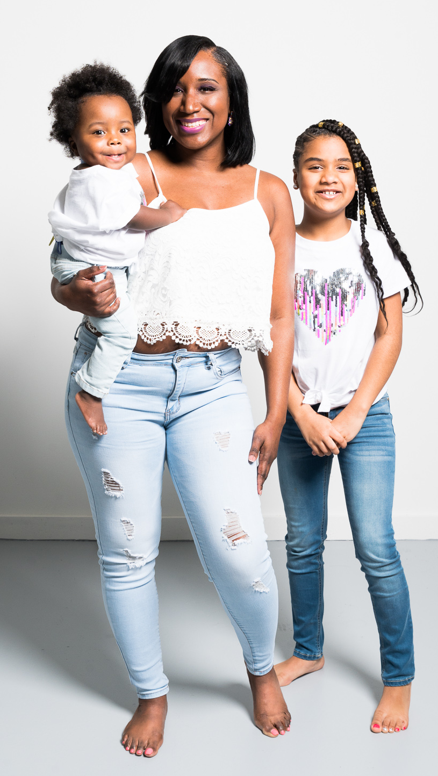
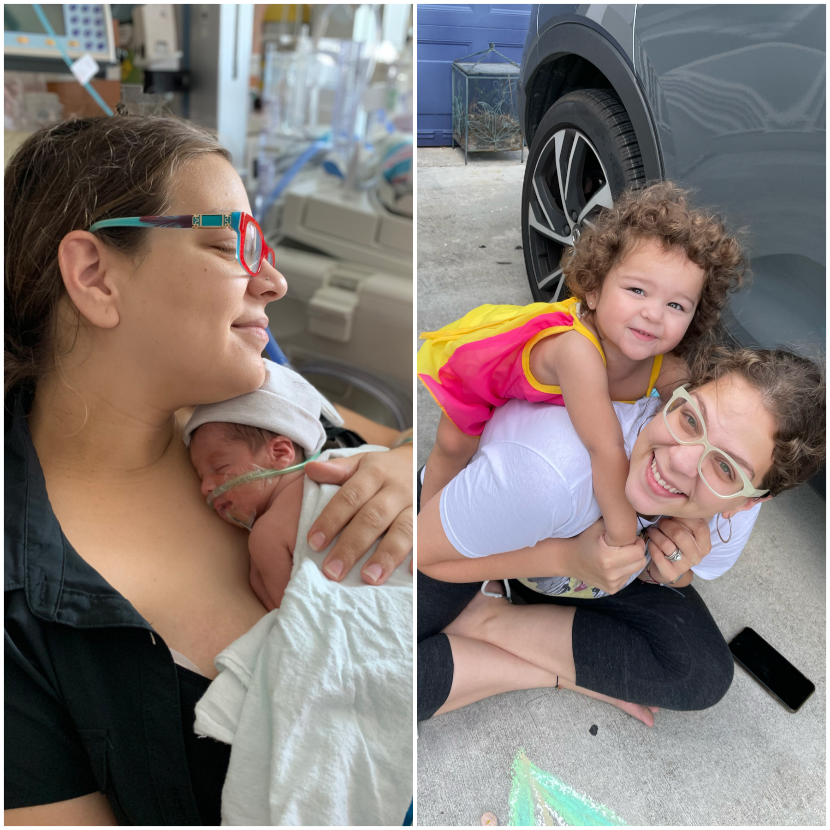
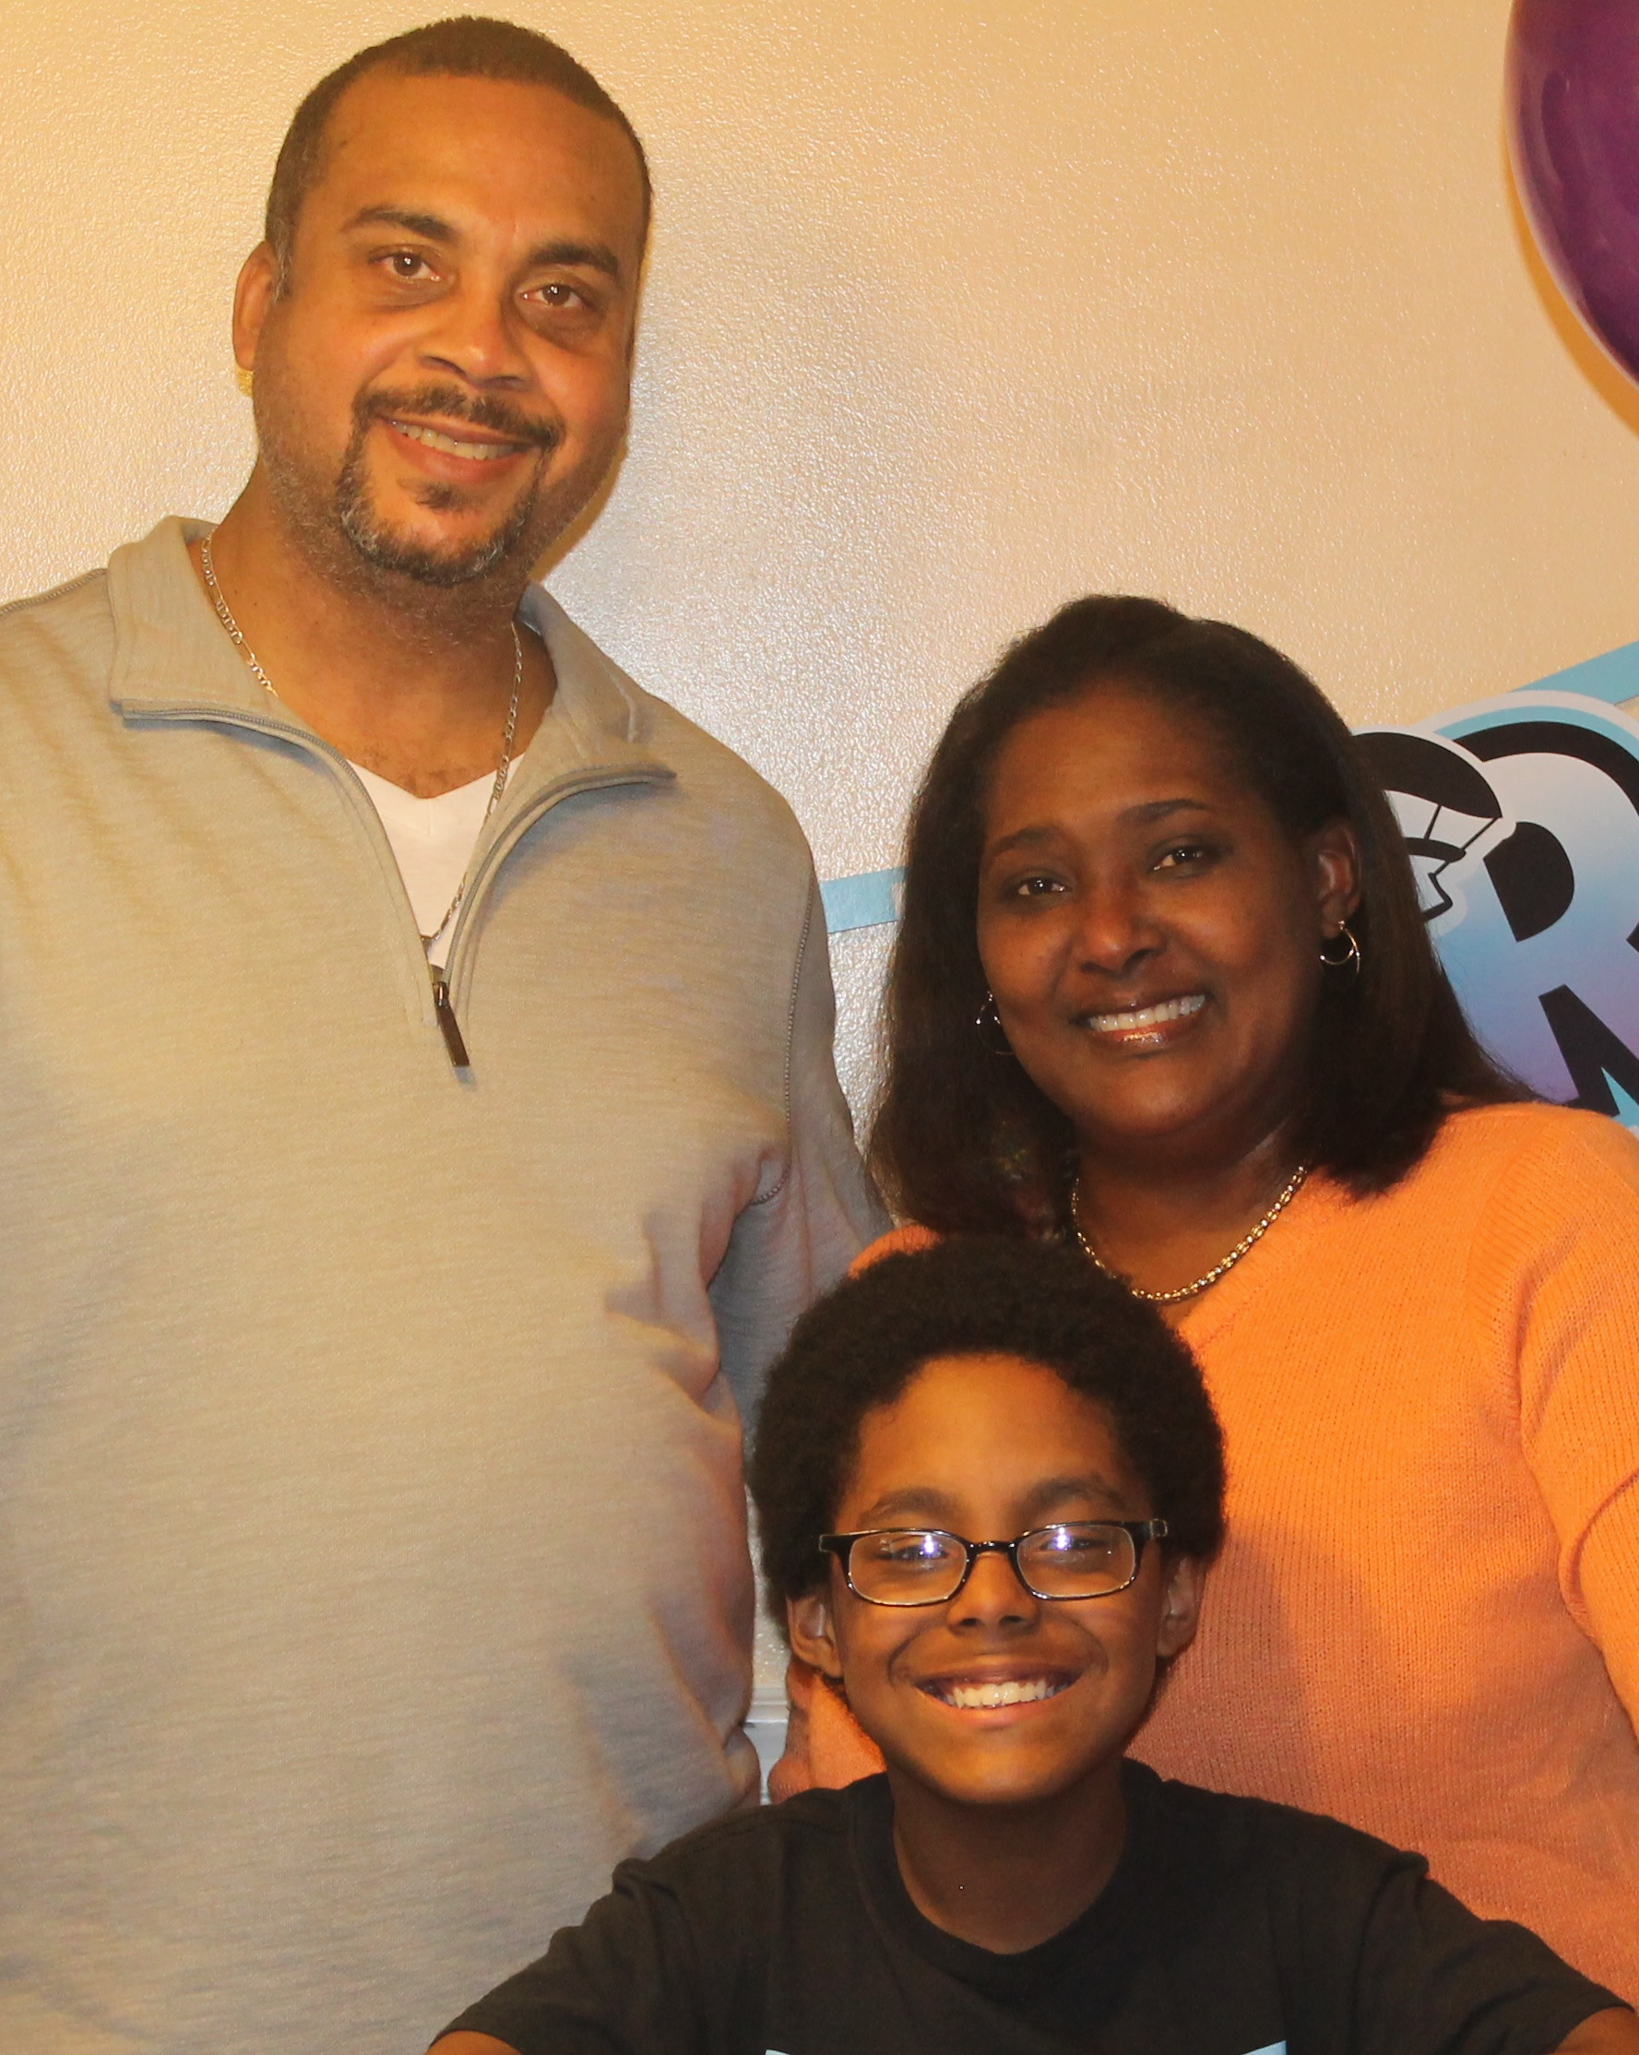
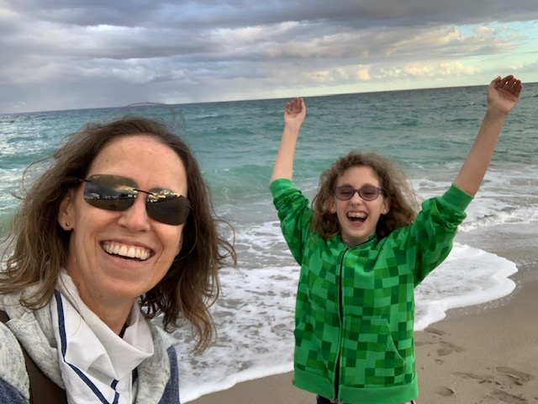
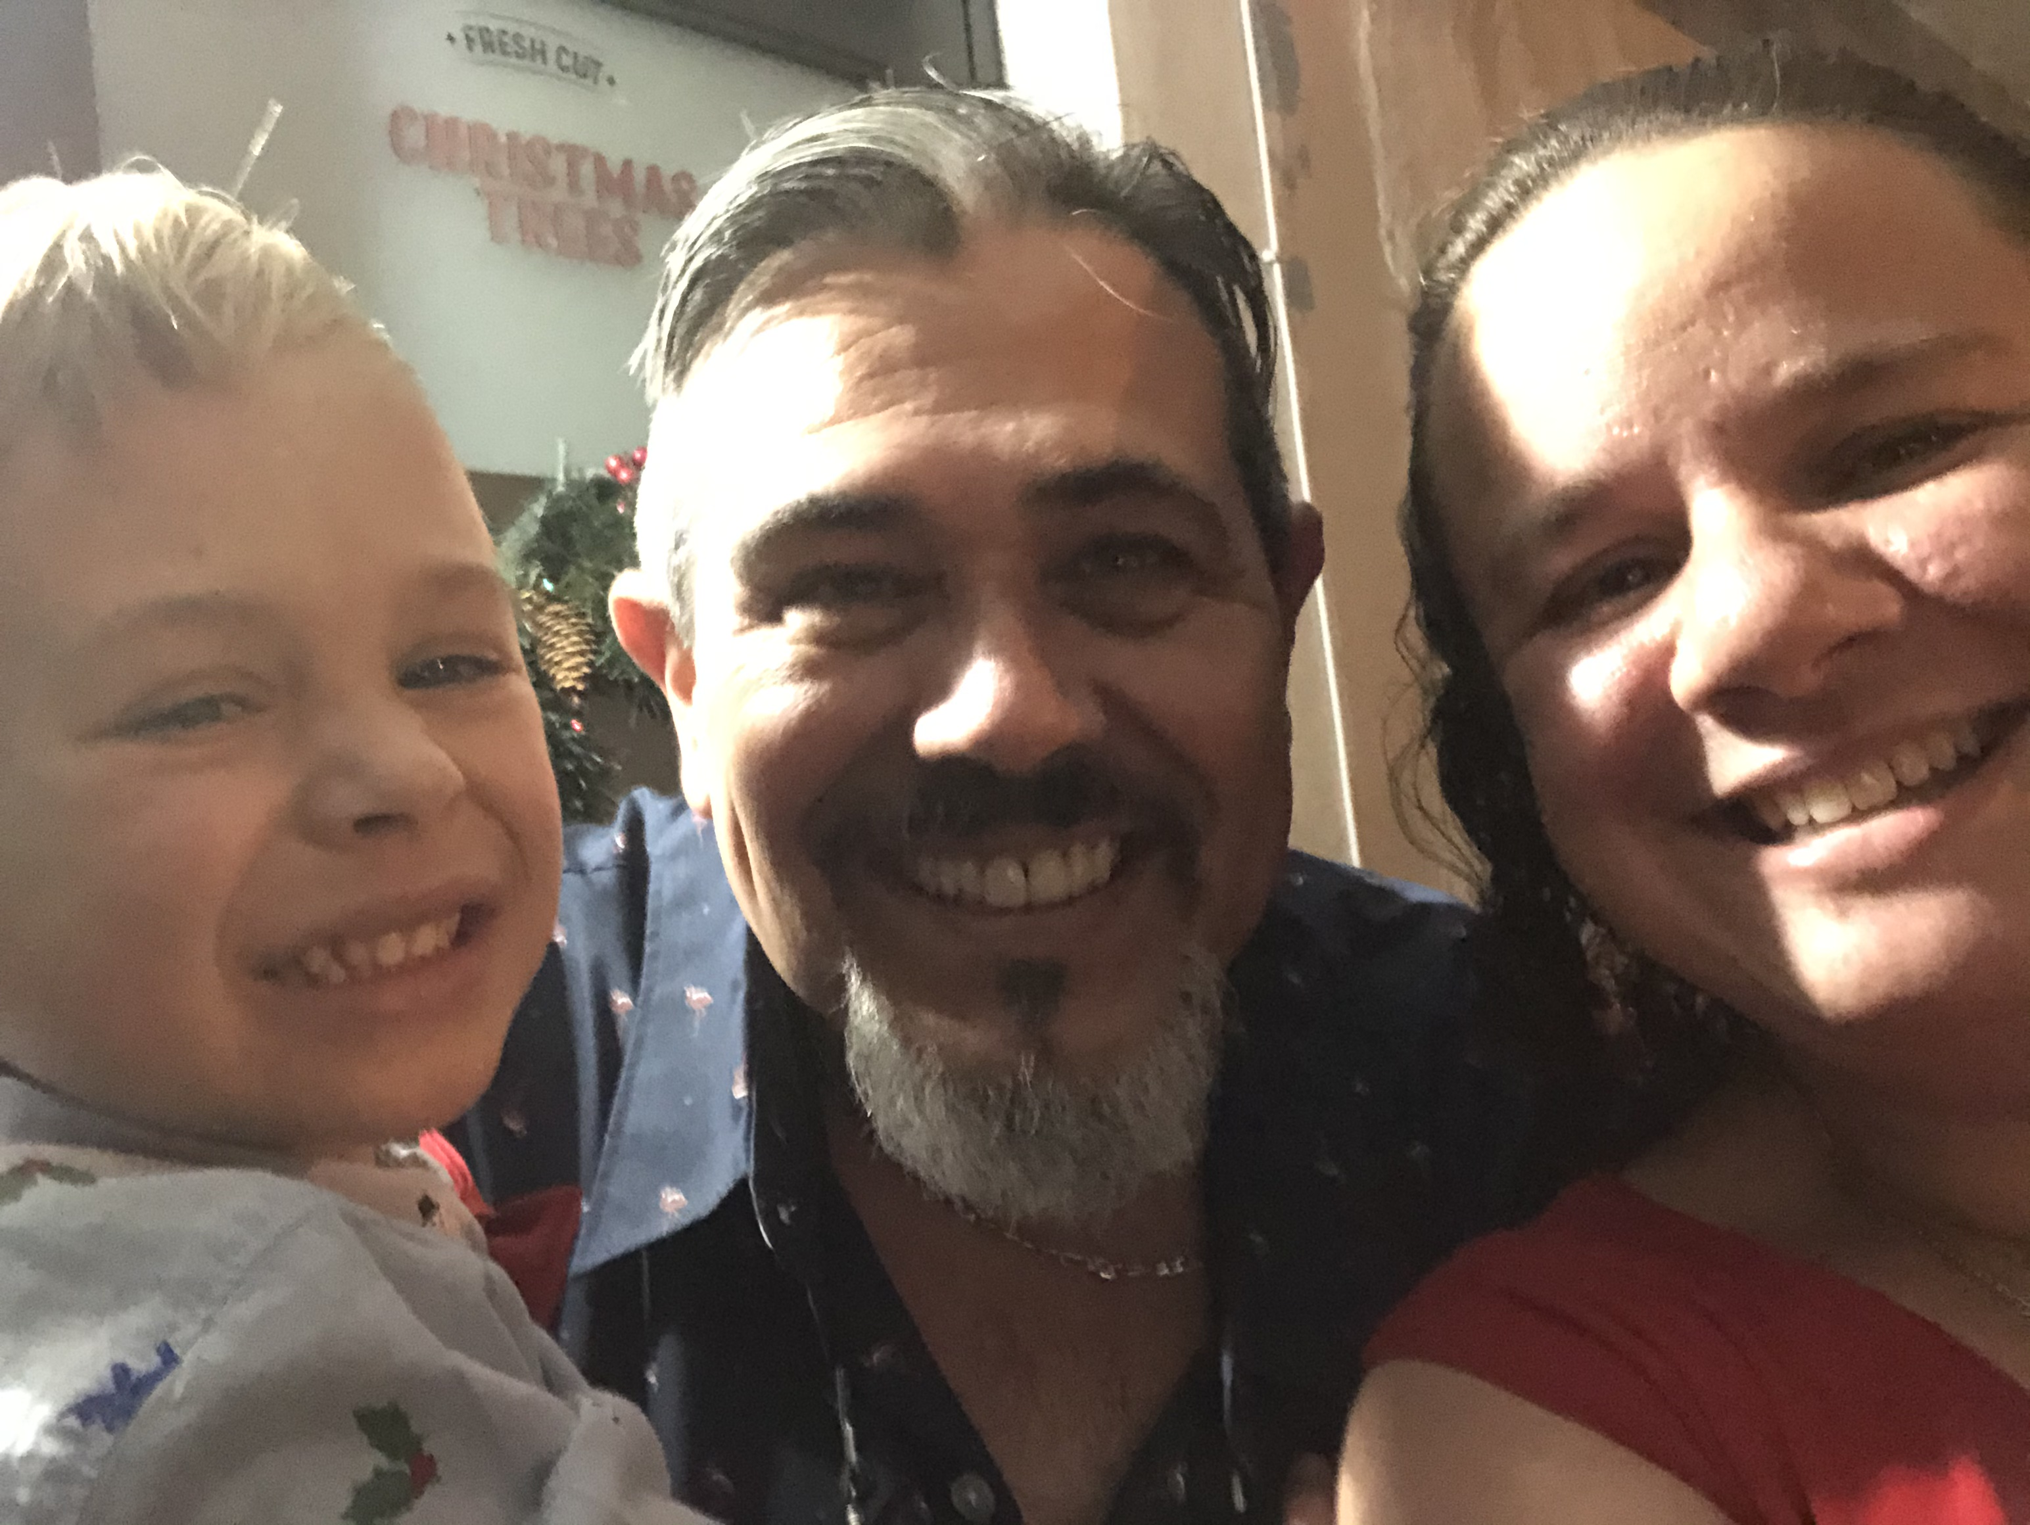
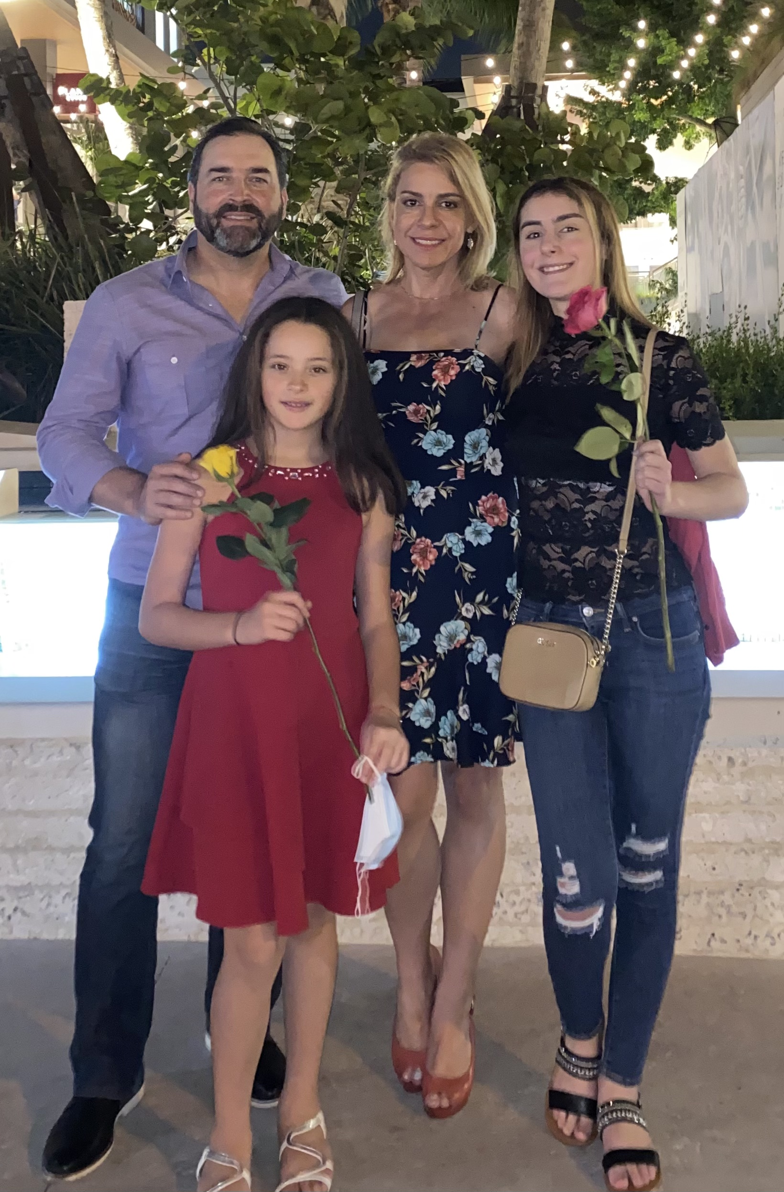
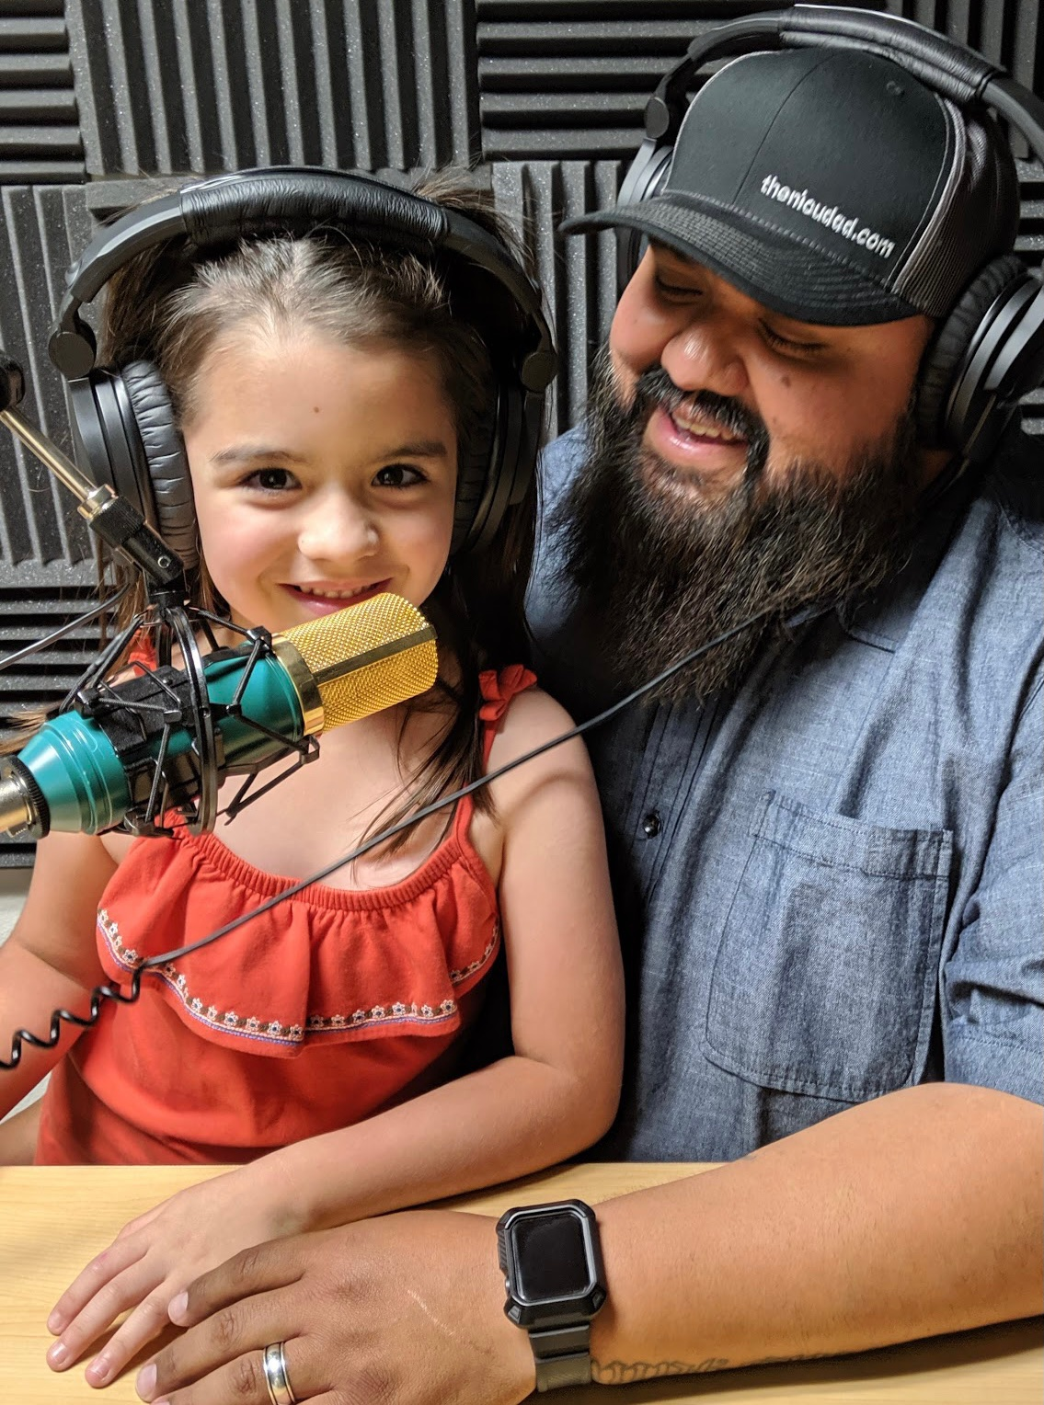
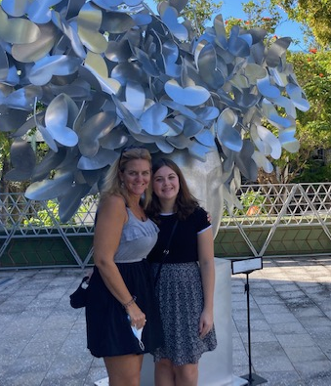
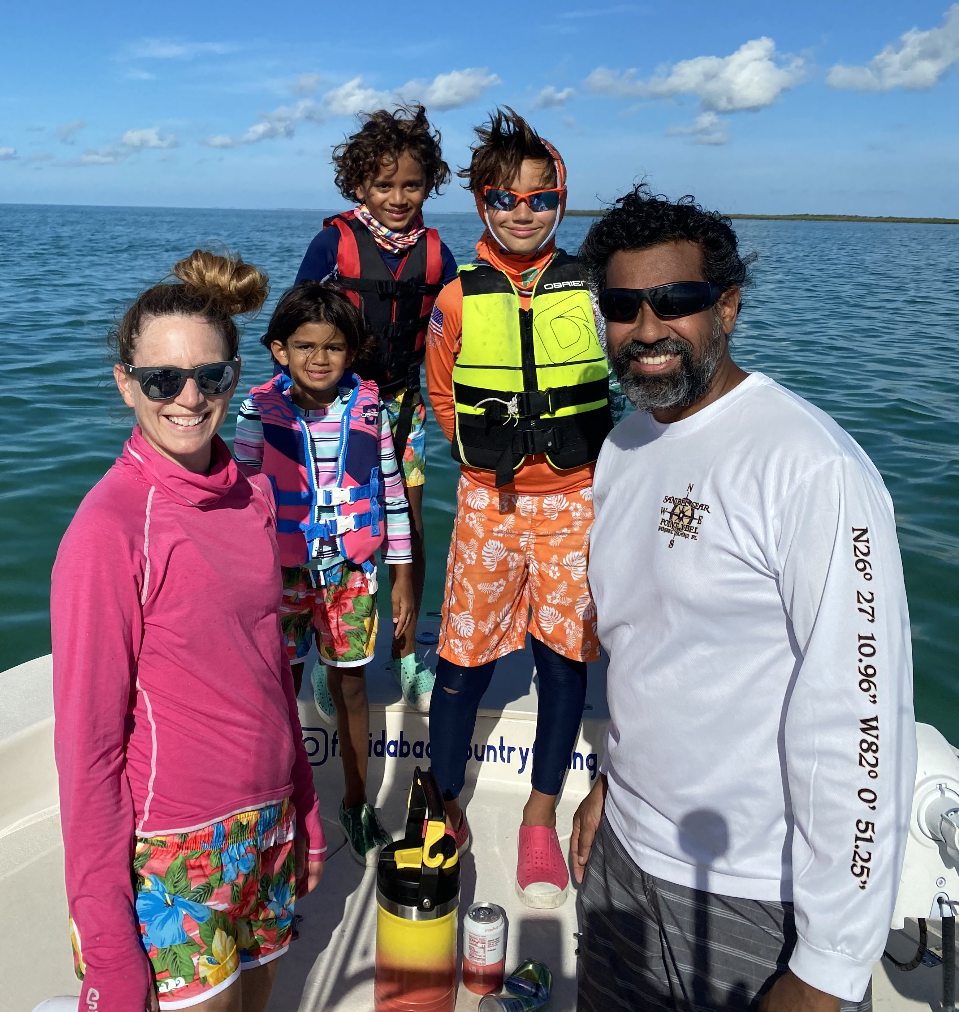
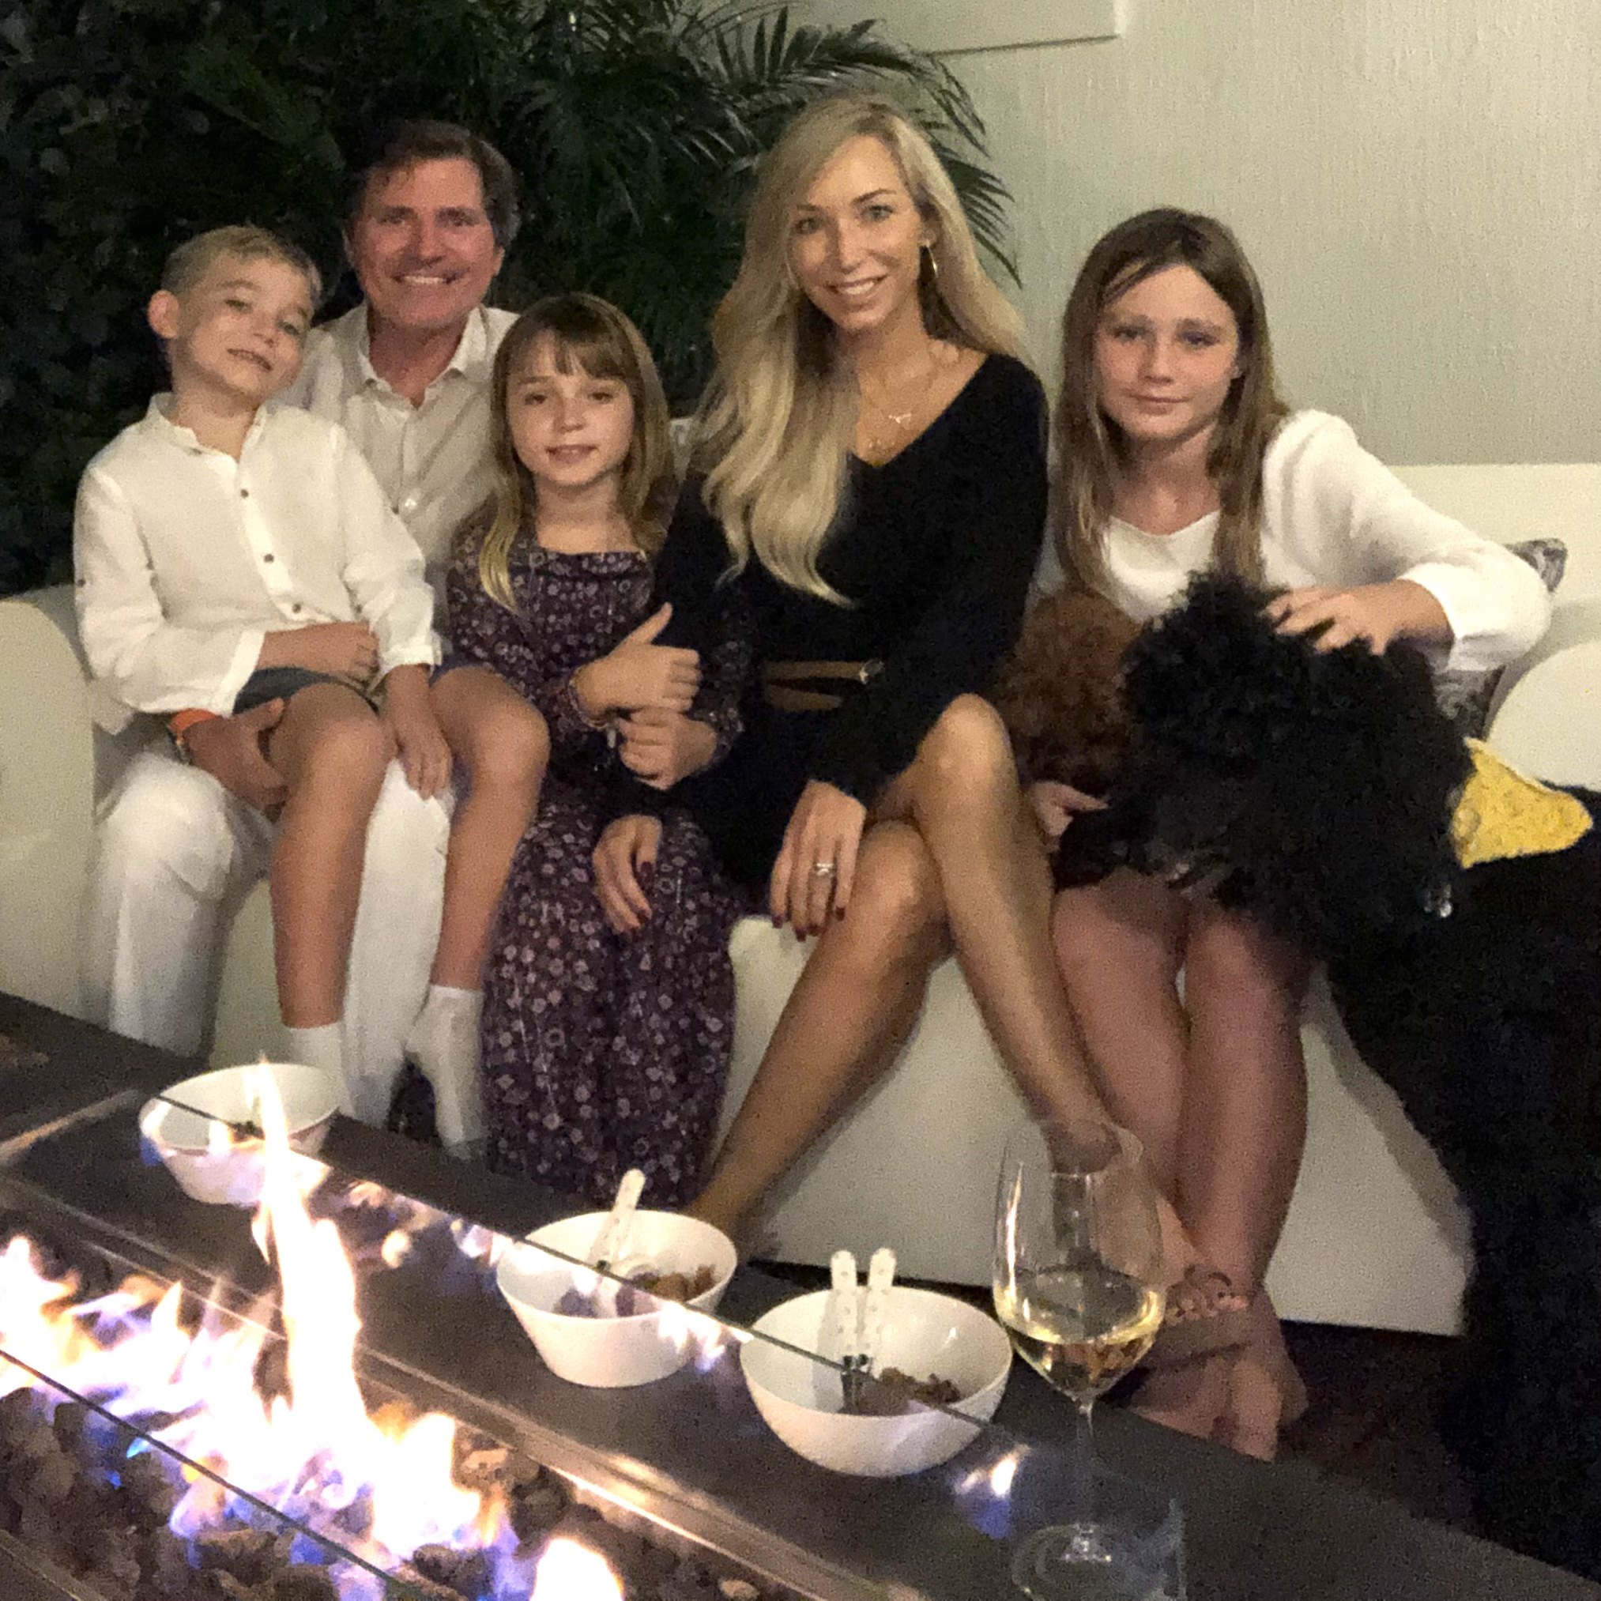
Parent Advisory Committee
2021 FPQC Director’s Award Recipient

Slide 11
Special Thanks to the PAIRED Pilot Hospitals
Bayfront Health Port Charlotte
Cleveland Clinic Tradition Hospital
Golisano Children’s Hospital of Southwest Florida
Health First Holmes Regional Medical Center
Holtz Children’s Hospital at UM Jackson Memorial
Joe DiMaggio Children’s Hospital
Johns Hopkins All Children’s Hospital
Lawnwood Regional Medical Center
Memorial Hospital Miramar
Memorial Hospital West
Mt. Sinai Medical Center
Salah Foundation Children's Hospital
Broward Health Medical Center
South Miami Hospital
Tallahassee Memorial Hospital
Tampa General Hospital
UF Health Jacksonville
Wolfson’s Children’s Hospital

Slide 12
New PAIRED Hospitals
One minute for 2 questions:
Give us one reason why your hospital joined PAIRED?
Give us one thing that your hospital wants to get out of today?

Slide 13

AdventHealth for Children
PAIRED Team:
Kathryn Mikulencak
Sadie William
Jacqueline Heitz
Carla Snider
Lisa Bowman
Robyn Muyet
Jeff Cousins
Orlando

Slide 14
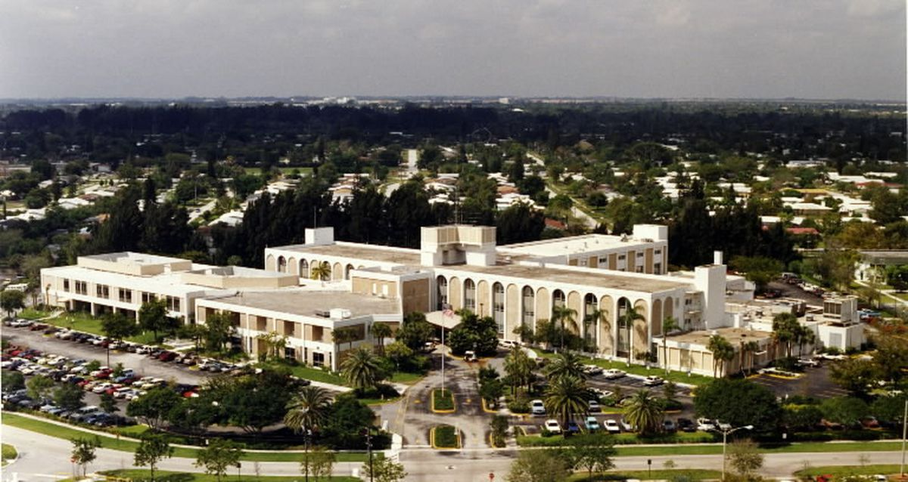
HCA Florida University Hospital
PAIRED Team:
Vanessa Phillips
Daphna Barbeau
Anna Duenas
Judy Ann Lyewsang
Plantation

Slide 15
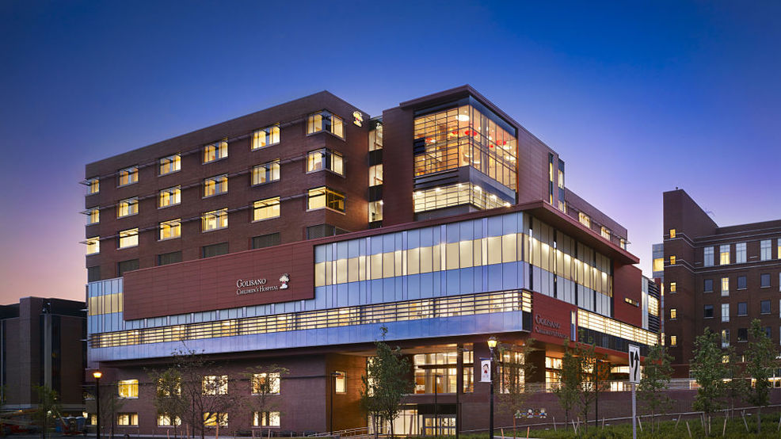
Golisano Children’s Hospital, University of Rochester Medical Center
PAIRED Team:
Colby Day Richardson
Dacia Terrano
Jamey Tulloch
Tom Greenwood
Jeff Meyers
Hyacinth Lewis
Rochester, NY

Slide 16
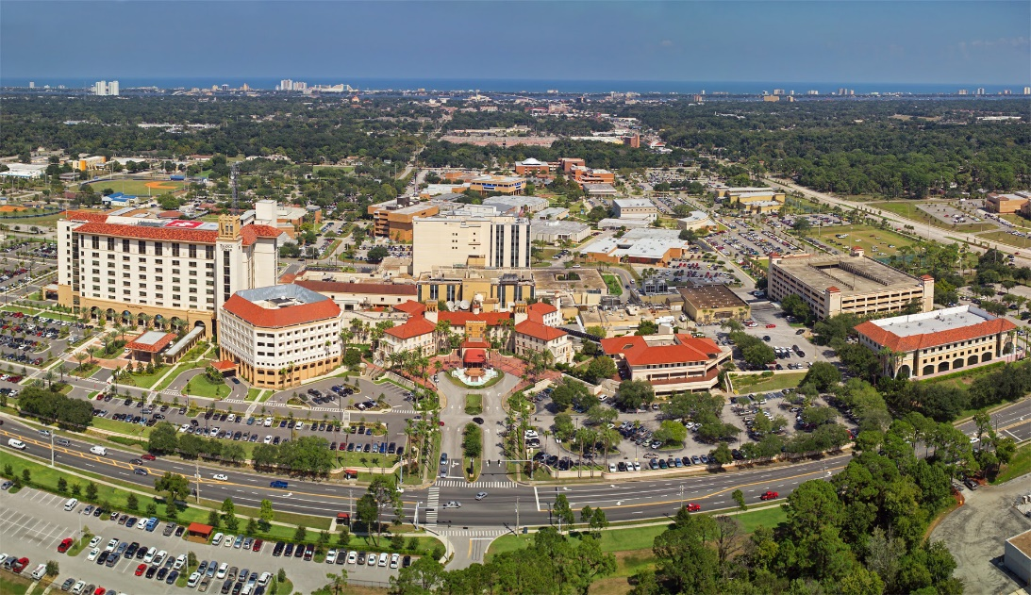
Halifax Health
PAIRED Team:
Susan Johnsen
Tanya Wolfe
Anthony Barone
Kailey Chambers
Patty Littlefield
Heidi Wright
Colleen Scolari
Daytona Beach

Slide 17
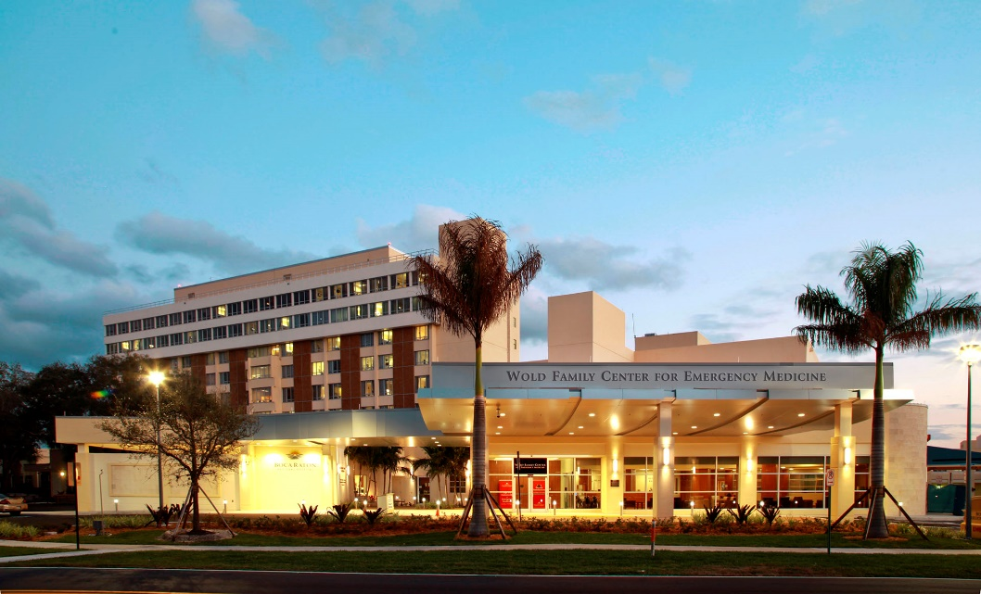
Boca Raton Regional Hospital, Baptist Health
South Florida
PAIRED Team:
Karen Edlington
Howard Brenker
Susan Knapp
Randi Boike
Boca Raton

Slide 18
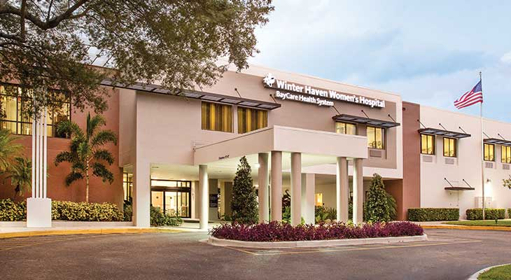
Winter Haven Women’s Hospital
PAIRED Team:
Valerie Butler
Jennifer Fynn
Dawn Jarman
Brandi Sasnett
Nicci Lambert
Stefanie Spanier
Winter Haven

Slide 19
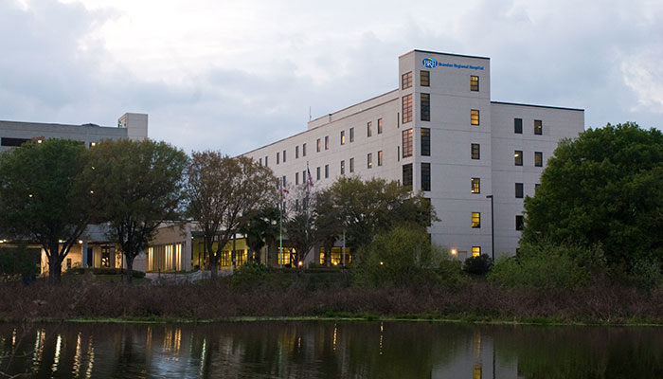
HCA Florida Brandon Hospital
PAIRED Team:
Marie Berg
Jordan Teper
Peggy Nickens
Mary Meiron
Bella Cabrera
Brandon

Slide 20

Jupiter Medical Center
PAIRED Team:
Jodi Dolezel
John Harvey
Kerri D'Amico
Bernie Crosson
Palm City

Slide 21
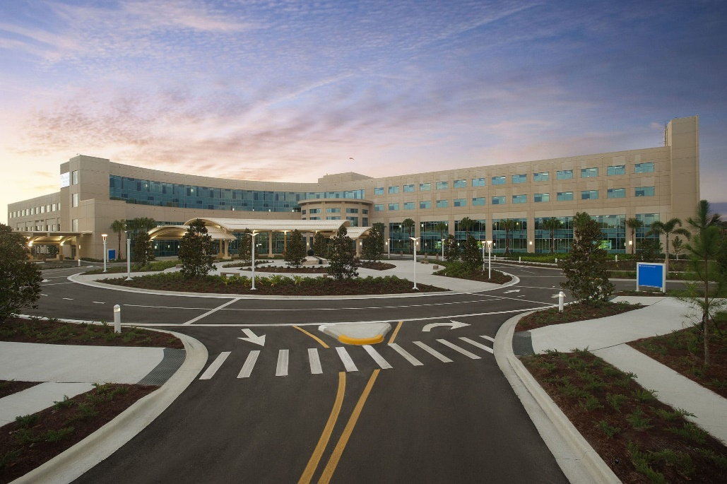
St. Joseph Hospital South
PAIRED Team:
Tiffany Botts
Rodrigo Azuero
Christy Wiggins
Corrie Long
Riverview

Slide 22
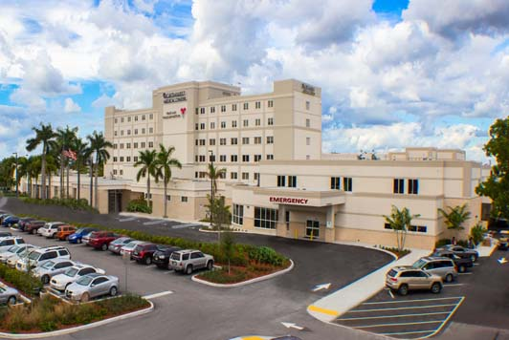
Northwest Medical Center
PAIRED Team:
Vargabi Ghei
Alexa Mitzner
Dr. Aviles
Jessica Thomas
Tamara Bledsoe
Deborah Tedder
Margate

Slide 23
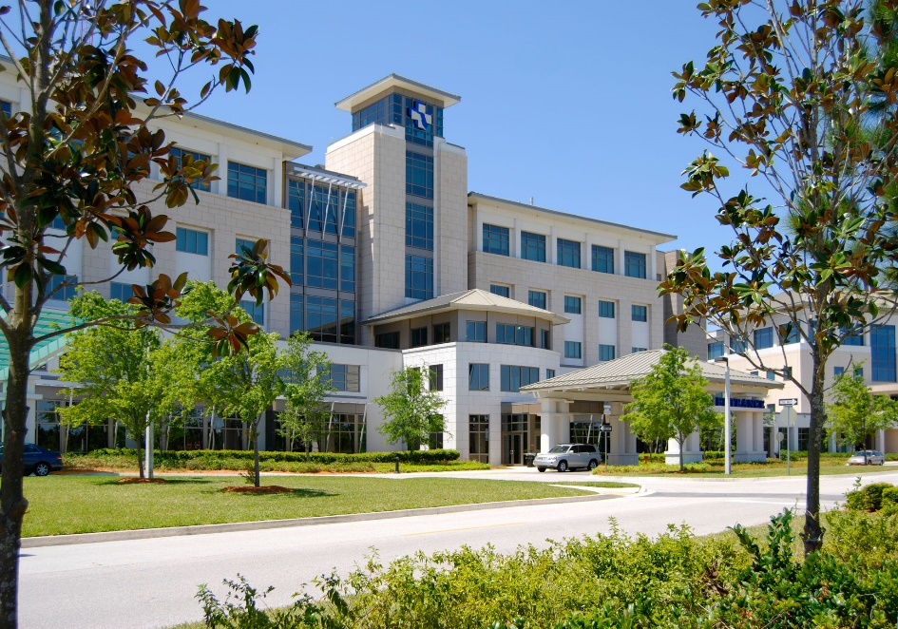
Baptist Medical Center South
PAIRED Team:
Natalie Taylor
William Driscoll
Anna Doyle
Amy Bankhead
Lucinda Deputy
Andrea Smith
Jacksonville

Slide 24
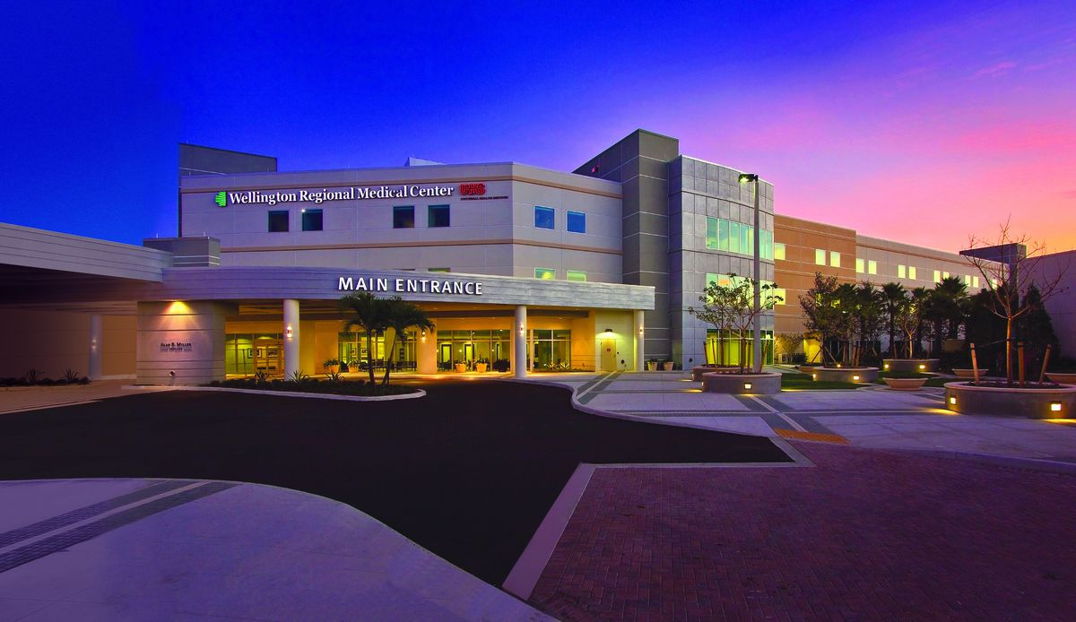
Wellington Regional Medical Center
PAIRED Team:
Kimberley Masterson
Edith Spencer-Morales
Jessica Eck
Mellissa Heath
Wellington

Slide 25
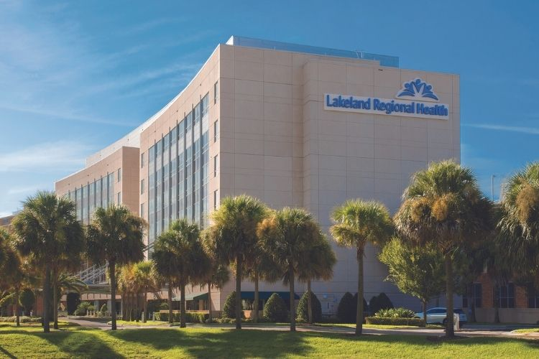
Lakeland Regional Health
PAIRED Team:
Tracey Mckinney
Jessica May-Rabbach
Carol Camino de Stone
Tracy Ayers
Lori Shea
Ashlyn Koonce
Danielle Moore
Lakeland

Slide 26

NCH North Naples Hospital
PAIRED Team:
Julianna Rosello
Carine Stromquist
Seletia Henriquez-Baretto
Paula DiGrigolo
Naples

Slide 27
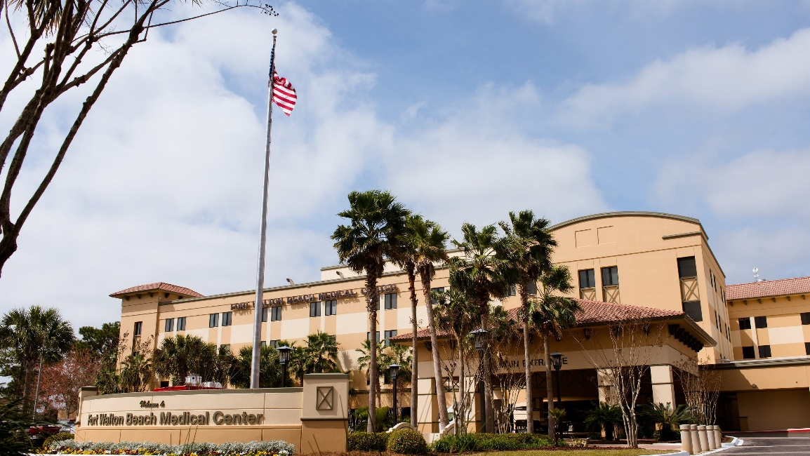
Fort Walton Beach Medical Center
PAIRED Team:
Jane Bradley
Dr. S Sims
Kristina Sims
Lauren Hignite
Stacey Watkins
Fort Walton Beach

Slide 28
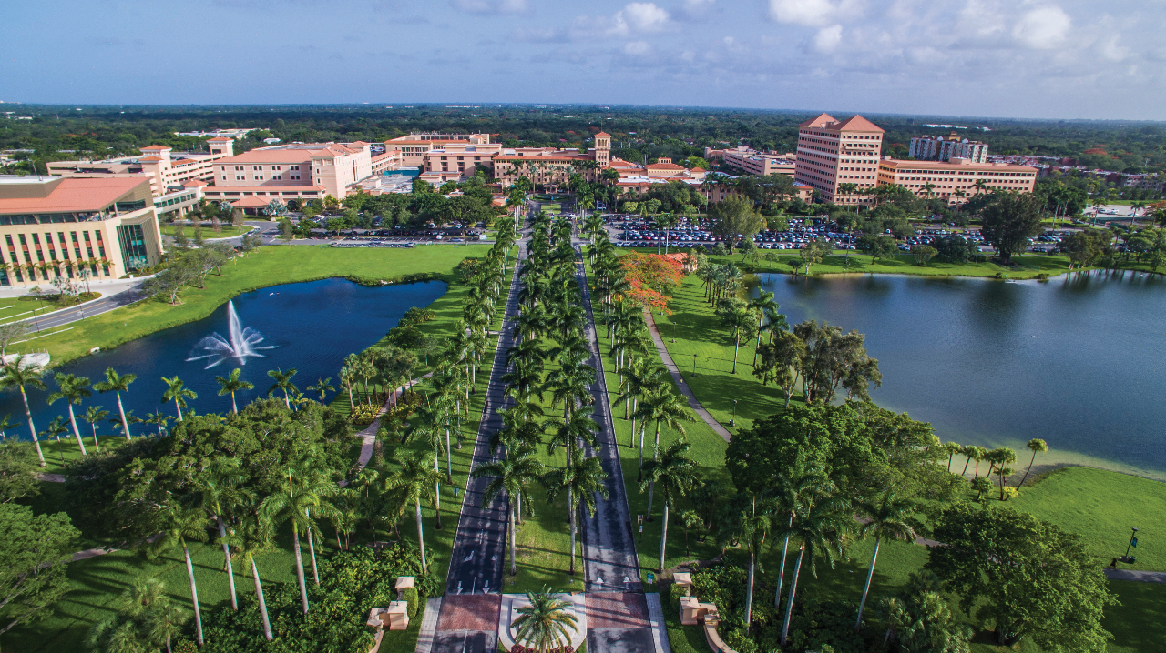
Baptist Hospital of Miami
PAIRED Team:
Allison Diaz
Kara del Valle
Vanessa Perez
Ricardo Diaz Torres
Rachel Evers
Adrian Molina
Miami

Slide 29
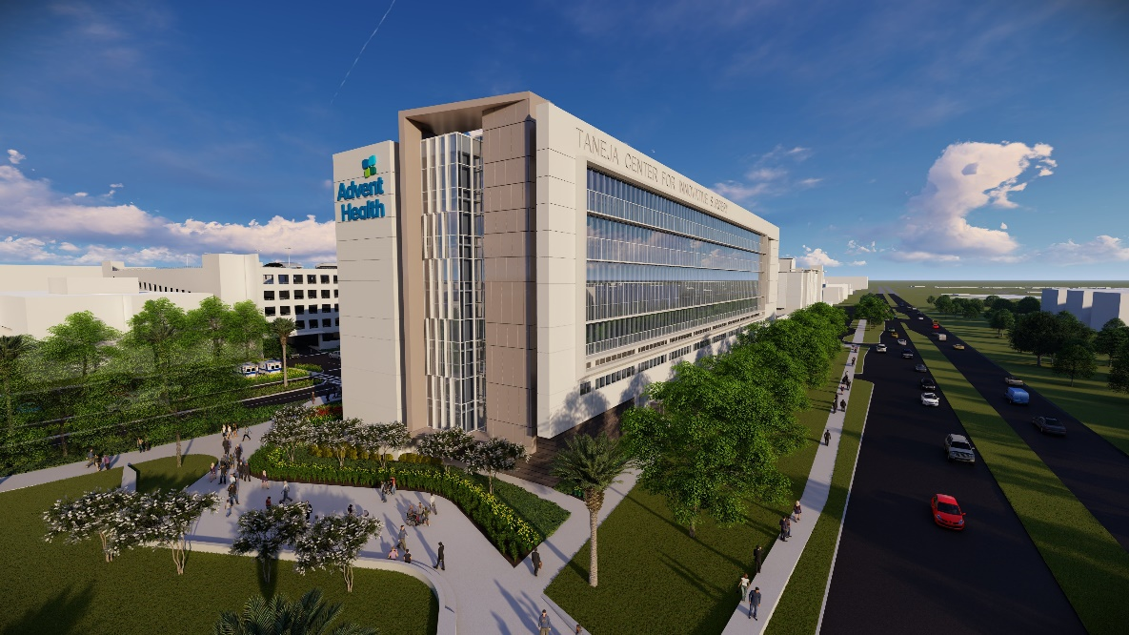
AdventHealth Tampa
PAIRED Team:
Narendra Dereddy
Angela Isbel
Kristin Clopton
Daneen Brittenbach
Sandra Burnetter
Tampa

Slide 30
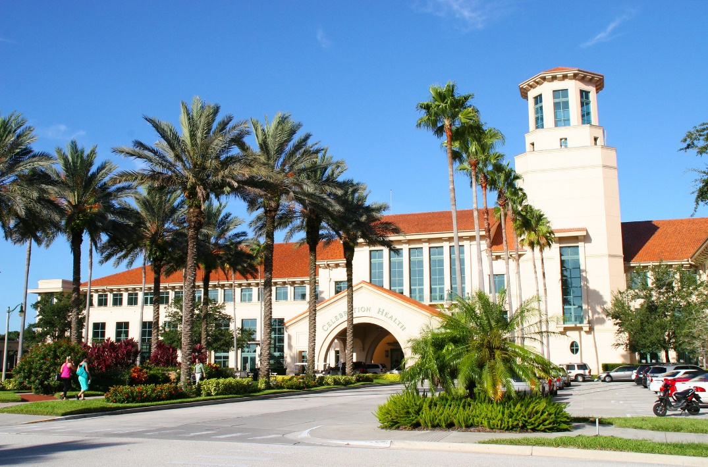
AdventHealth Celebration
PAIRED Team:
Beverley Press
Christine Davis
Jane Godfrey
Jennifer Pellegrino
Riki Scales
Celebration

