Slide 1
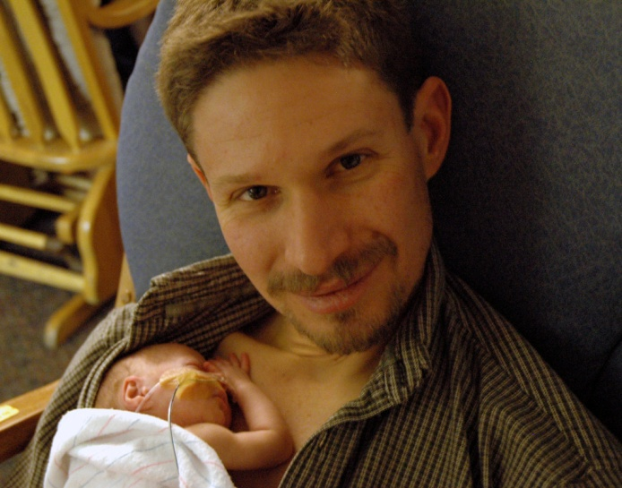
PAIRED Implementation Guidance
Susan M. Bowles, DNP, RNC-NIC,
PAIRED Nurse Consultant

Slide 2


Keys to Building a Successful Initiative
Engage key stakeholders FROM THE START
Multidisciplinary planning and implementation
C- Suite Support
Consistent commitment By all team members

Slide 3

Components of Successful Participation
Create a QI culture—a team environment emphasizing quality and patient safety
Hold regular QI team meetings to follow and make progress
Share important information, progress and successes with everyone around
Be creative and flexible!
Notes:
Why are we doing this?
Schedule you meetings. Select a day and time
Bathroom Briefs, Gemba Board, Huddles,

Slide 4

WHO SHOULD BE ON THE TEAM
Neonatologists
Nursing Staff
Director/Manager
Quality Improvement
IT
Social Work
Therapists/ RT, OT,PT,
Parents
Others
Notes:
The team should have a clearly identified “champion” who is committed to the project.
The optimal size of a QI team is between five and eight individuals, although this may vary. The most important requirement is not size, but diversity of the participants. It is important that the team include a diverse group of individuals who have different roles and perspectives on the project.
The IHI says that successful teams contain the following:
Clinical Leadership
Technical expertise
Day-to-day leadership
Project sponsorship

Slide 5


Create a Culture Ready for Change
Must be a multidisciplinary effort
Teams must meet regularly
Ability to provide a safe environment for:
  Listening
  Questioning
  Persuading
  Respecting
  Helping
  Sharing
  Participating
Use the Toolkit!
Notes:
Make sure you have the right people at the table. Get a commitment from all TMs that they will make every effort to attend the meetings.

Slide 6

Team Meetings
  Meet bi-weekly/ monthly to start then may be less frequent later
  Include all departments impacted by your work
  Have an agenda and take minutes.
    Review data, 30-60-90 Day Plan, PDSA cycles, and potential community partners
    Discuss insights from webinars/coaching
  Share progress and challenges with administration – follow communication plan
Notes:
Meet bi weekly or monthly to start then may be less frequent later
Include all departments impacted by your work
Use agendas and take minutes items on the agenda and minutes below
Review data, 30-60-90 Day Plan, PDSA cycles, and potential community partners
Discuss insights from webinars/coaching
Share progress and challenges with administration – follow communication plan

Slide 7
Quick Start Checklist
30-60-90 Day Plan
Key Driver Diagram
PDSA Cycle

Slide 8

Quick Start Checklist
Recruit QI team – lead, physician lead, nurse lead, QI/data lead, administrative champion
Review, complete and return PAIRED Data Use Agreement
Attend PAIRED Kick-off Meeting
Complete the PAIRED Team Readiness Survey and identify team goals
Write down questions or concerns
Notes:
You have already done most of this you are here!

Slide 9
Quick Start Checklist
30-60-90 Day Plan
Key Driver Diagram
PDSA Cycle
Tools to Use
Notes:
Key driver models are roadmaps to particular outcomes that help focus the work . Key drivers define the pathway to a desired transformation. Key driver models graphically display the strategies and activities needed to achieve goals and aims of the practice improvement effort (DeWalt, et al., 2010).

Slide 10
PAIRED—Family-Centered Care
Date: 10/9/2020
AIM
PRIMARY DRIVERS
SECONDARY DRIVERS
PBPs
PRIMARY
By 6/2023, each NICU will achieve a 20% increase from baseline in the percentage of infants who receive skin-to-skin care from at least one family caregiver within 3 days of clinical eligibility as defined by individual unit protocols.
SUPPLEMENTAL
By 6/2023, family caregiver surveys will demonstrate a 20% improvement from baseline in the perception of the culture of family-centered care in each NICU as averaged across all 4 domains.
Participation
Participation of family in care
Educate family caregiver(s) to become active participants in the care of their infant from admission to discharge
Encourage family caregiver(s) participation in early skin-to-skin care
Include of families in daily rounds/creation of daily care plans/handoffs
Provide early and continuing lactation support to promote breastfeeding
Revisit and revise policies that limit caregiver interaction with infant
Provide family caregiver(s) with appropriate and increasing direct care opportunities.
Create a culturally sensitive environment supportive of skin-to-skin care (reclining chairs, access to food and water, privacy)
Identify infant and family caregiver(s) by appropriate names in all interactions
Celebrate milestones and transitions
Dignity and Respect
Identification of each infant and family member as an individual
Acknowledge that each infant and family member is an individual. Incorporate family knowledge, values, beliefs and cultural backgrounds into the planning and delivery of care.
Consult families, revisit and revise policies that limit family caregiver interaction with infant (protocols regarding skin-to-skin care, holding, visitation, signage, etc.)
Improve antenatal counseling
Adopt technologies to improve communication with family caregiver(s) who cannot be at bedside
Recruit, create and sustain a family advisory council/partnership team
Engage families in the development of effective patient safety and quality initiatives
Develop uniform approach to scheduling and staffing complex care conferences with families
Establish a culturally sensitive environment in which families feel respected and that fosters anticipatory and effective communication with and trust from family caregiver(s).
Collaboration
Respectful and effective communication and partnership with families
Encourage collaboration with families, caregivers and unit leaders in the development, implementation, and evaluation of policies and procedures; in educational programs; and in protocols for family participation in care.
Information Sharing
Education about medical care and clinical processes
Initiate family caregiver and staff competency training on skin-to-skin care
Initiate medical education early and throughout NICU stay
Utilize verbal, written, and graphic methods of teaching to support family understanding and health literacy
Provide family caregiver(s) with complete, accurate and unbiased information and graduated education throughout the NICU stay to allow effective participation in care, to optimize decision-making, and to enable caregivers to become competent primary caregivers for their infant(s).
Notes:
As of 10.9.20
For potential interventions: Identify which intervention may address which secondary driver
For each intervention: Identify measures for each (e.g., Caregiver perception of care)
GLOBAL AIM?
To improve processes of FCC in the NICU that are integrally paired with the care of the medical team, providing opportunities to adopt potentially best practices (PBP) in 4 domains:
PArticipation of families in care
Identification of each infant as an individual
Respectful and effective communication with families
EDucation about medical care
To improve parental perceptions of family-centered care in these 4 domains as measured by standardized survey instruments administered in real-time during the NICU stay.
Family-centered care is defined as a shared approach to the planning, delivery, and evaluation of healthcare that is based upon a partnership between healthcare professionals and family caregiver(s). There are four essential domains of FCC: 1) family participation in care, 2) dignity and respect, 3) family collaboration, and 4) information sharing.

Slide 11
Quick Start Checklist
30-60-90 Day Plan
Key Driver Diagram
PDSA Cycle

Slide 12
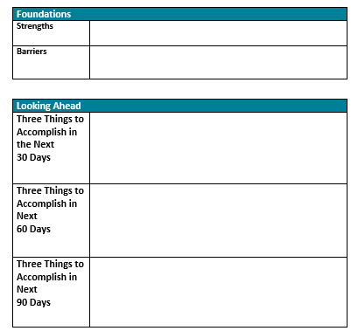
30-60-90 Day Plan

Slide 14


Review multidisciplinary team members and fill any gaps
Three Things to
Accomplish in the Next
30 Days
Schedule team meetings for 6 months
Review and revise unit policies to allow for early Skin to Skin Care.
Notes:
Get it on the calendar!

Slide 15
Quick Start Checklist
30-60-90 Day Plan
Key Driver Diagram
PDSA Cycle

Slide 16
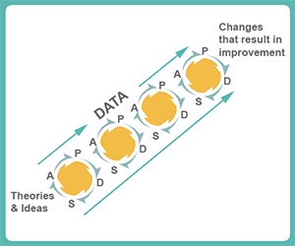
What is a PDSA cycle?
Useful tool for developing & documenting tests of change to for improvement
AKA PDCA, Deming Cycle, Shewart Cycle
P – Plan a test
D – Do a test
S – Study & learn
from test results
A – Act on results
Dr. Balakrishnan will delve into PDSAs during her presentation!

Slide 17

Reasons to test changes
Learn whether change will result in improvement
Predict the amount of improvement possible
Evaluate the proposed change work in a practice environment
Minimize resistance at implementation

Slide 18
Potential Implementation Barriers & Strategies to Overcome
Potential Barrier Drivers
Strategies to Overcome
Time limitations
Make sure meetings are organized and succinct to decrease the impact on time
Use efforts of staff members-consider use of nurse clinical ladder to support project
Standardize meeting time for ease of scheduling; consider web-based meetings for those off site
Use regularly scheduled department meetings to highlight project and results-be succinct
Notes:
Agendas and minutes are very important.

Slide 19
Potential Implementation Barriers & Strategies to Overcome
Potential Barrier Drivers
Strategies to Overcome
Resource limitations
Connect with other hospitals or QI leaders for potential solutions; or sharing resources through collaborative work
Notes:
Coaching calls- Give the example of the tocos belt for S2S

Slide 20




As the Project Continues…
Celebrate successes along the way
Display data by keeping it current AND interesting
Make it stick
  Routinization
Plan for sustainability

Slide 21


21

Slide 22
February – March
Assess
Assess your team to assure all critical departments included
Review
Plan
Plan for PAIRED launch – bulletin boards; staff meetings; event invitations
Attend
Attend Data Collection Webinar Wednesday, February 16, 2022, 2-3 PM ET
Review PAIRED resources

Slide 23
March
Launch
Official launch in your hospital!
Begin
Begin submitting prospective data
Educate providers and facility leadership on importance of facility-wide standards
Engage staff and clinicians
Present your hospital’s PAIRED participation

Slide 24
PAIRED Initiative Resources
Online Tool Box
Algorithms, Sample protocols, education tools, Slide sets, etc.
Custom, Personalized
webcam, phone, or on-site Consultations & Grand Rounds Education
Monthly and Quarterly QI Data Reports
Educational sessions, videos, and resources
Project-wide in-person collaboration meetings
Monthly e-mail Bulletins
Technical Assistance
from FPQC staff, state Clinical Advisors, and National Experts
Monthly Collaboration Calls with hospitals state-wide
Notes:
Host an online PROVIDE resource toolbox for hospital implementation
Offer guidance and feedback to participating hospitals on executing improvement strategies
Provide educational events, i.e. grand rounds and regional trainings on labor support skills
Provide email, telephone, webcam, and on-site technical assistance consultations
Convene regular learning sessions to support hospitals in driving change
Support baseline assessments and reports to assist in choosing your hospital’s improvement area
Facilitate monthly online data submission and providing monthly quality improvement data reports
Communicate progress and deliverables to the stakeholders of FPQC
Evaluate and report PROVIDE results in a fashion that does not publicly identify hospitals and providers

Slide 25
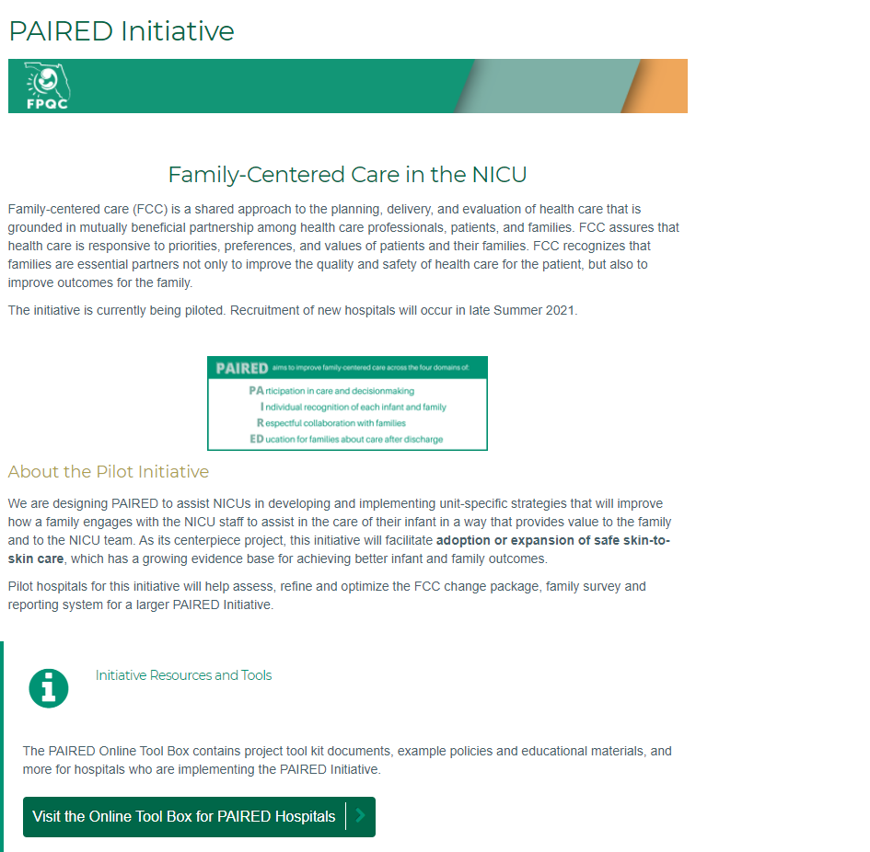
PAIRED Initiative Website
http://www.fpqc.org/PAIRED
Click here to visit the TOOL BOX
Notes:
Host an online PROVIDE resource toolbox for hospital implementation
Offer guidance and feedback to participating hospitals on executing improvement strategies
Provide educational events, i.e. grand rounds and regional trainings on labor support skills
Provide email, telephone, webcam, and on-site technical assistance consultations
Convene regular learning sessions to support hospitals in driving change
Support baseline assessments and reports to assist in choosing your hospital’s improvement area
Facilitate monthly online data submission and providing monthly quality improvement data reports
Communicate progress and deliverables to the stakeholders of FPQC
Evaluate and report PROVIDE results in a fashion that does not publicly identify hospitals and providers

Slide 26
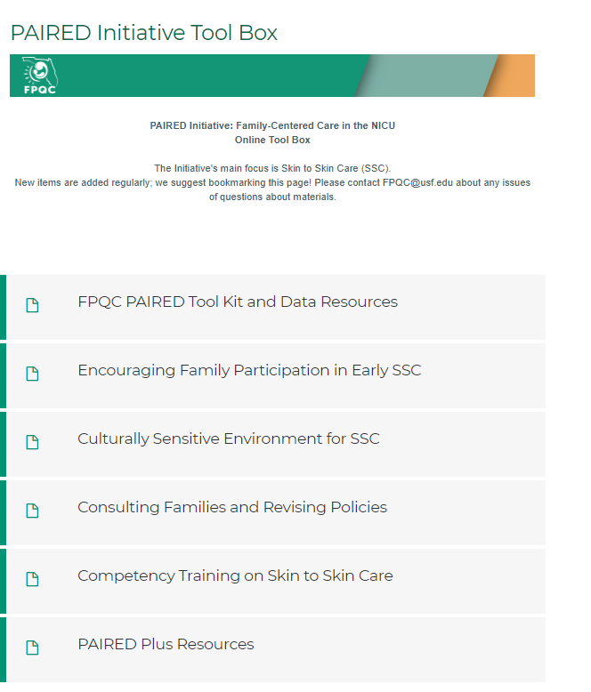
PAIRED Initiative Tool Box
http://www.fpqc.org/PAIRED/toolbox
Notes:
Host an online PROVIDE resource toolbox for hospital implementation
Offer guidance and feedback to participating hospitals on executing improvement strategies
Provide educational events, i.e. grand rounds and regional trainings on labor support skills
Provide email, telephone, webcam, and on-site technical assistance consultations
Convene regular learning sessions to support hospitals in driving change
Support baseline assessments and reports to assist in choosing your hospital’s improvement area
Facilitate monthly online data submission and providing monthly quality improvement data reports
Communicate progress and deliverables to the stakeholders of FPQC
Evaluate and report PROVIDE results in a fashion that does not publicly identify hospitals and providers

Slide 27

Questions?
NOW IT’S YOUR TURN!

